Slide 1
Welcome
ORGANIZATION: The Housing Agency from Catalonia / AHC MEETING: BARCELONA 06 – 08 June 2018
www.agenciahabitatge.cat

Slide 2
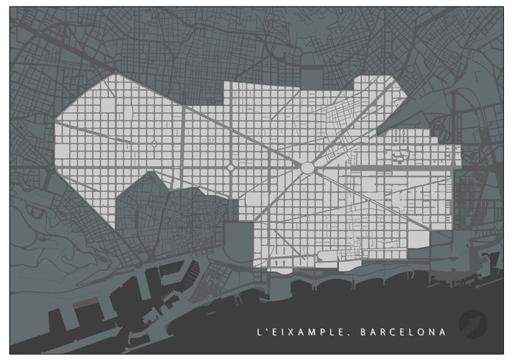
Venue 1 - Diputació Street
1
2
Venue 2 - Aragó Street
AHC Delegations | Workforce
Barcelona | 377
Girona | 22
Lleida | 31
Tarragona | 24
Terres de l’Ebre | 6
Total | 460

Slide 3
The AHC Budget is distributed in several lines of action:
Social Programs
Housing Promotion
Renovation
Neighbourhood remodelling
Housing management, Public promotion and Heritage
Revision Master plan

Slide 4
AHC Management
José Pablo Rodríguez Marín
Carol Diaz
External Action Technicians and Management WP1, WP4, WP5
Anna Mestre
Amelia Cabrera
Josep Linares
Gerard Valls
Other Resources
Montse Enriquez
AHC Technical Support WP4
Comunication & Protocol

Slide 5
Welcome
ORGANIZATION: The Housing Agency from Catalonia / AHC MEETING: BARCELONA 06 – 08 June 2018
www.agenciahabitatge.cat

Slide 6
Plans for Implementation – Sant Quirze del Vallés
ORGANIZATION: AGÈNCIA HABITATGE DE CATALUNYA / AHC PRESENTER(S): ANNA MESTRE AND AMELIA CABRERA MEETING: BARCELONA 06 – 08 January 2018

Slide 7
Democase Sant Quirze del Vallés – Tender Process
0
18
Design Team
27
34
Requirements
Design Team
Contractor
42 Monitoring
WP 1
WP 3
WP 5
WP 1 WP5
WP 5
WP 4
TENDER FOR CONSTRUCTION
Construction /implementation + commissioning
Measurement & Verification
internal approval from the Generalitat and publication in the official newspaper "DOGC"
the companies present their offers regarding construction works and their cost
The Generalitat studies the proposals made by the companies
Resolution and notification of the winning company
signature of the contract between the Generalitat and the company
Exploitation & Maintenance
Conceptual/Basic Design
Technical/Final Design
TENDER FOR POST MONITORING
internal approval from the Generalitat and publication in the official newspaper "DOGC"
the companies present their offers regarding construction works and their cost
The Generalitat studies the proposals made by the companies
Resolution and notification of the winning company
signature of the contract between the Generalitat and the company

Slide 8
Democase Sant Quirze del Vallés
Internal approval & official publication
1 Month
The companies present their offers
1 Month
TENDER / PUBLIC PROCUREMENT
TASK
The Generalitat studies the proposals
3 Months
Resolution and notification of the winning company
1 Month
Signature of the contract between the Generalitat & the company
1 Month

Slide 9
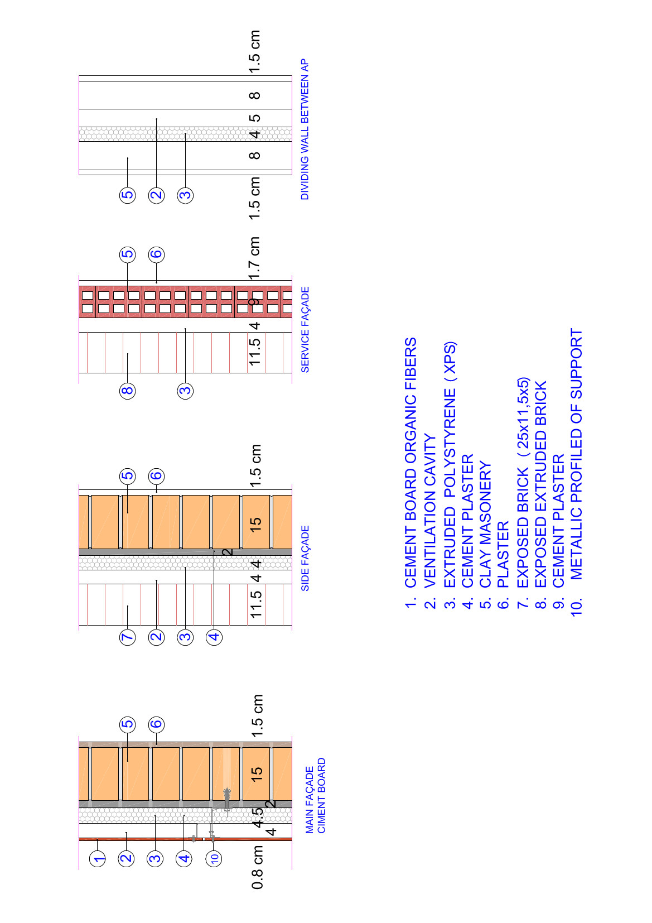
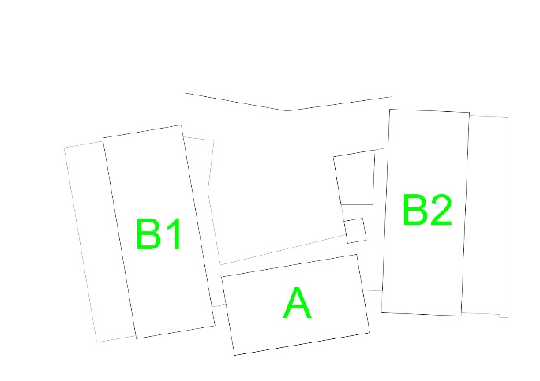
Democase Sant Quirze del Vallés – Façade 3 Types

Slide 10
Democase Sant Quirze del Vallés
89 m2

Slide 11
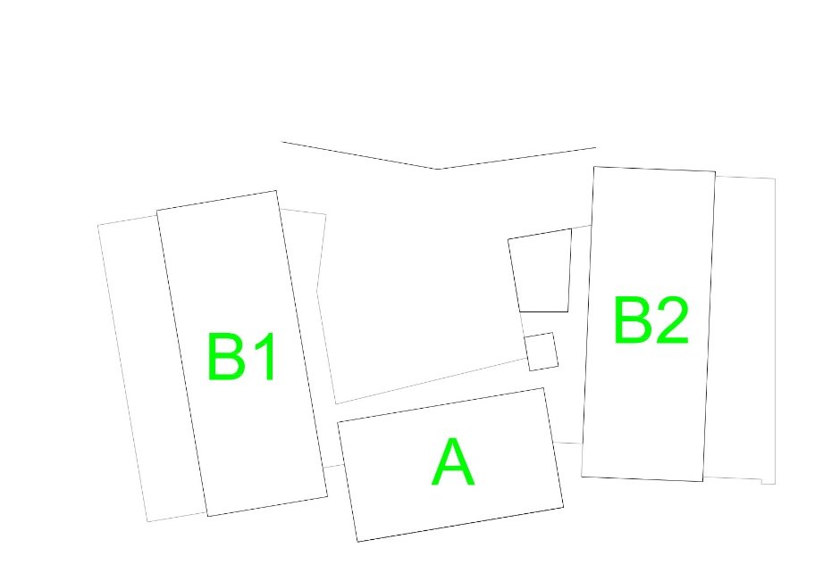
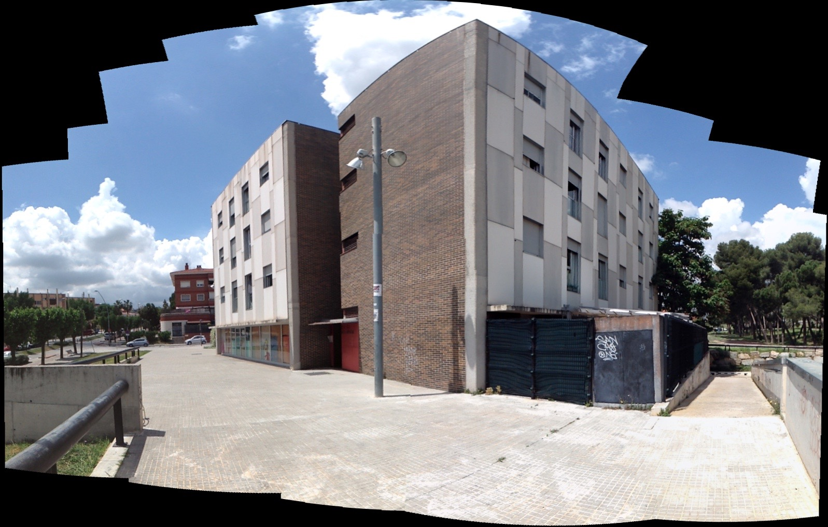
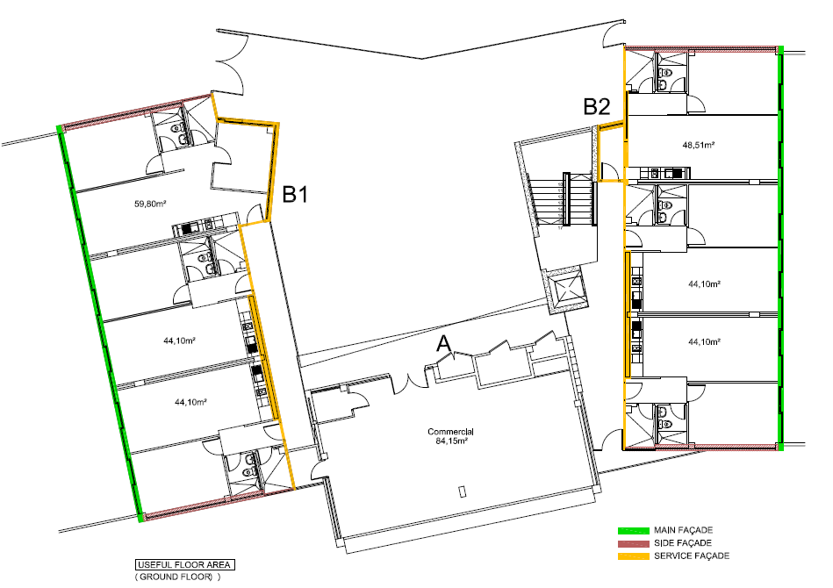
Democase Sant Quirze del Vallés
South – Est Façade

Slide 12
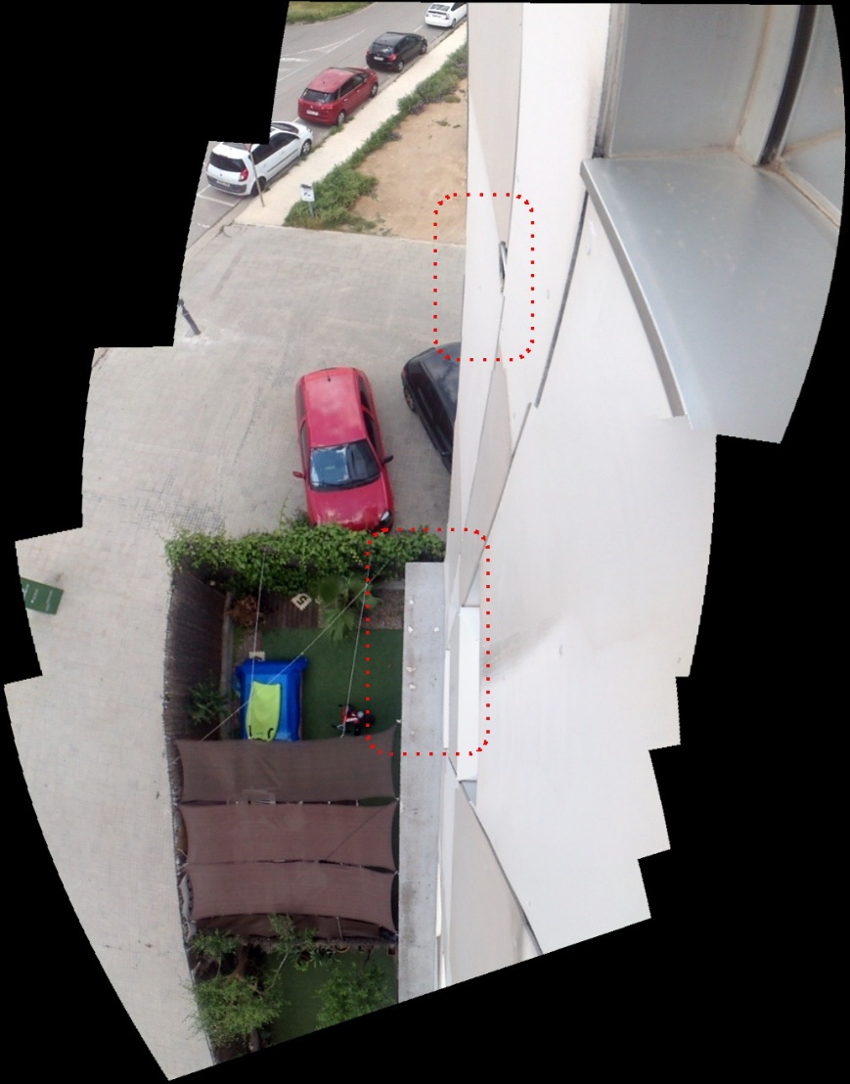
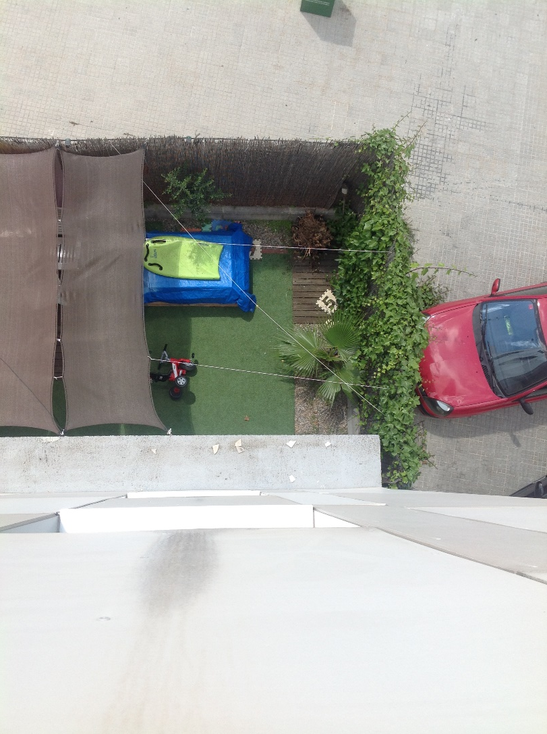
Democase Sant Quirze del Vallés

