Slide 1
Plug-N-Harvest
WP1 – END-USER AND BUSINESS REQUIREMENTS
ORGANIZATION: AIGUASOL
PRESENTER(S): A. GONZÁLEZ, O. GAVALDÀ, J. PASCUAL
MEETING: Kickoff Meeting, Aachen, 21-22 September 2017

Slide 2
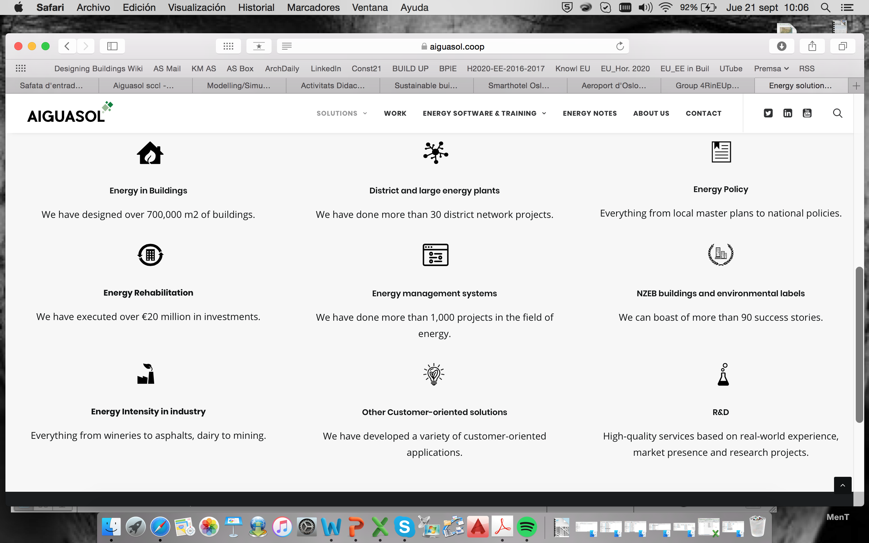
AIGUASOL Company
AIGUASOL offers engineering and energy consulting services to reduce CO₂ emissions in several sectors, from urbanism to industry; https://aiguasol.coop/solutions/

Slide 3






AIGUASOL R+D
Ever since AIGUASOL was founded, we have devoted a third of our resources to research activity (https://aiguasol.coop/solutions/r-d). Currently on-going R+D projects
Integrated Smart GRID Cross-Functional Solutions for Optimized Synergetic Energy Distribution, Utilization Storage Technologie
http://www.integridy.eu
AIGUASOL leads of inteGRIDy Modelling Mechanisms for Topology Analysis, DR Flexibility and support the demo undertaking the roles of engineering and commissioning of the specific demo activity
New technologies for utilization of heat recovery in large industrial systems
http://www.indus3es.eu
AIGUASOL contribution focuses on the development of the Indus3es system and the exploitation of the project results
Robust and Reliable technology concepts and business models for triggering deep Renovation of Residential buildings in EU
http://4rineu.eu
AIGUASOL co-develops the eralyReno tool, the intelligent energy auditing definition, the cost optimal tool, and the Plug and Play Energy Hub. AIGUASOL leads the Spanish demo
Sustainable urban Planning with Innovative and low energy Thermal And power Generation frOm Residual And renewable Sources
http://pitagorasproject.eu
AIGUASOL is in charge of the thermal storage and Rankine management on the final solutions, and the business models definition
GrowSmarter: transforming cities for a smart, sustainable Europe
http://www.grow-smarter.eu/home/
AIGUASOL acts as consultancy engineering in the several Barcelona demos and develops the new HEMS tool
http://www.exsergy.com

Slide 4
Content
WP1 Work Plan
  Time line
  Objectives
  Involved partners
Tasks and their links to wider project
  Objectives partners and plan per task
  Links to wider project per task
  Deliverables quality reviews proposal

Slide 5
Work Plan WP1 - Requirements Analysis and Engineering

Slide 6
Timeline
Q1
Q2
Q3
Q4
Q5
Q6
Q7
Q8
Q9
Q10
Q11
Year 1 Year 2 Year 3
D1.1, D1.2, D1.3
Final
D1.4, D1.5
Final
T1.4, T1.5 Start
T1.1, T1.2, T1.3
Start
T1.4, T1.5 End
T1.1, T1.2, T1.3
End
D1.1, D1.2, D1.3
First
D1.4, D1.5
First

Slide 7
WP1 Main Objectives
OBJECTIVES
Systematically formalize all initial stakeholder requirements (functional and non-functional)
Provide input for technical and non-technical work packages and align with validation activities
Perform thorough pilot surveys on-site at early stages of the project (for both project’s use cases) to identify special needs and existing infrastructures of pilot premises.
Elicit the generic and specific User & Business requirements and perform evolutionary requirements refinement based on lessons learned and iterative elicitation of relevant stakeholders feedback
Prepare a pilot evaluation and system validation framework towards assessing the fulfillment of the PLUG-N-HARVEST integration framework to its original objectives during the deployment phase in pilots

Slide 8
Involved partners
 | CERTH | RWTH | CU | ALUMIL | AIGUASOL | ODINS | SIEMENS | ETRA | ET | EIG | AHC | RMW | CCC
T1.1 End user and business requirements | 2 |  | 2 | 2 | 8 | 4 | 4 | 4 | 2 | 4 | 2 | 2 | 2
T1.2 Use Cases, Test Scenarios and Evaluation Plans | 2 | 2 | 6 |  | 5 | 5 | 5 | 5 | 2 | 2 | 2 | 2 | 2
T1.3 Analysis of Building Types and Construction Requirements |  | 6 | 6 | 2 | 6 | 4 |  |  | 4 |  | 2 | 2 | 2
T1.4 PnH Architectural Design, Functional & Technical Specifications | 4 | 6 | 2 | 2 | 5 | 4 | 4 | 4 | 2 | 2 |  |  | 2
T1.5 Active-façade CFD simulation and optimization guidelines | 8 | 2 | 2 |  | 1

Slide 9
WP1 Tasks & their links to wider project

Slide 10
Tasks & subtasks in WP1 overview of connection to wider project
T1.1 End-User and Business Requirements
T1.2 Use Cases, Test Scenarios and Evaluation Plans
Identification of requirements and results and Evaluation of the impact on the future development
Development of an extensive Survey of the Use Cases focusing on the thorough analysis of each Use Case site with respect to specific products and production lines as well as potential modifications.
WPs Lessons Learned
T1.3 Analysis of Building Types and Construction Requirements
WP2, WP3 and WP4
Analysis of the exiting condition of buildings in the selected pilot sites across Europe and establishment of the baseline performance of these buildings
T1.5 Active-façade CFD simulation and optimization guidelines
T1.4 PnH Architectural Design, Functional & Technical Specifications
Identification of requirements and results and Evaluation of the impact on the future development
CFD tool will able to derive guidelines about the façade design parameters and optimize the behaviour.

Slide 11
T1.1 End-User and Business Requirements
Task Leader: AIGUASOL (SP 8PM)
Contact person: Jordi Pascual E-mail jordi.pascual@aiguasol.coop
Involved partners: CERTH (2PM), CU (2PM), ALUMIL (2PM), ODINS (4PM), ETRA (4PM), ET (2PM), EIG (4PM), AHC (2PM), RWM (2PM), CCC (2PM)
Deliverable: D1.1 - End-Users and Business Requirements Report. M12-M30
Objective: To define the User & Business requirements of the proposed framework that facilitates the different stakeholder´s needs involved in optimizing the business and production processes.
Methodology: Use a two-fold analysis;
capture the industrial requirements needed to define the different components of the PnH framework
provide a technical efficient solution that addresses stakeholders’ tangible and intangible needs.
The requirements will be measurable (KPIs definition) and will be improved in a loop process with WP2, WP3 and WP4.
Starting point: Definition of a first draft KPIs list, sorted by topics and derived from existing methodologies, to be contrasted and commented by the involved partners, and shared with third parties. Consider to analyze and test the new EU tool/methodology Level (http://ec.europa.eu/environment/eussd/buildings.htm).

Slide 12
T1.1 - Links to other tasks
From Task | Nature | To WP/Task | Description
T1.1 | Input / Output | WP1 – T1.2 | KPIs definition to the required survey and for the definition of the Evaluation plan.
 | Input / Output | WP1 – T1.3 | End-users requirements to be considered as a part of the hypothesis implemented in the definition of the baseline and the savings potential.
 | Input | WP1 – T1.4 | Feedbacks related to the exiting projects and relevant references, as well as focused KPIs required for the architecture definition.
 | Output | WP2 | Refinement of the energy assessment KPIs as an output of the parametric analysis (T2.2) and of the energetic and economic assessment KPIs and materials KPIs as an output of the Prototype Verification Tests (T2.4).
 | Output | WP3 | Validation of the main KPIs related to the optimized management (T3.1, T3.2).
 | Output | WP4 | Validation of the main KPIs from the demo validation process (T4.6).
 | Output | WP5 | Validation of the main KPIs related to the business models (T5.2, T5.3, T5.5)

Slide 13
T1.2 Use Cases, Test Scenarios and Evaluation Plans
Task Leader: CU (UK 6PM)
Contact person: Dr. Hu Du, E-mail duh4@cardiff.ac.uk
Involved partners: CERTH (2PM), RTWH (2PM),AIGUASOL (5PM), ODINS (5PM), SIEMENS (5PM), ETRA (5PM), ET (2PM), EIG (2PM), AHC (2PM), RWM (2PM), CCC (2PM)
Deliverable: D1.2.1 - Use Case Site Survey and Audit Report. M12-M30 / D1.2.2 - Evaluation Plan. M12-M30
Objective: to understand the functions of proposed products and match the needs of general users with specific products and production lines.
Methodology: dedicated meetings and workshops with all partners to assessing the features and its potential application in wider context
Starting point: Establish a common understanding of proposed products among users, business partners and technology providers, therefore develop a feasible evaluation plan and test scenarios.

Slide 14
T1.2 - Links to other tasks
From Task | Nature | To WP/Task | Description
T1.2 | Input | WP1 – T1.1 | KPIs are required for developing survey and evaluation plan.
 | Output | WP1 – T1.3 | Evaluation plan is needed for conducting building performance evaluation
 | Output | WP4 | Evaluation plan is needed for specifying monitoring devices
 | Input | WP4 | Parameters for Life Cycle Costing are needed for define evaluation plan
 | Input | WP4 – T4.6 | Evaluation plan will guide the performance evaluation in T4.6

Slide 15
T1.3 Analysis of Building Types and Construction Requirements
Task Leader: CU (UK 6PM)
Contact person: Dr. Hu Du, E-mail duh4@cardiff.ac.uk
Involved partners: RTWH (6PM), ALUMIL (2PM), AIGUASOL (6PM), ODINS (4PM), ET (4PM), AHC (2PM), RWM (2PM), CCC (2PM)
Deliverable: D1.3 - Systems engineering requirements definition. M12-M30
Objective: To understand exiting condition of buildings in the selected pilot sites across Europe and establish baseline performance data of these buildings and potential savings.
Methodology: Eight elements Building performance Evaluation method (three steps: forensic walkthrough, energy survey, user surveys and interviews)
Starting point: Identity pilot sites and demonstration buildings; collect following information of buildings: drawings, size, usage, age, material, construction type, thermal property, condition of existing facade, historical monitoring data and existing monitoring sensors.

Slide 16
T1.3 - Links to other tasks
From Task | Nature | To WP/Task | Description
T1.3 | Input | WP1 – T1.1 | KPIs are required for developing survey and evaluation plan.
 | Input | WP1 – T1.2 | Evaluation plan is needed for conducting building performance evaluation
 | Output | WP1 – T1.4 | Site data will be fed into design specification
 | Output | WP1 – T1.5 | Site data will be fed into CFD modelling
 | Output | WP1 – T2.2 | Site data will be fed into energy simulation
 | Output | WP4 – T4.6 | Baseline data support the benchmarking in performance evaluation

Slide 17
T1.4 PnH Architectural Design, Functional & Technical Specifications
Task Leader: RWTH (G 6PM)
Contact person: Verena Dannapfel [vdannapfel@eonerc.rwth-aachen.de] Tanja Osterhage [tosterhage@eonerc.rwth-aachen.de]
Involved partners: CERTH (4PM), CU (2PM), ALUMIL (2PM), AIGUASOL (5PM), ODINS (4PM), SIEMENS (4PM), ETRA (4PM), ET (2PM), EIG (2PM), CCC (2PM)
Deliverable: D1.5 - Detailed Architectural Design, Functional & Technical Specification. M15-M33
Objective: To ensure consistency with other European projects and activities of stakeholders, a detailed analysis will be performed initially on the relevant research projects in the topics addressed by the PLUG-N-HARVEST framework
Methodology:
General overview of the system design, summarizing the technical and functional design
Conceptual architecture design: an overview of the system architecture describing the different components of PLUGN-HARVEST framework the different sub-systems, the interfaces between them, etc.
Components Functional and Technical specifications: a) to provide a high-level b) to describe in detail the constraints of the system elements in terms of hardware and/or software resources, compatibility with standards, etc.
Starting point: Definition of a first draft KPIs list, time/milestone and task planning, literature and project research, to be contrasted and commented by the involved partners

Slide 18
T1.4 - Links to other tasks
From Task | Nature | To WP/Task | Description
T1.4 | Input from | WP1 – T1.1 | Requirements will mostly focus on the overall architecture of the framework and on deriving specifications regarding core system components and functionalities
 | Input from | WP1 – T1.2 | Use Case site with respect to specific products and production lines as well as potential process modifications
 | Input from | WP1 – T1.3 | Results in various requirements for the new ADBE System regarding its structural and building energy behavior depending on the different climatic and architectural regions
 | Output | WP2 | Basis input for the PLUG-N-HARVEST ADBE System

Slide 19
T1.5 Active-façade CFD simulation and optimization guidelines
Task Leader: CERTH (GR 8PM)
Contact person: Nikolaos, Nikolopoulos E-mail: n.nikolopoulos@certh.gr
Involved partners: RWTH (2PM), CU (2PM), AIGUASOL (1PM)
Deliverable: D1.5 - Active-façade CFD simulation and optimization guidelines. M15-M33
Objective: To develop and build a CFD platform for the prediction of a) achievable naturally driven ventilation rates (m3/h of high T), b) thermal gains considering as well c) PV add-on electricity production (W) achievable by the active facade.
Methodology: The CFD tool will model in a comprehensive way the underlying radiative and convective heat transfer mechanisms, to calculate the dependence of achievable convective and radiative heat transfer coefficients, on a) slat tilt angles, b) solar irradiation profiles (dependent on atmospheric external conditions) and c) façade basic design parameters (e.g. shape, dimensions, materials used).
  Added value: To derive guidelines about the façade design parameters, allowing it to operate more efficiently and maximize its energy/electricity gains. On a second level and after the definition of the optimum façade design aspects, before being demonstrated in the demos sites, a CFD run will be made to quantify the local aeration rates it can achieve for a typical building shaped envelope.
Starting point: Drawings and physical properties of active façade main components (e.g. shape, dimensions, materials, air channels configuration) and key properties solar irradiation properties (absorption, refractive index) of the a) internal and external glazing and b) blind.

Slide 20
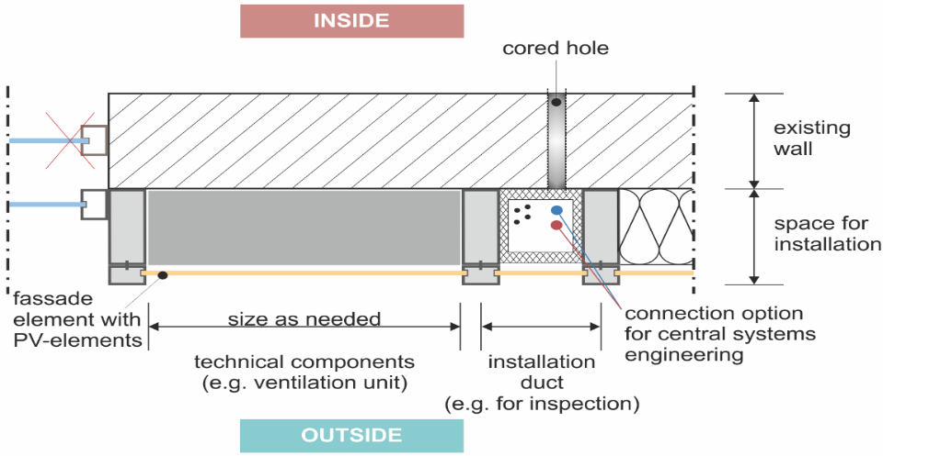
Task 1.5: Active-façade CFD simulation and optimization guidelines
Input data: Drawings and physical properties of active façade main components (e.g. shape, dimensions, materials, air channels configuration) and key properties solar irradiation properties (absorption, refractive index) of the a) internal and external glazing and b) blind.
The conceptual design should be provided by Aachen.
Based on them a geometry of the key components will be made, alongside the definition of the control volume and its proper boundary conditions.

Slide 21
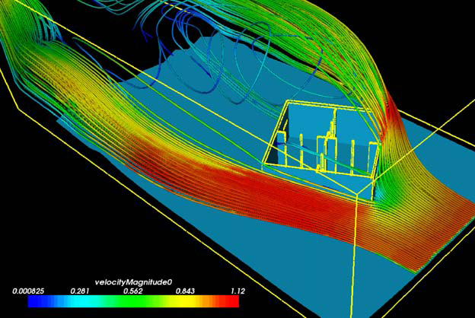
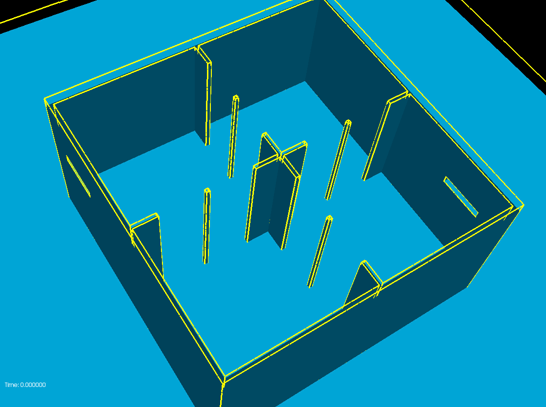
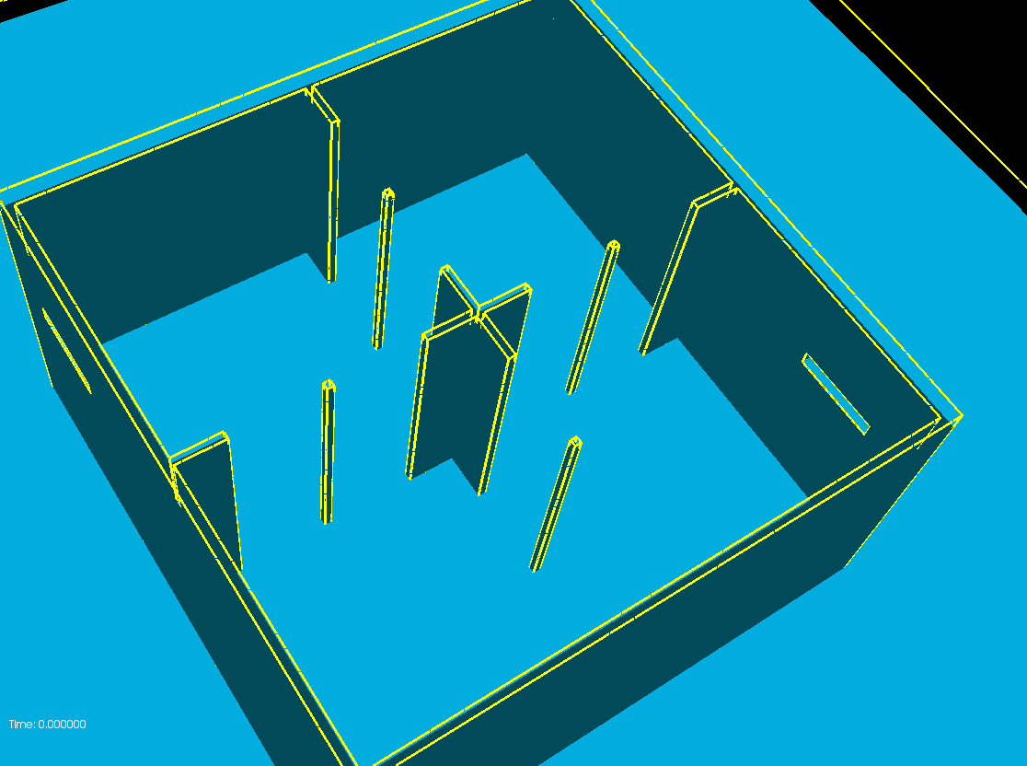
Task 1.5: Active-façade CFD simulation and optimization guidelines
From PV size simulations: how we can beneficiate from an integrated PV (T) electricity + hot air ventilated system
To buildings size effect
Simple case of Air streamlines around a building
Effect of building volume configuration on achievable aeration rates (ventilation aspects)

Slide 22
Deliverables quality reviews proposal
Derivable | Main partner | Involved partners | Proposed reviewers
D1.1 - End-Users and Business Requirements Report | AIGUASOL | ALL except RWTH | RWTH
D1.2.1 - Use Case Site Survey and Audit Report. | CU | ALL except ALUMIL | ALUMIL
D1.2.2 - Evaluation Plan | CU | ALL except ALUMIL | ALUMIL
D1.3 - Systems engineering requirements definition | CU | ALL except CERTH, SIEMENS and ETRA | CERTH, SIEMENS and ETRA
D1.4 - Detailed Architectural Design, Functional & Technical Specification | RWTH | ALL except AHC and RMW | AHC and RMW
D1.5 - Active-façade CFD simulation and optimization guidelines | CERTH | RWTH, CU and AIGUASOL | ODINS

