Slide 1
Plug-N-Harvest
WP1 – Task 1.2: Uses cases test scenarios and evaluation. Deliverable D1.2.1 Building information surveY
ORGANIZATION: AGÈNCIA HABITATGE DE CATALUNYA / AHC
PRESENTER(S): ANNA MESTRE
MEETING: GREECE 24 January

Slide 2
The PLUG-N-HARVEST pilot sites & BMS
The Spanish Pilot site & BMS:
National (or particular) DSO limitations for renewables and energy storage installations.
Heating and cooling available infrastructure.
Existing renewable sources.
Existing sensing and operating infrastructure (data centers, building management systems, etc.)
Brainstorming on hardware requirements and solutions (CERTH/ITI, ETRA, OdinS, SIEMENS) by AIGUASOL

Slide 3
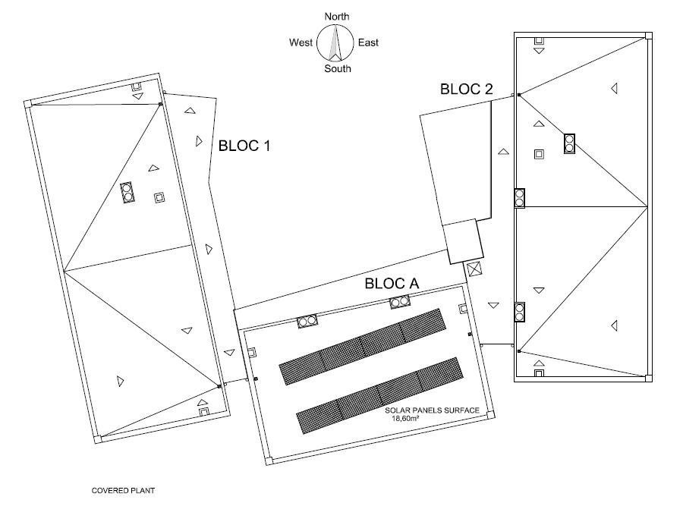
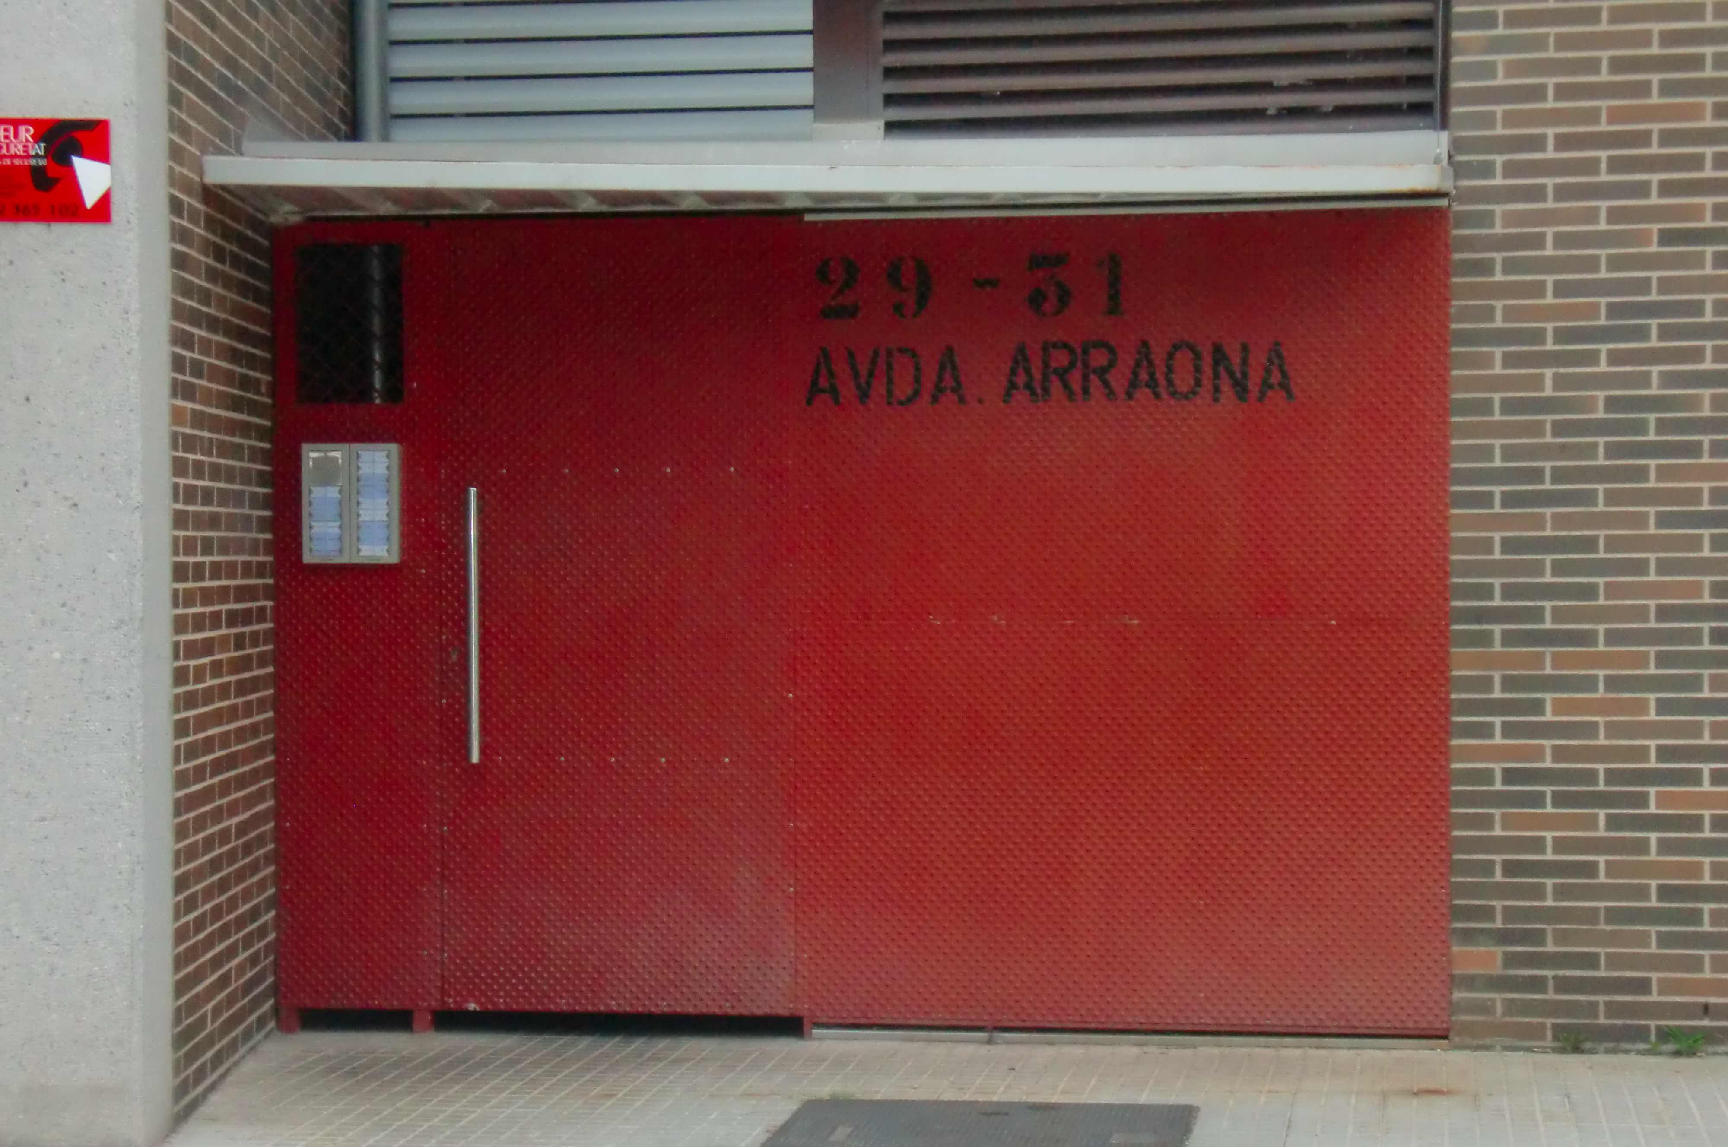
The PLUG-N-HARVEST pilot sites & BMS. The Spanish Pilot site & BMS:

Slide 4
The PLUG-N-HARVEST pilot sites & BMS. The Spanish Pilot site & BMS:
Spanish Pilot Case: Building sevices systems
Spanish Pilot Case | Arraona-30 Sant Quirze del Vallés
Number of blocs | 3
General characteristics
Heating | The building does not have a heating system installed. Users often use portable electric radiators. The common electrical radiator has a power of 1.000 W to 2.500 W
Cooling | no
Domestic Hot Water (DHW) | Individual Electrical DHW tank for each dwelling connected to solar thermal panels Energy source: electricity (resistance – joule) Power: average of 1.500 W Capacity: Individual tank of 80 litres (average).

Slide 5
The PLUG-N-HARVEST pilot sites & BMS. The Spanish Pilot site & BMS: r
Spanish Pilot Case: Building services systems
Spanish Pilot Case | Arraona-30 Sant Quirze del Vallés
Number of blocs | 3
General characteristics
ventilation system | only natural ventilation
renewable electricity generation source | no
renewable heat generation source | Yes, for domestic hot water
any sales contract on renewable energy export to the grid ? | no
local weather station installed in the building | no

Slide 6
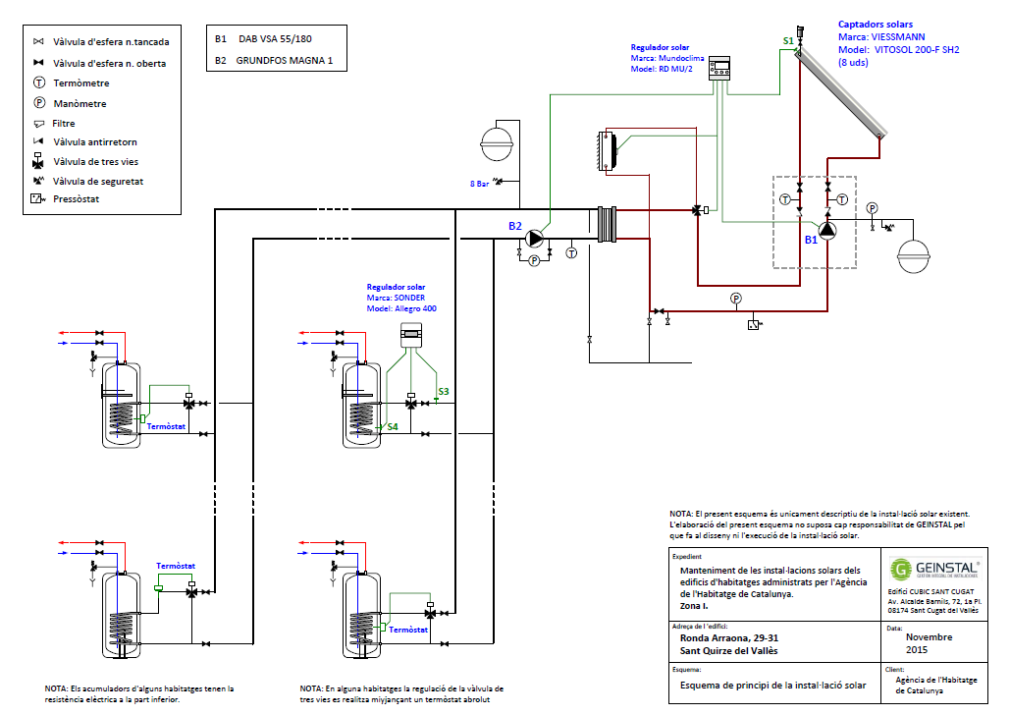
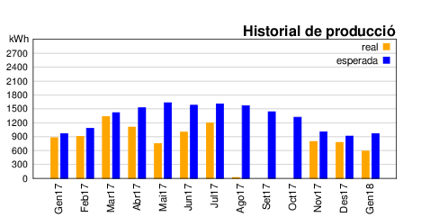
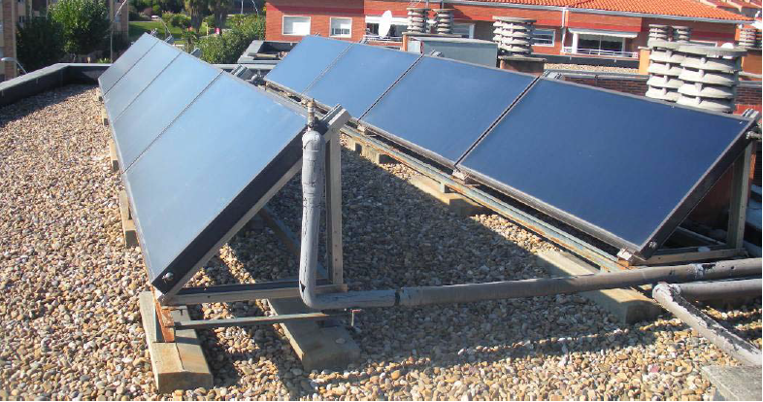
Solar Thermal system for DHW
Solar collectors surface: 18.6 m²
Expected annual solar thermal energy produced: 16.000 kWh
DHW support system: Electrical resistance (joule effect)
Monitored system: The real energy produced in 2017 is 8.765 kWh, lower than expected result of some breakdowns.
PLUG-N-HARVEST
ID: 768735 - H2020-EU.2.1.5.2.

Slide 7
Maintenance
Preventive Maintenance
  Solar Thermal System:
    Frequency: Every 3 months
    Cost: 240 €/trimester
  Preventive Maintenance dwelling’s DHW tanks:
    Frequency: Every 2 years
    Cost: 45 €/year
  Fire extinguish system:
    Frequency: 3 months
    Cost: 208 €/year
  Elevator:
    Frequency: monthly
    Cost: 45 €/month
Corrective Maintenance
  General building and dwelling maintenance: roof, doors, windows, toilets, light, common areas, etc..
    Cost 2017: 8.600 €
  Maintenance related with change of tenants: Painting, cleaning, updates, etc…
    Cost 2017: 5.450€
PLUG-N-HARVEST
ID: 768735 - H2020-EU.2.1.5.2.

Slide 8
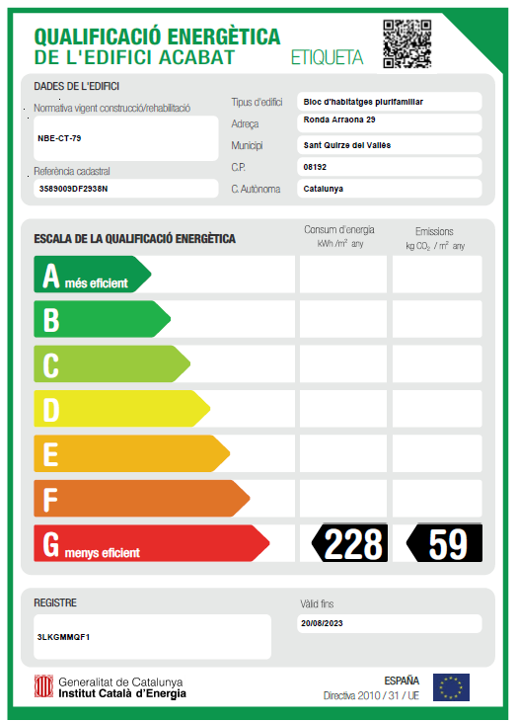
Energy Performance Label
Arraona-30
Sant Quirze del Vallès
ENERGY QUALIFICATION:
Non-renowable primary energy consumption
228,15 kWh/m² year
CO₂ emissions
59,22 kg CO₂/m² year

Slide 9

Occupants
Occupation rate | 28/30
Social class | Families that fulfil social housing conditions
Average type of family | 22 6
Rent | 270 €/month
PLUG-N-HARVEST
ID: 768735 - H2020-EU.2.1.5.2.

Slide 10
Daily average electricity consumed
PLUG-N-HARVEST
ID: 768735 - H2020-EU.2.1.5.2.

Slide 11
Daily average electricity consumed
Font: ICAEN http://icaen.gencat.cat/web/.content/10_ICAEN/17_publicacions_informes/08_guies_informes_estudis/informes_i_estudis/arxius/201706_ObservatoriEnergeticEdificisCatalunya.pdf
UPC https://upcommons.upc.edu/bitstream/handle/2117/15059/Consumo%20energ%C3%A9tico%20y%20emisiones%20asociadas%20del%20sector%20residencial%20-%20Juan%20Manuel%20Hern%C3%A1ndez%20S%C3%A1nchez.pdf
Daily average electricity consumed per unit during period between 25/05/2010 to 26/01/2012
PLUG-N-HARVEST
ID: 768735 - H2020-EU.2.1.5.2.

Slide 12
Renewable Energy Policy
RD 1699/2011 transposes European Directives 2009/28/EC and regulates grid connection by small facilities. However, it is Law 24/2013, governing the electricity sector, which makes a clear distinction between producers and consumers. The law includes the concept of self-consumption, which is defined in Article 9 as “the consumption of electricity from generating facilities connected within a consumer’s network or through a direct power line associated with a consumer”.
RD 900/2015 regulates the administrative, technical, and economic conditions for self-consumption and production with self-consumtion. The decree provides two types of self-consumption, both defined in Law 24/2013. These are: Type 1, facilities of under 100 kW (Article 9.1 a); and Type 2 (Article 9.1 b and 9.1 c of the law). In type 1 facilities, there is only one “legal” subject, namely the consumer; in Type 2 there are two: the producer and the consumer.
  One controversial issue of the current regulation on self-consumption (RD 900/2015) is the payment of charges for the electricity produced from facilities in the 10-100 kW range. Installations with a capacity of under 10 kW are exempt from this charge.
Sources: Explicació detallada del RD 900/2015 per l’Autoritat Catalana de la Competència http://acco.gencat.cat/web/.content/80_acco/documents/arxius/actuacions/Electricity-self-consumption-and-competition.pdf
Innovation and Disruption at the Grid’s Edge: How distributed energy . Fereidoon P. Sioshansi
PLUG-N-HARVEST
ID: 768735 - H2020-EU.2.1.5.2.

Slide 13
Limitations on Microgrids
Text extracted from ELECTRICITY SELFCONSUMPTION AND COMPETITION, May 2016, Autoritat Catalana de la Competència:
“Being connected to an energy source different from the distribution grid means constructing a grid between the energy consumption point and its source. For example, the various neighbours of a community who opt for the installation of a photovoltaic panel have to provide a grid which connects each of them to that panel. Or a grid can even be constructed between two adjacent buildings where one has more sunshine than the other and can pass the surplus energy produced to the second building. It could be thought that direct lines make connections between energy generators and consumers possible. However, current regulations impose a very important obligation which makes many cases non-viable. Article 42.1 of the LSE (ley sector electrico) lays down that “In every case, the proprietor of the production installation and the consumer must be the same enterprise or belong to the same business group, as defined in article 42 of the Commercial Code.” That is, a direct line from production installations to consumer cannot be constructed unless they are both the same enterprise. In a similar sense, article 4.3 of RD 900/2015 establishes that “In no case can a generator be connected to the internal grid of several consumers.” As a result, the installation of a community photovoltaic panel to generate energy and its connection to various consumers would be contrary to this Royal Decree. “
Sources: Explicació detallada del RD 900/2015 per l’Autoritat Catalana de la Competència http://acco.gencat.cat/web/.content/80_acco/documents/arxius/actuacions/Electricity-self-consumption-and-competition.pdf
Innovation and Disruption at the Grid’s Edge: How distributed energy ...
editado por Fereidoon P. Sioshansi
PLUG-N-HARVEST
ID: 768735 - H2020-EU.2.1.5.2.

