Slide 1
Plug-N-Harvest
Greek Pilot & BMS
ORGANIZATION: Certh PRESENTER(S): Stelios krinidis MEETING: 2nd plenary MEETING in Thessaloniki, greece

Slide 2
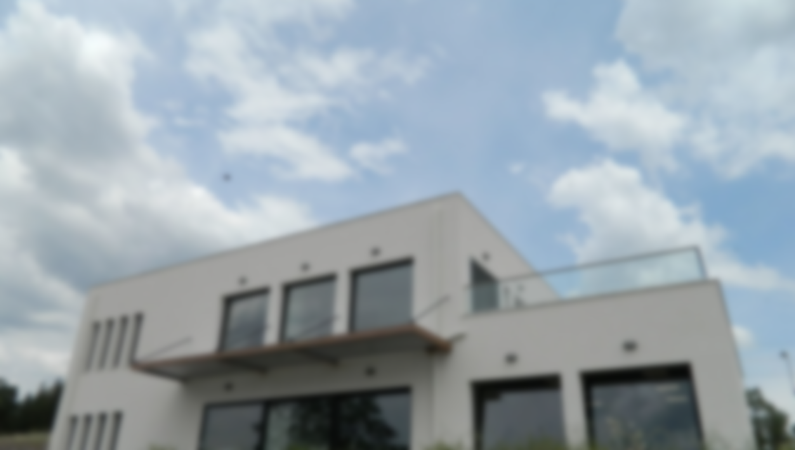
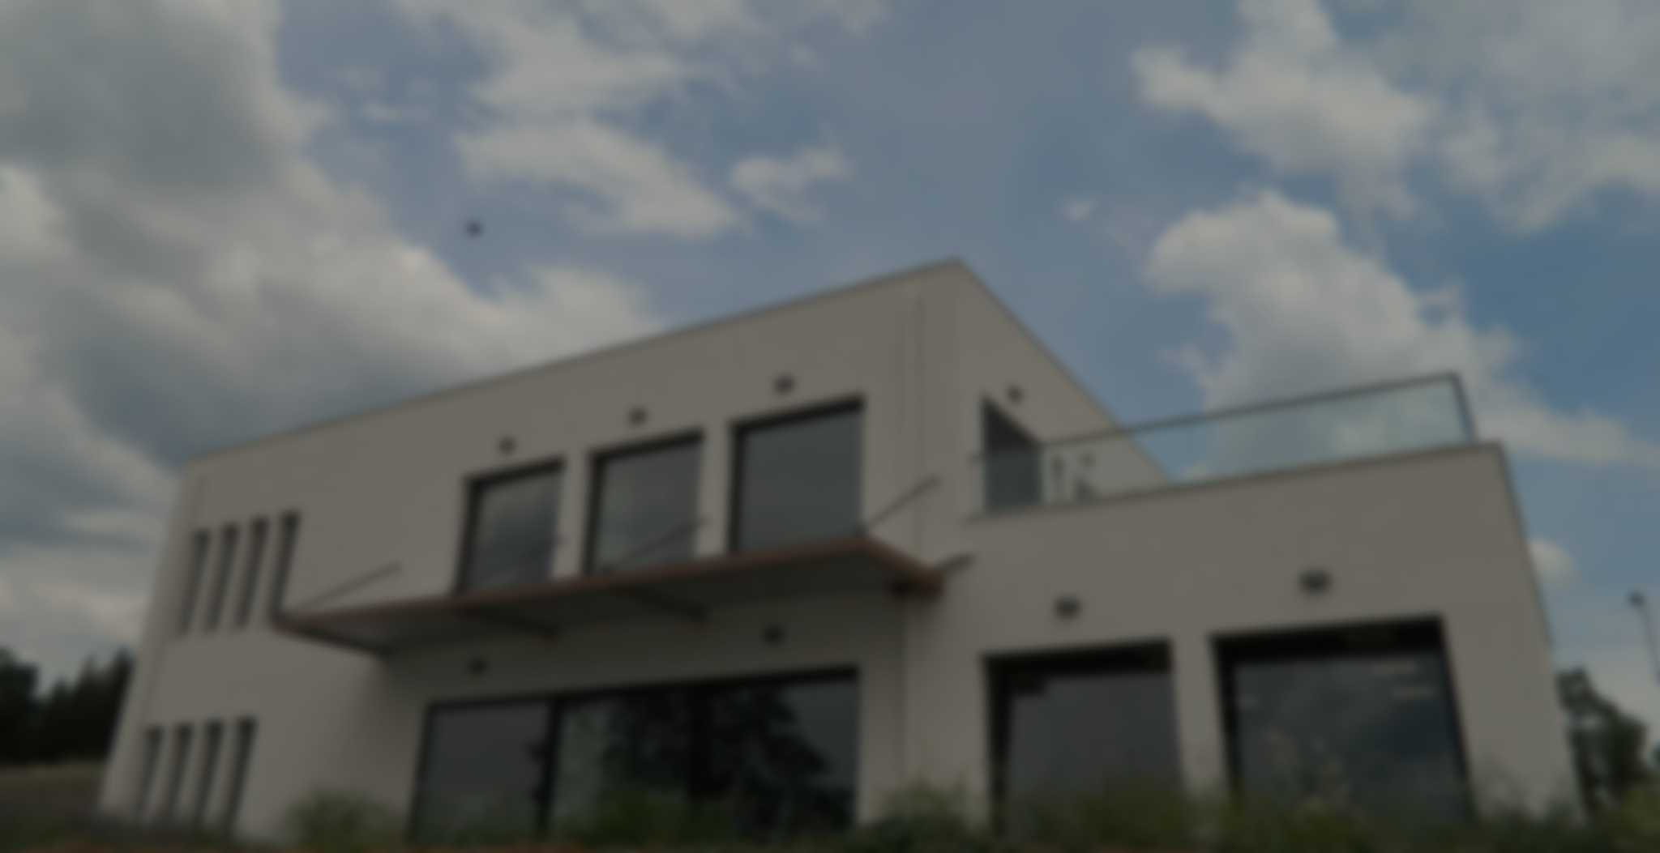
nZEB Smart House
Part of the Digital Innovation Hub

Slide 3
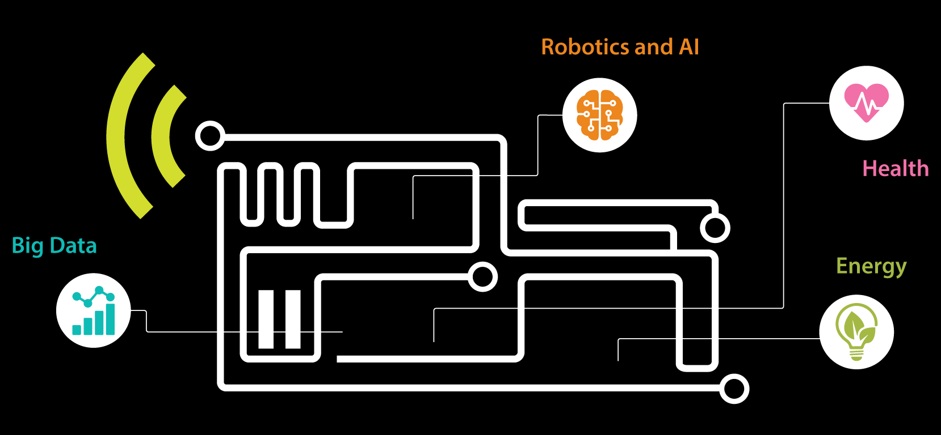
Plug-N-Harvest: CERTH nZEB Smart Home
A rapid prototyping & novel technologies demonstration infrastructure resembling a real domestic building where occupants can experience actual living scenarios while exploring various innovating smart IoT-based technologies.

Slide 4
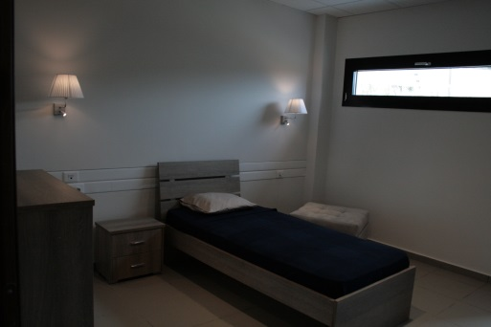
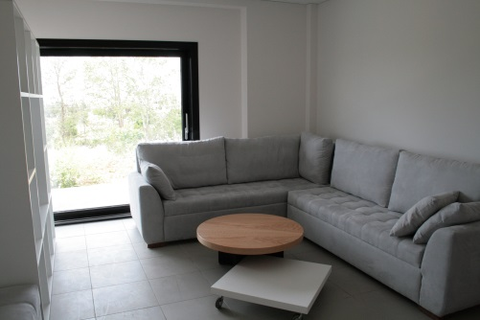
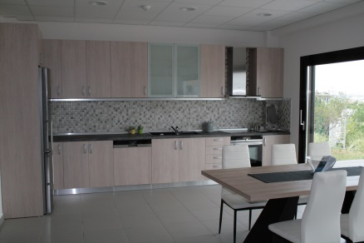
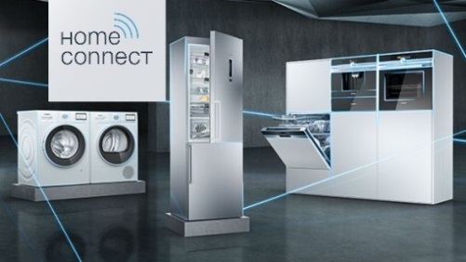
Plug-N-Harvest: Existing Infrastructure – Overview I
As the first Smart near-Zero Energy Building in Greece, it combines enhanced construction materials and intelligent ICT solutions creating a future-proof, sustainable and active testing, validating and evaluating ecosystem.
SoA Construction concept
16cm insulation materials
Triple glasses for windows with low Ug
Modern Design
>300m² - Main House and Supporting Areas ( Demo Room, Control Rooms )
Smart and Fully controllable LOADs
Dimming & On/Off Lighting – Indoor and Outdoor
HVAC (complete monitoring and control of a VRV installation)
Smart Home Appliances (Siemens WiFi enabled appliances)

Slide 5
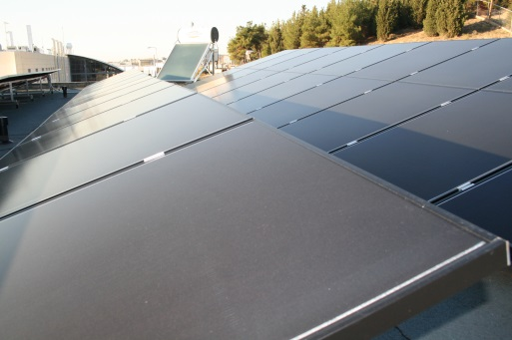
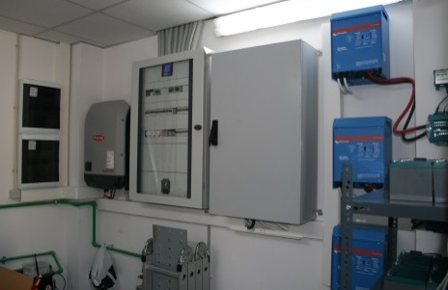
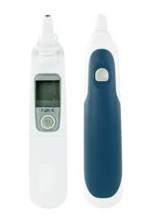
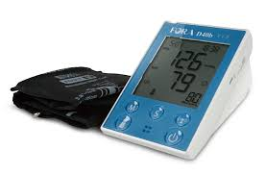
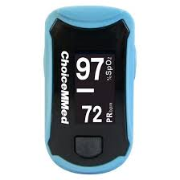
Plug-N-Harvest: Existing Infrastructure – Overview II
Energy Generation & Storage
A highly flexible and adaptable installation that includes:
9,57 kWp Thin Film PVs with a 10 kW Inverter (Modbus enabled)
4,68 kWh Lithium Ion Batteries distributed to 3 single phase 3kW Inverters (Modbus enabled).
Islanding capability of basic House Loads.
Health
Variety of Wireless Medical Devices (oxygen, blood pressure, glucose, body temperature, etc.)
High Resolution Occupancy Detection Devices (i.e. Bluetooth beacons)
Smart Watches & Wristbands for biometrics
Minimal Invasive surgery infrastructure (monocular endoscopic camera along with a phantom knee)

Slide 6
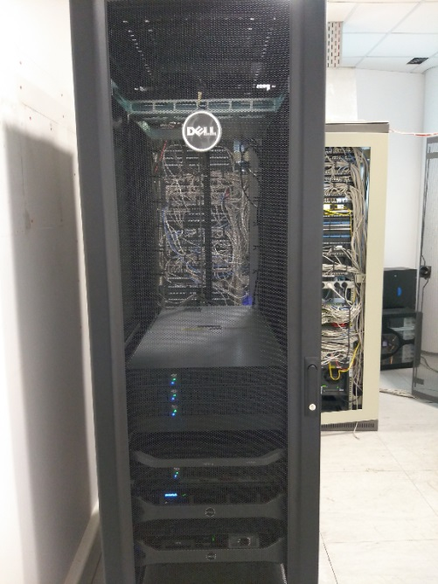
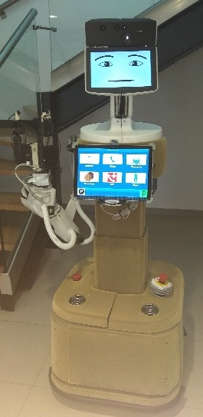
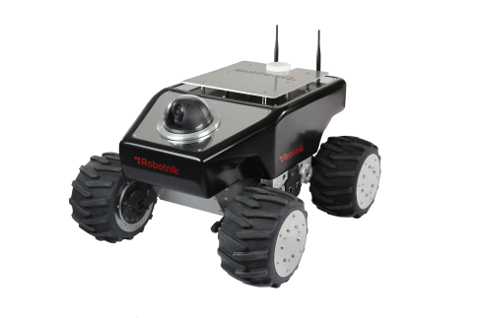
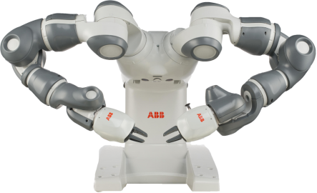
Plug-N-Harvest: Existing Infrastructure – Overview III
Big Data
High-Performance Computing Online and Connected
Four processing nodes, where each node has :
2 Intel Xeon 2.2GHz processors, 25MB cache memory each,
128GB RAM,
2 NVIDIA TESLA K40M graphic cards,
960 GB of SSD storage space
Red Hat Enterprise Linux for HPC
Robotics
Commercial Robot for Intelligent Assembly Processes (ABB YuMi)
Commercial Robot for Multi-surface and underground exploration (Robotnik Summit)
Prototype Robot for Assistive Living at Home

Slide 7
Plug-N-Harvest: DIH Ecosystem

Slide 8
Plug-N-Harvest: Existing Infrastructure – WiFi
Siemens Smart Home Appliances
HM638GRS6: Oven (Program, temperature, time, … )
SN578S36TE: Dishwasher (Program, temperature, time, … )
KG36NHI32: Fridge (Temperature, camera screenshots, …)
WT4HW569DN: Dryer (Program, rpm, time, … )
WM16W6H0EU: Washing Machine ((Program, temperature, rpm, time, … )
CERTH/ITI Smart Dimmer: Dimming Control and Luminance information. Profiling supported.
CERTH/ITI Smart Door Locking and Parking Systems Control Unit
CERTH/ITI People Counter: Occupancy

Slide 9
Plug-N-Harvest: Existing Infrastructure – ZigBee
PlugWise Stealth: On/Off Actuation / Consumption
PlugWise Circle/Circle+: On/Off Actuation / Consumption
Watt&Volt Smart Relay: On/Off Actuation / Consumption
PlugWise Sense: Temperature / Humidity
Centralite 3328-Veu: Motion / Temp.
Centralite 3323-Veu: Contact / Temp.
Centralite 3310-Geu: Temp./ Hum.
Innr RB 185 C: Smart Lamp
Innr GU 10 RS 125: Smart Spot Light
TVES Motion Sensor
TVES Magnetic Contact
GATEWAYS
PlugWise USB Dongle
RasBee Shield on a Rashberry Pi v3
ConBee USB shield (tested on a Rashberry as well)

Slide 10
Plug-N-Harvest: Existing Infrastructure – enOCEAN
Eltako FSG71/1-10V: Dimming
Eltako FUD71 230V: Dimming
Eltako FIH65B: Luminance
Thermokon SR04CO2Z: CO2 / Temperature
GATEWAY
Thermokon STC-Ethernet

Slide 11
Plug-N-Harvest: Existing Infrastructure – Z-Wave
Fibaro FGMS-001: Motion, Temperature, Luminance
Fibaro FGK-101: Door/Window/Cupboard
Fibaro FGCD-001: CO, Temperature
GATEWAY
Razberry Shield on a Rashberry Pi v3

Slide 12
Plug-N-Harvest: Existing Infrastructure – Bluetooth
FORA D40: Blood Pressure / Glucose
FORA IR20: Body Temperature
ChoiceMMED MD300C318T2: Oxygen Level
SENSORO Beacon: Occupancy
Bluecats Coin Beacon: Occupancy
Estimote Proximity Beacon: Occupancy
Sony SmartWatch 3 SWR50
GATEWAY
USB Bluetooth Dongle Antennas (tested also on a Rashberry Pi v3)

Slide 13
Plug-N-Harvest: Existing Infrastructure – LoRa
Libelium Nodes/WaspMotes
Event: Motion, Water leakage, Horizontal Liquid Level
Parking: Presence/Absence
Gases: CO, NO2, CH4, CH-CH3, H2, CH3-CH2-OH, NH3, H2S, CH3-CH2-OH, C6H5CH3)
Smart Water: pH & Temperature
Agriculture: Temperature, Humidity, pressure, Luminosity, Leaf Wetness, Soil Moisture, Weather Station (wind speed, wind direction, rain volume, … ), Soil/Water Temperature, Solar radiation
Other
Water Meters (NASys Metromatic® WMS & Maddalena Arrow WAN MVM)
GATEWAY
iC880A - LoRaWAN® Concentrator 868MHz on a Rashberry Pi v3.

Slide 14
Plug-N-Harvest: Existing Infrastructure – Wired
BACnet
LG HVAC: complete monitoring and control
Modbus
Gavazzi EM340: Energy, Power, Voltage, Amperage, PF, …
Gavazzi EM210: Energy, Power, Voltage, Amperage, PF, …
Gavazzi EM270: Energy, Power, Voltage, Amperage, PF, …
Fronius SYMO 10.0-3-M: Access to PV Generation
Victron Colour Control GX: Access to Battery Inverters – Islanding coordination
Mastervolt Masterbus: Access to Battery Shunt Information.
GATEWAY
Rashberry Pi v3 TCP/IP

Slide 15
Plug-N-Harvest: Existing Infrastructure – Other
TVES Panic Button (RF 869 MHz)
Broadlink RM PRO: Infrared control of various devices
XBOX Kinect Camera: Occupancy
Electrical rotors for controlling windows and shades (currently not integrated)
Arthrex AR-5970SP monocular endoscopic camera: Suitable for arthroscopic surgery in both ex-vivo and in-vivo cases.
AR-3580SP 100 watt xenon light source
A medical grade SONY SU-560 monitor
Sawbones anatomically accurate Dry Arthroscopy Knee

Slide 16
Thank you!

