Slide 1
Plug-N-Harvest
WP1 – REQUIREMENTS ANALYSIS AND ENGINEERING
ORGANIZATION: AIGUASOL, CU, RWTH, CERTH
PRESENTER(S): ARNAU GONZÁLEZ (AIGUASOL), HU DU (CU), VeRENA DANNAPFEL (RWTH), Panagiotis Drosatos (CERTH)
Notes:
Integration, Pilot Implementation and assessment

Slide 2
Content
WP1 progress
Task 1.1 – End-Users and Business Requirements
Task 1.2 – Use Cases, Test Scenarios and Evaluation Plans
Task 1.3 – Analysis of building types and Construction Requirements
Task 1.4 – PnH architectural design, functional and technical specifications
Task 1.5 – Active-façade CFD simulation and optimization guidelines

Slide 3
WP1 Timeline
Q1
Q2
Q3
Q4
Q5
Q6
Q7
Q8
Q9
Q10
Q11
Year 1 Year 2 Year 3
D1.1, D1.2, D1.3
Final
D1.4, D1.5
Final
T1.4, T1.5 Start
T1.1, T1.2, T1.3
Start
T1.4, T1.5 End
T1.1, T1.2, T1.3
End
D1.5, D1.6
First
D1.1, D1.2, D1.3, D1.4
First

Slide 4
WP1 progress
Task 1.1 delivered first version of D1.1 in August 31st
  Lists of relevant project indicators: 17 KPIs (key indicators) and 28 DPIs (secondary indicators)
Task 1.2 & Task 1.3 delivered first version of D1.2, D1.3 and D1.4 in September 30th
  Use case site survey and audit reports
  Evaluation plan layout
  Systems engineering requirements definition
Task 1.4 & Task 1.5
  About to deliver first versions of D1.5 and D1.6

Slide 5
WP1 – Requirements Analysis and Engineering
T1.1 END-USER AND BUSINESS REQUIREMENTS
Task responsible: AIGUASOL
PRESENTER(S): ARNAU GONZÁLEZ
MEETING: CARDIFF Meeting, CARDIFF, 20-22 NOVEMBER 2018
Notes:
Integration, Pilot Implementation and assessment

Slide 6
Task 1.1 progress
OCT
NOV
DEC
JAN
FEB
MAR
APR
MAY
JUN
JUL
AUG
2018
2017
D1.1a
Final
KPI list 1st Proposal (ALL)
KPI list Internal Validation (ALL)
KPI/DPI refinement (ALL)
KPI/DPI definitive lists (ALL)
KPI/DPI methodologies development (ALL)
D1.1a Final Version 1st Draft (AIGUASOL, ALL)

Slide 7
Task 1.1 – KPI / DPI
The main output of Task 1.1 was the delivery of the list of project’s performance indicators and their calculation methodology layout:
  17 Key Performance Indicators (KPI) – These are those indicators directly measuring the performance of the project in energy, economic and circularity terms
  28 Design Performance Indicators (DPI) – These are indicators internally required to address the performance of the design of certain systems of the PnH solution (ADBE, IMCS, OEMS, Circularity of the solutions,…) or to calculate KPIs
This was a coral task with almost all partners involved and AIGUASOL wants to thank everyone for your valuable contributions

Slide 8
Task 1.1 – External Survey
External Validation of KPIs was successful
  There were obtained 46 expert responses

Slide 9
Task 1.1 – External Survey
External Validation of KPIs was successful
  From “Absolutely not relevant” to “Absolutely Relevant”, all indicators were qualified between “Relevant” and “Absolutely Relevant”
The best rated indicators were:
  Primary Energy Consumption Reduction Percentage and Energy Bill Reduction Percentage, in the category of Energy Indicators
  OPEX, in the category of Economic indicators
The worst rated indicators were:
  Modularity, Disassembly and Toxic Materials, in the category of Circularity Indicators

Slide 10
Task 1.1 – NEXT STEPS
Task 1.1 (as others in WP1) hibernates for half a year
The next version of D1.1 will be an updated version of the list of indicators, calculation methodologies and it should include the baseline calculation for all of them

Slide 12
WP1 – Requirements Analysis and Engineering
T1.2 Use Cases, Test Scenarios and Evaluation Plans
Task responsible: CU
PRESENTER(S): Dr Hu Du, Dr Puxi Huang, Prof Phil Jones
MEETING: CARDIFF Meeting, CARDIFF, 20-22 NOVEMBER 2018
Notes:
Integration, Pilot Implementation and assessment

Slide 13
Task 1.2 Deliverables and Milestones
Del. no. | Deliverable name | WP no. | Lead beneficiary | Nature | Dissemination level | Delivery date from DoW | Actual delivery date | Status / Comments
D1.2 (also known as D1.2.1) | Use Case Site Survey and Audit Report | WP1 | CU | Report | Public, Confidential, only for members of the consortium | M30 (Version [a], M12) | M14 | Submitted, Slight delay was performed due to quality checking activities.
D1.3 (also known as D1.2.2) | Evaluation Plan | WP1 | CU | Report | Public, Confidential, only for members of the consortium | M30 (Version [a], M12) | M14 | Submitted, Slight delay was performed due to quality checking activities.

Slide 14
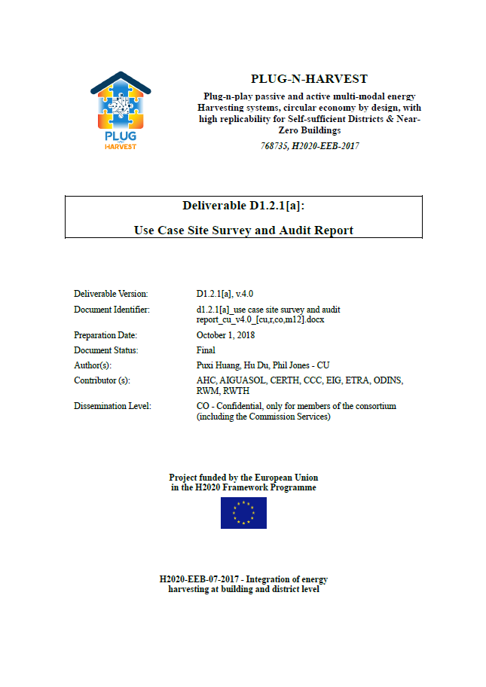
D1.2 Use Case Site Survey and Audit Report (D1.2.1a)
247 pages document covering:
Review of the use case of other European projects for energy harvesting in façades
Site and building information survey
Occupants satisfaction survey
Test scenarios
Conclusion and suggestion

Slide 15
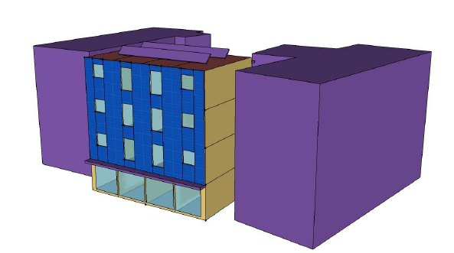
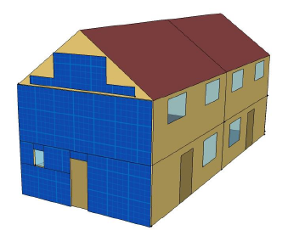
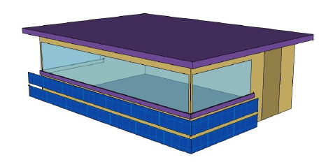
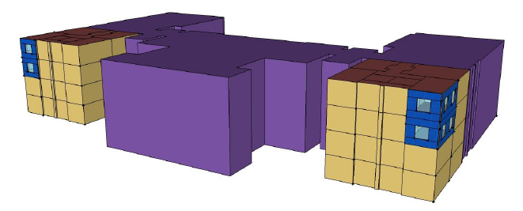
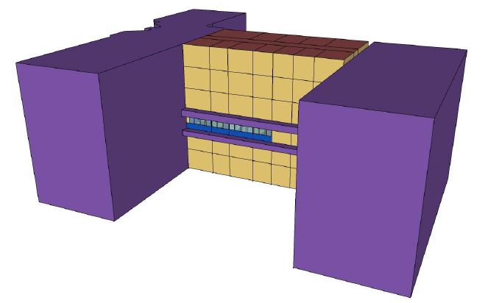
D1.2 Use Case Site Survey and Audit Report (D1.2.1a)
Test scenarios
Orientation vs annual energy generation
Each pilot site in different climate condition
Insulation position vs annual heating demand
Energy saving potential on the old or new building

Slide 16

D1.3 Evaluation Plan (D1.2.2a)
98 pages document covering:
Evaluation design and methodology
Historical energy and weather data investigation
Review of the existing metering systems
Tangible and intangible needs
Evaluation scenarios and essential parameters
KPIs and monitoring equipment requirement
Monitoring system and equipment planning
Evaluation schedule

Slide 17
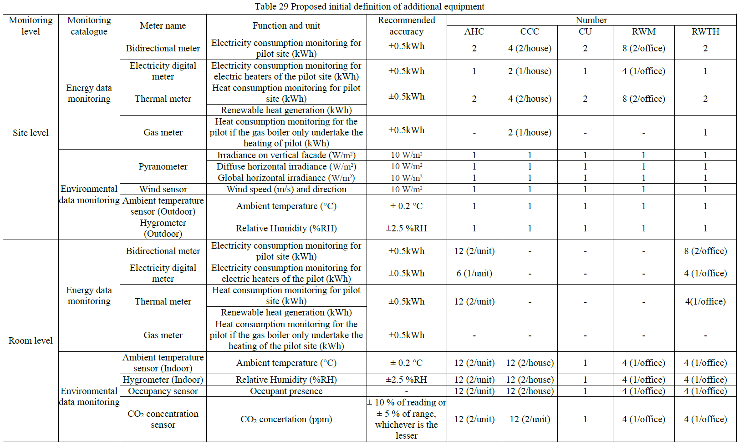
D1.3 Evaluation Plan - Monitoring equipment requirement
Page 50 of D1.3 report

Slide 18
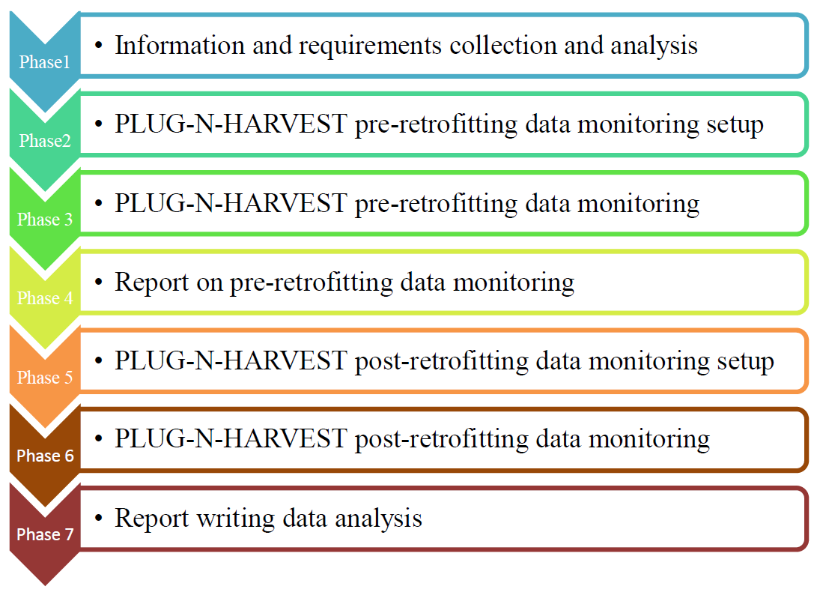
D1.3 Evaluation Plan - Evaluation schedule
PLUG-N-HARVEST performance evaluation will be conducted under WP4 Task 4.6 Evaluation design and methodology
7 phases of evaluation are recommended
D4.6 M36 should cover reports from phase 1-3 (pre-retrofit baseline)
D4.6 M51 should cover reports from phase 4-7 (post-retrofit baseline)

Slide 19
WP1 – Requirements Analysis and Engineering
T1.3 Analysis of Building Types and Construction Requirements
Task responsible: CU
PRESENTER(S): Dr Hu Du, Dr Puxi Huang, Prof Phil Jones
MEETING: CARDIFF Meeting, CARDIFF, 20-22 NOVEMBER 2018
Notes:
Integration, Pilot Implementation and assessment

Slide 20
Task 1.3 Deliverables and Milestones
Del. no. | Deliverable name | WP no. | Lead beneficiary | Nature | Dissemination level | Delivery date from DoW | Actual delivery date | Status / Comments
D1.4 (also known as D1.3) | System Engineering requirements definition | WP1 | CU | Report | Public, Confidential, only for members of the consortium | M30 (Version [a], M12) | M14 | Submitted, Slight delay was performed due to quality checking activities.

Slide 21

D1.4 System Engineering requirements (D1.3a)
352 pages document covering:
Review of the existing condition of pilot buildings
Construction requirements
Appendix A: Loading requirement of wall cladding in Spain
Appendix B: loading requirement of wall cladding in the UK
Appendix C: Building information survey
Appendix D: Building services system survey
Appendix E: Building regulation information

Slide 22
D1.4 System Engineering requirements – the review
Building fabric performance
HVAC and Domestic Hot Water (DHW) system
Lighting system
Usability and operation of controls
Structural performance
Fire prevention
Cultural aesthetic and requirements of the neighborhood
Waste recycle and incentive scheme
Transport
Low carbon technologies

Slide 23
D1.4 System Engineering requirements – the requirements
Fire safety
Energy conservation
Waste
Ventilation
Structure
Acoustic
Lighting
Appearance
Use of toxic and pollutants material
Battery
Additional requirements for each pilot

Slide 24
Future works
Update the deliverable of D1.2 Use Case Site Survey and Audit Report (due M30, 29th Feb 2020), mainly including the post-retrofit occupants survey (also contribute to WP4 T4.6 performance evaluation)
Update the deliverable of D1.3 Evaluation Plan (due M30, 29th Feb 2020), mainly including baseline parameter monitoring (also contribute to WP4 T4.6 performance evaluation)
Update the deliverable of D1.4 Systems engineering requirements definition (due M30, 29th Feb 2020)

Slide 26
WP1 – Requirements Analysis and Engineering
T1.4 architectural design, functional and technical specifications
Task responsible: RWTH
PRESENTER(S): RWTH
MEETING: CARDIFF Meeting, CARDIFF, 20-22 NOVEMBER 2018
Notes:
Integration, Pilot Implementation and assessment

Slide 27
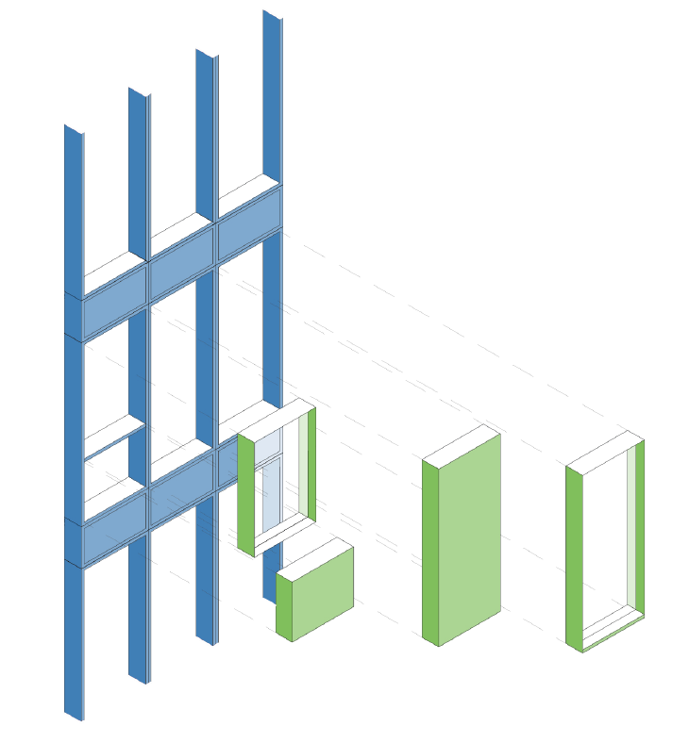
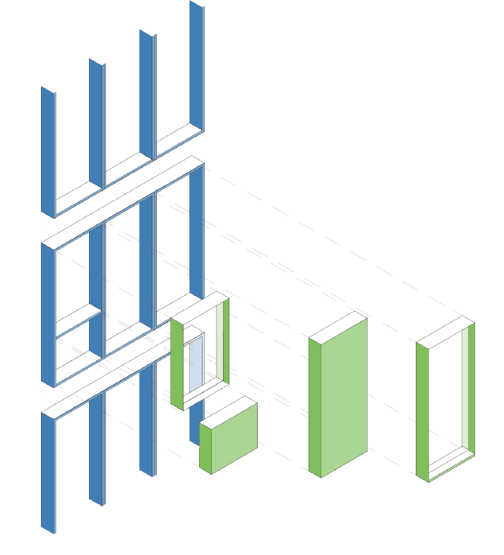
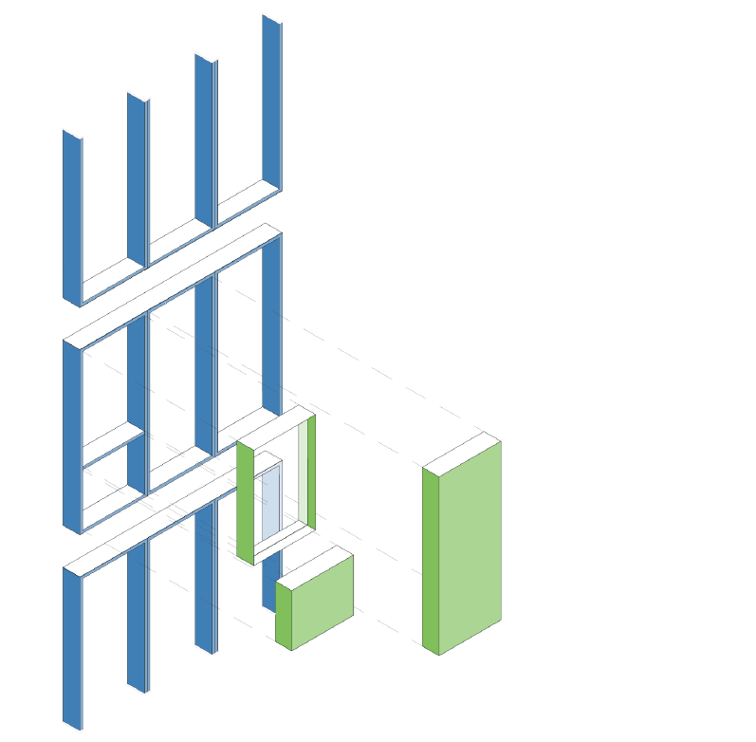
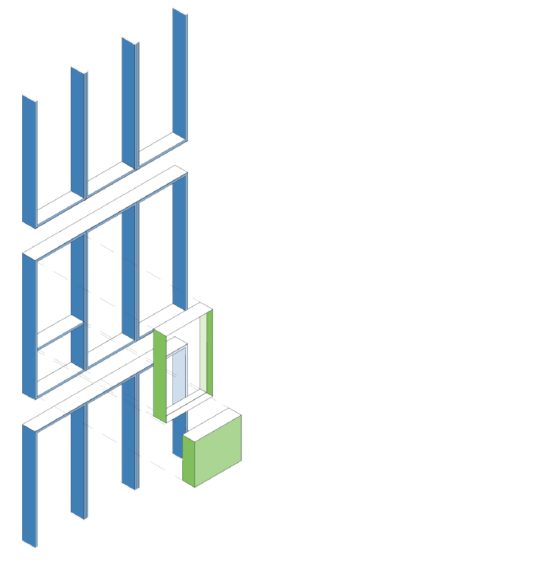

Modular Toolkit
Site Measured Elements
Aluminium Frame
Full Opaque Module
Top Window Module
Balustrade Module
Full Window Module

Slide 28
D1.5 – Database in Configuration Process

Slide 29
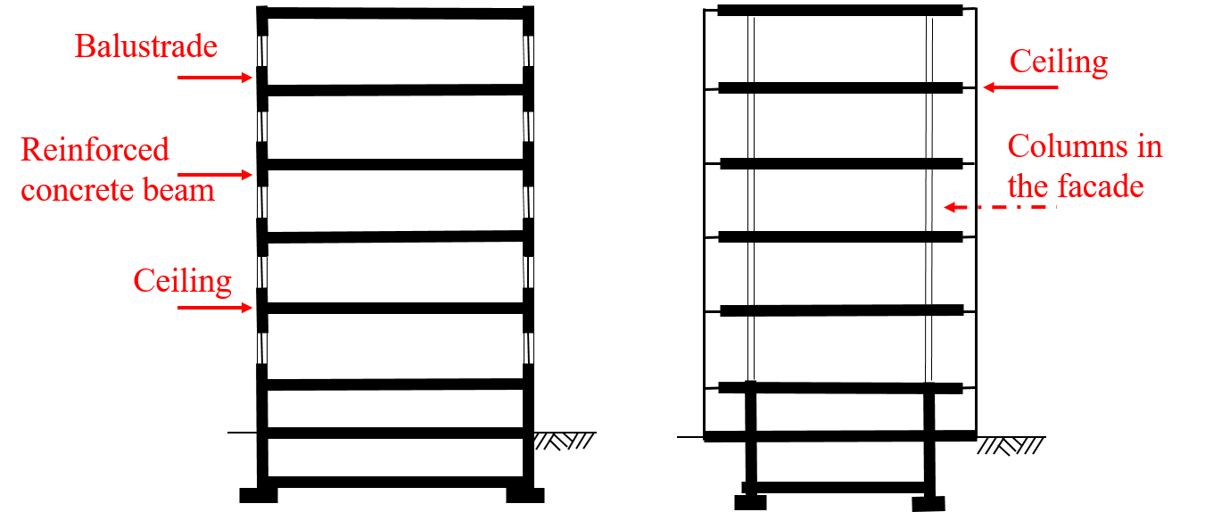
Functional Requirements: Statics
The universal fixing point of the ADBE system is the ceiling head.
  Alumil, we need your contribution. Please add a chapter on
  limitations and requirements resulting from the manufacturing
  process
The ceiling mountings and all mountings in the module
must be designed for loads from wind suction and
pressure.
German windloads according to EN 1991-1-1-4/NA
  We need your contribution (see D1.5, Tab. 1.3):
Pilot |  | Significant wind load for the ABDE q_{p} kN/m²
1 | Germany | ± 0,775
2 | Greece | ???
3 | Spain | ???
4 | Wales | ???

Slide 30
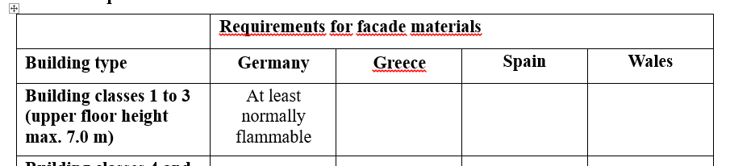
Functional Requirements: Fire protection
According to D1.3, the requirements for the fire resistance of facades are limited to the fire resistance classes of the overall structure (D1.3 Table 16.)
  Fire resistance in Germany, Greece and Spain: 90 minutes
  Fire resistance in Wales: 60 minutes
In Germany, concrete requirements are also placed on materiality depending on the building structure and use.
  We need your contribution (see D1.5, Table 3):

Slide 31
Functional Requirements: U-Values
Required maximum, average heat transmission coefficient (U-value) depends on country specific building regulations.
The German requirements are decisive for the design of the ADBE
All required U-values apply to exterior walls without integrated building technology.
Structural component | construction | Country specific required U-value for retrofitting [W/(m²K)]
 |  | Germany | Greece | Spain | Wales
Windows, window doors | Windows | 1.30 | 2.60 | 2.00 | 1.60
 | Curtain walls | 1.40 | 2.60 | 2.00 | 1.60
Exterior wall (opaque) | Masonry, Concrete, Timber, etc. with new external insulation | 0.24 | 0.35 | 0.41 | 0.30

Slide 32
D1.5 - Components Assessment

Slide 33
D1.5 – Database Components - Research Sources
Technology: PV: CIGS/CIS
Thin-film PV module with highest efficiency 2014 (global) | Measurement by U.S. Energy Department for research and development for renewable energy and energy efficiency | Avancis | PowerMax 3.5 | Yes
Technology: Heatpumps Air-Water (Split)
Proposal of project partner | List from CERTH | Helioscience (IMERYS) | ECO | No: Depth > 280mm
Technology: Power Storage: Lithium-Ion Battery
Top 3 leading manufacturers of li-ion batteries (global) | Navigant Research Leaderboard: Assessment of Strategy and Execution for 10 Li-Ion Battery Manufacturers | LG Chem | Residential ESS (Energy Storage System) RESU3.3, RESU6.5 | No or limited; solutions to fulfil security requirement are under examination
Technology: Power storage: Redox-Flow Battery
Top 3 vanadium redox battery manufacturers (global) | HTF Market Intelligence Consulting: Vanadium Redox Battery (VRB) Market 2018 Forecast to 2023 | Rongke Power |  | Under examination: Current products too large for application

Slide 34
WP5 – Merging of RWTH and EIG Database
Will be introduced during the WP5 presentation

Slide 35
D1.5 – Drawings
To be presented in the afternoon together with the ADBE modular toolkit

Slide 36
WP1 – Requirements Analysis and Engineering
T1.5 Active-façade CFD simulation and optimization guidelines
Task responsible: CERTH
PRESENTER(S): P.Drosatos, P.Stamatopoulos, N.Nikolopoulos, Ν.Margaritis, Μ.Zeneli, Ι.Violidakis, I.Malgarinos, E.Kakaras
MEETING: CARDIFF Meeting, CARDIFF, 20-22 NOVEMBER 2018
Notes:
Integration, Pilot Implementation and assessment

Slide 37

CPERI
Motivation & Progress | Problem description | Models | Results | Concluding Remarks
Presentation Outline
Motivation of Work
  Work Progress
Investigation of the building
  Geometrical Model and Numerical Grid
  Boundary Conditions
  Aeration Rates
  Validation of Model
  Modelica Correlations
Simplifying Perforated metal sheet
  Geometrical Model of Perforated Sheet and Porous Medium
  Numerical Grids
  Coefficients for Porous Medium
  Validation of Porous Media Approach (Natural convection Simulation)
PV/T cladding simulation
  2D and 3D Geometry
  Numerical Grids
  Boundary Conditions
  Results
Conclusions

Slide 38
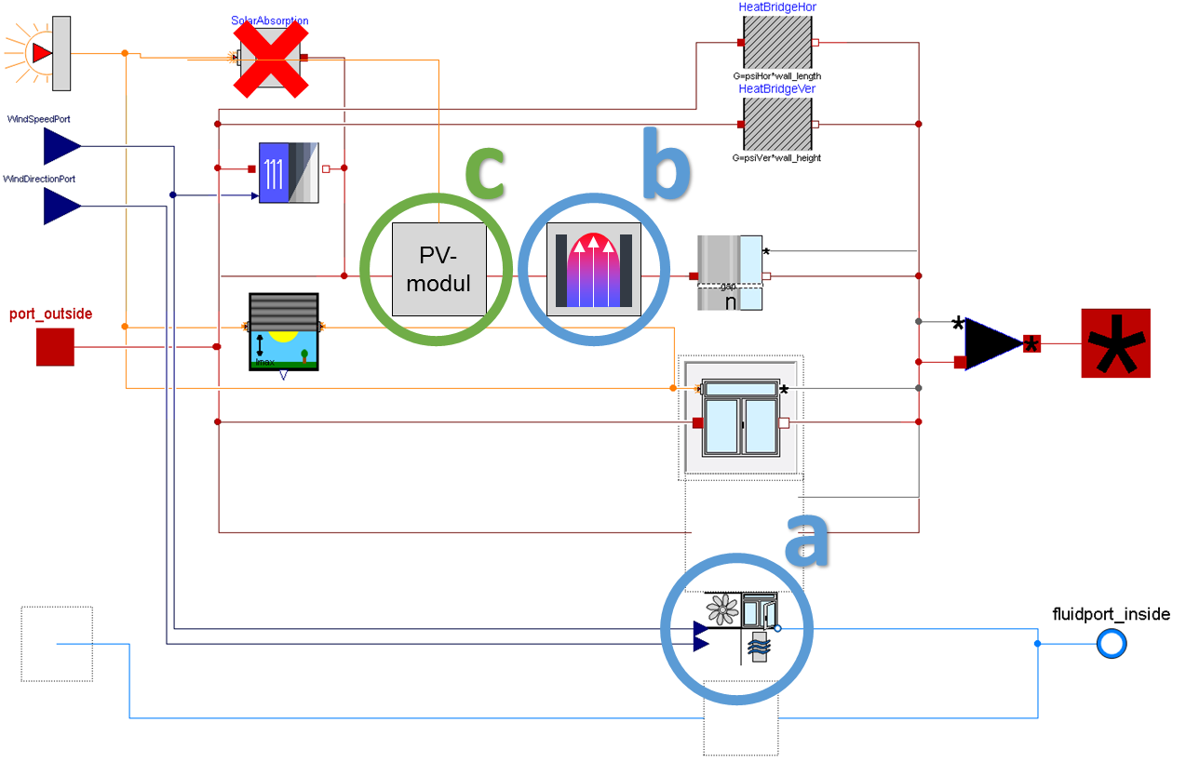
CPERI
Motivation & Progress | Problem description | Models | Results | Concluding Remarks
Motivation of Work
RWTH Aachen University is developing a Modelica model for the energetic analysis of a building (D2.2)
Main object: calculation of heat fluxes through the entire building
In order to complete the Modelica model it is necessary the following correlations to be used as input data:
estimation of volume flow rate through an open window under different wind scenarios
(point A)
estimation of the thermal influence of the channel flow inside the canal on the PV system
(point B)
These correlations can be resulted by CFD results

Slide 39
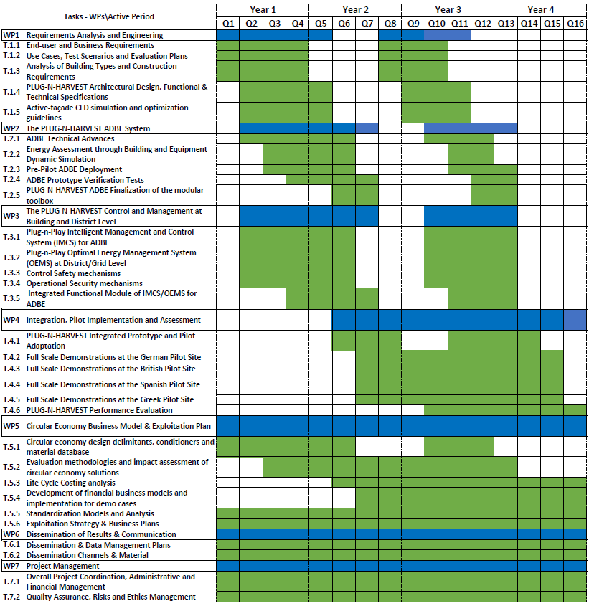
CPERI
Motivation & Progress | Problem description | Models | Results | Concluding Remarks
Work Progress
T1.6: Active-façade CFD simulation and optimization guidelines
D
D
50% completed
50% pending
12/2017
11/2018
5/2020
WP 1 | Task | Deliverable | M
Requirements Analysis and Engineering | Τ1.5 Active-façade CFD simulation and optimization guidelines | D1.6 Active-façade CFD simulation and optimization guidelines | 15 33

Slide 40
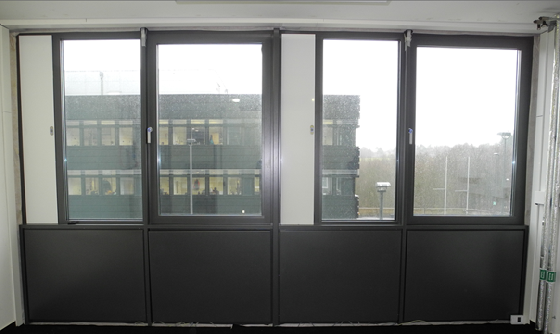
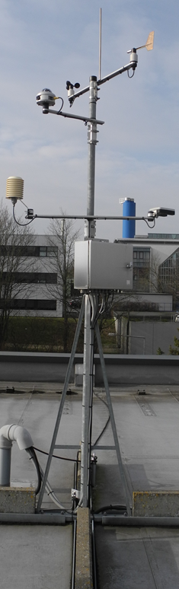
CPERI
Motivation & Progress | Problem description | Models | Results | Concluding Remarks
 | Building
Building sketch
Calculation of aeration rates in the investigated room for different wind conditions using CFD simulations
Wind conditions measured by weather station installed on the building roof
Validation of the developed mathematical model using experimental values (tracer gas concentration decay method)
Derivation of correlations that will be used in Modelica model
Photo of window
Weather station

Slide 41
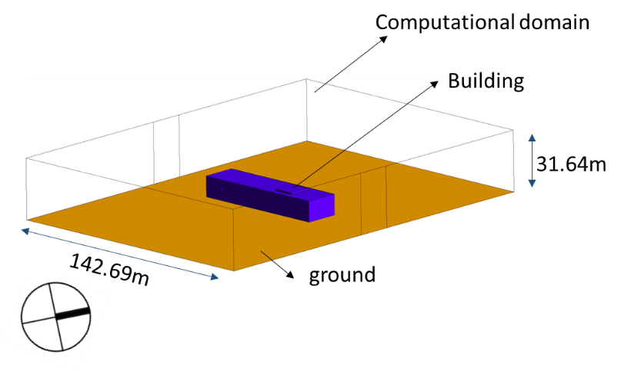
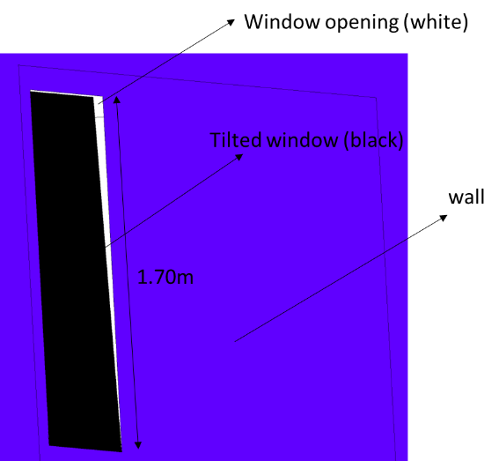
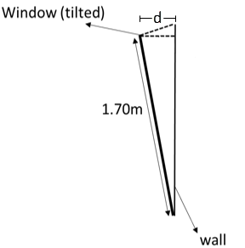
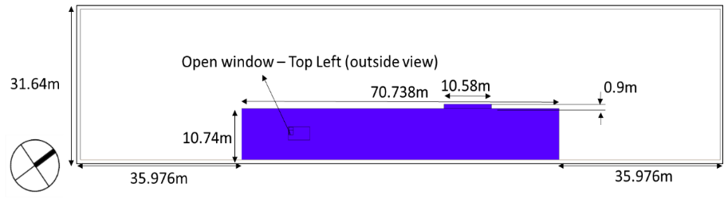
CPERI
Motivation & Progress | Problem description | Models | Results | Concluding Remarks
 | Building
Geometrical Model and Numerical Grid
Computational domain for CFD simulation
Two window openings:
25% , d = 0.0425m
100% , d = 0.17m
Total amount of elements | Type of elements | Max skewness
8.7millions | Hexahedrons | 0.92
Simulation of window
Very dense and high quality mesh
Hexahedrons ensure smooth convergence

Slide 42
CPERI
Motivation & Progress | Problem description | Models | Results | Concluding Remarks
 | Building
Boundary Conditions
Three cases (3) for validation purposes (A,B,C)
Case | Incident angle (º) | Velocity magnitude (m/sec) | Ambient temperature (ºC) | Room temperature (ºC) | Window opening (%) | Beaufort scale
A | 205.71 | 1.57 | 5.24 | 16.51 | 25 | 2
B | 195.27 | 2.56 | 16.04 | 19.23 | 100 | 2
C | 238.88 | 1.54 | 4.11 | 14.22 | 100 | 2
L_{a} | 215.22 | 6.0 | 13.73 | 19.23 | 100 | 4
L_{b} | 215.22 | 10.0 | 13.73 | 19.23 | 100 | 5
L_{c} | 215.22 | 15.0 | 13.73 | 19.23 | 100 | 7
L_{1a} | 180.00 | 6.0 | 13.73 | 19.23 | 100 | 4
L_{1b} | 180.00 | 10.0 | 13.73 | 19.23 | 100 | 5
L_{1c} | 180.00 | 15.0 | 13.73 | 19.23 | 100 | 7
L_{2a} | 135.00 | 6.0 | 13.73 | 19.23 | 100 | 4
L_{2b} | 135.00 | 10.0 | 13.73 | 19.23 | 100 | 5
L_{2c} | 135.00 | 15.0 | 13.73 | 19.23 | 100 | 7
L_{3a} | 90.00 | 6.0 | 13.73 | 19.23 | 100 | 4
L_{3b} | 90.00 | 10.0 | 13.73 | 19.23 | 100 | 5
L_{3c} | 90.00 | 15.0 | 13.73 | 19.23 | 100 | 7
L_{4a} | 45 | 6.0 | 13.73 | 19.23 | 100 | 4
L_{4b} | 45 | 10.0 | 13.73 | 19.23 | 100 | 5
L_{4c} | 45 | 15.0 | 13.73 | 19.23 | 100 | 7
Fifteen cases (15) for Modelica correlations
The aeration rates used as input for Modelica model should be expressed as a function of air magnitude and direction
For each direction of free airflow three different velocities have been selected (4bft,5bft,7bft in Beaufort scale)

Slide 43
CPERI
Motivation & Progress | Problem description | Models | Results | Concluding Remarks
 | Building
Aeration Rates
Aerations rates of CFD and experimental data
Case | Aeration rate (CFD) (1/h) | Aeration rate (experiments) (1/h) | Relative difference (%)
A | 1.16 | 1.68 | -31.15
B | 4.87 | 2.70 | 129.13
C | 2.12 | 2.10 | 1.38
L_{a} | 4.77 | n/a | -
L_{b} | 13.00 | n/a | -
L_{c} | 14.04 | n/a | -
L_{1a} | 10.41 | n/a | -
L_{1b} | 19.48 | n/a | -
L_{1c} | 27.78 | n/a | -
L_{2a} | 11.64 | n/a | -
L_{2b} | 20.42 | n/a | -
L_{2c} | 31.05 | n/a | -
L_{3a} | 9.05 | n/a | -
L_{3b} | 15.47 | n/a | -
L_{3c} | 22.83 | n/a | -
L_{4a} | 6.40 | n/a | -
L_{4b} | 9.66 | n/a | -
L_{4c} | 7.62 | n/a | -
Based on relative difference between CFD and experimental values as regards the aeration rate, the validation of the model is not possible
Validation
This is attributed to the location of the weather station that measures the direction and magnitude of air free stream
Modelica correlations

Slide 44
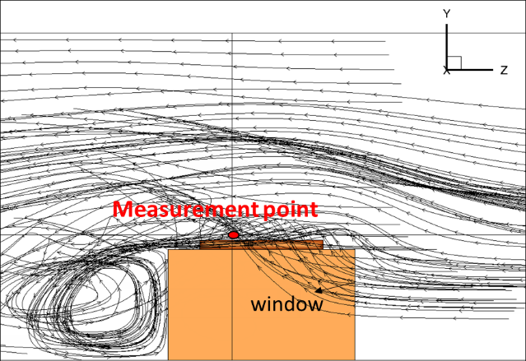
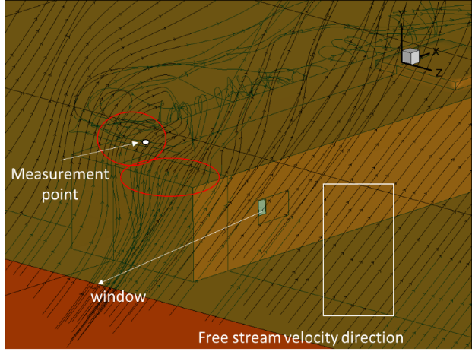
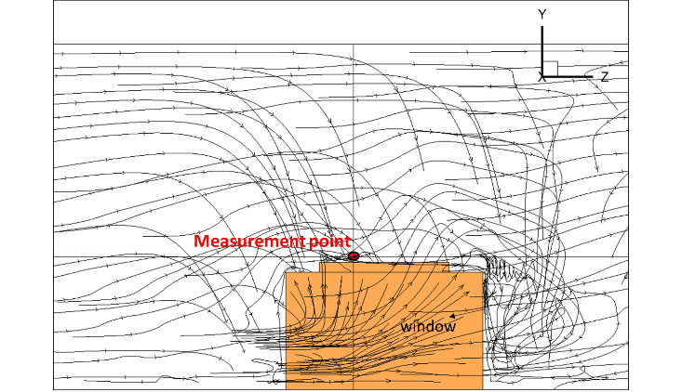
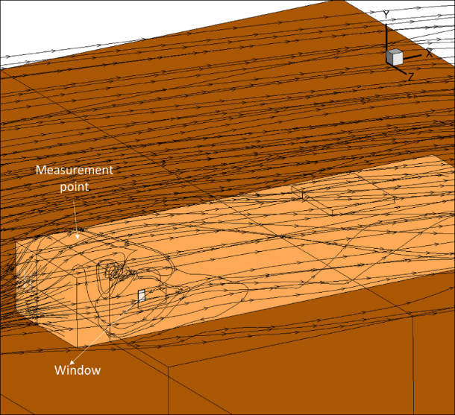
CPERI
Motivation & Progress | Problem description | Models | Results | Concluding Remarks
 | Building
Validation of Model
Stream lines of velocity field in case B
The weather station is located inside the developed boundary layer
The measurements that have been used as reference cannot be considered as representative for time-averaged free airflow conditions due to recirculations
Stream lines of velocity field in case C

Slide 45
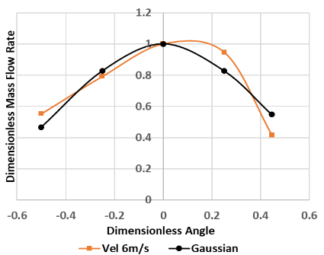
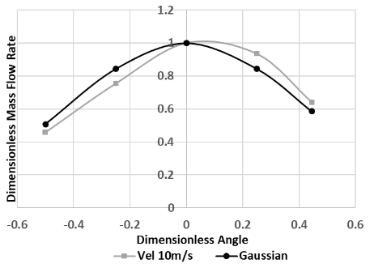
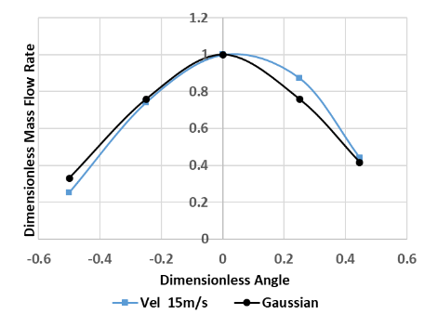

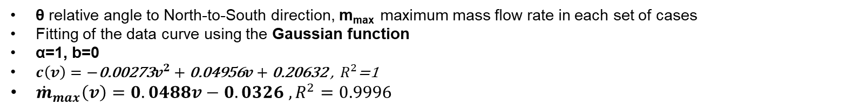

CPERI
Motivation & Progress | Problem description | Models | Results | Concluding Remarks
 | Building
Modelica Correlations
$$f\left(x\right)=ae^{− \frac{{\left(x−b\right)}^{2}}{2c^{2}}}$$
Incident velocity (v=6m/sec) | Incident velocity (v=10m/sec) | Incident velocity (v=15m/sec)
R²= 0.8417 | R²= 0.8892 | R²= 0.9465
$$\hat{θ}=\frac{θ−{135}^{o} }{{180}^{o}} dimensionless angle$$
$\hat{\dot{m}}=\frac{\dot{m}}{{\dot{m}}_{max}}$ $dimensionless mass flow rate$
θ relative angle to North-to-South direction, m_{max} maximum mass flow rate in each set of cases
Fitting of the data curve using the Gaussian function
α=1, b=0
$c\left(v\right)=−\text{0.00273}v^{2}+\text{0.04956}v+\text{0.20632}\text{ , }{ R}^{2}\text{=1}$
${\dot{m}}_{max}\left(v\right)=0.0488v−0.0326 , R^{2}=0.9996$

Slide 46
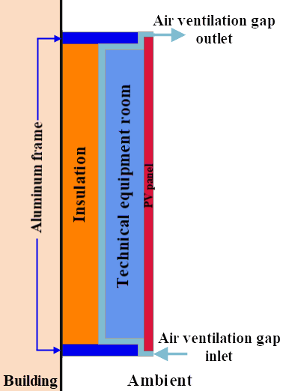
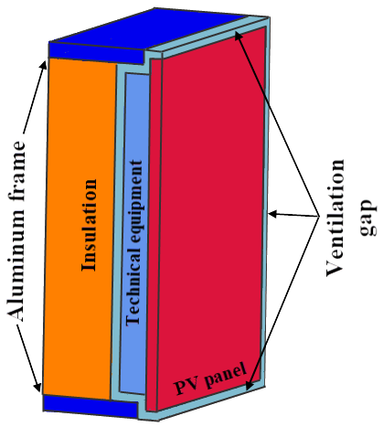
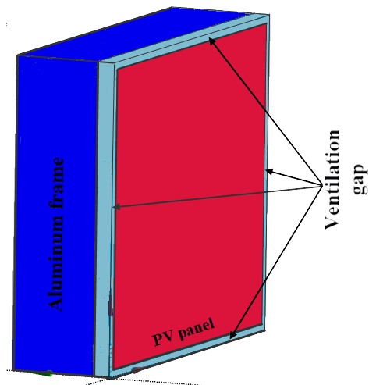
CPERI
Motivation & Progress | Problem description | Models | Results | Concluding Remarks
 | Simplifying Perforated Metal Sheet
The second step is the simulation of the airflow behind an active-façade system installed on building envelope for various conditions
The geometrical formation of the system includes insect mesh (perforated metal sheet)
The detailed simulation of this perforated metal sheet demands high computational resources and time
    To simplify the case we replace the sheet with porous medium
    Validation of the model in two cases with arbitrary computational domain (not that of active-façade):
        Forced flow
        Natural-convection flow
Perforated metal sheet

Slide 47
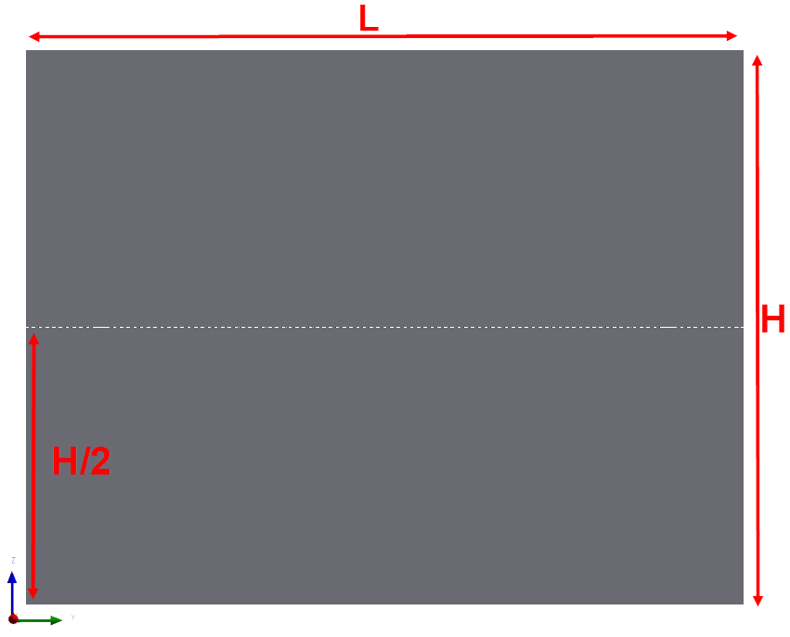
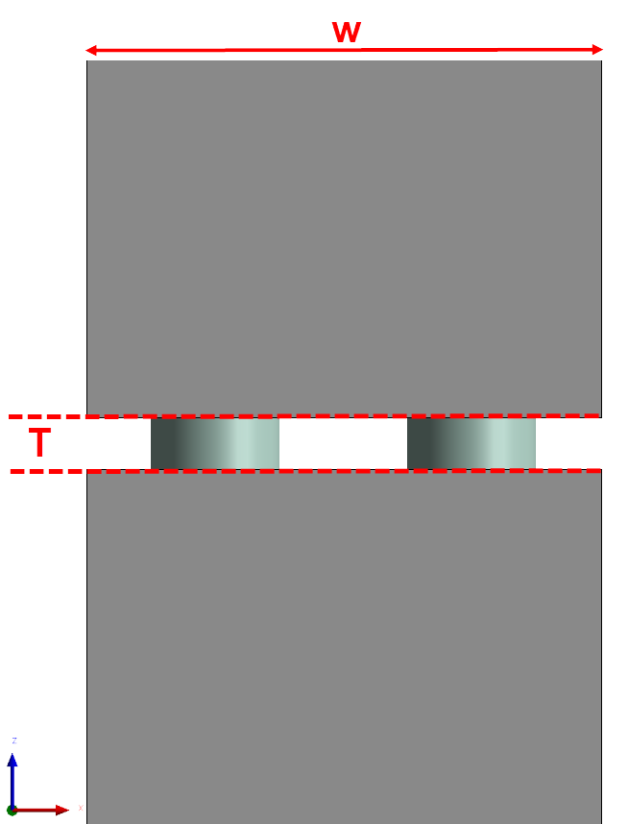
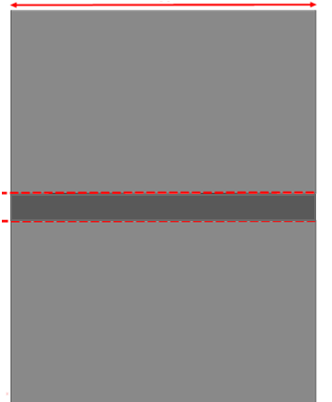
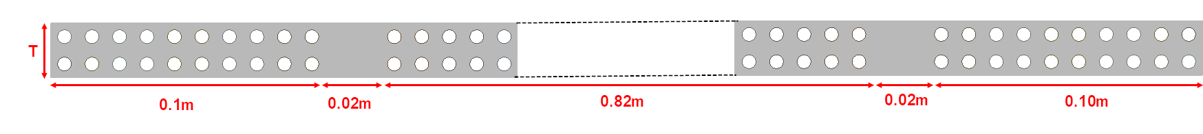
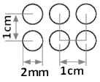
CPERI
Motivation & Progress | Problem description | Models | Results | Concluding Remarks
 | Simplifying Perforated Metal Sheet
Geometrical Model of Perforated Sheet and Porous Medium
z-y view | z-x view zoom of perforated sheet | z-x view zoom of porous zone
L=1.06m
W=0.02m
W=0.02m
H=0.82m
T=0.02m
T=0.02m
Pattern and dimensions of perforated sheet
Sketch of perforated sheet

Slide 48
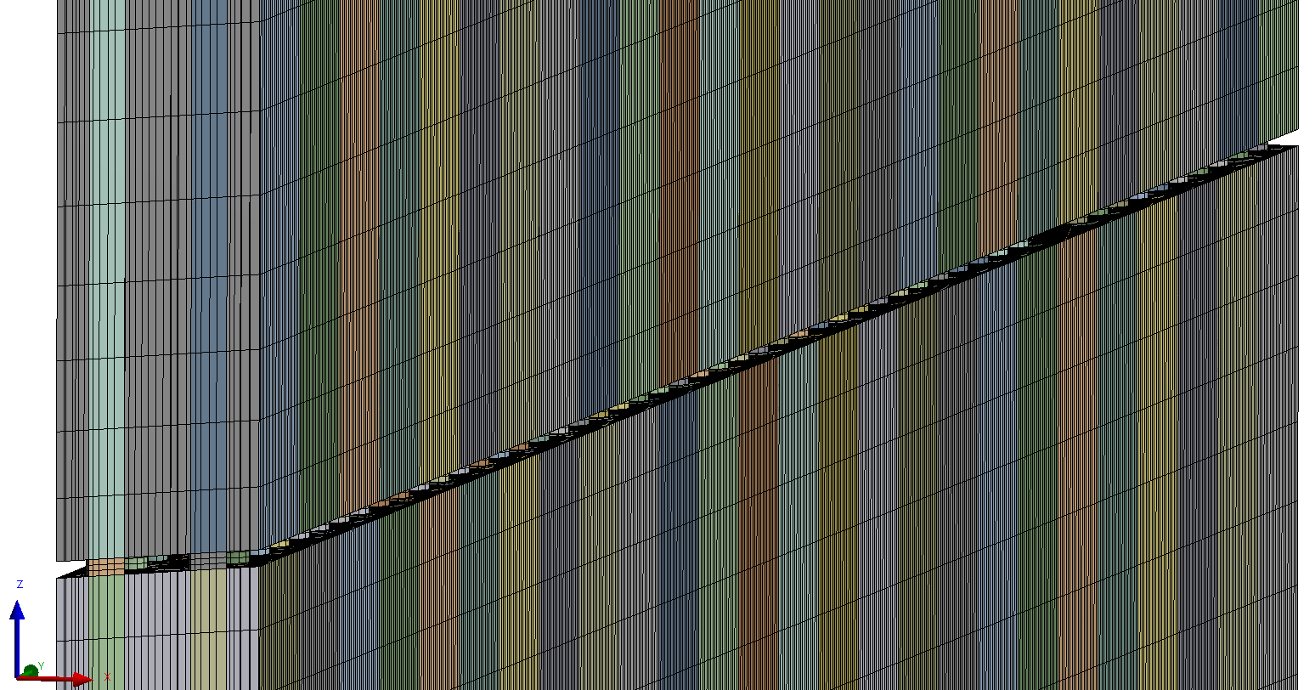
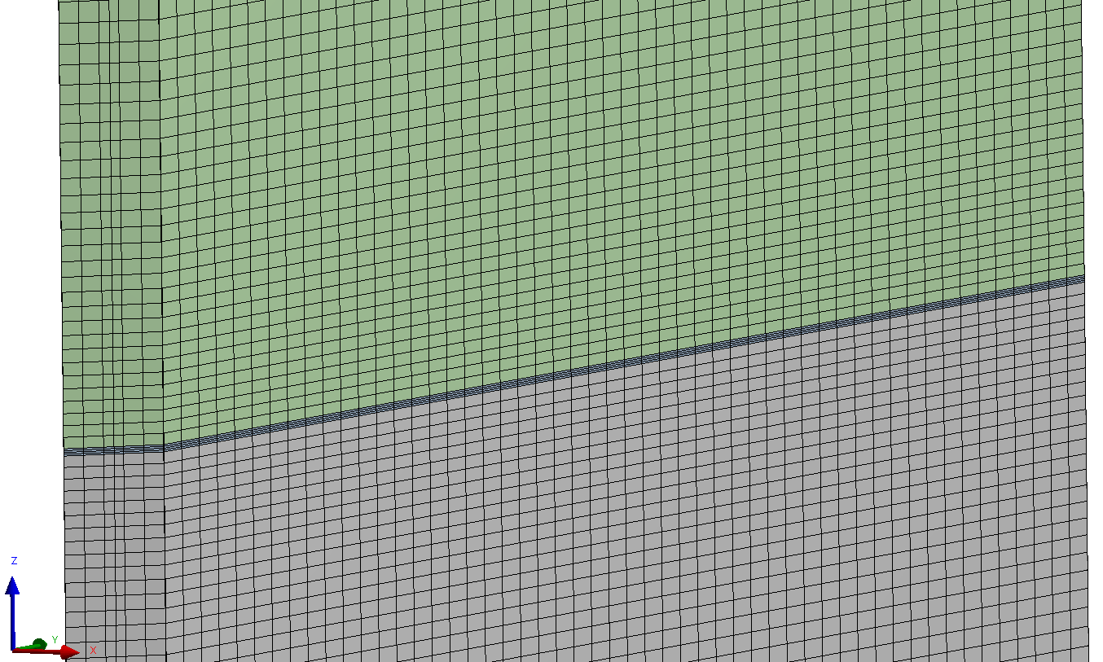
CPERI
Motivation & Progress | Problem description | Models | Results | Concluding Remarks
 | Simplifying Perforated Metal Sheet
Numerical Grids
 | Perforated sheet | Mesh elements distribution | Porous medium | Mesh elements distribution
Total amount of mesh elements | 1,291,143 |  | 136,684
Hexahedral | 1,273,371 | 98.6% | 136,684 | 100%
Wedges | 17,772 | 1.4% | 0 | 0%
Mesh quality
Max Skewness | 0.80 |  | 0.26
In porous media analysis:
Significant less mesh elements
Better quality (lower skewness)
All hexahedrons (smooth convergence)
Computational meshes
Perforated sheet | Porous medium

Slide 49
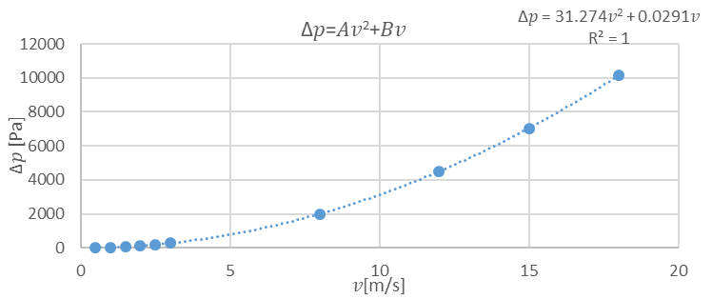
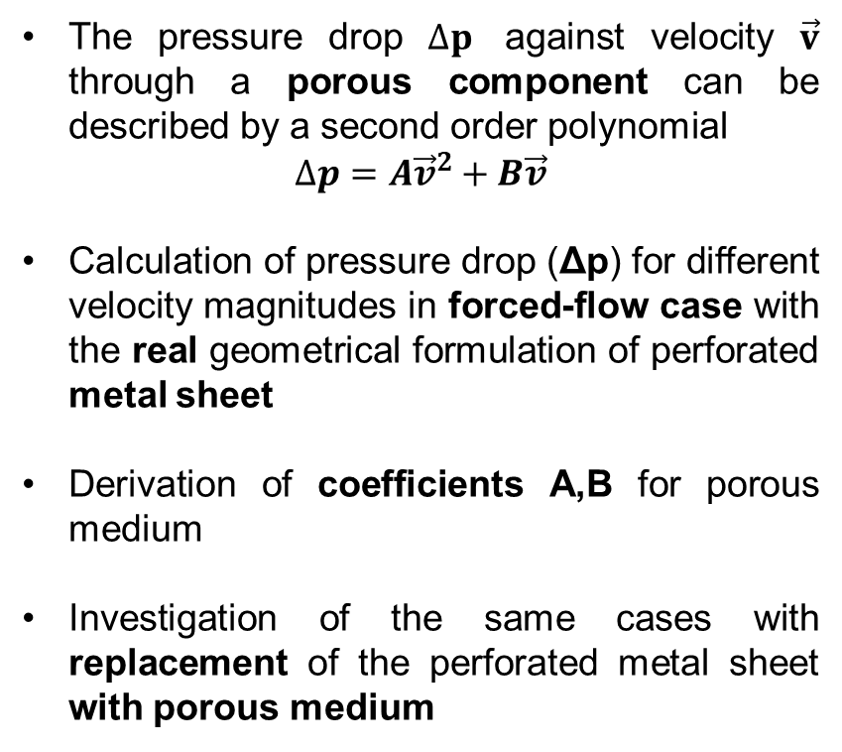
CPERI
Motivation & Progress | Problem description | Models | Results | Concluding Remarks
 | Simplifying Perforated Metal Sheet
Coefficients for Porous Medium
The pressure drop $∆p$ against velocity $\vec{v}$ through a porous component can be described by a second order polynomial
$$∆p=A{\vec{v}}^{2}+B\vec{v}$$
Calculation of pressure drop (Δp) for different velocity magnitudes in forced-flow case with the real geometrical formulation of perforated metal sheet
Derivation of coefficients A,B for porous medium
Investigation of the same cases with replacement of the perforated metal sheet with porous medium
Fit of data with second order polynomial

Slide 50
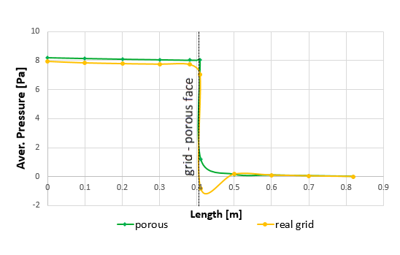
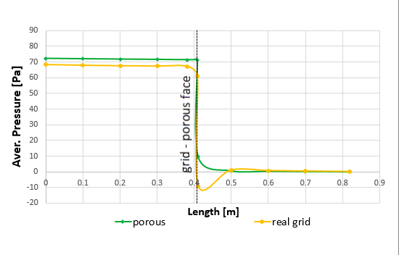
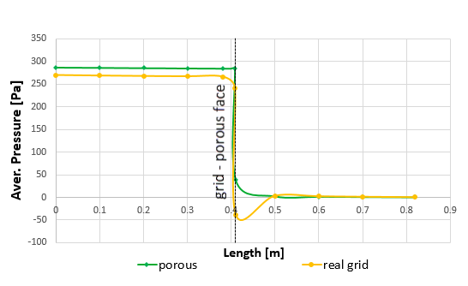
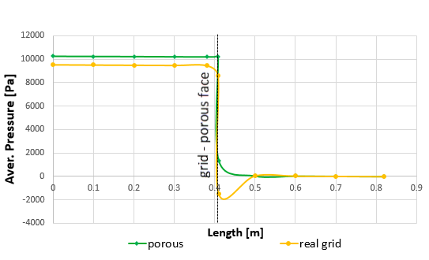
CPERI
Motivation & Progress | Problem description | Models | Results | Concluding Remarks
 | Simplifying Perforated Metal Sheet
Validation of Porous Media Approach
Velocity inlet 0.5m/s | Velocity inlet 1.5m/s
Good agreement between two approximations in all cases examined
Velocity inlet 3m/s | Velocity inlet 18m/s
Differences downward the perforated sheet

Slide 51
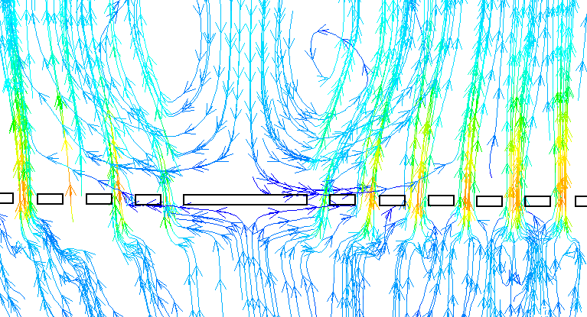
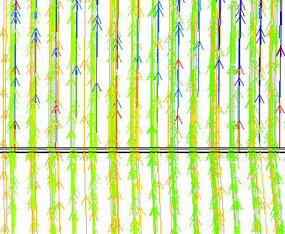
CPERI
Motivation & Progress | Problem description | Models | Results | Concluding Remarks
 | Simplifying Perforated Metal Sheet
Validation of Porous Media Approach
Stream lines
Perforated sheet | Porous medium
The difference between the cases of the real geometry and the porous media analysis is attributed to the developed recirculations that cannot be simulated in the second case

Slide 52
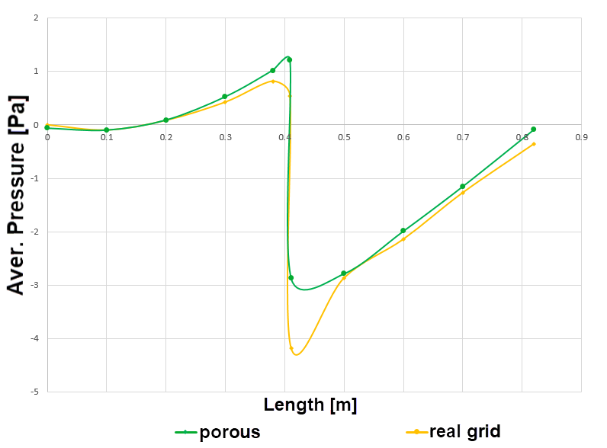
CPERI
Motivation & Progress | Problem description | Models | Results | Concluding Remarks
 | Simplifying Perforated Metal Sheet
Natural Convection Simulation
Mass-weighted average pressure along the flow direction
The same agreement between the two approximations (real geometry and porous media analysis) as regards the average pressure distribution can be seen in the case of natural convection
The difference downward the perforated metal sheet location is again attributed to the developed recirculations that cannot be approximated in the case where porous media analysis is implemented
Mass flow rate
Length [m] | Real grid [kg/s] | Porous media [kg/s] | Error
0.0 | 0.01031 | 0.010312 | 0.01%
0.82 | 0.010312 | 0.010311 | 0.01%

Slide 53
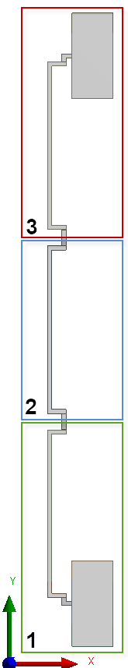



CPERI
Motivation & Progress | Problem description | Models | Results | Concluding Remarks
 | PV/T cladding
Geometry | First module | Second module | Third module
Simulation of an active-façade system installed on a building envelope.
Calculation of mass flow rate for different operating conditions assuming natural convection
Derivation of correlations for Modelica
Consideration of worst-case conditions:
Three successive modules along the vertical direction
No entrainment of air through the gaps between two successive modules
High ambient temperature (T_{amb}=40ºC) and minimum ΔΤ , i.e. T_{cl1} = 65ºC and T_{cl2} = 30ºC.

Slide 54





CPERI
Motivation & Progress | Problem description | Models | Results | Concluding Remarks
 | PV/T cladding
3D Geometry
Geometry | First module | Second module | Third module | Porous medium
We have used both 3D and 2D geometrical models in order to investigate if the simpler 2D model can approximate the 3D model with validity

Slide 55



CPERI
Motivation & Progress | Problem description | Models | Results | Concluding Remarks
 | PV/T cladding
Numerical Grids
Model | Total amount of elements | Quadrilateral | Hexahedral | Max skewness
2D | 231,624 | 231,624 | - | 0.48
3D | 2,435,400 | - | 2,435,400 | 0
In 2D case:
Significant less mesh elements
First module | Second module | Third module

Slide 56







CPERI
Motivation & Progress | Problem description | Models | Results | Concluding Remarks
 | PV/T cladding
Boundary Conditions
1st module | 2nd module | 3rd module
2D model | 3D model
T_{cl1} = 65 ºC
T_{cl2} = 30 ºC
T_{in} = 40 ºC
Surface heat flux:
Q₁ from the wall adjacent to the technical room to the air canal
Q₂ from the air canal to the back wall
Outlet area

Slide 57

CPERI
Motivation & Progress | Problem description | Models | Results | Concluding Remarks
 | PV/T cladding
Mass Flow Rates and Heat Flux
 |  | 2D reduced to equivalent 3D model | 3D model | Relative error
Mass flow rate [kg/s] | $${\dot{m}}_{inlet}$$ | 0.001339 | 0.001371 | 2.38%
First module | Q₁ [W] | 75.83 | 76.63 | 1.06%
 | Q₂ [W] | -52.34 | -52.58 | 0.47%
Second module | Q₁ [W] | 57.95 | 56.94 | 1.75%
 | Q₂ [W] | -58.26 | -57.02 | 2.13%
Third module | Q₁ [W] | 60.26 | 60.87 | 1.02%
 | Q₂ [W] | -58.22 | -57.85 | 0.63%
 |  | 2D model | 3D model
Temperature [ºC] | T_{inlet} | 40.22 | 40.43
 | T₁ | 57.70 | 57.53
 | T₂ | 57.71 | 57.55
 | T_{outlet} | 57.71 | 58.33
Velocity [m/s] | V_{inlet} | 0.057 | 0.058
 | V₁ | 0.068 | 0.067
 | V₂ | 0.068 | 0.067
 | V_{outlet} | 0.075 | 0.075
The agreement between 2D and 3D models is quite good, since the maximum relative percentage error between these two cases as regards the calculated mass flow rate is lower than 2.5%. Therefore, the 3D model can be replaced by a simplified 2D model
The temperature of air before the second module has already been increased by 17ºC, T₁=57.70ºC, and reaches the critical temperature, T_{cl1}. All heat absorbed from the wall adjacent to PV technical room is directly transfer towards the back wall
The decrease in heat extraction from the walls adjacent to technical room is expected to deteriorate the thermal efficiency of the PV panels in modules 2 & 3
Modules 2 & 3 are representative for worst-case conditions

Slide 58




CPERI
Motivation & Progress | Problem description | Models | Results | Concluding Remarks
 | PV/T cladding
Recirculation Areas
2D model |  | 3D model
1st module | Recirculation area | 1st module | Recirculation area
The walls adjacent to PV technical room show higher temperatures than the air flow temperature values → upwards motion due to natural convection
The back walls show lower temperatures than the air flow temperature values → downwards motion due to higher density
This mechanism implies recirculation zones inside the air canal

Slide 59




CPERI
Motivation & Progress | Problem description | Models | Results | Concluding Remarks
 | PV/T cladding
Recirculation Areas
2D model |  | 3D model
2nd module | Recirculation area | 2nd module | Recirculation area

Slide 60




CPERI
Motivation & Progress | Problem description | Models | Results | Concluding Remarks
 | PV/T cladding
Recirculation Areas
2D model |  | 3D model
3rd module | Recirculation area | 3rd module | Recirculation area
However, there is a difference in the spatial distribution of these zones between 2D and 3D cases.
The recirculations enhance the heat transfer coefficients

Slide 61

CPERI
Motivation & Progress | Problem description | Models | Results | Concluding Remarks
Conclusions
Scope of CFD simulations → derivation of correlations for Modelica model as regards the air volume flow rate through an open window of a building → derivation of correlations for Modelica model as regards the thermal effect of airflow on the PV module
Validation of the mathematical model regarding the aeration rate is not possible, since the weather station is located inside the developed boundary layer of the building
Fitting of data curve using the Gaussian function:
a=1, b=0 while c has been proven to be a function of the applied free airflow velocity
Development of the mathematical model for the simulation of the airflow behind the PV system
Replacement of the insect mesh using porous media analysis
Validation of the porous media approach both in forced and natural-convection flows
Worst case scenario: three successive modules, no penetration of air through gaps, high ambient temperature, small temperature difference between canal walls
The heat extraction from modules (2) and (3) is deteriorated compared to module (1)
Therefore the thermal efficiency of modules (2) and (3) is expected to be lower→ modules (2) and (3) represent worst-case scenarios
Future work: conduction of further scenarios for different pairs of temperature values in order to derive correlations for Modelica model
$$f\left(x\right)=ae^{− \frac{{\left(x−b\right)}^{2}}{2c^{2}}}$$

Slide 62

CPERI
Motivation & Progress | Problem description | Models | Results | Concluding Remarks
Thank you for your attention

Slide 63
Appendix

Slide 64



CPERI
Motivation & Progress | Problem description | Models | Results | Concluding Remarks
 | Building
Mesh formation
The mesh consists of approximately 8.7million hexahedrons cells
Computational meshes
Entire domain | Between external environment | Window’s area

Slide 65


CPERI
Motivation & Progress | Problem description | Models | Results | Concluding Remarks
 | Simplifying Perforated Metal Sheet
Fitting data with second order polynomial
    Assumptions of the Porous Media Model
A simplified version of the momentum equation, relating the pressure drop to the source term, can be expressed by :
$∇p=S_{i}$ or $Δp=−S_{i}L$ (1)
Where, S_{i} is the momentum source term which is composed of a viscous loss term (Darcy Law) and an inertial loss term :
$S_{i}=−\left(\frac{μ}{α}v_{i}+C_{2}\frac{1}{2}ρ\left|\vec{v}\right|v_{i}\right)$ (2)
The pressure drop $∆p$ against velocity $\vec{v}$ through a porous component can be described by:
$∆p=A{\vec{v}}^{2}+B\vec{v}$ (3)
By comparing (1), (2) and (3):
$$C_{2}= \frac{2A}{ρL}$$
$$\frac{1}{α}=\frac{B}{μL}$$
Since, A=31.274 and B=0.0291
we calculated:
the inertial resistance
$C_{2}$ = 25529.796
viscous resistance
$\frac{1}{a}$ = 8.1312172E+05
Fit of data with second order polynomial

Slide 66



CPERI
Motivation & Progress | Problem description | Models | Results | Concluding Remarks
 | Simplifying Perforated Metal Sheet
Natural convection simulation
T_{wall}=200ºC and T_{ambient}=0ºC
Temperature contours
Perforated sheet | Porous medium
Mass weighted temperature along the flow direction

Slide 67





CPERI
Motivation & Progress | Problem description | Models | Results | Concluding Remarks
 | PV/T cladding
Distribution of Temperature 2D model
2D model
1st Module | 2st Module | 3rd Module
3D model
1st Module | 2st Module | 3rd Module

