Slide 1
Plug-N-Harvest
WP3: The PLUG-N-HARVEST Control and Management at Building and District Level
ORGANIZATION: Certh, Odins, Etra i+d, siemens PRESENTER(S): iakovos Michailidis, Antonio skarmeta, ANA ISABEL MARTINEZ GARCIA MEETING: 2nd plenary MEETING 23-24 January 2018, Thessaloniki, greece

Slide 2
Plug-N-Harvest: Project Information
Cordis Europa URL: http://cordis.europa.eu/project/rcn/211287_en.html
Project Website: www.plug-n-harvest.eu
Project Acronym : PLUG-N-HARVEST
Project ID: 768735
Funded under: H2020-EU.2.1.5.2. - Technologies enabling energy-efficient systems and energy-efficient buildings with a low environmental impact
Project Start Date: 1st of September 2017
Duration: 51 months
List of Participants
1 | Centre for Research and Technology Hellas - CERTH
2 | Rheinisch-Westfaelische Technische Hochschule Aachen - RWTH
3 | Cardiff University – CU
4 | Aloumyl, Biomichania Alouminioy Anonimi Etairia - ALUMIL
5 | Sistemes Avancats De Energia Solar Termica Sccl - AIGUASOL
6 | Odin Solutions s.l. - ODINS
7 | SIEMENS SRL - SIE
8 | Etra Investigacion Y Desarrollo Sa - ETRA
9 | Energy Transitions Limited - ET
10 | Eco Intelligent Growth, SL - EIG
11 | Agencia De L'habitatge De Catalunya - AHC
12 | Perifieria Dytikhs Makedonias - RWM
13 | County Council Of The City And County Of Cardiff - CCC

Slide 3
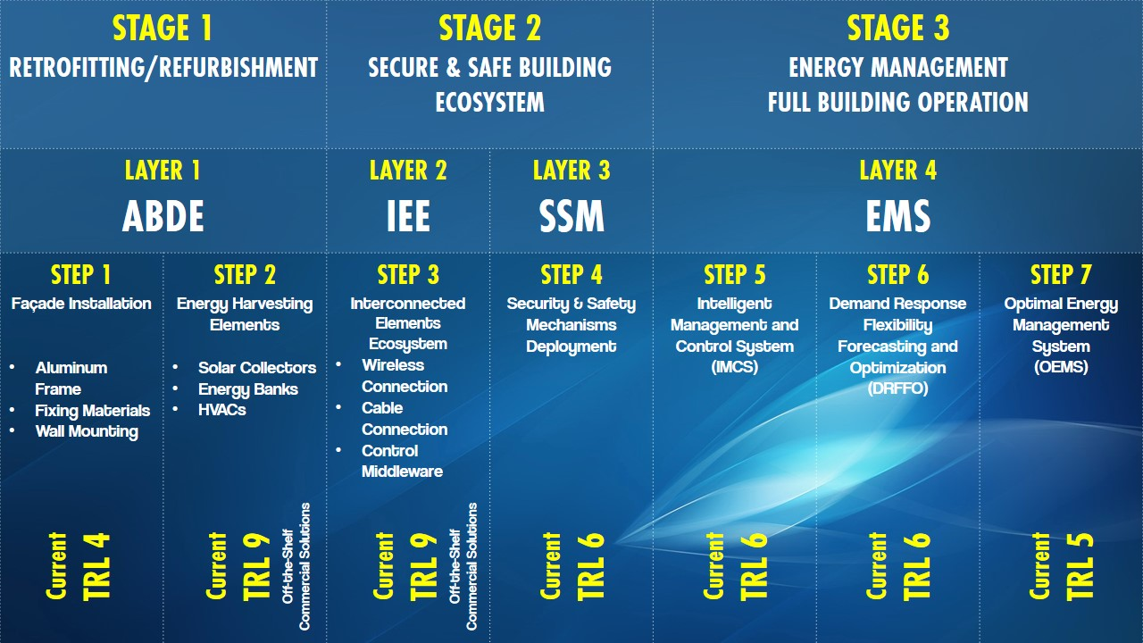
Plug-N-Harvest: WP3 Description
WP3 activities are related to:
Support the requirements identification and suggest solutions for the Interconnected Elements Ecosystem (IEE) – Layer 2.
Develop tailored solutions for Security and Safety Mechanisms (SSM) – Layer 3.
Develop tailored solutions for Energy Management System (EMS) – Layer 4.
Integrate and verify the functionalities of the aforementioned layers.

Slide 4
Plug-N-Harvest: WP3 Description
WP3 activities are related to:
Support the requirements identification and suggest solutions for the Interconnected Elements Ecosystem (IEE) – Layer 2.
Mainly Supported by: WP1, WP5 and WP3
Develop tailored solutions for Security and Safety Mechanisms (SSM) – Layer 3.
Mainly Supported by: Tasks 3.3, 3.4
Develop tailored solutions for Energy Management System (EMS) – Layer 4.
Mainly Supported by: Tasks 3.1, 3.2
Integrate and verify the functionalities of the aforementioned layers.
Mainly Supported by: Task 3.5
WP1, WP5 & WP3
Task 3.5
Tasks 3.3 & 3.4
Task 3.1
Task 3.2
Task 3.2
Notes:
These activities are mainly supported by…

Slide 5
Plug-N-Harvest: WP3 Progress
Start Date: 01/12/2017 (M4)
Functional description for all WP3 components was ready by 10/01/2018.
1st telco on 08/01/2018:
to discuss about missing/poor information of use cases.
to define a list of minimum required equipment.
to propose a list of commercially available equipment solutions.
2nd telco on 18/01/2018:
to draw a mock-up of an abstract high-level architectural topology.
to discuss about BMS solutions, data modelling and protocols.

Slide 6
Plug-N-Harvest: WP3 Time-plan
Items for End-User Questionnaire
1st Version of Functional Prototypes
Final Integrated EMS & SSM Layers based
Task | Q1 | Q2 | Q3 | Q4 | Q5 | Q6 | Q7 | Q8 | Q9 | Q10 | Q11 | Q12 | Q13
3.1-CERTH
3.2-ETRA
3.3-CERTH
3.4-ODINS
3.5-CERTH
Dummy EMS & SSM Versions
Initial Adaptation to Demo Feedback, Integrated Layers
WP4: Initial Demo Feedback
WP1: Draft Use Case Information
WP1: Stakeholders’ Survey Feedback
WP4: 2nd round of Demo Feedback

Slide 7
Plug-N-Harvest: Task 3.1

Slide 8
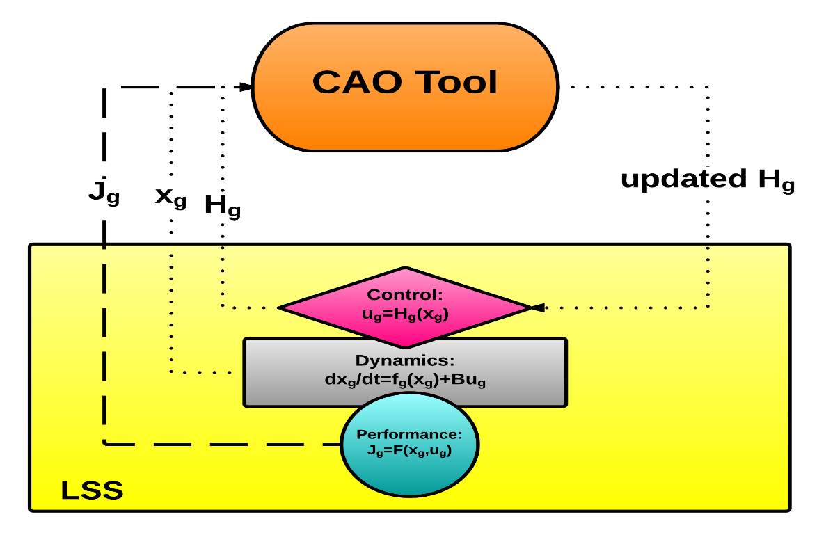
Plug-N-Harvest: Task 3.1 Description
Task 3.1 activities (1st cycle: M4 – M18, 2nd cycle: M28 - M33) are related to:
Developing a tailored Plug-n-Play Intelligent Management and Control System (IMCS) for ADBE System (WP2).
The AGILE-IMCS (current TRL-6) will be considered as the initial point/core ingredient – also abbreviated as CAO.
Main features of the AGILE-IMCS:
Plug-n-Play: no preliminary calibration of parameters required.
Model-Free: no simulation model required.
Automated-Calibration: no manual recalibration during operation required.
Easy Configuration: easy to reconfigure during operation.
Robust: situation-aware reaction to emergent dynamics.

Slide 9
Plug-N-Harvest: Task 3.1 Function
Optimization Mode Technical Description (T₁=24 hours [configurable]):
STEP 1: Every T₁ get the total energy consumption measurements of the controllable assets as well as the total renewable energy generation.
STEP 2: Every T₁ get the total indoor comfort measurements [can be also internally calculated based on ASHRAE 62.1-201 and ASHRAE 55-2013 standards].
STEP 3: Every T₁ calculate the total cost-criterion as follows:
$$J_{g}=w∙Comfort+ \left(1−w\right)∙Energy, 0≤w≤1$$
STEP 4: Every T₁ update $H_{g}$ control strategy to be applied for the next T₁.

Slide 10
Plug-N-Harvest: Task 3.1 Function
Control Mode Technical Description (T₂=15 mins [configurable]):
STEP 1: Every T₂ get the current indoor temperature, CO₂, relative humidity, presence, battery state, PV generation measurements.
STEP 2: Every T₂ get the current outdoor temperature, CO₂, relative humidity, solar radiation conditions.
STEP 3: Every T₂ get the forecasted outdoor temperature, CO₂, relative humidity, solar radiation and occupancy conditions.
STEP 4: Every T₂ generate a new $u_{g}$ set of control decisions (set-points) to be applied for the next T₂, as follows:
$u_{g}=H_{g}∙x_{g}, x_{g}=\left[\begin{matrix}STEP 1 \\ STEP 2 \\ STEP 3\end{matrix}\right]$

Slide 11
Plug-N-Harvest: Task 3.1 Equipment
OR install a central energy meter and disaggregate energy measurements
RH and CO₂ indoor sensors can be neglected if required
One energy meter for each controllable HVAC in order to calculate the total energy consumption of the specified plant.
One temperature, relative humidity, CO₂, presence sensor for each participating thermal zone (e.g. apartment, office).
One energy meter for battery state (if battery elements do not support interfacing)
One energy meter for PV generation (if PV elements do not support interfacing)
A local weather station with outdoor temperature, humidity, CO₂, solar radiation measuring and forecasting capabilities OR internet access available to extract all necessary weather data from a web-based repository.
A low-end device (PC) per pilot site for hosting/executing locally the module.
RH and CO₂ indoor sensors can be neglected if required

Slide 12
Plug-N-Harvest: Task 3.1 Current ICT Features
Develop an HTTP client compatible with BMS!
Inputs | Required in common file formats e.g. TXT, XML, DAT, EXCEL files. The module can be also synchronized with an SQL database to acquire data directly from a shared database and avoid using structured files.
Outputs | Currently available in TXT, XML, DAT, EXCEL files. The structure and format of the outputs is quite flexible and should be defined based on the communication channels with the SCADA interface that will be used.
Frequency | Usually a reasonable execution and control frequency is defined to be over 5 minutes and less than 15 minutes.
Programming | Executable file from Matlab-based implementation (or C# if necessary).
Maximum execution time required | Less than 10 seconds (per control cycle) Less than 30 seconds (per optimization cycle)

Slide 13
Plug-N-Harvest: Task 3.1 Current ICT Features
Software dependencies and requirements | MCR Installer vX.X (C++ libraries for Matlab code compilation). Optimization Toolbox, NCalc and Bluebit.MatrixLibrary for C# implementation.
Hosting hardware requirements | Windows OS or Linux Based OS. Over 2GB/RAM. Over 2MB of processor cache. Double core processor (or higher). Less than 200MBs of storage space (for internal database management) – if the shared database cannot be extended with more complex data points.
Deployment Strategy | Local deployment. MS Office Excel based configuration file.

Slide 14
Plug-N-Harvest: Task 3.2

Slide 15
Plug-N-Harvest: Task 3.2 OEMS
This module controls:
Communication and energy exchange among all the Plug-N-Harvest buildings
Communication among the buildings and the energy networks
Communication between the buildings and external actors
Receives sensors information from ICMS via BMS
Monitoring of:
Energy related assets (HVAC, lighting, electric heaters…)
Energy related components of the ADBE (the PV panels and the battery)
Other external assets (PV panels, HSW panels, district heating networks…)
Calculation of:
Overall energy consumption,
Production and
Flexibility of a single building and/or from all the buildings in the district
It generates the next set-points/control decisions for the considered appliances and assets.
Operation at small time intervals (e.g. every 20 seconds) if necessary.

Slide 16
Plug-N-Harvest: Task 3.2
Main Tasks | Developer | Support
Overall Arquitecture | ETRA
DRFFO | ETRA | CERTH
Building optimization strategies | ETRA
Maintenance module | ETRA
External signals collection | ETRA
Dynamic simulations | CERTH | ETRA
Integration with the IMCS (if there is any connection) | CERTH | ETRA
Integration with the BMS | ODINS | ETRA
Payment platform (energy trading) | SIEMENS | ETRA
Pilot site details | AIGUASOL | ETRA

Slide 17
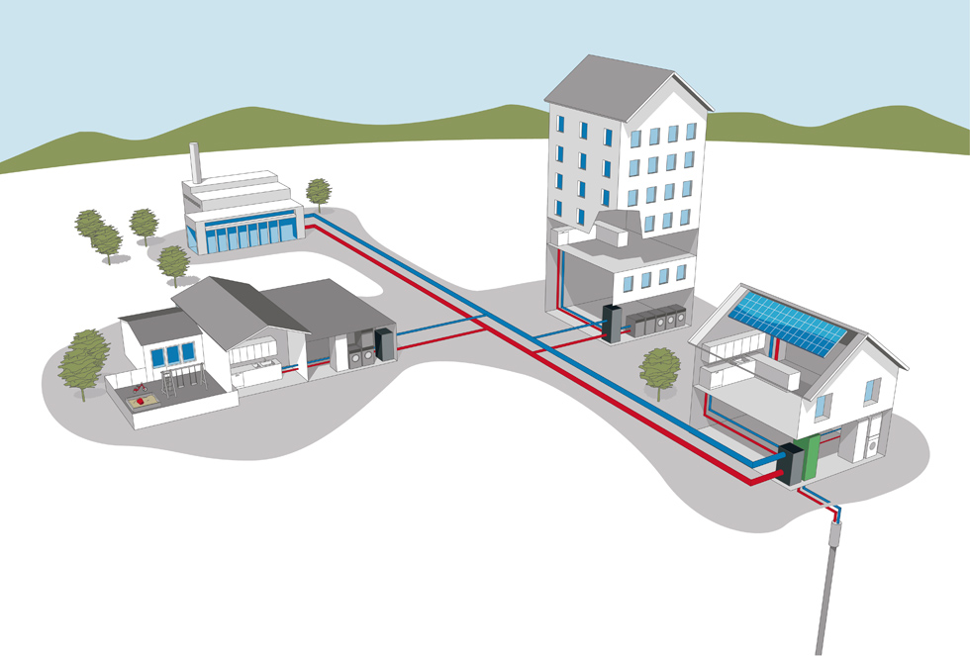
ADBE signals (through BMS or IMCS)
Third party: ESCO, aggregator…
Bidirectional communications
Controllable assets signals (through BMS or IMCS)
Common energy infrastructures (Solar panels)
Bidirectional electricity meter
Natural Gas measurements
DHN measurements

Slide 18
Plug-N-Harvest: Task 3.2 OEMS
Foreseen execution frequency | Usually a reasonable execution and control frequency is defined to be over 5 minutes and less than 15 minutes.
Inputs | Sensor measurements (when available): occupancy (presence), energy consumption of controlled appliances, energy generation from RES, RES production forecast and energy reserved in storages. Grid conditions Simulations From external actors (Facility managers, aggregators…) This inputs will be formatted as JSON data, and will be received from an API REST or MQTT AMQP protocols (RABBIT MQ).

Slide 19
Plug-N-Harvest: Task 3.2 OEMS
Outputs | Flexibility of the buildings (including consumption and production). Common or single strategies for the buildings (DR, P2P, or energy efficiency). Maintenance alerts. Interface with external actors.
Foreseen execution frequency | Usually a reasonable execution and control frequency is defined to be over 5 minutes and less than 15 minutes.
Programming Language | C# or Java for Backend processes Javascript for API REST
Maximum execution time required | Less than 20 seconds (per control cycle).

Slide 20
Plug-N-Harvest: Task 3.2 OEMS
Software dependencies and requirements | Docker
Hosting hardware requirements | 12GB RAM 4 cores Ubuntu server LTS (v16) 100GB storage space.
Deployment Strategy | Local deployment.

Slide 21
Plug-N-Harvest: Task 3.2 OEMS
General architecture

Slide 22
Plug-N-Harvest: Task 3.2 OEMS
General architecture
To be discussed?

Slide 23
Plug-N-Harvest: Task 3.2 OEMS
Detailed architecture:

Slide 24
Plug-N-Harvest: Task 3.2 OEMS
Detailed architecture:
To be discussed?

Slide 25
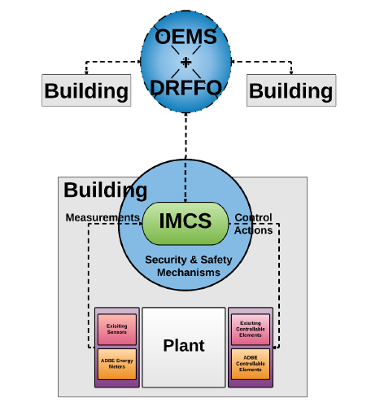
Plug-N-Harvest: Task 3.2 DRFFO
Demand Response Forecasting & Optimization tool
Short-term predictions/ forecasting
Estimation of the buildings’ flexibility
Light-weight simulations of different building operational states
Evaluation of different building operational states (specific KPIs)
Selection of the optimal state
Demand/ Response capabilities

Slide 26
Plug-N-Harvest: Task 3.2 DRFFO
Demand/ Response queries
Sensors measurements
Format?
Forecasting module
Simulation module
MQTT broker
Evaluation of different states
(KPIs)
Storage DB?

Slide 27
Plug-N-Harvest: Task 3.3

Slide 28
Plug-N-Harvest: Task 3.3 - SIEMENS
Siemens: iCore, CityPulse and D-Cep: where, a central complex event processing (CEP) framework based on open frameworks (e.g. Drools or Esper) are integrated employing time series over patterns. [Faults Detection and Recognition]
Siemens: can provide mechanisms and tools for ML libraries in order to detect deviations from predefined patterns (i.e. expected values). [Faults Mitigation]
More details are collected for such tools at the current stage.

Slide 29
Plug-N-Harvest: Task 3.3 - ETRA
ESTRATEGO detects situations and sends the actuation plan to the actuator module
Situations identifier
k-means algorithm
Input = dimension
Automatic learning
Avoids situations of oscillations (hysteresis)
Graphical interface:
Map of situations
Creation of manual actuations,
Etc…

Slide 30
Plug-N-Harvest: Task 3.3 - ETRA
Inputs:
Sensors measures,
Historical situations
Outputs:
The actuation plan (name of set of actions).
Matlab, C#, C++
More details are collected for such tool at the current stage.

Slide 31
Plug-N-Harvest: Task 3.4

Slide 32
Plug-N-Harvest: Task 3.4 description
Task 3.4 activities (1st cycle: M4 – M18, 2nd cycle: M28 - M39) are related to:
Provide in-depth analysis of the technical risks of security and privacy, and of the legal risks associated with personal data protection issues.
Provide end-to-end protocols that protect the data communication among sensors, IoT gateway and BMS system to mitigate security and privacy risks.
Provide attribute-based encryption (ABE) schemes for fine-grained access control to BMS system with privacy policies.
Deliverable | Responsible | Deadline
D3.4 First-Cycle: Privacy and Security Components Description | ODINS | M18
D3.4 Second-Cycle: Privacy and Security Components Description | ODINS | M39

Slide 33
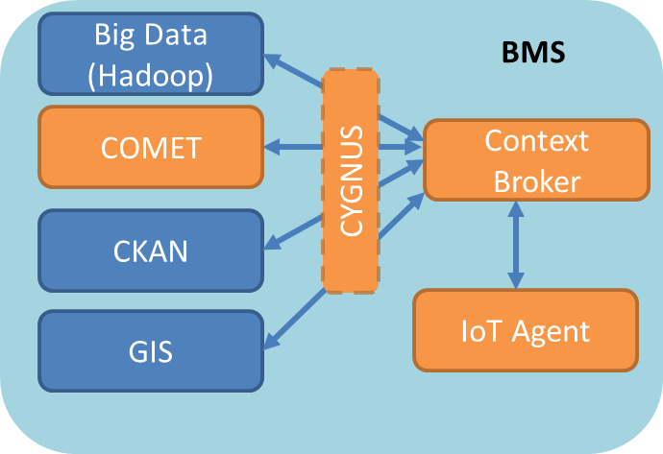
Plug-N-Harvest: BMS Architecture
BMS is responsible to provide monitoring and control functions in each building to allow the interaction between energy management systems (IMCS and OEMS) and energy related equipment (sensors, HVAC, etc) through IoT gateways.
BMS is based on FIWARE platform with subcomponents:
Context Broker
IoT Agents
Big Data
COMET
CKAN
GIS

Slide 34
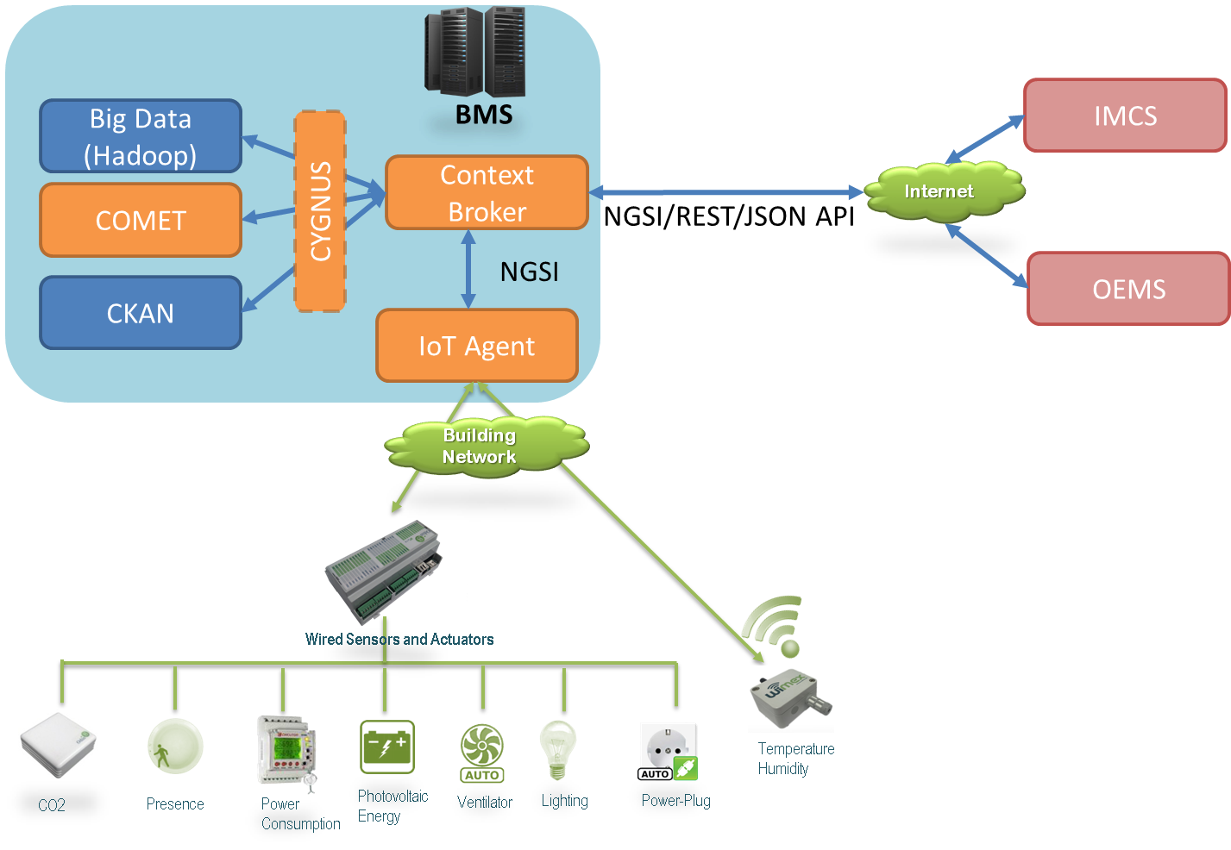
Plug-N-Harvest: BMS Integration
Approach for BMS integration with IMCS and OEMS based on NGSI standard with API REST and JSON data format.
IoT gateways to support analog and digital inputs/outputs to monitor and control wired sensors and actuators.
Temperature, humidity, CO2
Presence
Power Meter
Photovoltaic inverter
Ventilator
Air-conditioner.
Etc.
Support to wireless sensors (i.e. temperature, humidity) with standard protocols (i.e. COAP).

Slide 35
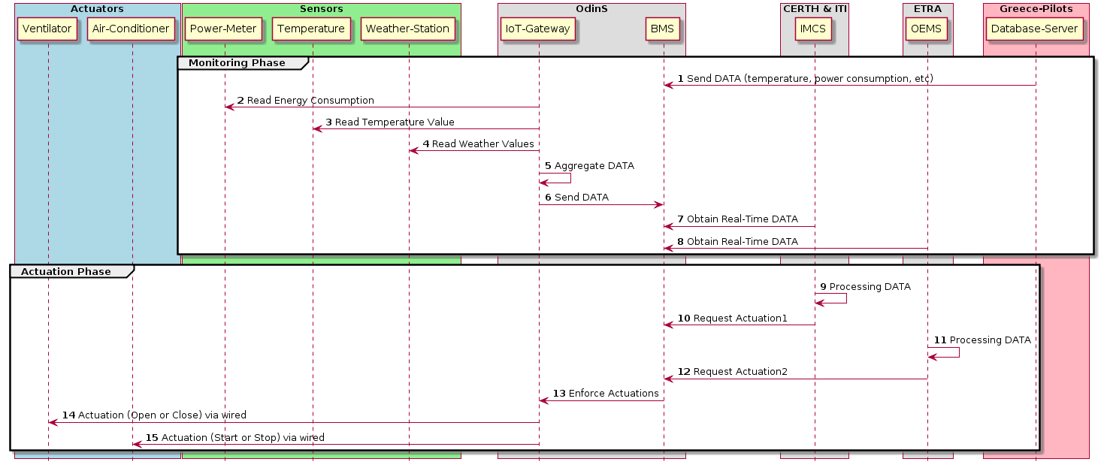
Plug-N-Harvest: Interoperability
Approach for interoperability of the IEE, SSM and EMS layer components (BMS, IMCS, OEMS, IoT gateways, sensors and actuators):

Slide 36
Plug-N-Harvest: NGSI Examples
Actuation Query to turn ON Ventilator.
Example of Information request of all IoT gateways in the building called “pilot1”
(curl localhost:1026/v1/updateContext -s -S --header 'Content-Type: application/json' \
--header ’fiware-service: PlugNHarvest’ \
--header ’fiware-servicepath: /pilot1’ \
--header 'Accept: application/json' -d @- | python -mjson.tool) <<EOF
{ "contextElements": [
{ "type": "Gateway",
"isPattern": "true",
"id": "Gateway:01",
"attributes": [
{ "name": "Ventilator",
"type": "text",
"value": "On"
}
]
}
], "updateAction": "UPDATE"
} EOF
(curl localhost:1026/v1/queryContext -s -S --header 'Content-Type: application/json' \
--header ’fiware-service: PlugNHarvest’ \
--header ’fiware-servicepath: /pilot1’ \
--header 'Accept: application/json' -d @- | python -mjson.tool) <<EOF
{
"entities": [
{
"type": "Gateway",
"isPattern": "true",
"id": "Gateway:.*"
}
]
}
EOF

Slide 37
Plug-N-Harvest: Security Protocols
DCapBAC provides a distributed scheme for the generation and verification of capability tokens to authorize actions such as the data publication in BMS system or the actuation in an IoT gateway.
XACML enables the Policy Decision Point to resolve the authorization decision to obtain a capability token for the access of resources in IoT gateways and BMS system.
CP-ABE is a ciphering schema enabling to access information ciphered in BMS system according to privacy policies.
ECC enables elliptic curves for constrained IoT gateways to allow security mechanisms such as encryption and digital signature.
CoAPS (DTLS+COAP) provides secure channel for data communication between IoT gateways and the BMS system. COAPS provides the security services such as integrity, authentication and confidentiality in end-to-end communications.

Slide 38
Plug-N-Harvest: Security Entities
Policy Decision Point (PDP) evaluates XACML access control policies to come up with an authorization decision.
Policy Administration Point (PAP) provides a web interfaces to make users able to specify access control policies to be evaluated by the PDP.
Capability Manager (CM) generates capability tokens according to the authorization decisions from the PDP.
Policy Enforcement Point (PEP) verifies the capability token for access control and takes the decision to perform the actions requested.
Attribute Authority (AA) generates CP-ABE keys and provides ciphered data based on a set of identity attributes.
CP-ABE Client deciphers messages to access privacy data according to CP-ABE scheme.

Slide 39
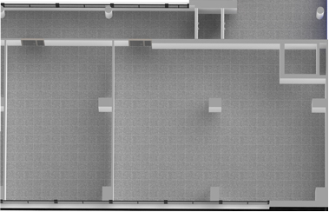
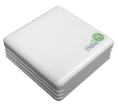
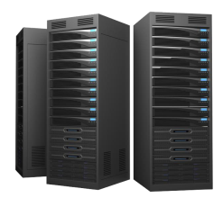
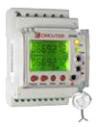
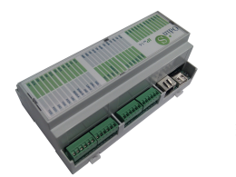
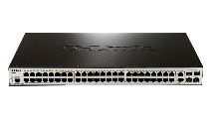
Plug-N-Harvest: Secure Deployment
Approach for deployment with security mechanisms in the components BMS, IMCS, OEMS, IoT gateways and IoT sensors:
BMS
System
NGSI API
PDP
PAP
CM
PEP
IMCS
CP-ABE Client
Internet
IoT Gateway
COAP-DTLS-ECC
OEMS
CP-ABE Client
IoT Sensor
COAP-DTLS-ECC
Ethernet
Router
Wireless Router

Slide 40
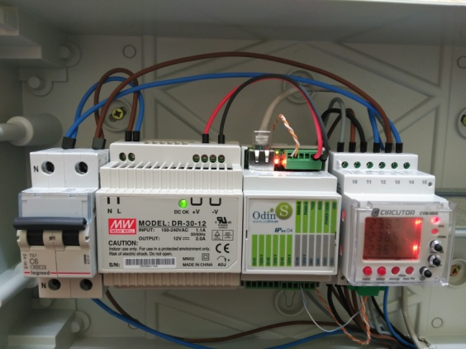
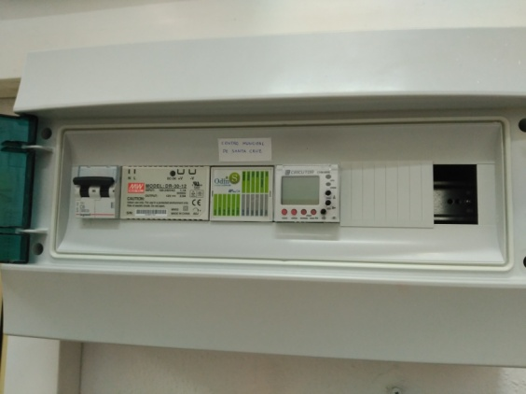
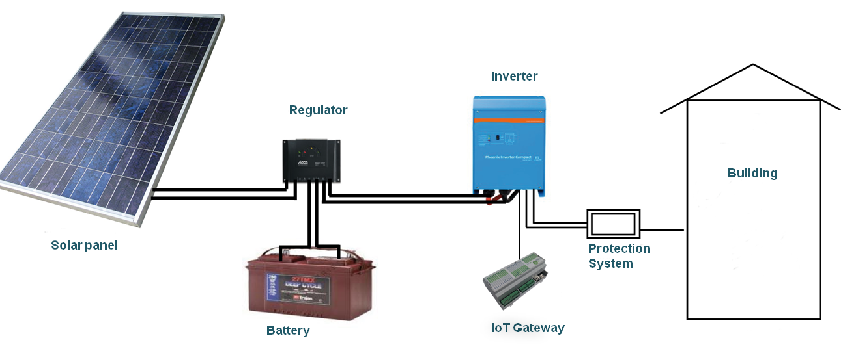
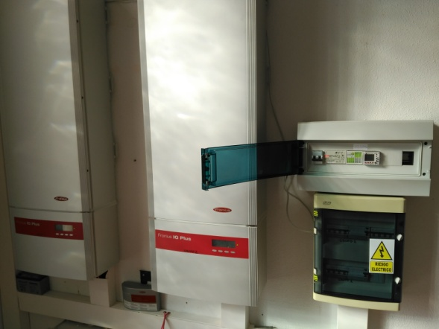
Plug-N-Harvest: Example of Installation

Slide 41
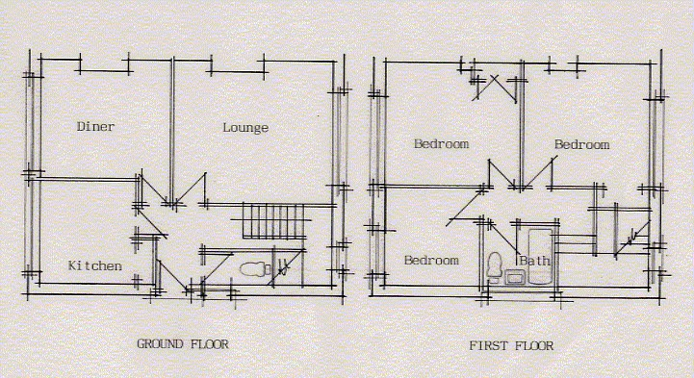
Plug-N-Harvest: Real Deployment
BMS
System
NGSI API
IMCS
Internet
OEMS
Wifi/Ethernet
Router

Slide 42
Plug-N-Harvest: WP3 Next Steps
Finalize the functional description for Task 3.3 existing tools [SIEMENS, CERTH, OdinS and ETRA].
Finalize the additional questionnaire items to acquire more detailed information from End-Users regarding the existing sensing, actuating and data-routing infrastructure of the buildings [ALL – input for WP1].
Finalize the list with the minimum required equipment and the respective proposed commercial solutions [ALL – input for WP4].
Align with materials and circularity [ALL – input from WP5].
Formulate the relative KPIs and cost-criterions for the energy management system according to the survey [ALL – input for WP1].
Identify actions for OEMS and IMCS cooperation [CERTH, ETRA I+D].
Identify actions for interfacing and synchronizing all ICT modules with the BMS [ALL – input from WP1].

Slide 43
Thank you!

