Slide 1
Plug-N-Harvest
WP3: The PLUG-N-HARVEST Control and Management at Building and District Level
ORGANIZATION: Certh, Odins, Etra i+d, siemens
PRESENTER(S): iakovos Michailidis, STELIOS KRINIDIS, RAFAEL MARIN-PEREZ, ANA ISABEL MARTINEZ GARCIA, CHRISTIAN VINTILA
MEETING: 3Rd plenary MEETING 6-7 JuNE 2018, BARCELONA, SPAIN

Slide 2
Plug-N-Harvest: Project Information
Cordis Europa URL: http://cordis.europa.eu/project/rcn/211287_en.html
Project Website: www.plug-n-harvest.eu
Project Acronym : PLUG-N-HARVEST
Project ID: 768735
Funded under: H2020-EU.2.1.5.2. - Technologies enabling energy-efficient systems and energy-efficient buildings with a low environmental impact
Project Start Date: 1st of September 2017
Duration: 51 months
List of Participants
1 | Centre for Research and Technology Hellas - CERTH
2 | Rheinisch-Westfaelische Technische Hochschule Aachen - RWTH
3 | Cardiff University – CU
4 | Aloumyl, Biomichania Alouminioy Anonimi Etairia - ALUMIL
5 | Sistemes Avancats De Energia Solar Termica Sccl - AIGUASOL
6 | Odin Solutions s.l. - ODINS
7 | SIEMENS SRL - SIE
8 | Etra Investigacion Y Desarrollo Sa - ETRA
9 | Energy Transitions Limited - ET
10 | Eco Intelligent Growth, SL - EIG
11 | Agencia De L'habitatge De Catalunya - AHC
12 | Perifieria Dytikhs Makedonias - RWM
13 | County Council Of The City And County Of Cardiff - CCC

Slide 3
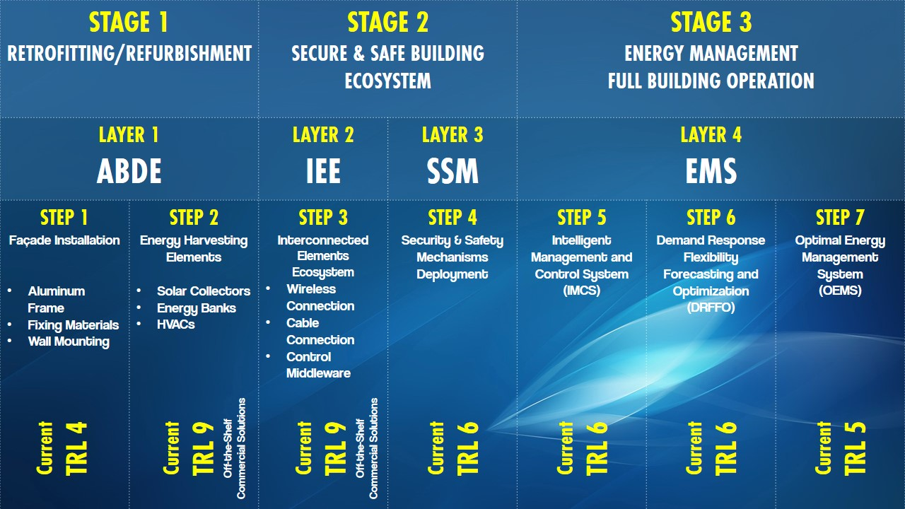
Plug-N-Harvest: WP3 Description
WP3 activities are related to:
  Support the requirements identification and suggest solutions for the Interconnected Elements Ecosystem (IEE) – Layer 2.
  Develop tailored solutions for Security and Safety Mechanisms (SSM) – Layer 3.
  Develop tailored solutions for Energy Management System (EMS) – Layer 4.
  Integrate and verify the functionalities of the aforementioned layers.

Slide 4
Plug-N-Harvest: WP3 Progress
Start Date: 01/12/2017 (M4)
Outcomes so far:
  Functional description for all WP3 components [10/01/2018].
  Internal technical discussion of WP3 contributors to resolve minor collaboration issues [6/3/2018].
  Equipment specifications for BMS compatibility [23/4/2018].
  List of necessary equipment for building control (feedback vector) [11/5/2018].
  Merged list of necessary equipment both for building control and evaluation (monitoring) [24/5/2018].

Slide 5
Plug-N-Harvest: Task 3.1

Slide 6
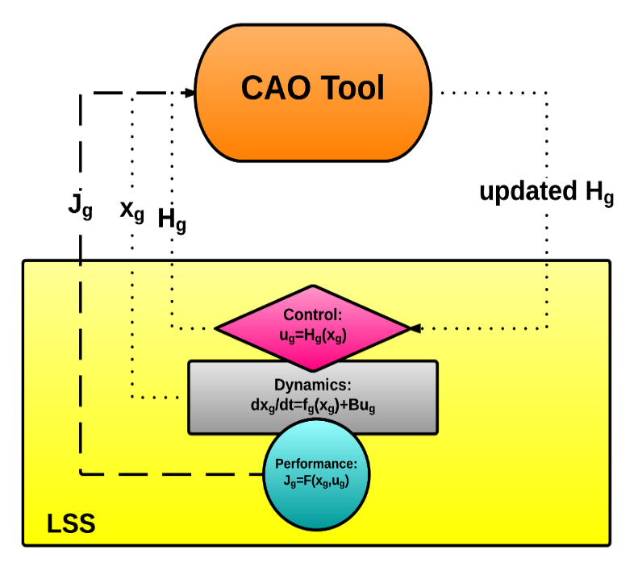
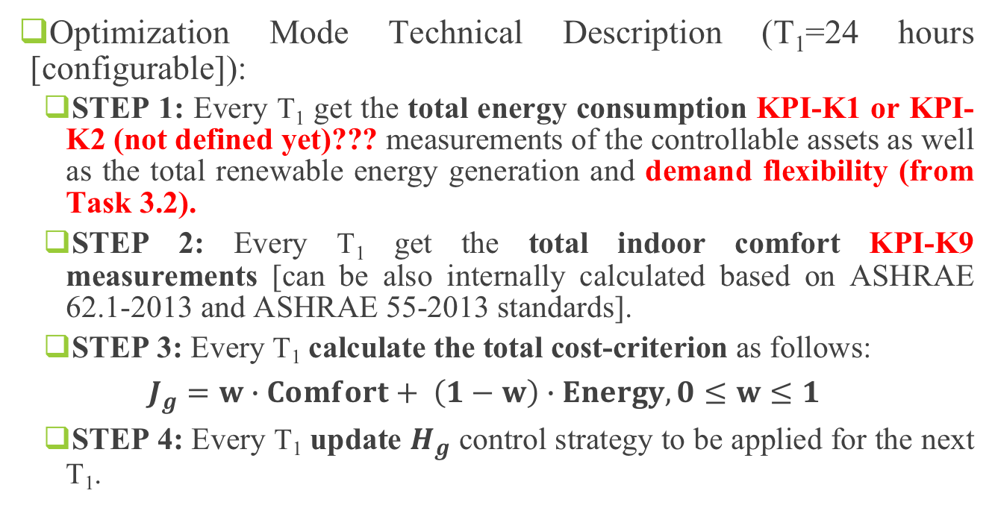
Plug-N-Harvest: Task 3.1 Function
Optimization Mode Technical Description (T₁=24 hours [configurable]):
  STEP 1: Every T₁ get the total energy consumption KPI-K1 or KPI-K2 (not defined yet)??? measurements of the controllable assets as well as the total renewable energy generation and demand flexibility (from Task 3.2).
  STEP 2: Every T₁ get the total indoor comfort KPI-K9 measurements [can be also internally calculated based on ASHRAE 62.1-2013 and ASHRAE 55-2013 standards].
  STEP 3: Every T₁ calculate the total cost-criterion as follows:
  $$J_{g}=w∙Comfort+ \left(1−w\right)∙Energy, 0≤w≤1$$
  STEP 4: Every T₁ update $H_{g}$ control strategy to be applied for the next T₁.

Slide 7
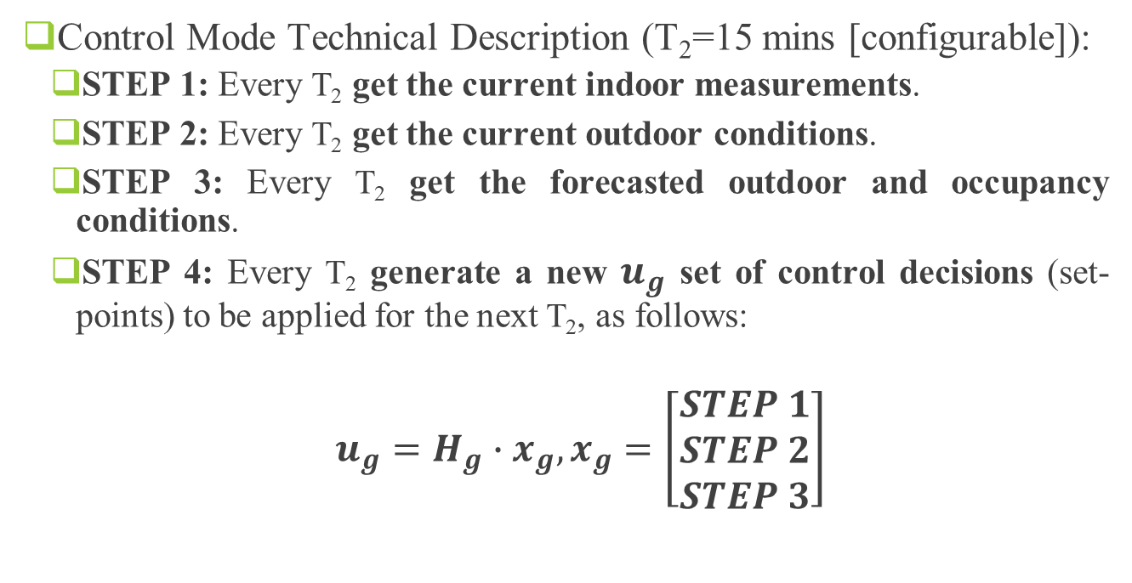
Plug-N-Harvest: Task 3.1 Function
Control Mode Technical Description (T₂=15 mins [configurable]):
  STEP 1: Every T₂ get the current indoor measurements.
  STEP 2: Every T₂ get the current outdoor conditions.
  STEP 3: Every T₂ get the forecasted outdoor and occupancy conditions.
  STEP 4: Every T₂ generate a new $u_{g}$ set of control decisions (set-points) to be applied for the next T₂, as follows:
  $u_{g}=H_{g}∙x_{g}, x_{g}=\left[\begin{matrix}STEP 1 \\ STEP 2 \\ STEP 3\end{matrix}\right]$

Slide 8
Plug-N-Harvest: Task 3.2

Slide 9

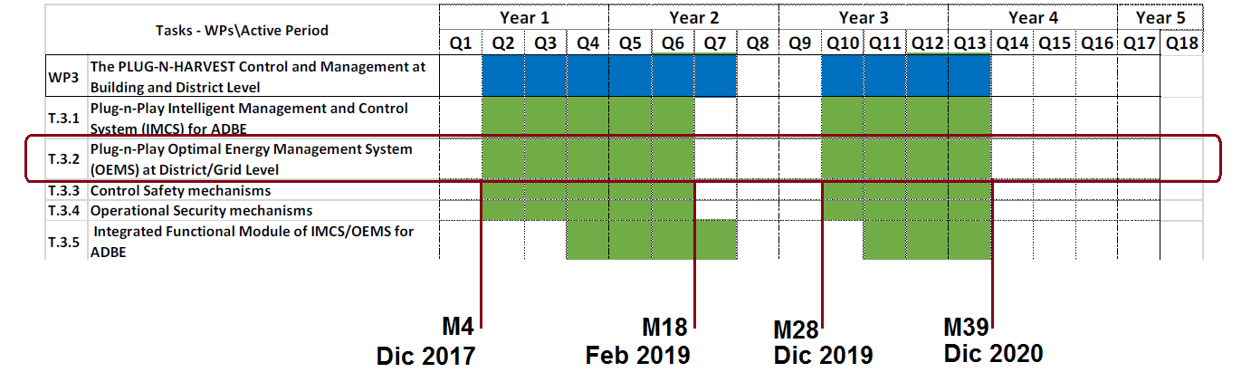
Plug-N-Harvest: Task 3.2
Optimal Energy Management System (OEMS) at District/Grid Level.

Slide 10
Plug-N-Harvest: Task 3.2

Slide 11
Plug-N-Harvest: Task 3.2 OEMS
Responsible for the communication and energy exchange:
  among all the Plug-N-Harvest buildings,
  between the buildings and the energy networks, and
  between the buildings and external actors (ESCOs, aggregators, etc.).
Inputs: BMS information from sensors
Outputs: BMS commands for actuators

Slide 12
Plug-N-Harvest: Task 3.2 OEMS
Implemented as 2-levels system:
  A RABBIT system on each building
    Immediately analysis of consumption, alarms, etc.
    Inputs/outputs from/to BMS
  One REST API Server in the server side:
    Management, configuration…
    Demand response,
    Optimizations,
    Interchange of energy,
    Information for ESCO, Aggregators, etc…

Slide 13
Plug-N-Harvest: Task 3.2 OEMS
Status: On time (first period)
  Architecture definition: DONE
    Identification of required modules.
    Identification of modules location (building, server or both).
  Identification of inputs/outputs. PENDING
    Waiting for knowing final sensors/actuators
  Integration with BMS client library. STARTED
    Accorded with Odins the way of integration (client library).
    Waiting for Odins library (expected during June).
  Implementation of modules (v1). STARTED

Slide 14
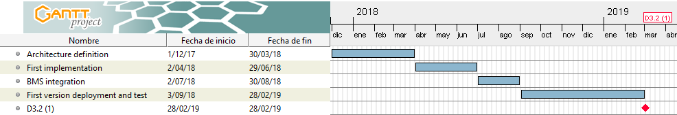
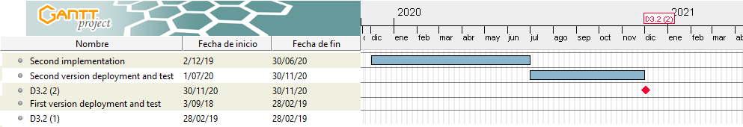
Plug-N-Harvest: Task 3.2 OEMS
Status: On time (first period)

Slide 15
Plug-N-Harvest: Task 3.2 OEMS
Functionalities detected (1/2)

Slide 16
Plug-N-Harvest: Task 3.2 OEMS
Functionalities detected (2/2)

Slide 17
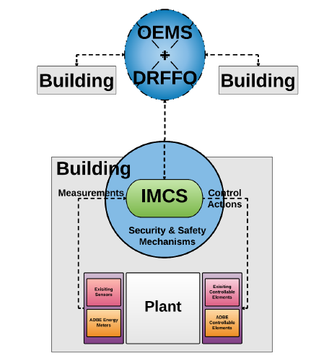


Plug-N-Harvest: Task 3.2 DRFFO
STARTED
Short-term predictions/ forecasting
Estimation of the buildings’ flexibility
Evaluation of different building operational states (specific KPIs)
Selection of the optimal state
Demand/ Response capabilities
Light-weight simulations of different building operational states
District Simulations

Slide 18
Plug-N-Harvest: Task 3.2 DRFFO
Demand/ Response queries
Sensors measurements
Forecasting module
Simulation module
MQTT broker
Evaluation of different states
(KPIs)
Storage
DB

Slide 19
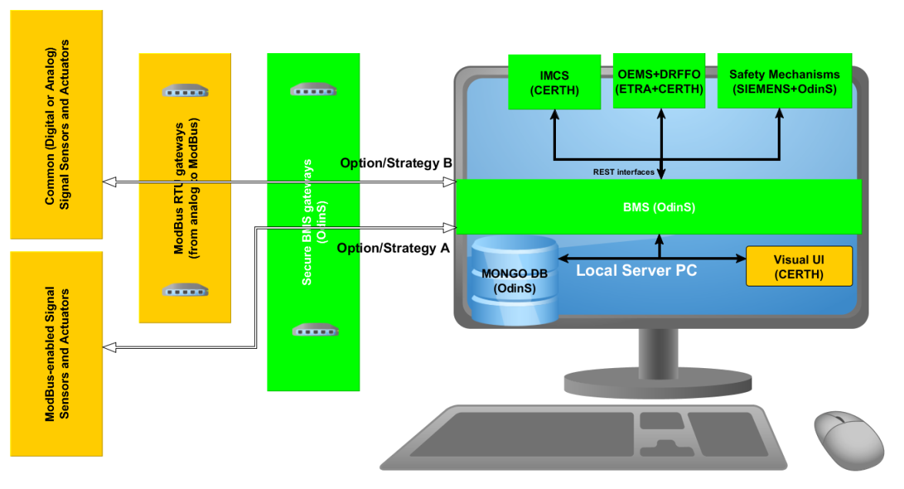

Plug-N-Harvest: Task 3.2 DRFFO
Light-weight simulations of different building operational states
Evaluation of different building operational states
Selection of the optimal building operational state
Estimation of the building flexibility
Short-term predictions/ forecasting
Demand/ Response capabilities
District simulations

Slide 20
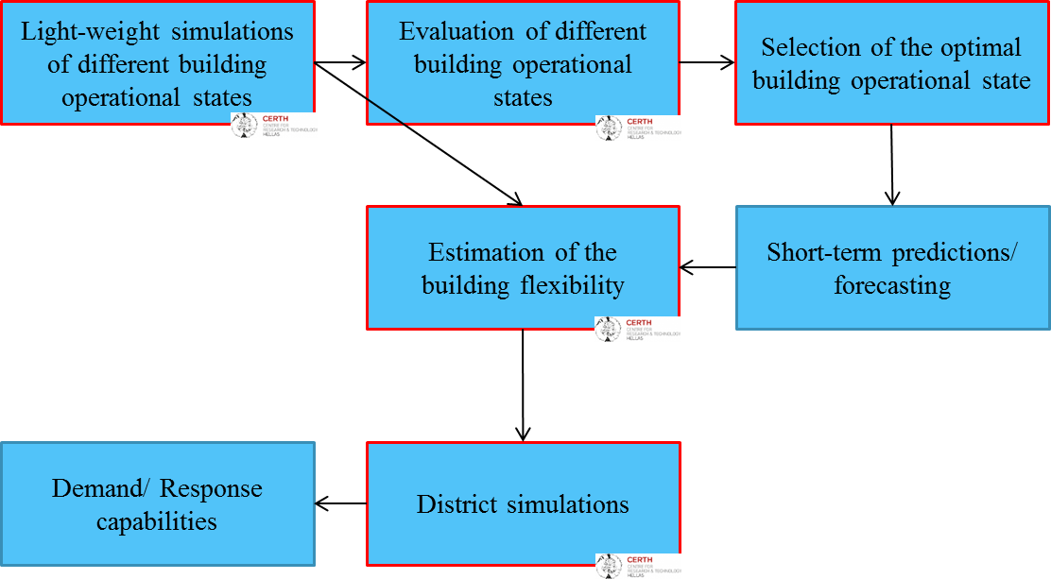
Plug-N-Harvest: Task 3.2 DRFFO
Light-weight simulations of different building operational states
Training:
  Data gathering from the pilots
    Energy consumption
    Indoor environmental information (e.g. occupancy, temperature, etc.)
    Outdoor environmental information
  Training of the simulation engine
Testing/ Running:
  Stochastic generation of different building operational states
  Simulation of the energy consumption
    Heating/ Cooling devices
    Lighting
    Appliances
  Estimation of the energy consumption for each different building state
  Estimation of the occupants’ comfort for each different building state

Slide 21
Plug-N-Harvest: Task 3.2 DRFFO
Evaluation of different building operational states
Evaluation based on various KPIs:
  Energy consumption
  Comfort values (visual & thermal comfort)
  Footprint
  Previous building states
  etc.
Dynamic weights for all KPIs
Evaluation/ Ranking of each simulated building state

Slide 22
Plug-N-Harvest: Task 3.2 DRFFO
Estimation of the building flexibility
Analysis of different building operational states
Analysis of the short-term predictions/ forecasting
Analysis of the flexibility of each device in the building
Estimation of the building flexibility

Slide 23
Plug-N-Harvest: Task 3.2 DRFFO
District simulation
Analysis of the building energy consumption
Multidisciplinary assessments of energy systems in the districts/ neighborhoods
Training based on real data from the pilots
Simulation of the grid state
  Normal use
  Extreme conditions (need for D/R actions)

Slide 24
Plug-N-Harvest: Task 3.3

Slide 25
Plug-N-Harvest: Task 3.3 – Safety Mechanisms
Siemens: iCore, CityPulse and D-Cep: where, a central complex event processing (CEP) framework based on open frameworks (e.g. Drools or Esper) are integrated employing time series over patterns. [Faults Detection and Recognition]
Siemens: can provide mechanisms and tools for ML libraries in order to detect deviations from predefined patterns (i.e. expected values). [Faults Mitigation]

Slide 26






Plug-N-Harvest: Task 3.3 – Safety Mechanisms
Sensor Data
Configuration Data
Log Data
Time Based Events Data
Event Based Data
Alarms
Operational Data to mine for Patterns
Operations Knowledge (Models) Repository
Discrimination Maker
Fault Prognostics
Engine
Operation
Model
Updater
Optimizer
Context Classifier

Slide 27
Plug-N-Harvest: Task 3.4

Slide 28
Plug-N-Harvest: Task 3.4 description
Task 3.4 activities (1st cycle: M4 – M18, 2nd cycle: M28 - M39) are related to:
  Provide in-depth analysis of the technical risks of security and privacy, and of the legal risks associated with personal data protection issues.
  Provide end-to-end protocols that protect the data communication among BMS system and OEMS/IMCS applications to mitigate security and privacy risks.
Deliverable | Responsible | Deadline
D3.4 First-Cycle: Privacy and Security Components Description | ODINS | M18
D3.4 Second-Cycle: Privacy and Security Components Description | ODINS | M39

Slide 29
Plug-N-Harvest: Task 3.4
Siemens:
  Trust and reputation mechanism based initially only on stochastic rules. To be enhanced with ML
  Contextual access control mechanism, requiring:
    Custom access models and ontology
    ML-based rules for handlers
      I.e. “learn” behavior of users of the system
    Generates XACML policies

Slide 30
Plug-N-Harvest: T3.4 Security Protocols
DCapBAC provides a distributed scheme for the generation and verification of capability tokens to authorize actions such as the data publication in BMS server or the actuation in an BMS gateway.
XACML enables the Policy Decision Point to resolve the authorization decision to obtain a capability token for the access of resources in BMS gateways and BMS system.
CP-ABE is a ciphering schema enabling to access information ciphered in BMS system according to privacy policies.
ECC enables elliptic curves for constrained BMS gateways to allow security mechanisms such as encryption and digital signature.
CoAPS (DTLS+COAP) provides secure channel for data communication between BMS gateways and the BMS system. COAPS provides the security services such as integrity, authentication and confidentiality in end-to-end communications.

Slide 31
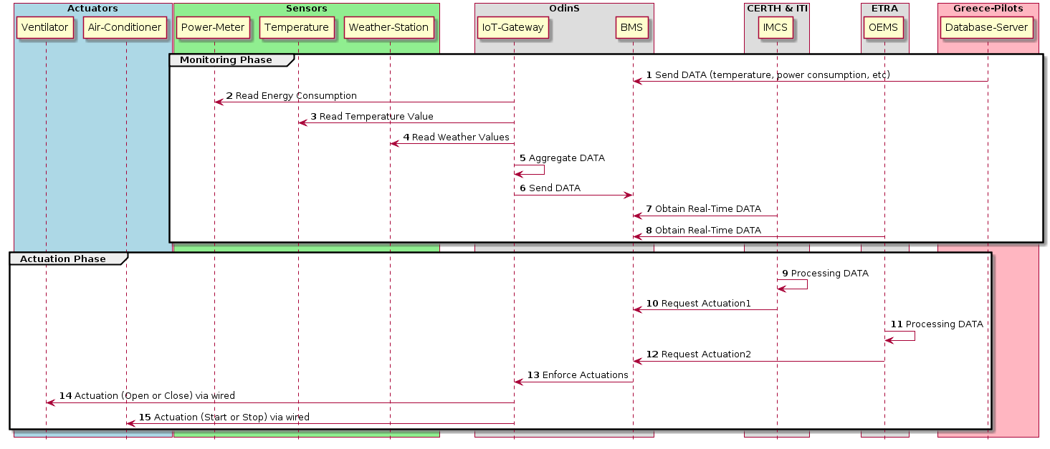
Plug-N-Harvest: T3.4 BMS Interoperability
Approach for interoperability of the IEE, SSM and EMS layer components (BMS, IMCS, OEMS, IoT gateways, sensors and actuators):
3. Direct Integration with BMS server
via Open Interfaces (MQTT/REST)
1. Integration through IoT gateway
via wired Modbus-RTU connection
2. Direct Integration with BMS server
via secure JAVA-client application

Slide 32
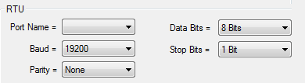
Plug-N-Harvest: T3.4: Modbus-RTU Integration with BMS-gateway
BMS-gateway supports Modbus-RTU devices via wired RS-485 connection.
BMS-gateway acts as Master to control until 32 Slave devices.
Table shows the compatible Modbus-RTU configuration of BMS-gateway.

Slide 33
Plug-N-Harvest: T3.4: Open-REST Integration with BMS-Server.
Actuation Query to turn ON Ventilator.
  Example of Information request of all IoT gateways in the building called “pilot1”
(curl localhost:1026/v1/updateContext -s -S --header 'Content-Type: application/json' \
--header ’fiware-service: PlugNHarvest’ \
--header ’fiware-servicepath: /pilot1’ \
--header 'Accept: application/json' -d @- | python -mjson.tool) <<EOF
{ "contextElements": [
{ "type": "Gateway",
"isPattern": "true",
"id": "Gateway:01",
"attributes": [
{ "name": "Ventilator",
"type": "text",
"value": "On"
}
]
}
], "updateAction": "UPDATE"
} EOF
(curl localhost:1026/v1/queryContext -s -S --header 'Content-Type: application/json' \
--header ’fiware-service: PlugNHarvest’ \
--header ’fiware-servicepath: /pilot1’ \
--header 'Accept: application/json' -d @- | python -mjson.tool) <<EOF
{
"entities": [
{
"type": "Gateway",
"isPattern": "true",
"id": "Gateway:.*"
}
]
}
EOF

Slide 34
Plug-N-Harvest: Responsibilities for Integration and Deployment in Pilots
The main responsibility is to provide Security/Privacy solutions for the communications between BMS-system and OEMS/IMCS platform to cope with the task T3.4 and the KeyObjetive-4 of the PnH project.
Offer 3 different options for the integration with BMS system:
  For each ModbusRTU device, we can provide the integration with BMS gateway and the communication with BMS-FIWARE server using Security/Privacy mechanisms.
  For NO-ModbusRTU devices, we can provide the open JSON-API interfaces (REST/MQTT) in BMS server to enable the integration by the pilot partners or subcontracting entity.
  For OEMS/IMCS or any Server application, we can provide a Client Application for the easy integration by any partners using Security/Privacy mechanisms.
For deployment, we can provide technical documentations about BMS-gateway, BMS-server and Secure-JAVA-client for the installation in the pilot sites.

Slide 35
Plug-N-Harvest: Needs for Integration and Deployment in Pilots
Required activities for the Modbus-RTU deployment by pilot partners or subcontracting entities:
  The hardware validation of the proposed Modbus-RTU equipment before the acquisition.
  The network configuration in the building for the Ethernet communication for BMS-system.
  The deployment validation of the Modbus-RTU equipment installation in each building.
  The whole configuration of the Modbus-RTU installation before programming the BMS-gateways.
    The Modbus-RTU configuration of all devices connected to the same BMS-gateway.
    For each Modbus-RTU device, it needs the bus identification, the memory map of registers and the functions available (Read/Write).
Required activities for NO-Modbus deployment by pilot partners or subcontracting entity:
  For NO-ModbusRTU equipment or Server-PC, the integration of a client application with JSON format to enable the direct communication with BMS-server.

Slide 36
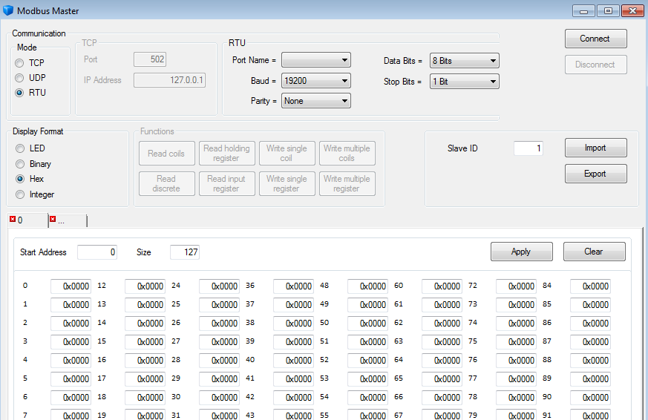

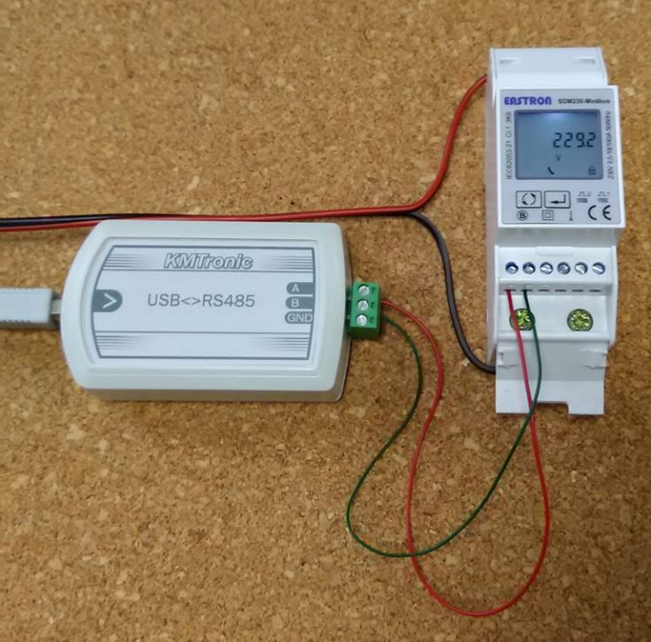
Plug-N-Harvest: Task 3.4: Deployment Validation of Modbus-RTU Slave Devices
1. Modbus Configuration
Validation equipment
  Laptop or PC with Windows OS
  Modbus-Master Application
  USB-RS485 Adapter
  Wired connection to Modbus-RTU Devices
Hardware tests
  1. Modbus configuration
  2. Slave Identification
  3. Addresses of Memory Registers
  4. Functions (Read/Write)
2. Identification
4. Functions (Read/Write)
3. Addresses of Memory Registers

Slide 37
Plug-N-Harvest: WP3 Control and Metering Network

Slide 38
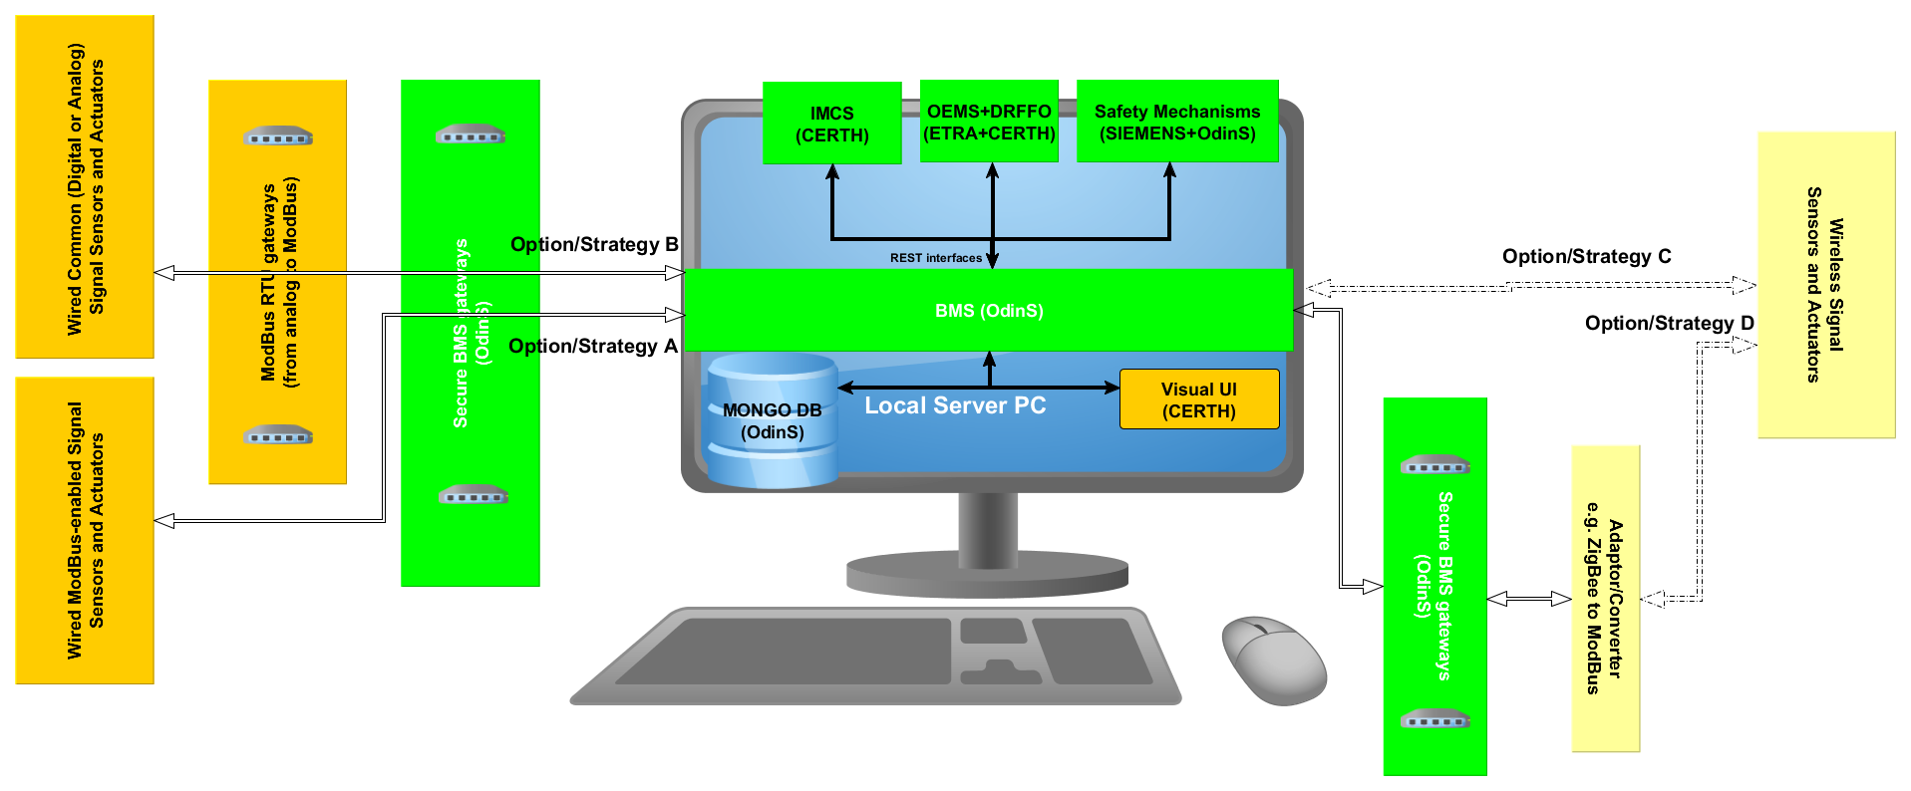
Plug-N-Harvest: WP3 Equipment Deployment
Strategy A and B are fully wired.
Strategy C is fully wireless.
Strategy D considers both wired and wireless connections.

Slide 39
Plug-N-Harvest: WP3 Feedback Control Equipment
Legend:
Necessary equipment
Not necessary equipment
Out of WP3 scope
Indoor Meters | Installation/Deployment | Comments
Power | One per power socket/smartplug | To measure the energy consumption per electric heater
Bidirectional Power (at a central building supply point node) | One at a central building power supply point | To measure the energy generation and exchange input/output from/to the grid.
Gas Meter (at a central boiler supply node) | One at a central building gas supply point | Not necessary if smart valves are installed since usually smart valves can also measure the heat exchange (consumption) per radiator
Temperature | One per thermal zone (room/office) | To calculate a simplified version of KPI-K9 Thermal Comfort
Humidity | One per thermal zone (room/office) | To calculate a more elaborate version of KPI-K9 Thermal Comfort
CO2 | One per thermal zone (room/office) | To calculate a more elaborate version of KPI-K9 Thermal Comfort
Illuminance? | One per thermal zone (room/office)
Presence/Occupancy | One per thermal zone (room/office) | We can predefine a simplified occupancy schedule e.g. from 9:00-17:00 the offices are always occupied, instead.

Slide 40
Plug-N-Harvest: WP3 Feedback Control Equipment
Legend:
Necessary equipment
Not necessary equipment
Out of WP3 scope
Indoor/Control | Installation/Deployment | Comments
Smart-plugs (plugged per socket) | One per power socket/smartplug | To control each electric heater independently
Smart-valves for radiators | One per existing radiator | To control each radiator independently
Smart-thermostat | One at a central building/apartment water supply point | To control all radiators connected centrally (if no smart valves are installed)
Outdoor/Meters
Temperature | One per demo site case | Web weather repository can provide the precise enough current and forecasted weather conditions (free of charge: https://www.openweathermap.org/price )
Humidity | One per demo site case
Solar Radiation (Pyranometer) | One per demo site case
CO2 | One per demo site case
Data Routing Middleware (Strategy B)
ModBus RTU-Gateway | One per 4/8/16/32 devices installed per demo site case | Necessary only in cases where the OdinS ModBus wired gateways will be demonstrated

Slide 41
Plug-N-Harvest: WP3 Feedback Control Equipment
Legend:
Necessary equipment
Not necessary equipment
Out of WP3 scope
Indoor/Control | Installation/Deployment | Comments
Light-weight HVAC (for the ADBE)? | One per “retroffitted” office/room? | Able to communicate with the BMS in an automated manner
Energy Generation and storage / Energy flow? | One per façade / pilot site? | Able to communicate with the BMS in an automated manner
Auxiliary
3G/4G router | One per demo site case | In cases where no internet connection is available.
PC server machine / Data and Control Centre | One per demo site case | To host all WP3 S/W services and interfaces locally in each pilot site.

Slide 42
Plug-N-Harvest: WP3 Indicative Commercial Solutions
ETRA / OdinS: Spanish-market list of compatible commercial paradigms for strategy A and B.
CERTH: Greek-market list of BMS compatible commercial paradigms for strategy A and B.
RWTH: German-market list of BMS compatible commercial paradigms for strategy A and B.
ETL / CU / CCC: British-market list of BMS compatible commercial paradigms for strategy A and B.
All contributors are expected to be finished by the end of June 2018 the latest so as these lists will be presented to the end-users as recommendations/examples.

Slide 43
Plug-N-Harvest: WP3 Next Steps
Market-driven list with compatible solutions for Strategy A and B [ready by June 2018].
BMS dummy remote server by OdinS [ready by June/July 2018].
REST/API functional interfaces for WP3 S/W services [ready by September 2018].
First functional version of the WP3 S/W services [ready by November 2018].

Slide 44
Thank you!

