Slide 1
Plug-N-Harvest
WP3: The PLUG-N-HARVEST Control and Management at Building and District Level
ORGANIZATION: Certh, Odins, Etra i+d, siemens
PRESENTER(S): iakovos Michailidis, christos korkas, STELIOS KRINIDIS, RAFAEL MARIN-PEREZ, Diego García-Casarrubios Gálvez, CRISTIAN-RAUL VINTILA
MEETING: 5TH plenary MEETING 26-27 February 2019, aachen, germany

Slide 2
Plug-N-Harvest: Project Information
Cordis Europa URL: http://cordis.europa.eu/project/rcn/211287_en.html
Project Website: www.plug-n-harvest.eu
Project Acronym : PLUG-N-HARVEST
Project ID: 768735
Funded under: H2020-EU.2.1.5.2. - Technologies enabling energy-efficient systems and energy-efficient buildings with a low environmental impact
Project Start Date: 1st of September 2017
Duration: 51 months
List of Participants
1 | Centre for Research and Technology Hellas - CERTH
2 | Rheinisch-Westfaelische Technische Hochschule Aachen - RWTH
3 | Cardiff University – CU
4 | Aloumyl, Biomichania Alouminioy Anonimi Etairia - ALUMIL
5 | Sistemes Avancats De Energia Solar Termica Sccl - AIGUASOL
6 | Odin Solutions s.l. - ODINS
7 | SIEMENS SRL - SIE
8 | Etra Investigacion Y Desarrollo Sa - ETRA
9 | Energy Transitions Limited - ET
10 | Eco Intelligent Growth, SL - EIG
11 | Agencia De L'habitatge De Catalunya - AHC
12 | Perifieria Dytikhs Makedonias - RWM
13 | County Council Of The City And County Of Cardiff - CCC

Slide 3
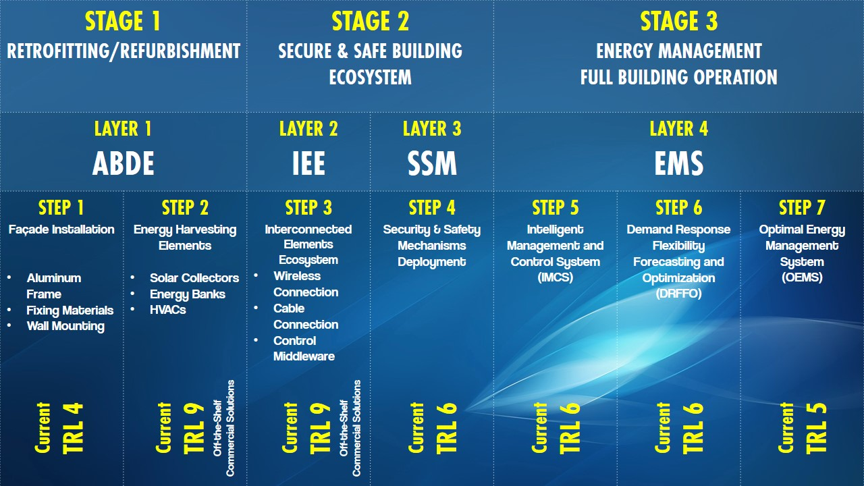
Plug-N-Harvest: WP3 Description
WP3 activities are related to:
  Support the requirements identification and suggest solutions for the Interconnected Elements Ecosystem (IEE) – Layer 2.
  Develop tailored solutions for Security and Safety Mechanisms (SSM) – Layer 3.
  Develop tailored solutions for Energy Management System (EMS) – Layer 4.
  Integrate Layer 2 and verify the functionalities Layers 3 and 4.

Slide 4
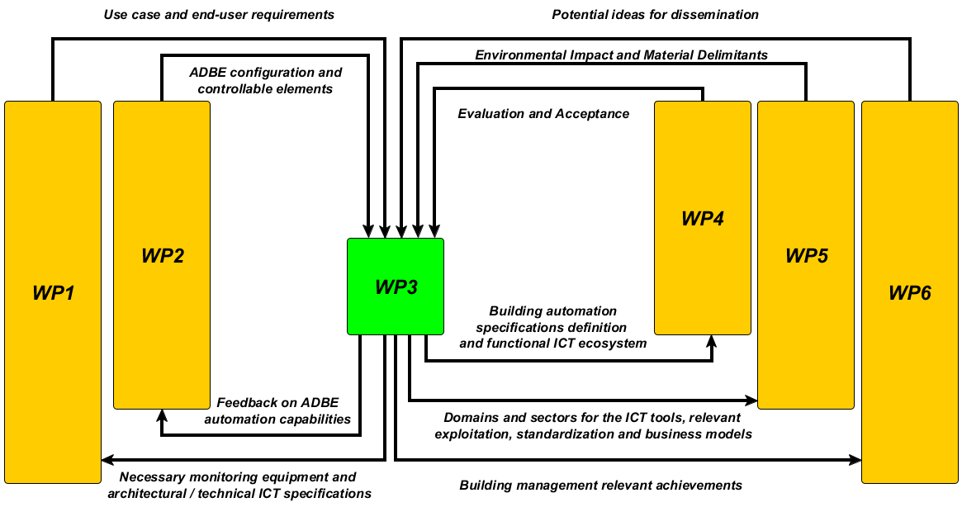
Plug-N-Harvest: WP3 Dependencies
Mapping of the main contributions expected for and from WP3 framework

Slide 5
Plug-N-Harvest: WP3 Milestones
No milestones have been linked with this WP in the signed Grant Agreement.
However it closely relates to “MS2 - System deployment and PLUG-N-HARVEST system seamless operation achieved”.
As sub-milestones of MS2 deriving from WP3 activities we consider:
  Sub-MS1: Functional ICT modules - Timely delivery of D3.1-D3.4[a] on M18 (March 2019)
  Sub-MS2: Functional integrated ICT module - Timely delivery of D3.5[a] on M21 (May 2019)

Slide 6
Plug-N-Harvest: WP3 Deliverables
No | Title | WP | Responsible | Type | Dissem. Level | Expected Del. Date | Actual Del. Date
3.1 | Plug-n-Play Intelligent Management and Control System (IMCS) for ADBE | 3 | CERTH | R | PU | a:M18 b:M39 | M19 (March 2019)
3.2 | Plug-N-Play Optimal Energy Management System (OEMS) at District/Grid Level | 3 | ETRA | R | PU
3.3 | Control Safety Mechanisms | 3 | CERTH | R | PU
3.4 | Privacy and Security Components Description | 3 | ODINS | R | PU
3.5 | Integration and Verification of IMCS/OEMS for ADBE | 3 | CERTH | R+DEC | PU/CI | a:M21 b:M39 | -

Slide 7
Plug-N-Harvest: WP3 Timeline and Progress
Start Date: 01/12/2017 (M4)
Outcomes so far: conducted 13? joint telcos
  Functional description for all WP3 components [10/01/2018].
  Internal technical discussion of WP3 contributors to resolve minor collaboration issues [6/3/2018].
  Equipment specifications for BMS compatibility [23/4/2018].
  List of necessary equipment for building control (feedback vector) [11/5/2018].
  Merged list of necessary equipment both for building control and evaluation (monitoring) [24/5/2018].
  Wireless indoor deployment strategy support map [in July 2018/by OdinS, CERTH]
  Dummy remote server for interfaces verification [in October 2018/by OdinS]
  Verified remote connections [in November 2018/by CERTH, ETRA, SIEMENS]
  WP3 modules architectural topology [in November 2018/by ALL]
  Cloud-based deployment strategy for ICT modules [in February 2019/by ALL]
  Integrated architectural topology peer reviewed publication [accepted in February 2019/by OdinS+CERTH]
  Data Annotation of common data model [in February 2019/by ALL]
  Modules execution sequence [in February 2019/by ALL]
  Data exchange mapping formalized [in February 2019/by ALL]
  Data exchange interfaces developed and verified [in March 2019/by ALL]

Slide 8
Plug-N-Harvest: WP3 Timeline and Progress
Start Date: 01/12/2017 (M4)
Outcomes so far: conducted 13? joint telcos
  Functional description for all WP3 components [10/01/2018].
  Internal technical discussion of WP3 contributors to resolve minor collaboration issues [6/3/2018].
  Equipment specifications for BMS compatibility [23/4/2018].
  List of necessary equipment for building control (feedback vector) [11/5/2018].
  Merged list of necessary equipment both for building control and evaluation (monitoring) [24/5/2018].
  Wireless indoor deployment strategy support map [in July 2018/by OdinS, CERTH]
  Dummy remote server for interfaces verification [in October 2018/by OdinS]
  Verified remote connections [in November 2018/by CERTH, ETRA, SIEMENS]
  WP3 modules architectural topology [in November 2018/by ALL]
  Cloud-based deployment strategy for ICT modules [in February 2019/by ALL]
  Integrated architectural topology peer reviewed publication [accepted in February 2019/by OdinS+CERTH]
  Data Annotation of common data model [in February 2019/by ALL]
  Modules execution sequence [in February 2019/by ALL]
  Data exchange mapping formalized [in February 2019/by ALL]
  Data exchange interfaces developed and verified [in March 2019/by ALL]

Slide 9
Plug-N-Harvest: Task 3.1 Intelligent Management and Control System (IMCS)

Slide 10
Plug-N-Harvest: Task 3.1 IMCS
Responsible for the management and control at the building level:
  PV generation;
  Batteries exploitation level;
  HVACs utilization level;
  Energy consumption for climating;
  Thermal comfort preservation.
Inputs:
  BMS information from indoor sensors
  BMS information from outdoor (weather) sensors
  BMS information from web-weather repositories
  OEMS/DRFFO flexibility levels requests
  OEMS/DRFFO demand shaping requests
  ?????
Outputs:
  Control decisions for building level actuators

Slide 11
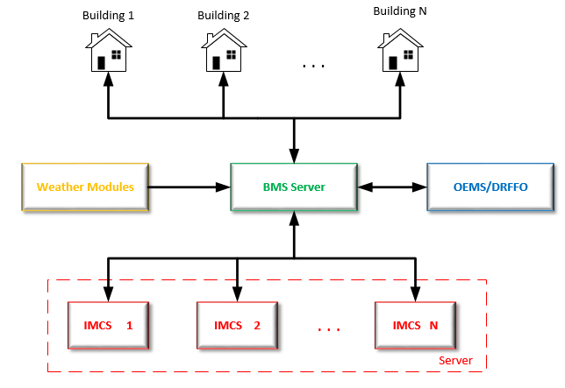
Plug-N-Harvest: Task 3.1 Intelligent Management and Control System
  IMCS Server Implementation:
    Dedicated Server for IMCS module.
    Multiple Instances ( one / building).
  Integration with BMS server:
    Inputs for each IMCS module.
    Outputs for every building actuator.
  Data Analysis:
    Inputs from building’s sensor network.
    Inputs from weather modules.
    Inputs from OEMS/DRFFO

Slide 12
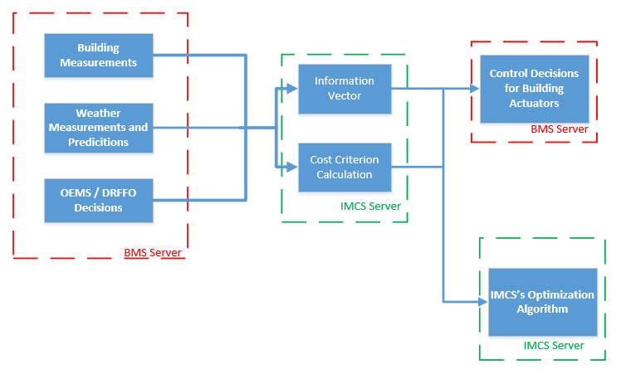
Plug-N-Harvest: Task 3.1 IMCS
  IMCS Server Implementation:
    Information Vector :
    Current Weather Conditions (temperature, humidity, solar radiation)
    Weather Predictions (6-hour prediction of temperature and solar radiation)
    Internal Conditions of each room/building (temperature, humidity, CO2, occupancy, battery SOC)
    Previous Control Actions (smart thermostats, battery actions, smart valves)

Slide 13
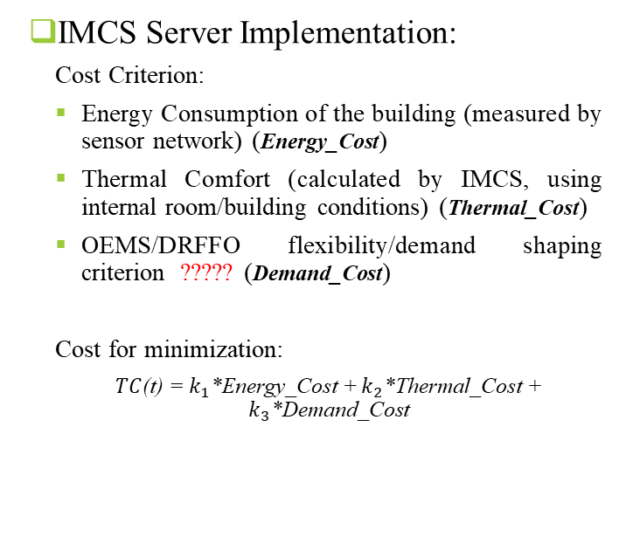
Plug-N-Harvest: Task 3.1 IMCS
  IMCS Server Implementation:
    Cost Criterion:
    Energy Consumption of the building (measured by sensor network) (Energy_Cost)
    Thermal Comfort (calculated by IMCS, using internal room/building conditions) (Thermal_Cost)
    OEMS/DRFFO flexibility/demand shaping criterion ????? (Demand_Cost)
    Cost for minimization:
    $TC$(t) = $k_{1}$*Energy_Cost + $k_{2}$*Thermal_Cost + $k_{3}$*Demand_Cost

Slide 14
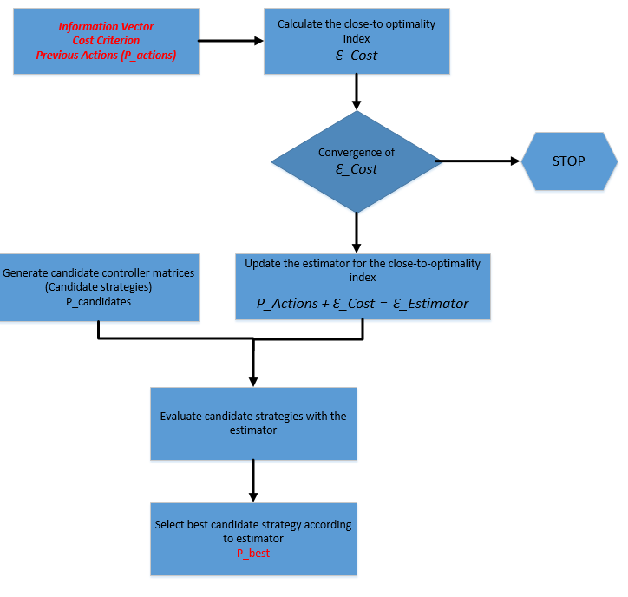
Plug-N-Harvest: Task 3.1 IMCS

Slide 15
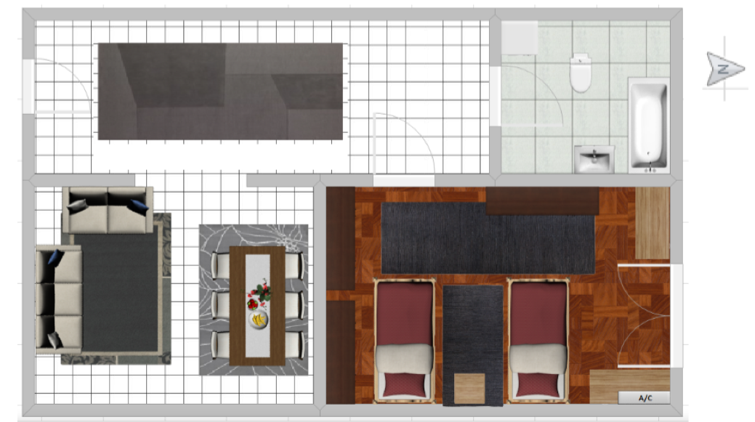
Plug-N-Harvest: Task 3.1 IMCS
  Real-life Testbed for IMCS
 | Daily Average Indoor PPD | Daily Total Energy Cost | Daily Average Ambient Temperature | Daily Average A/C setpoint
Setpoint 25 | 11% | 1.82 kWh | 3.2º C | 25º C
Setpoint 24 | 12.5% | 1.77 kWh | 2.1º C | 24º C
Day 1 – IMCS | 11% | 1.67 kWh | 3.9º C | 23º C
Day 2 – IMCS | 9.5% | 1.71 kWh | 3.1º C | 23.8º C
Day 3 – IMCS | 11.3% | 1.61 kWh | 2.9º C | 22.5º C
Day 4 – IMCS | 10.4% | 1.49 kWh | 4.6º C | 22.9º C

Slide 16
Plug-N-Harvest: Task 3.2 OEMS

Slide 17

Plug-N-Harvest: Task 3.2 OEMS
Responsible for the communication and energy exchange:
  among all the Plug-N-Harvest buildings,
  between the buildings and the energy networks, and
  between the buildings and external actors (ESCOs, aggregators, etc.).
Inputs:
  BMS information from sensors
  Data from external sources
  Manual inputs from system manager
Outputs:
  BMS commands for actuators????
  System analytics, forecasts, simulations, etc.

Slide 18
Plug-N-Harvest: Task 3.2 OEMS
Implemented as 2-level system:
  A RABBIT system at building level:
    Integration with BMS (input & output).
    Immediate analysis of building data.
    Generation of alarms, commands, etc.
  One REST API server at district level:
    Management, configuration…
    Demand response capabilities.
    Coordinated optimization.
    Exchange of energy.
    Information for ESCO, aggregators, etc.

Slide 19
Plug-N-Harvest: Task 3.2 OEMS
OEMS Rabbit App
  Secure IoT Agent (OdinS): Access to BMS
    Input collector:
      Data cleaned and sent to RabbitMQ exchange
    Command dispatcher
      Reception and coordination of commands
  External adaptor
    Retrieves information from external sources, e.g. energy mix, energy price, etc.
  Server Gateway
    Sends measurements to OEMS Server
    Receives commands and other outputs from OEMS Server

Slide 20
Plug-N-Harvest: Task 3.2 OEMS
OEMS Rabbit App (cont’d)
  Optimization Module
    Real time optimization on energy consumption at building level
  Failure Center
    Abnormal consumption identification
    Consumption alarms
    Technical alarms
  Network Monitoring
    Analysis by type of consumption
    CO2 emissions calculation
  Demand Response Strategies
    Basic consumption identification

Slide 21
Plug-N-Harvest: Task 3.2 OEMS
OEMS Server API REST
  OEMS Server GUI
    Visualization of consumption and production curves (real time, historical)
    Comparison between histories
    Management of calendar
    Billing optimization
  Network Monitoring
    High-level measurements analysis
    Performance assessment
  Maintenance module
    Consumption alarms
    Technical alarms
    Visualization of incident history

Slide 22
Plug-N-Harvest: Task 3.2 OEMS
OEMS Server API REST (cont’d)
  Energy trade platform (SIEMENS)
    Contract and billing management
    Audit for energy & energy trading
  DRFFO: Forecasting calculation
    Prediction of future consumption and productions
  DRFFO: Building simulation (CERTH)
    Light-weight simulations of different building operational states
  DRFFO: KPI evaluation
    KPI calculation
    KPI deviation alarms

Slide 23
Plug-N-Harvest: Task 3.2 OEMS
OEMS Server API REST (cont’d)
  DRFFO: Optimal state selection
    Optimal configuration of locations
    Command generation for actuators
  DRFFO: Flexibility calculation
    Basic consumption analysis
    Identification of patterns in behaviour
    Aggregate data of building use (calendar)
    Calculation of flexibility on consumption and production
  DRFFO: District simulation (CERTH)
    Multi-building behaviour simulation
  DRFFO: Demand Response Strategies
    Management of campaigns for demand response

Slide 24
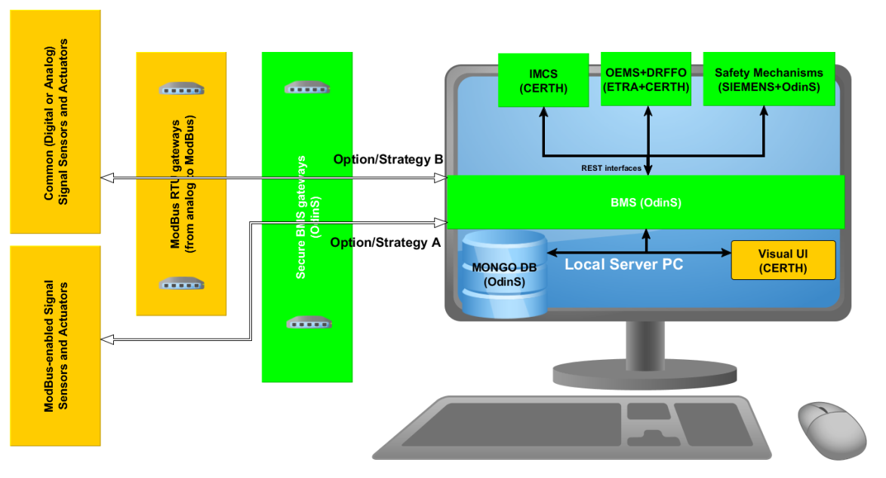
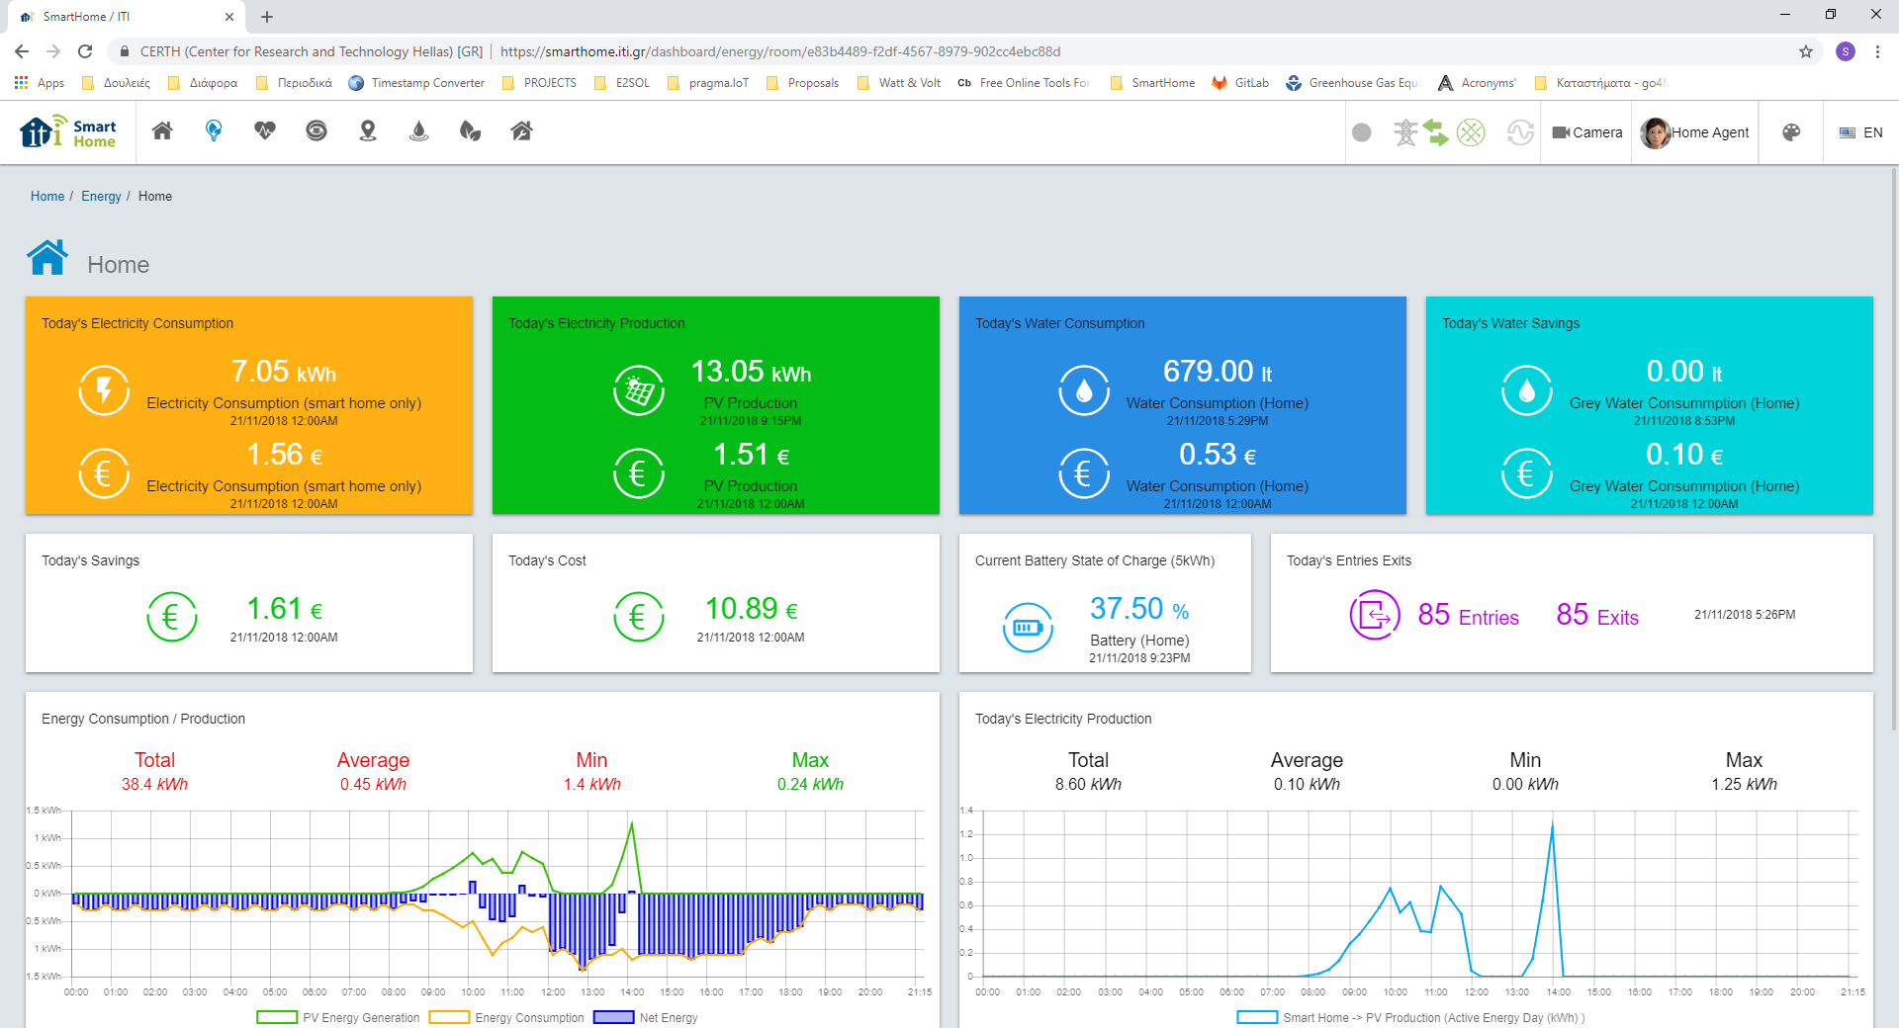
Plug-N-Harvest: Task 3.2 DRFFO

Slide 25
Plug-N-Harvest: Task 3.2 DRFFO
Building states generation
  based on the current states, various states will be generated reducing the energy consumption of the building
Building states simulation:
  simulation of building states
  produce information related to energy consumption and indoor environmental conditions???
District simulation:
  various building states simulation
  simulation of their next state
  simulation of district flexibility
  communication with Demand/Response sub-component
  demand/response strategies apply????

Slide 26
Plug-N-Harvest: Task 3.2 DRFFO
Information visualization
  building information
    energy consumption
    environmental conditions
    assets states
    flexibility
    other information such as potential energy savings, etc.
    demand/ response information
  district information
    district consumption
    flexibility
    demand/ response strategies
    drill in to each building

Slide 27
Plug-N-Harvest: Task 3.2 DRFFO

Slide 28
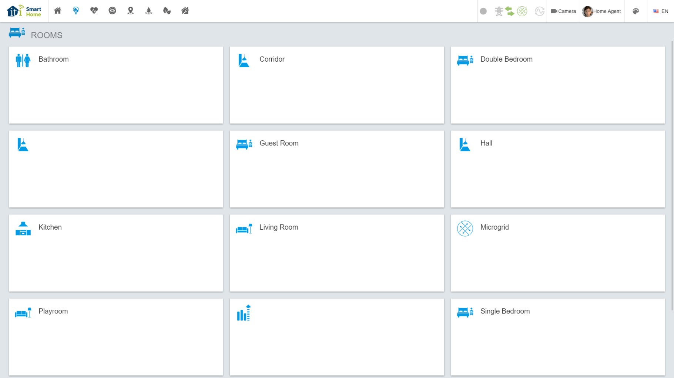
Plug-N-Harvest: Task 3.2 DRFFO

Slide 29
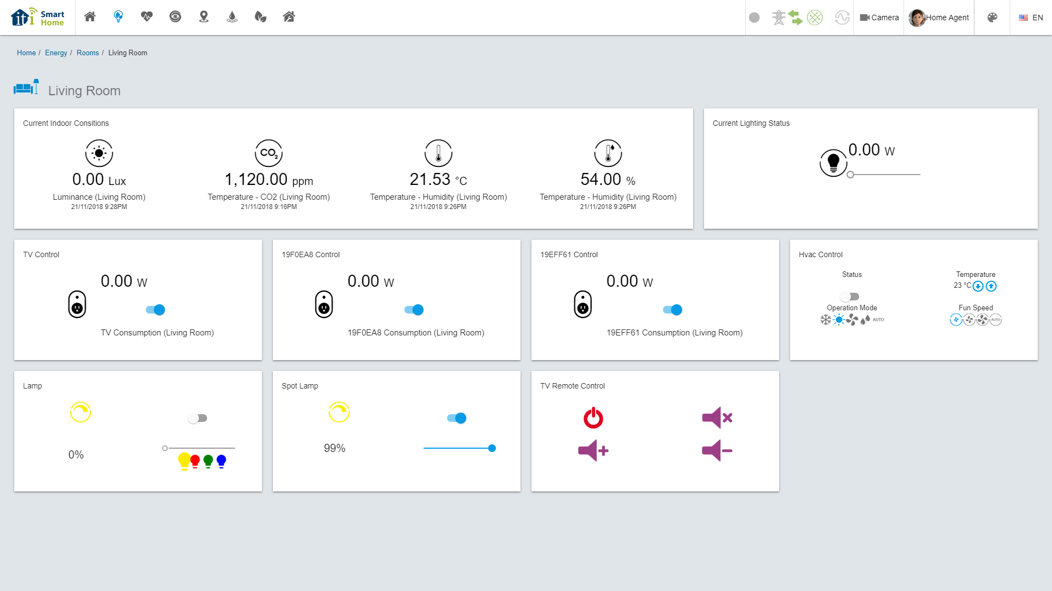
Plug-N-Harvest: Task 3.2 DRFFO

Slide 30

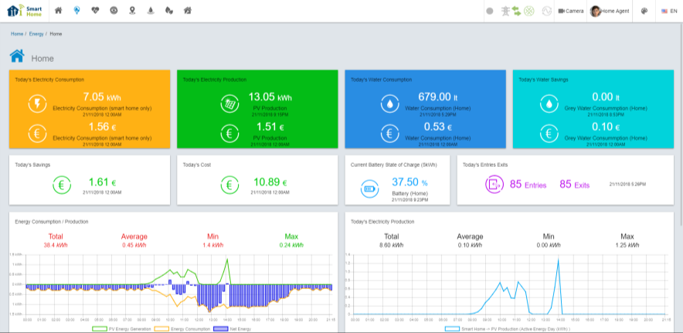
Plug-N-Harvest: Task 3.2 DRFFO
Light-weight simulations of different building operational states
Evaluation of different building operational states
Selection of the optimal building operational state
Estimation of the building flexibility
Short-term predictions/ forecasting
Demand/ Response capabilities
District simulations

Slide 31
Plug-N-Harvest: Task 3.3
Safety and Faults Mitigation

Slide 32
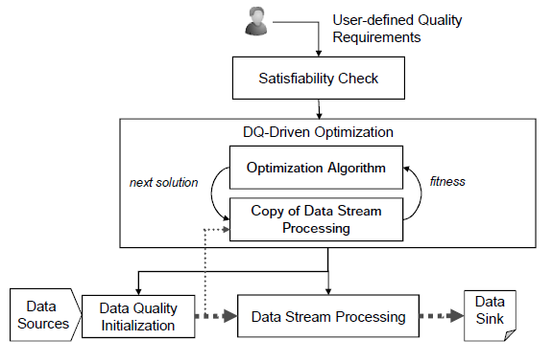
Plug-N-Harvest: Task 3.3
Safety and Faults Mitigation
  Core functionality:
    Acknowledging the trust and reputation of the emitter and consumer of streamed data.
    The safety management is a support for propagation decisions from sensors to actuators or given business applications.
  Measurements:
    Accuracy, Confidence, Completeness, Amount of data and Timeliness.
  Applications:
    Define quality requirements
    Acquire data from data source and analyze a significant copy of the stream
    Score the input data and analyze measurements
    Use optimization algorithm to apply rules on data or data source
    Publish results

Slide 33
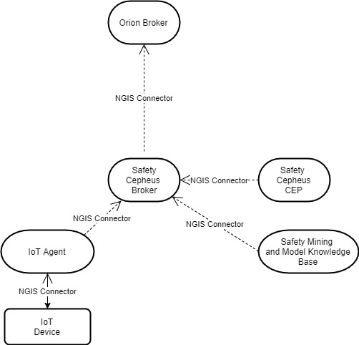
Plug-N-Harvest: Task 3.3
Safety and Faults Mitigation
  Components:
    Safety Cepheus lightweight broker works in tandem with BMS Orion broker
    Safety Cepheus CEP applies rules mined and managed by the Safety Mining and Model Knowledge base
    Data Source are the IoT Devices and data is acquired through the IoT Agent
    Safety Mining and Model Knowledge-Base scores the data and defines rules
  Safety Mining and Model Knowledge Base:
    Scoring for indication matchings based on pattern knowledgebase and/or the quality of information processed on a window size and described by measurement operators
    Patterns are identified continuedly to define complex events
    Measurements are used continuedly to define satisfiability
  Safety CEP:
    CEP rules are fired continuedly to validate data
    Validation events are published to describe the trust and reputation of IoT Devices and/or of data
    Consumers of Safety Broker result can decide on data consumption

Slide 34
Plug-N-Harvest: Task 3.4 Security and Privacy Components

Slide 35
Plug-N-Harvest: Task 3.4 Security and Privacy Components
Task 3.4 activities (1st cycle: M4 – M18, 2nd cycle: M28 - M39) are related to:
  Provide a detailed analysis of the technical risks of security and privacy in IoT environment and Smart Buildings.
  Propose security and privacy technologies to protect the data communication among IoT building equipment (i.e. gateway, sensor and actuators) and energy optimization systems (i.e. IMCS, OEMS, etc) through a Building Management System (BMS).
Deliverable | Responsible | Deadline
D3.4 First-Cycle: Privacy and Security Components Description | ODINS | M18 – Delivered
D3.4 Second-Cycle: Privacy and Security Components Description | ODINS | M39

Slide 36
Plug-N-Harvest: Analysis of Security and Privacy Risks
  Applications:
    Internet of Things (IoT) with heterogeneous entities (i.e. devices, services) and high connectivity
    Smart Buildings with massive data about sensing/actuation operations.
  Non-functional requirements:
    Scalable, Interoperable, Configurable, Efficient, Extensible, etc.
  Functional requirements:
    Identity Management / Entities registration / Authentication
    Security Policies Management,
    Authorization / Access Control
    Privacy Preserving Communications / Data Encryption.
    Integrity / Confidentiality

Slide 37
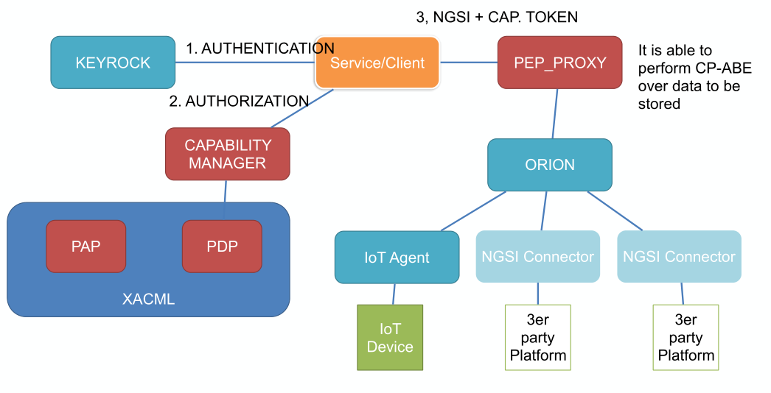
Plug-N-Harvest: BMS Components
The BMS is based on open FIWARE platform:
  Context Broker for scalable management of real-time data about sensing/actuation operations.
  IoT Agents to enable high connectivity of heterogeneous entities (i.e. devices and ICT systems).
Security / Privacy Components
    KeyRock: Identity Management / Authentication / Entities registration
    XACML: Security Policies Management,
    DCapBAC: Authorization / Access Control
    CP-ABE: Privacy Preserving Communications / Data Encryption.
Additional protocols:
    ECC: Elliptic Curve Cryptography to sign and validate certificates or tokens
    TLS: Transport Layer Security for End-to-End communication with Integrity and Confidentiality

Slide 38
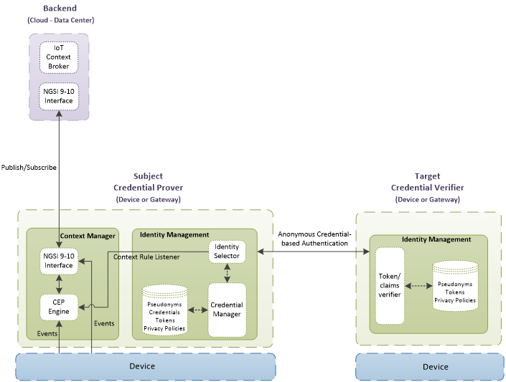
Plug-N-Harvest: Identity Management and Authentication based on KeyRock
  Objective: Validate the identity of each entity before enabling the data exchange.
  Technology: Privacy-preserving authentication based on anonymous KeyRock credential/token.
  Benefit: Minimal diffusion of private identity data of entities (i.e. users, systems and devices)
  Operations: First time, the entity presents its identity to request an anonymous KeyRock token. Next operations, the anonymous KeyRock token is used for authentication.
  Main subcomponents: KeyRock Manager validates the identity and generates the anonymous tokens.

Slide 39
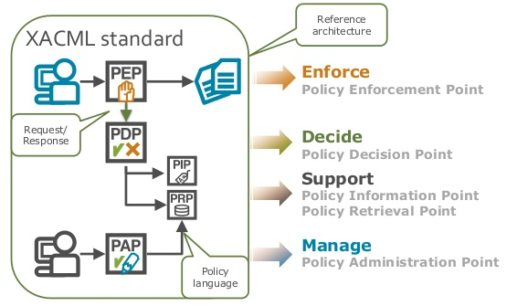
Plug-N-Harvest: Authorization based on XACML Management
  Objective: Manage the access permission to any involved entity (i.e. IoT devices, ICT systems, etc.)
  Technology: Extensible Access Control Model Language (XACML) for policies management.
  Benefit: Extensible and configurable solution to manage the access permissions of involved entities.
  Operations: First time, the owner defines the access policies with XACML language. Next times, the permission of an entity is validated before publishing or retrieving data of a resource.
  Subcomponents: Policy Administration, Policy Information, Policy Retrieval, Policy Decision, Policy Enforcement.

Slide 40
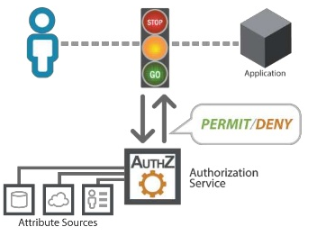
Plug-N-Harvest: Authorization based on XACML Management
  Example of XACML Policy:
    Rule: “Permit”
    Subject: “OdinS”
    Action: “requestData”
    Target resource: “Device01”
  Policy Decision:
    Permit or Deny
  If Permit, Policy Enforcement:
    Executes the action.
<Policy “PnH_example”> <Rule “Permit"> <Target> <Subject> <AttributeValue DataType="String">OdinS</AttributeValue> <SubjectAttributeDesignator AttributeId="subject-id" DataType="String"/> </Subject> </Target> </Rule> <Target> <Action> <AttributeValue DataType="String">requestData</AttributeValue> <ActionAttributeDesignator DataType="String" AttributeId="action-id " </Action> <Resource> <AttributeValue DataType="String">Device01</AttributeValue> <ResourceAttributeDesignator DataType="String" AttributeId="resource-id" /> </Resource> </Target> </Policy

Slide 41
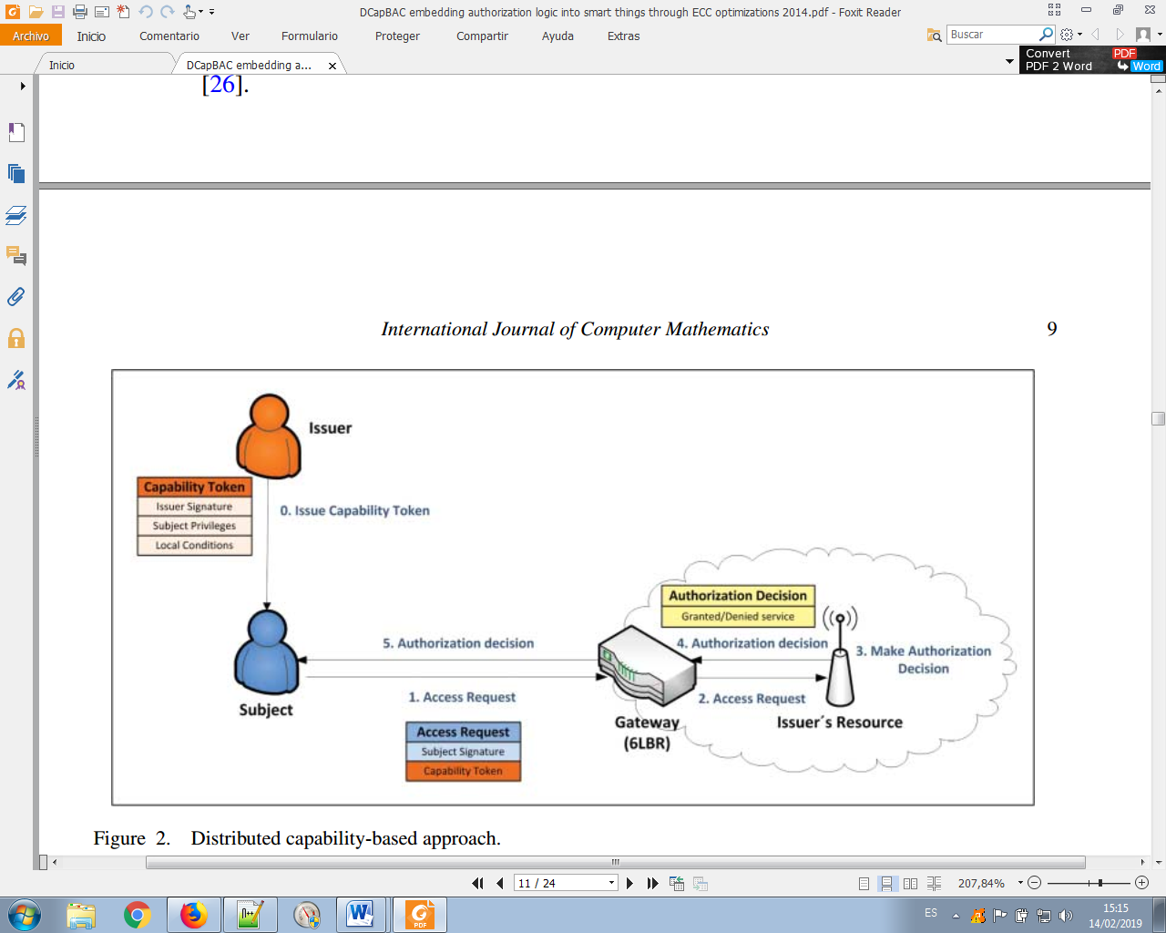
Plug-N-Harvest: Access Control based on Capabilities (DCapBAC)
  Objective: Validate the access permission of an entity before doing an action (i.e. publish data).
  Technology: Distributed Access Control based on Capabilities tokens (DCapBAC).
  Benefit: Efficient and Scalable solution to control the data access of distributed resources or devices.
  Operations: First time, a subject entity requests a Capability-token to access data of a target resource. Next times, the subject sends the data query with the capability-token to request the resource access. The target validates the token before sending data.
  Subcomponents: Capability Manager generates the tokens with signature that will be validated by distributed resources.

Slide 42
Plug-N-Harvest: Access Control based on Capabilities (DCapBAC)
  Example of Capability Token:
    The OdinS issuer gives permission to get the temperature from the temperature sensor of the first floor.
  Main Fields:
    Identifier (ID) is an unique value for each capability token.
    Issued-time (II) is the time when the token is generated.
    Issuer (IS) is the entity that generates the tokens.
    Subject (SU) refers the entity that obtains the permission.
    Device (DE) is the Internet address of the device
    Signature (SI) is used by the target device to validate the token.
    Access Rights (AR) indicates the permitted action.
    Not Before (NB) and Not After (NA) specify the time range at which the token is acceptable.
  Before the Capability Manager generates the tokens, the XACML PDP decides if the subject entity has permission to perform the specific action
{ “id”: “eg3fq:fb5r23tra3”, “ii”: 1485172121, “is”: “issuer@odins.es”, “su”: “zNwS5FetB4rwzSKsWwSBAxm5wDa=JgLjHU8zSnmeSFQgSG9HhdsJrE8=”, “de”: “coap://sensortemp.floor1.odins.es”, “si”: “SbUudG4zuXswFBxDeHB87N6t9hR=PBQqCN3gpu7nSkuPzDk7kaR3dq1=”, “ar”: [ { “ac”: “GET”, “re”: “temperature” } ], “nb”: 1485172121, “na”: 1485174121 }

Slide 43
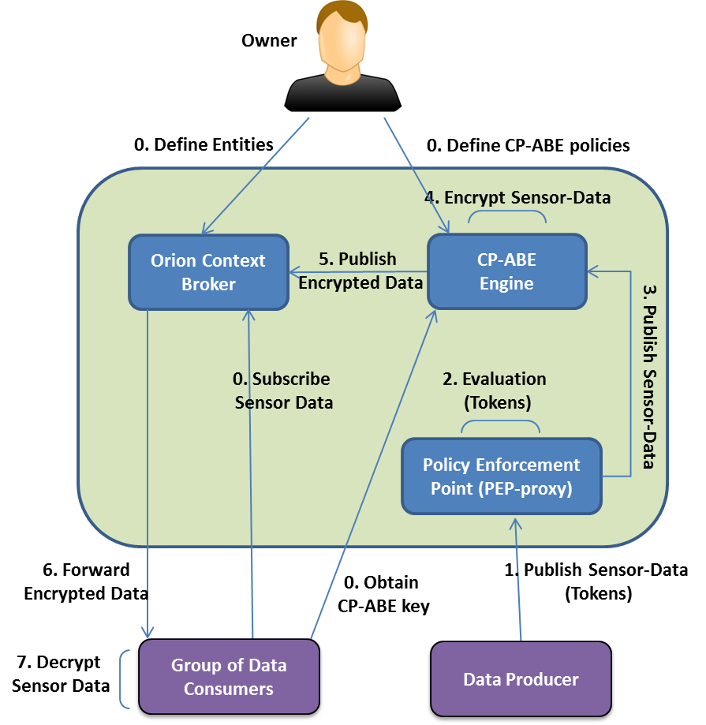
Plug-N-Harvest: Data Encryption based on Group Sharing (CP-ABE)
  Objective: Protect private data accessible by groups of entities.
  Technology: Ciphertext Policy Attribute Based Encryption (CP-ABE).
  Benefit: Efficient and Scalable Solution for Data Communication among groups with the same attributes
  Operations: First time, the owner defines the attributes of the groups to access the private data. Next operations, the data is encrypted by an specific CP-ABE policy that is only known by the accessible group.
  Subcomponents: CP-ABE engine manages the CP-ABE policies.

Slide 44
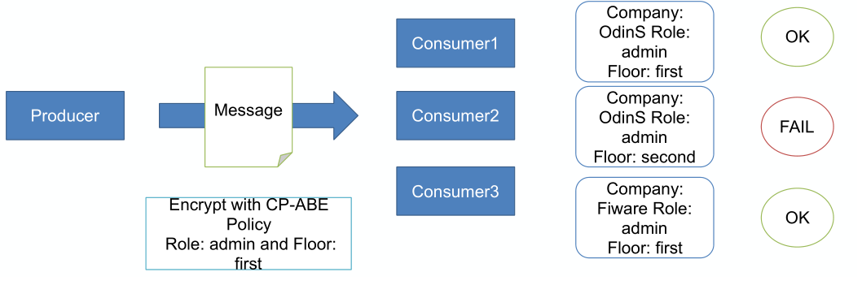
Plug-N-Harvest: Data Encryption based on Group Sharing (CP-ABE)
  CP-ABE enables to broadcast information to a group of subscribers entities.
  Only the legitimate ones with the right credentials can decrypt the information
  Data Encryption is performed with a CP-ABE policy based on a combination of attributes
  CP-ABE policies are defined with the attributes of the KeyRock Identity Management

Slide 45
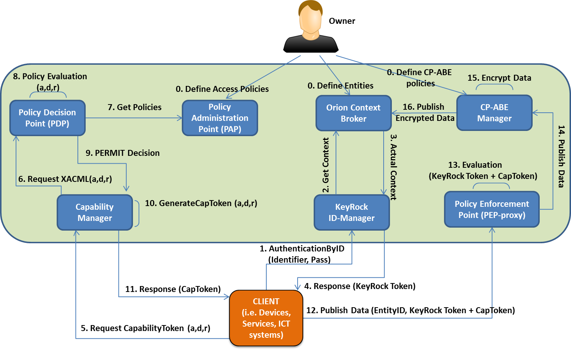
Plug-N-Harvest: BMS System with Security and Privacy Components
  Example of IoT device publishing sensor data in the BMS system. Main operations:
    1. Authenticates to get the anonymous KeyRock token
    2. Obtains Capability token to publish data
    3. XACML checks the permission of device
    4. If permit, device receives the CapToken.
    5. Device sends the data publication with both tokens
    6. PEP evaluates both tokens before executing the publication
    7. If both are ok, the data is encrypted by CP-ABE policy.
  Next time, it uses the same tokens.

Slide 46
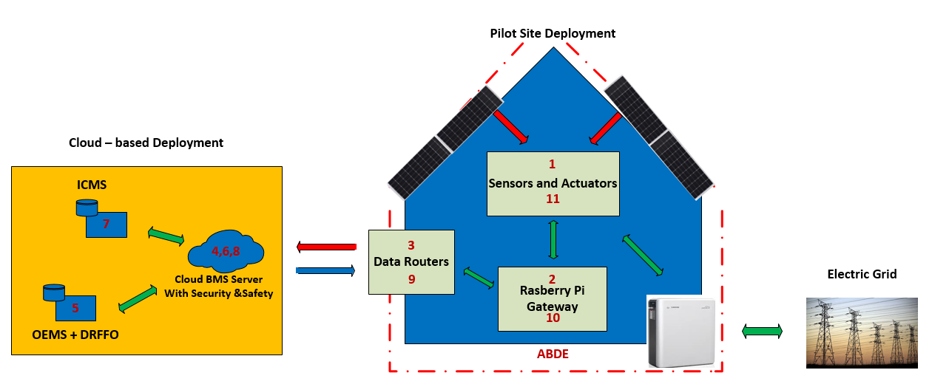
Plug-N-Harvest: BMS Integrated in PnH Architecture
  BMS enables secure communications among different clients like cloud energy systems and building equipment.
  Building equipment (i.e. IoT gateways, legacy sensors/actuators) produces sensing data and consumes actuations.
  Energy systems consumes sensor data and produces actuation data.
  All entities (i.e. IMCS, OEMS, IoT gateways, etc) integrates a client application to interact with BMS system via a security and privacy way

Slide 47
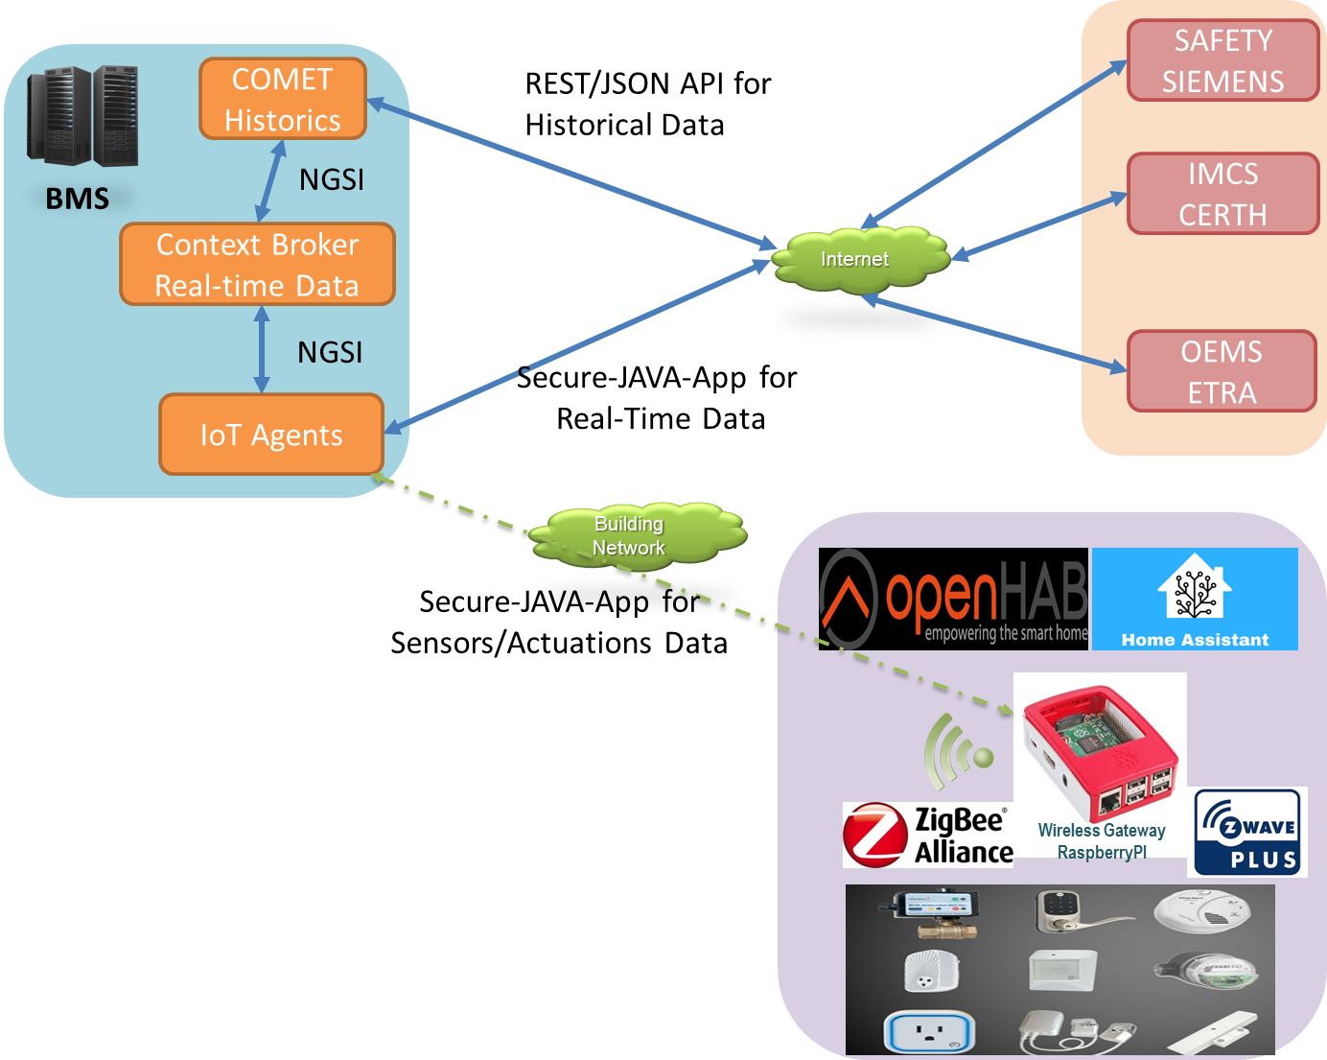

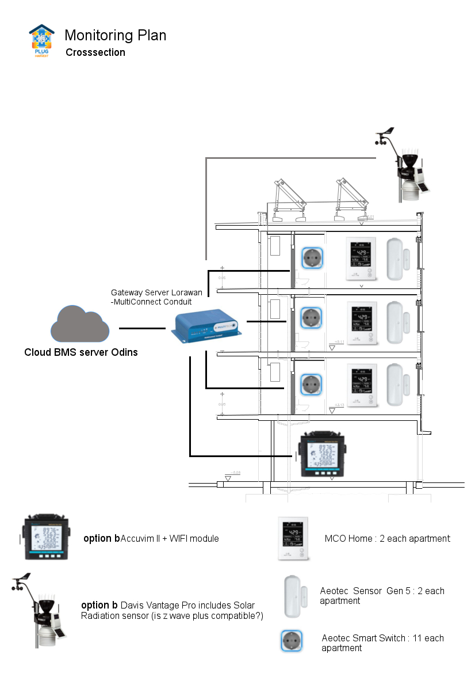
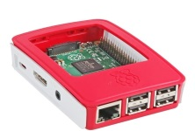
Plug-N-Harvest: Small Pre-pilot Testbed
Secure JAVA App for Real-time data (sensors, actuations, etc) to:
  ICT systems (IMCS, OEMS, etc)
  Wireless gateway (RaspberryPI)
A IoT gateway based RaspberryPI-3 with
  SecureApplication to interact with BMS
  HomeAssistant software to interact with Zwave devices:
    Temperature, humidity, presence, etc. (i.e. Aeotec Multisensor 6)
    Energy metering and turning on/off (i.e. Aeotec Smart Switch)
    Open door sensor (i.e. Aeotec Door)
Multi-Sensors for Temp, Hum, Presence
Sensor for Door or Window
Smart-Plug
and Monitor
RasberryPI Gateway

Slide 48
Plug-N-Harvest: Adaptation of SecureApp for RaspberryPI with HomeAssistant
The Secure-JAVA-App have been adapted to communicate with HomeAssistant via its REST API.
Each time, this app is executed, SecureApp does the following process:
  1) requesting sensor data in RaspberryPI via REST API of HomeAssistant.
  2) translating to JSON format and sending the sensor data to BMS system via security components,
  3) requesting the actuations stored in the BMS system for the specific gateway via security components.
  4) translating and sending the actuation operations to HomeAssistant via REST API.
SecureApp requires to define the time period to exchange sensing/actuation data with BMS server.
  Time period: 5 or 10 minutes.
  This time period affects the sensor monitoring and actuation operations. It is not immediate operations.

Slide 49
Plug-N-Harvest: JSON Data Model of BMS Configuration
To start the interoperability between any IoT-Gateway and ICT systems through BMS:
  Define JSON data model for specific entities and its attributes, for instance
    Each IoT-Gateway indicating the data provided by its connected sensors/actuators.
    Weather information with several parameters
  Create every entity based on the defined JSON data motel in BMS server that will be registered for ICT systems (IMCS, OEMS and Safety-SIEMENS).
Once the BMS and Gateways are configured, the following actions can be performed:
  IoT-Gateway can send the sensor data to the BMS.
  ICT systems can retrieve the sensor data related to each IoT-Gateway through BMS.
  ICT systems can send the actuation operations to IoT-Gateway through BMS.

Slide 50
Plug-N-Harvest: Task 3.5 Integrated Functional ICT Module

Slide 51
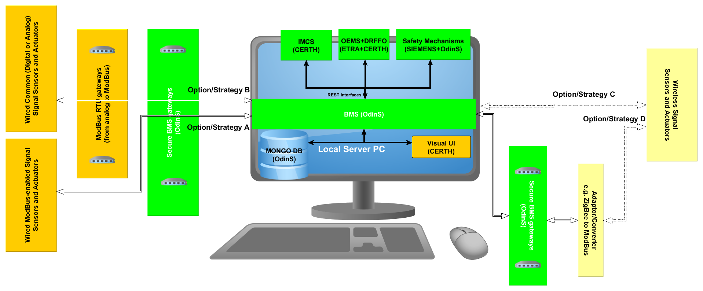
Plug-N-Harvest: Task 3.5
Integrated Functional ICT Module
Strategy A and B are fully wired.
Strategy C is fully wireless.
Strategy D considers both wired and wireless connections.
WP3 Architecture: Safety and Security Mechanisms together with the foreseen Energy Management Systems at building and district level are integrated within a fully functional cloud ecosystem.

Slide 52
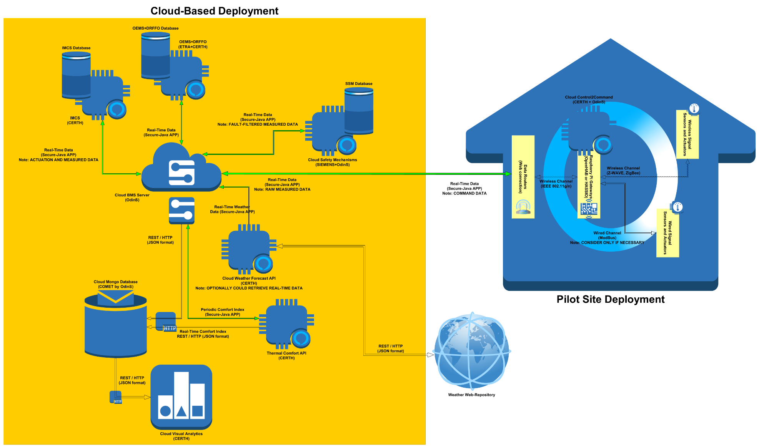
Plug-N-Harvest: Task 3.5
Integrated Functional ICT Module
WP3 Architecture: Safety and Security Mechanisms together with the foreseen Energy Management Systems at building and district level are integrated within a fully functional cloud ecosystem.

Slide 53
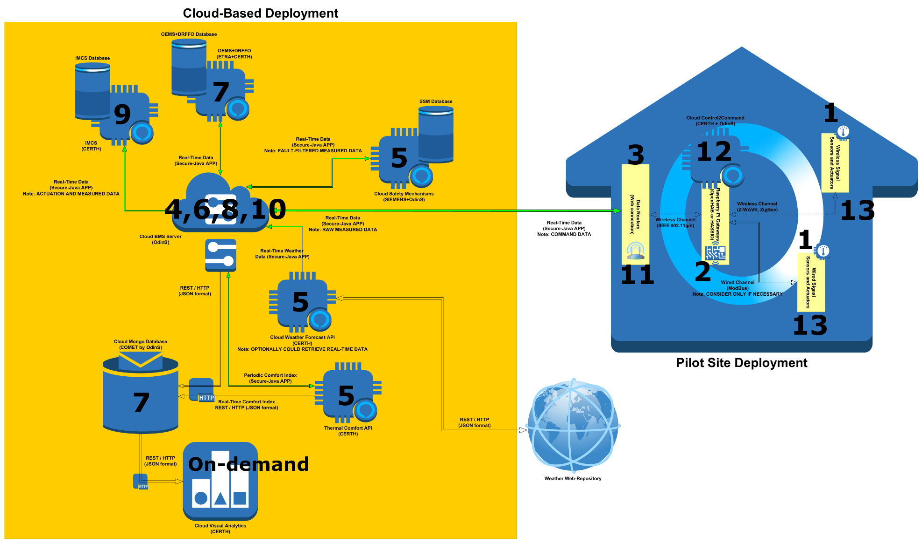
Plug-N-Harvest: Task 3.5
Integrated Functional ICT Module
Execution Sequence:
The integrated fully functional cloud ecosystem implements a control loop (T=15mins) as depicted in the figure above.

Slide 54
Plug-N-Harvest: Task 3.5
Integrated Functional ICT Module
Type | ID
Gateway:Indoor | Floor:01_Room:05_Number:02
Name | Type | Value (example) | Comment
Temperature | Float | 20.2 | Indoor temperature [C]
Humidity | Float | 25.5 | Indoor relative humidity [%]
CO2 | Float | 350.1 | Indoor CO2 levels [ppm]
Presence | Boolean | True | Indoor motion and presence detection [YES:TRUE/NO:FALSE]
Plug1_Consm | Float | 1.34 | Plug1 power readings [kW] * sampling rate [seconds]
Plug2_Consm | Float | 2.18 | Plug2 power readings [kW] * sampling rate [seconds]
Rad1_Consm | Float | 15.3 | Radiator1 heat consumption readings [kcal]
Rad2_Consm | Float | 11.2 | Radiator2 heat consumption readings [kcal]
Window1 | Boolean | True | Window1 contact sensor [CLOSED: TRUE/TRUE: FALSE]
Window2 | Boolean | False | Window2 contact sensor [CLOSED: TRUE/TRUE: FALSE]
Plug1_Set | Boolean | True | Plug1 setpoint [ON: TRUE/OFF: FALSE]
Plug2_Set | Boolean | True | Plug2 setpoint [ON: TRUE/OFF: FALSE]
Rad1_Set | Float | 13 | Radiator1 smart valve setpoint [CLOSED 0%-100% OPEN]
Rad2_Set | Float | 55 | Radiator2 smart valve setpoint [CLOSED 0%-100% OPEN]
[Any other missing]
Example of the data annotation mapping parsed by an indoor gateway.

Slide 55
Plug-N-Harvest: Task 3.5
Integrated Functional ICT Module
Type | ID
Gateway:Outdoor | Weather_and_ADBE
Name | Type | Value (example) | Comment
Temperature | Float | 17.9 | Ambient temperature [C]
Humidity | Float | 35.1 | Outdoor relative humidity [%]
SolRad | Float | 51.1 | Outdoor total solar radiation [kWh/m2]
HVAC_Consm | Float | 9.2 | Energy consumption of the ADBE HVAC [kWh]
Ser1_Battery | Float | 79.8 | Series1 of batteries state [%]
Ser2_Battery | Float | 77.2 | Series2 of batteries state [%]
Bidir_Consm | Float | 12.3 | Bidirectional energy meter at the central node [kWh]
PV_Energy | Float | 9.2 | Produced energy meter at the PV connection node [kWh]
PV_Inverter | Boolean | True | Operational thyristor frequency / or operational mode: DC2AC or AC2DC [TRUE: DC2AC/ FALSE: AC2DC]
[Any other missing]
Example of the data annotation mapping parsed by an outdoor gateway connected to the ADBE and local weather station.

Slide 56
Plug-N-Harvest: Task 3.5
Integrated Functional ICT Module
Type | ID
Gateway:Web | Weather_Forecast
Name | Type | Value (example) | Comment
Temperature_ForeHour1 | Float | 17.9 | Ambient temperature [C]
Temperature_ForeHour2 | Float | 15.2 | Ambient temperature [C]
… | … | … | …
Temperature_ForeHour24 | Float | 10.1 | Ambient temperature [C]
Humidity_ForeHour1 | Float | 35.1 | Outdoor relative humidity [%]
Humidity_ForeHour2 | Float | 44.7 | Outdoor relative humidity [%]
… | … | … | …
Humidity_ForeHour24 | Float | 65.2 | Outdoor relative humidity [%]
SolRad_ForeHour1 | Float | 51.1 | Outdoor total solar radiation [kWh/m2]
SolRad_ForeHour2 | Float | 101.5 | Outdoor total solar radiation [kWh/m2]
… | … | … | …
SolRad_ForeHour24 | Float | 0.2 | Outdoor total solar radiation [kWh/m2]
[Any other missing]
Example of the data annotation mapping parsed by a virtual web gateway connected to the web-repository for forecasted weather data.

Slide 57
Plug-N-Harvest: WP3 Next Steps
Written consent from end-users regarding the anonymized monitoring of their actions: Dependent to WP4 [ready by December 2018]?
Map-of-Responsibilities for building automation deployment [ready by July 2018]
Technical specifications definition for building automation elements [ready by September 2019]
First functional versions of all WP3 core modules [ready by December 2018]
First verified versions of all WP3 core modules [ready by February 2019]
Initial WP3 ICT cloud architecture [ready by November 2018] / Final WP3 ICT cloud architecture [ready by February 2019]
Initial execution sequence of the WP3 ICT cloud ecosystem [ready by November 2018] / Final execution sequence of the WP3 ICT ecosystem [ready by February 2019]
First integrated version (cooperative operation of all WP3 core modules) of WP3 ecosystem [ready by March 2019]
Data mapping and common annotations for seamless interfacing of all WP3 core modules [ready by February 2019]
Pre-pilot small scale deployment and verification of WP3 ICT ecosystem [ready by May 2019]?
Support the specification definition for the configuration of the gateways: Dependent to WP4 [ready by May 2019]?
Pilot polished integrated version of WP3 ecosystem: Dependent to WP4 [ready by July 2019]?
Basic version of a preliminary data collecting ecosystem (BMS server, weather API, comfort index calculation API, gateway dockers, central database, etc.) ready for historical data collection: Dependent to WP4 selections [ready by April 2019]?
Mostly relevant to T4.1? Relocate them?

Slide 58
Thank you!

