Slide 1
Plug-N-Harvest
WP7 : project Management
ORGANIZATION: CERTH PRESENTER(S): christos ravanis MEETING: 2nd plenary, thessaloniki, 23-24 january 2017

Slide 2
Mail lists – Boards – Website
PnH Google group (May 2017)
QCB , EAB , SIB , PB (Nov 2017)
Changes in ExAB (BAC ECG & Tata Steel instead of Elvial)
http://www.plug-n-harvest.eu/
?? Alternatives for Google groups ??

Slide 3
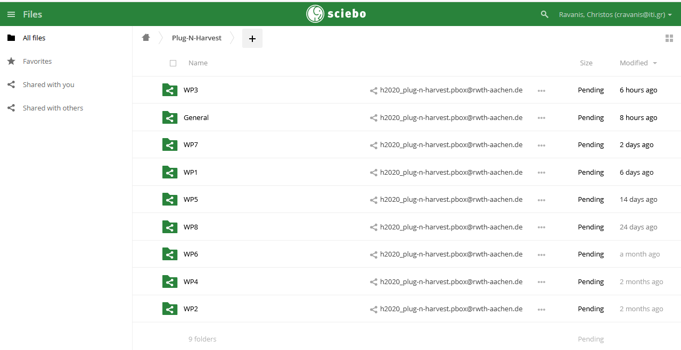
Project repository

Slide 4
In person Meetings
When | Who | Purpose
September 21-22, 2017 | all | KoM, German pre-pilot
November 28-29, 2017 | ALUMIL, CERTH, RWTH | Façade concept workshop, Greek pre-pilot
November 13, 2017 | AIGUASOL, AHC | Spanish pilot definition
December 23, 2017 | AIGUASOL, EIG | WP5, Circular Economy, exploitation
October 18, 2017 November 16, 2017 January 12, 2018 | CU, CCC | WP1, British pilots energy model results, building information survey & regulation
November 30, 2017 | CU, AHC | Work & staff arrangement
January 5, 2018 | ETL, CU | UK external advisory list
December 12, 2017 | RWTH, CU, CCC | Progress on the ADBE system, building info and survey results, energy model

Slide 5
Telcos
WP1 initial: October 11 coordination: November 9 and 23, December 13, January 4
WP3 initial: January 8 coordination: January 18
WP5 initial: December 13 coordination: January 4

Slide 6
Deliverables
Already delivered
To be delivered until end of February 2018
Del. No | Title | version
D6.3 | Project Website & Social Media | 1st version [D6.2.1 a]
D8.1 | H – Requirement No. 1
Del. No | Title | version
D6.1 | Dissemination Plans and Promotion | 1st version [D6.1.1 a]
D6.2 | Data Management Plan | 1st version [D6.1.2 a]
D7.1 | Project Management | [D7.1.1]
D7.4 | Quality Assessment Plan | [D7.2.1]
D7.5 | Risk Assessment | [D7.2.2]
D7.6 | Ethical Monitoring and Contingency plans | [D7.2.3]

Slide 7
Requests – Open issues
A 12,425€ budget increase request from AHC partner
PM exchange between OdinS and SIEMENS
3rd Plenary meeting date

