Slide 1
Plug-N-Harvest CCC Pilot Site Brainstorm
WP4 – Integration, Pilot Implementation and assessment
ORGANIZATION: ccc PRESENTER(S): Gareth Harcombe MEETING: CCC Pilot Site November 2018

Slide 2
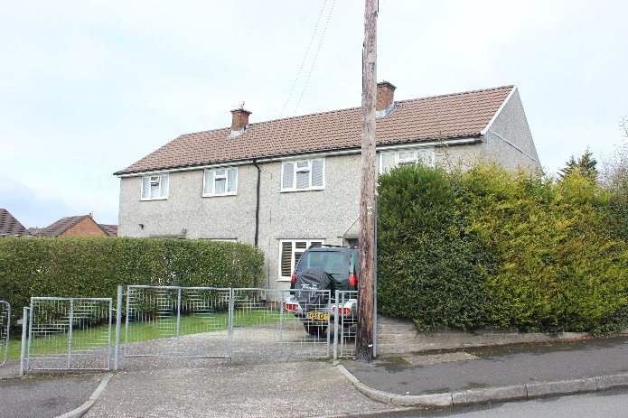
Cardiff Council social housing stock
PLUG-N-HARVEST ID: 768735 - H2020-EU.2.1.5.2.
PLUG-N-HARVEST ID: 768735 - H2020-EU.2.1.5.2.
2

Slide 3
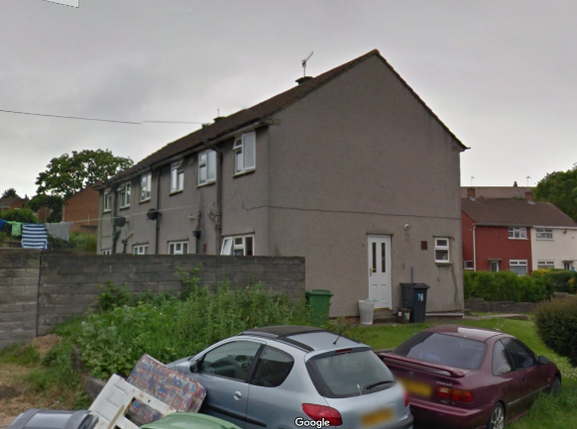
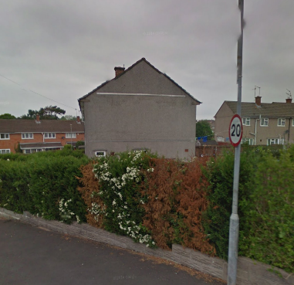
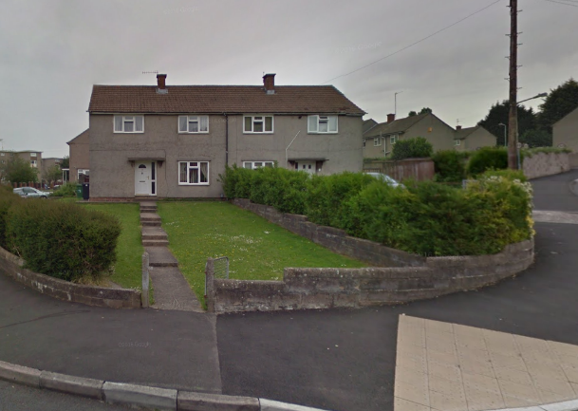
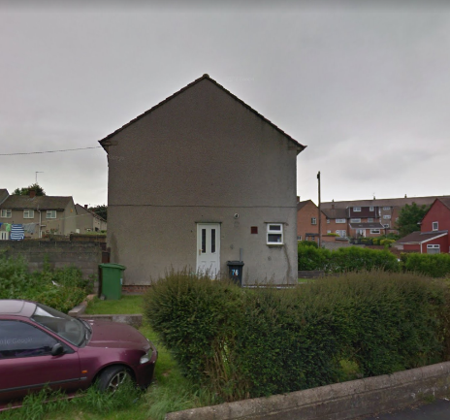
Elevations with retrofitting positions
East
South
West
North
PLUG-N-HARVEST ID: 768735 - H2020-EU.2.1.5.2.

Slide 4
Progress on tenders
Sensors/Meters
Council IT used project ‘proposed list of equipment’ to select wireless sensors/meters (Oct-Nov 2018).
Require further guidance on wireless options for compatible electricity, gas and thermal meters downstream of the existing energy supplier statutory meters (gas & electric).
Will request project approval for final selection of type & number of sensors/meters to meet project KPIs, but while also minimising impact to tenants (December 2018).
No ‘window contact sensors’.
Council IT will install sensors/meters and use project provided information to configure the sensors/meters – MAY REQUIRE SPECIFIC SUPPORT FROM PROJECT PARTNERS? (Jan –Feb 2018)

Slide 5
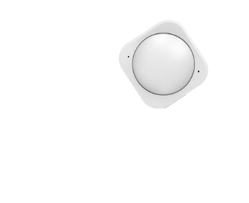
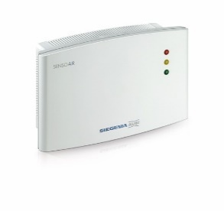
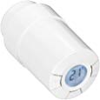
Aeotec Multisensor 6 (x8)
Rasberry Pi 3 Gateway (x1)
Sensoair RF / Z-Wave CO2 Sensor (x2)
Aeotec Zstick Gen 5 (x1)
Popp POPE010101 Z-Wave Radiator Thermostat (x8)
Popp POPE005206 Z-Wave Weather Sensor (x1 between properties)
NETGEAR 11AC 1200 Mbps (x2)

Slide 6
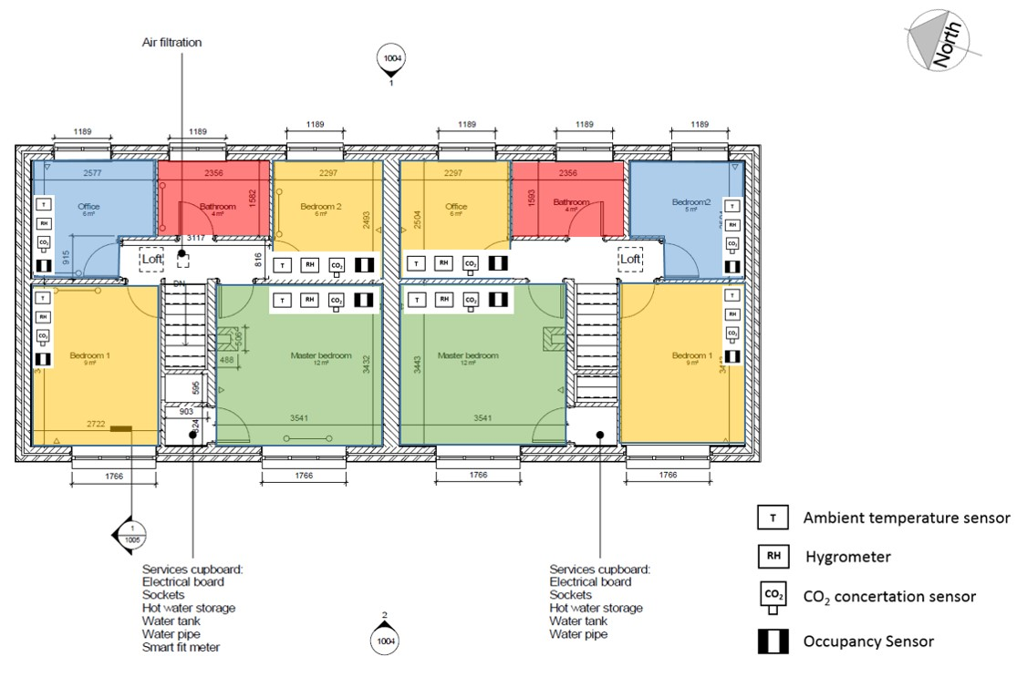

Slide 7
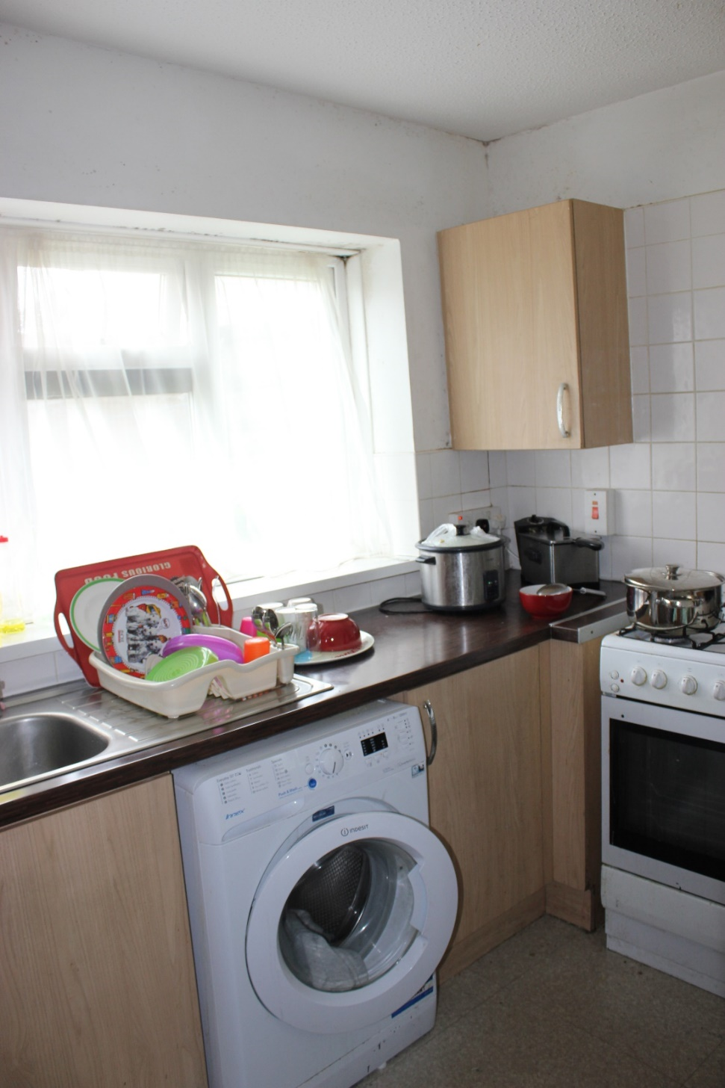
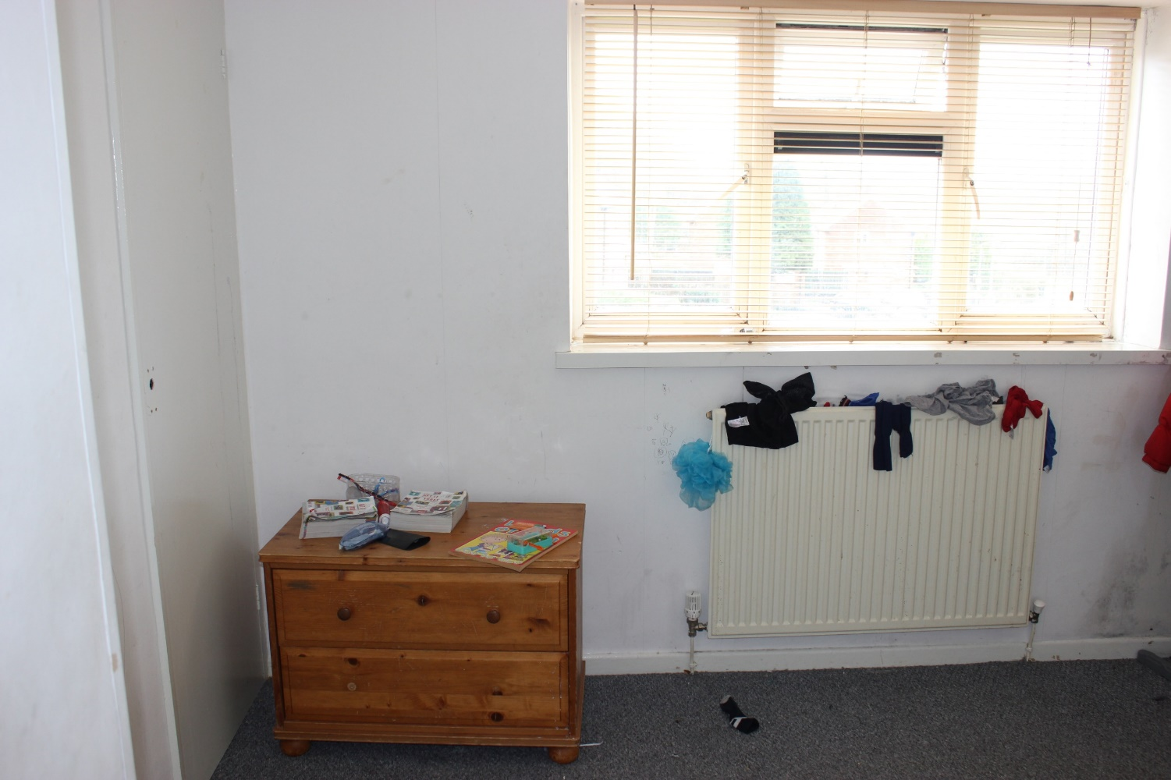
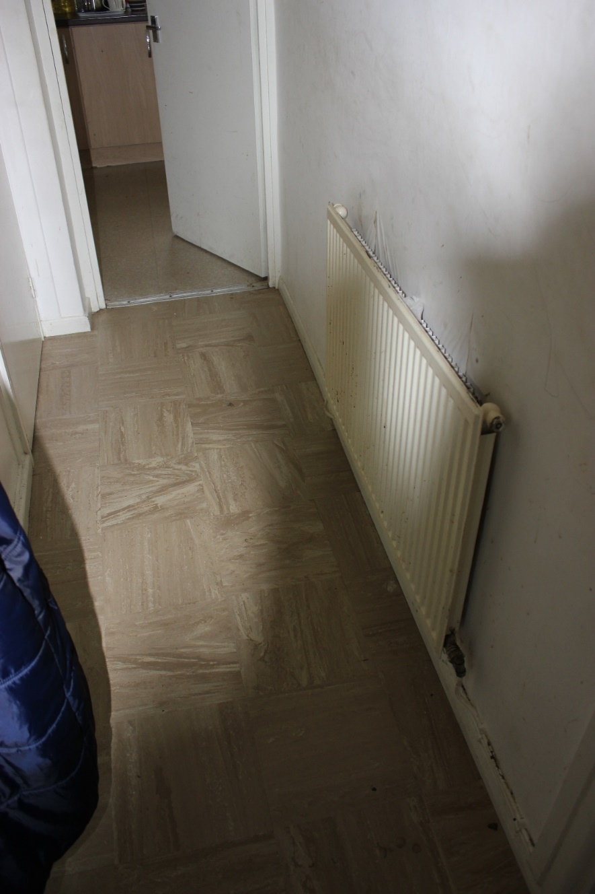
74 Uphill Road - interior

Slide 8
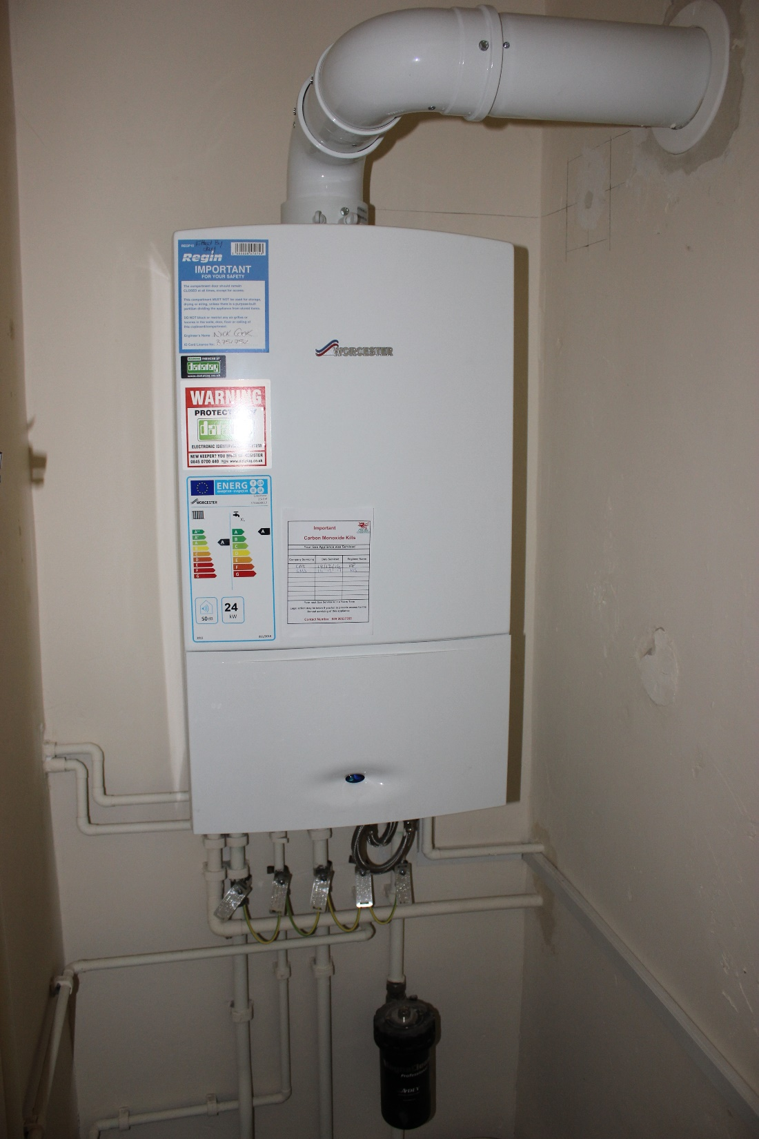
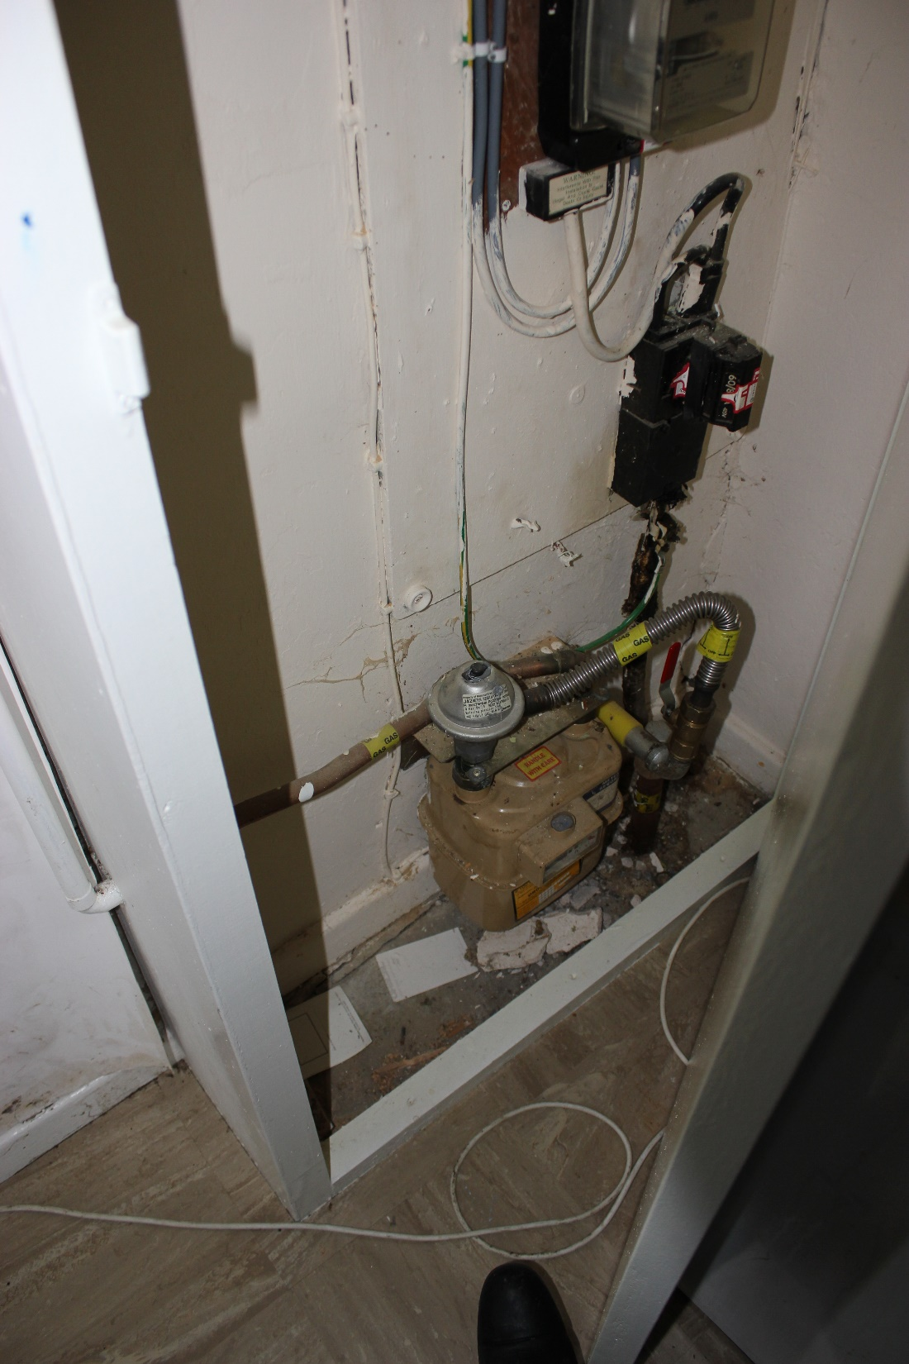
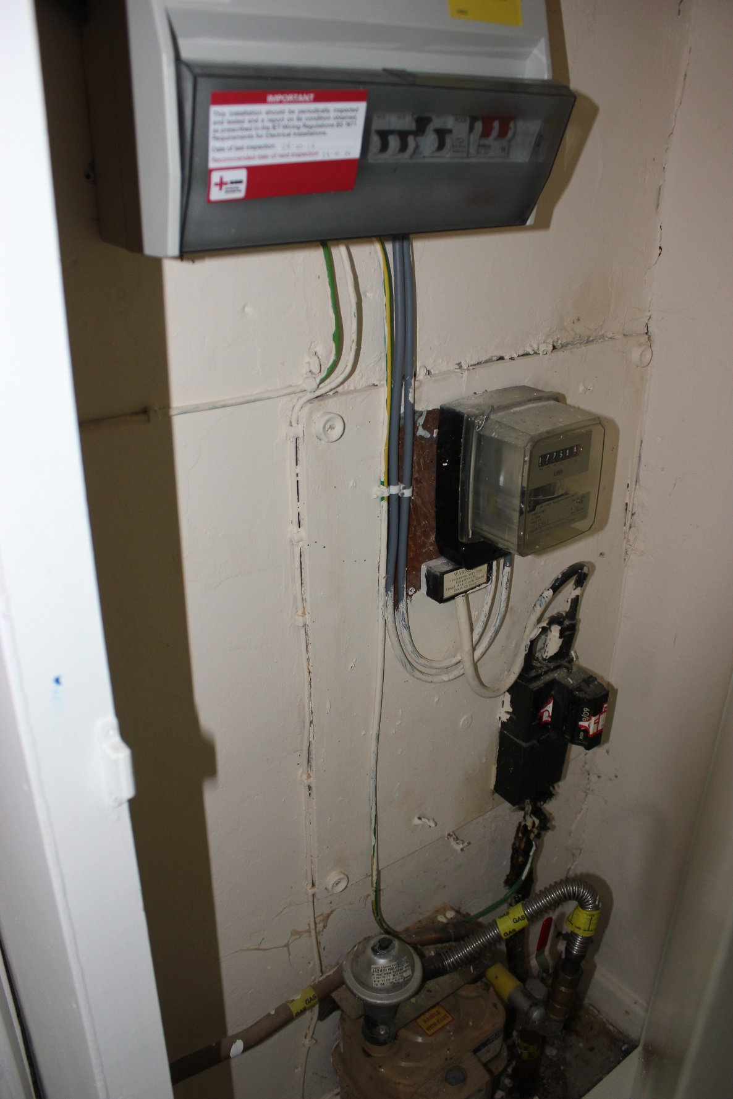

Slide 9
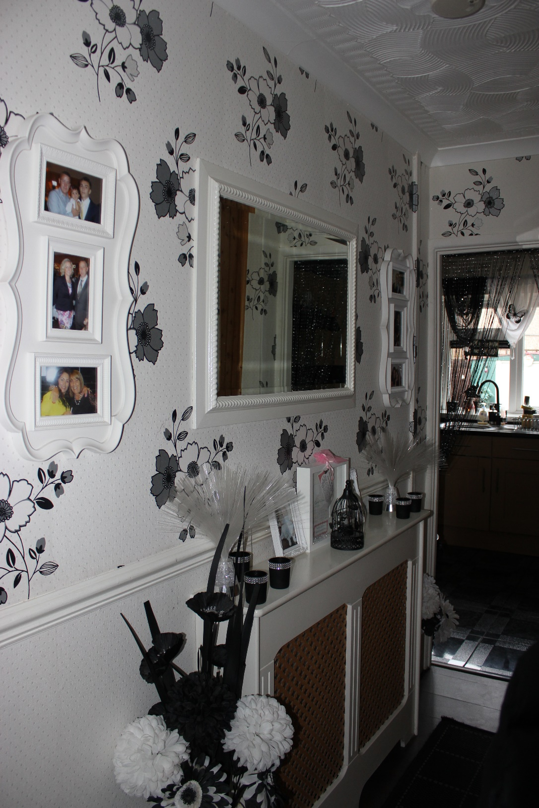
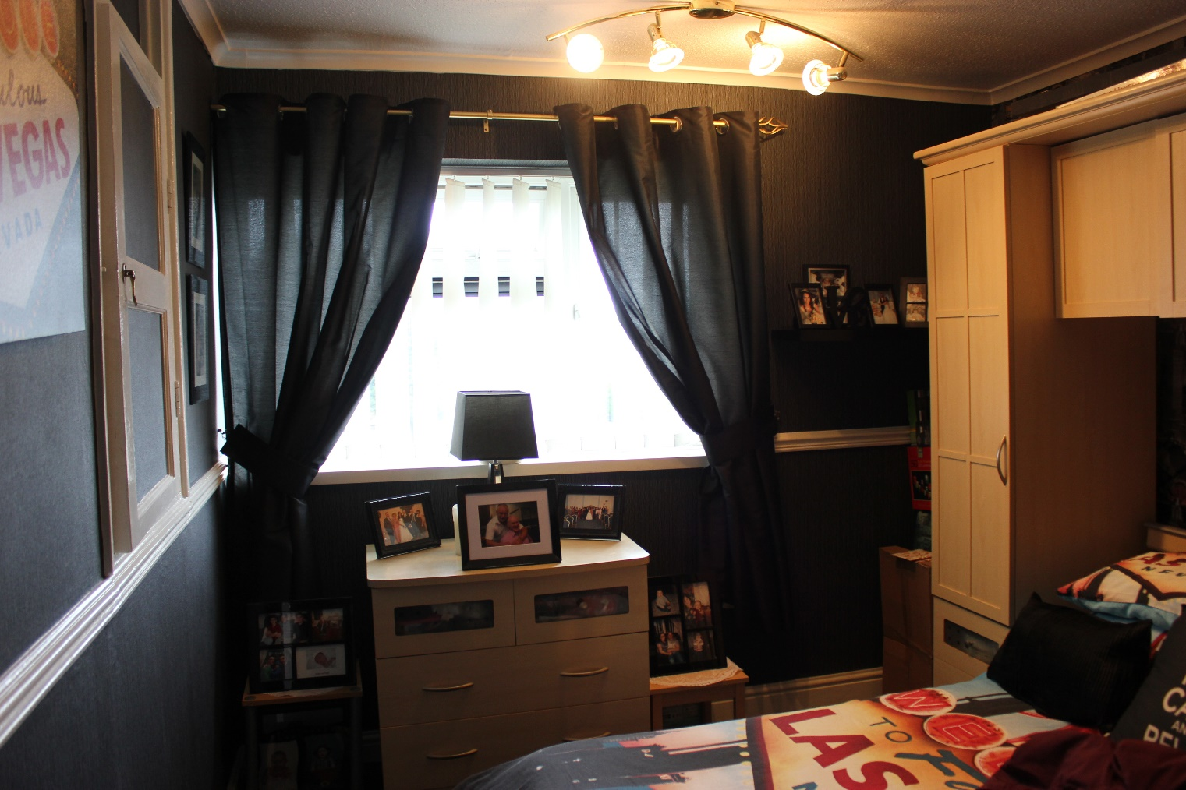
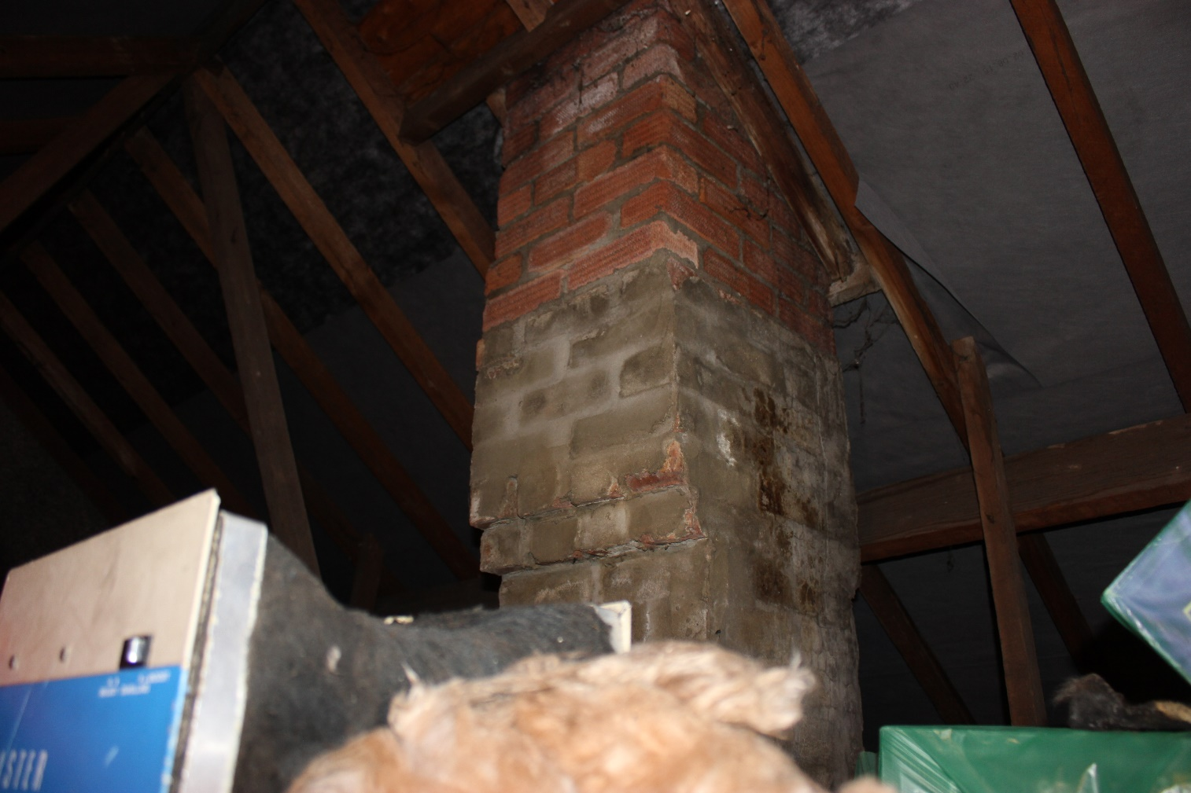
76 Uphill Road - interior

Slide 10
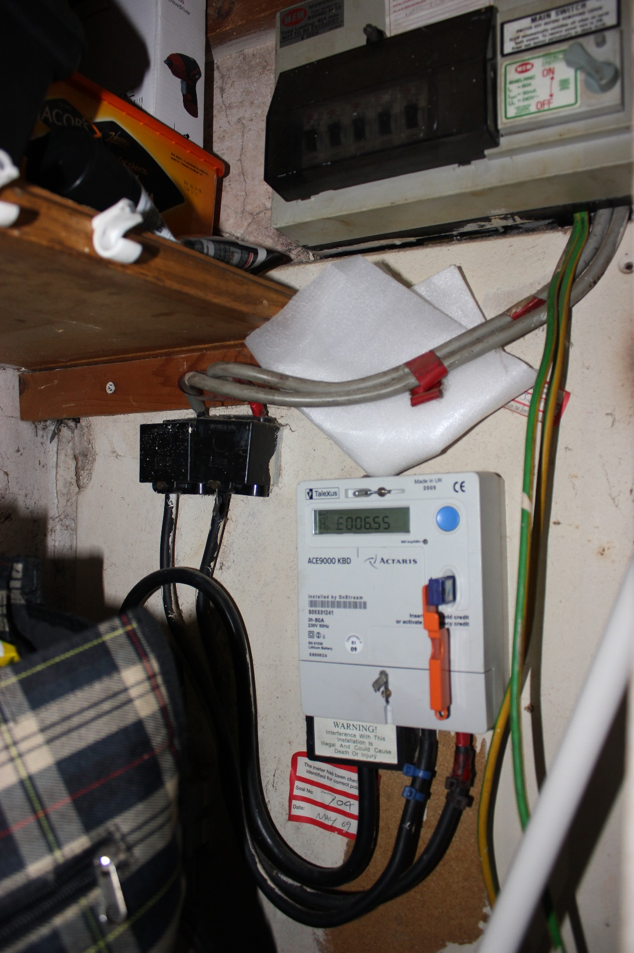
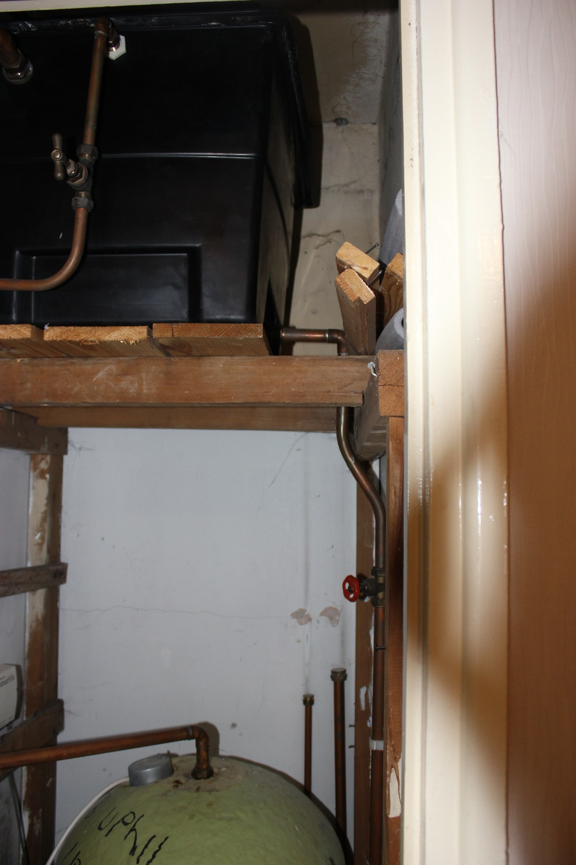
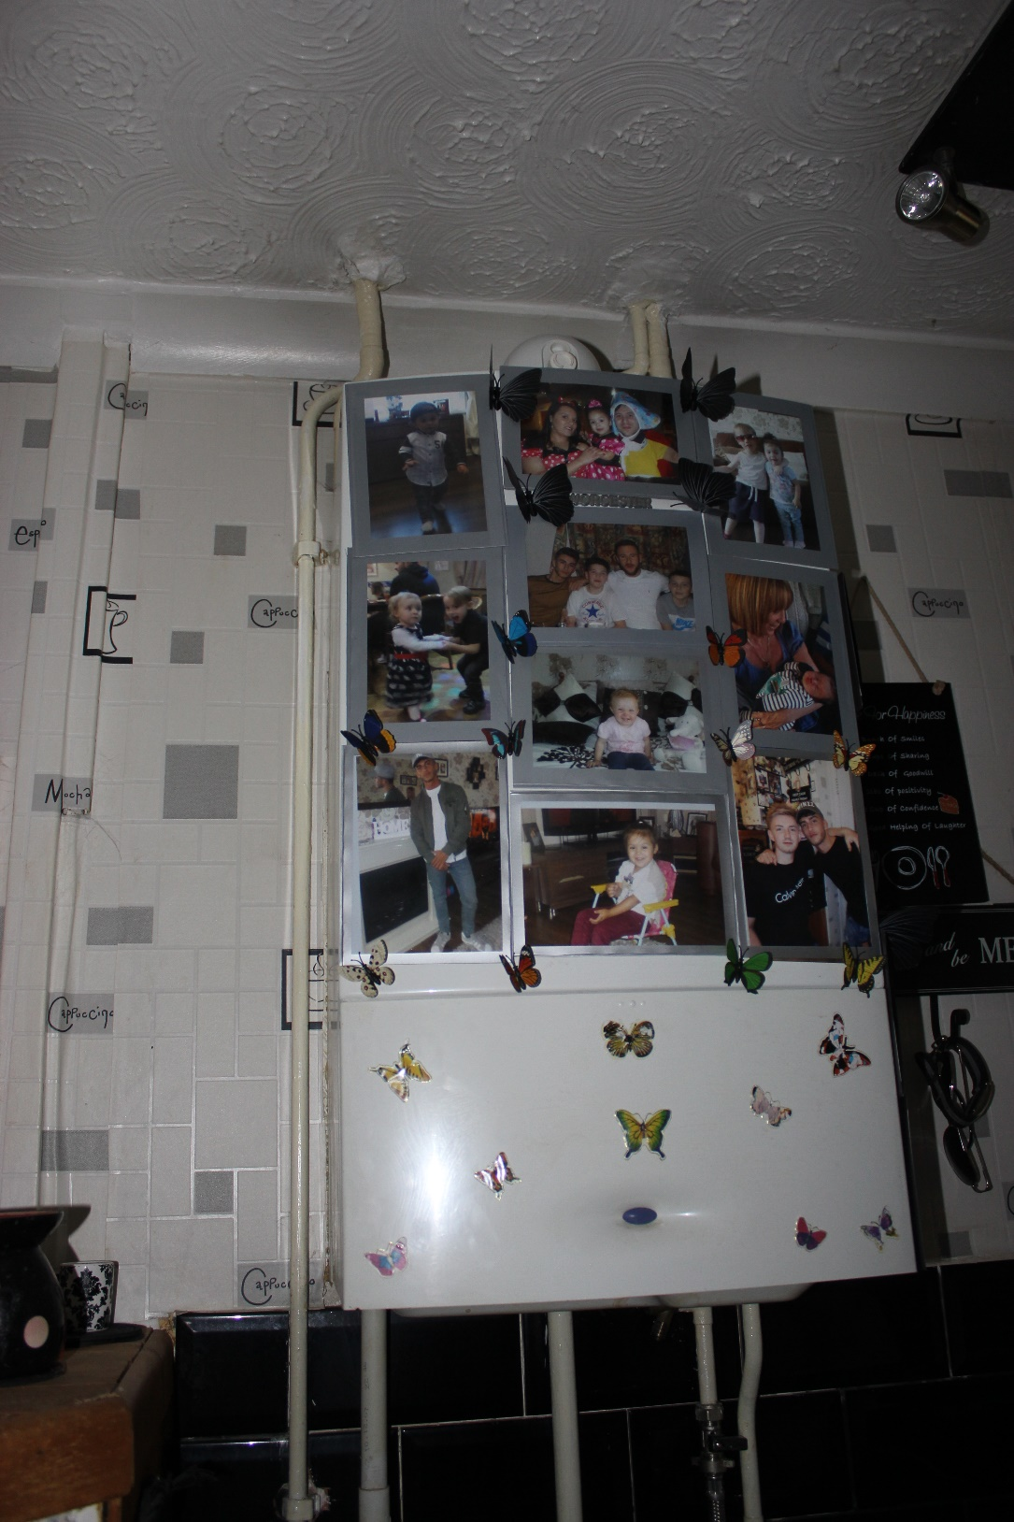

Slide 11
Pilot site survey
WP 1.3 Analysis of building types and construction requirements
Cardiff University Building information survey - Surveyors and structural engineers contracted:
Interrogatable Revit files for internal and external dimensions – floor and elevation plans.
Internal and external images to support floor and elevation plans
Wall construction detail and load bearing capacity.

Slide 12
Design considerations
How the modules will deal with junctions and interfaces, i.e.
o building corners,
o interface with existing roof line, eaves, soffits, etc?
o re-installation of rainwater goods, external flues and sockets etc,
• Joints/Gaps between panels – analysis of
o Visual appearance
o Rainwater ingress
o Thermal bridging

Slide 13
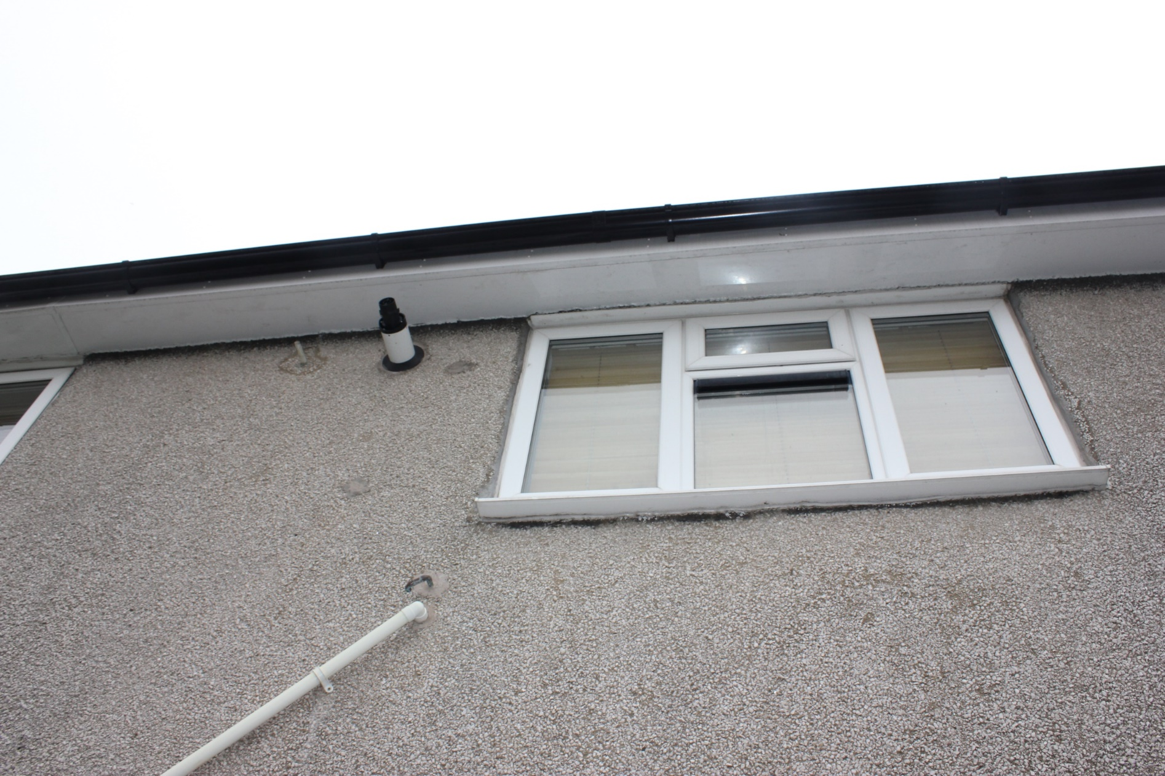
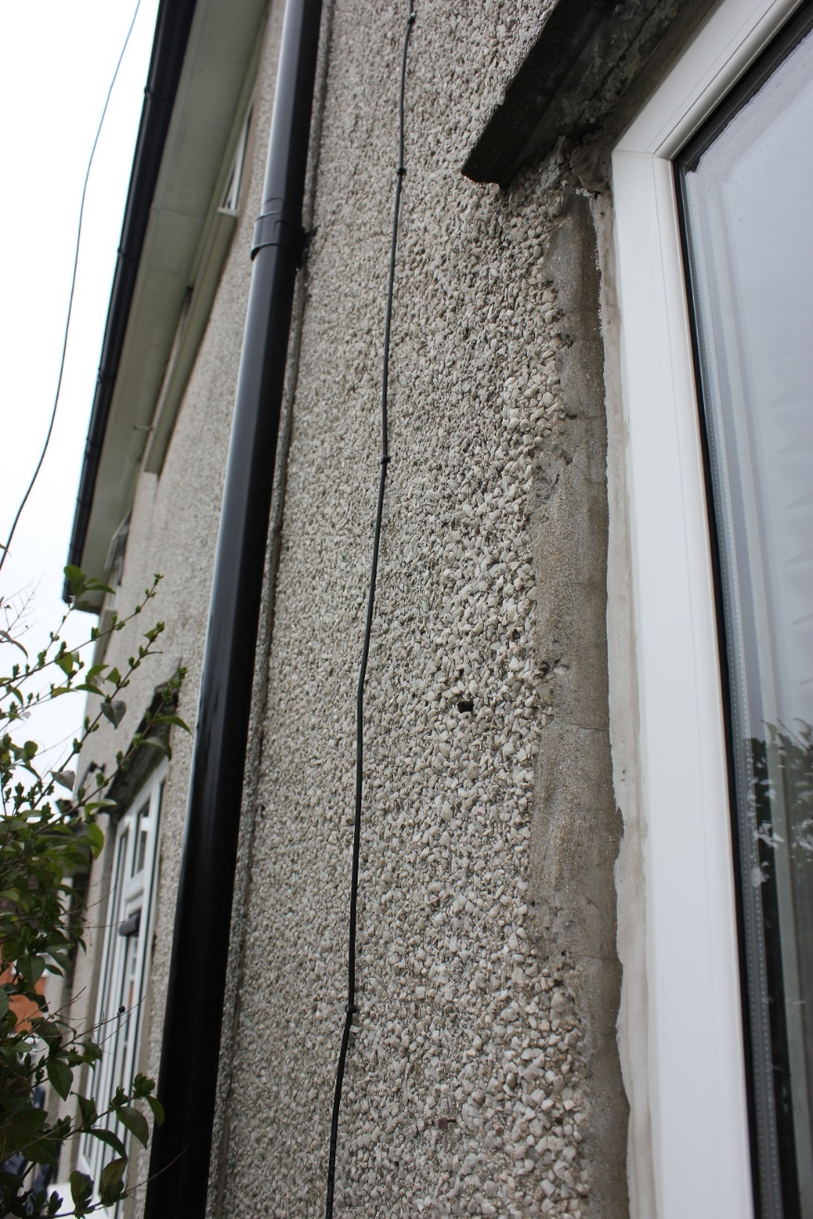
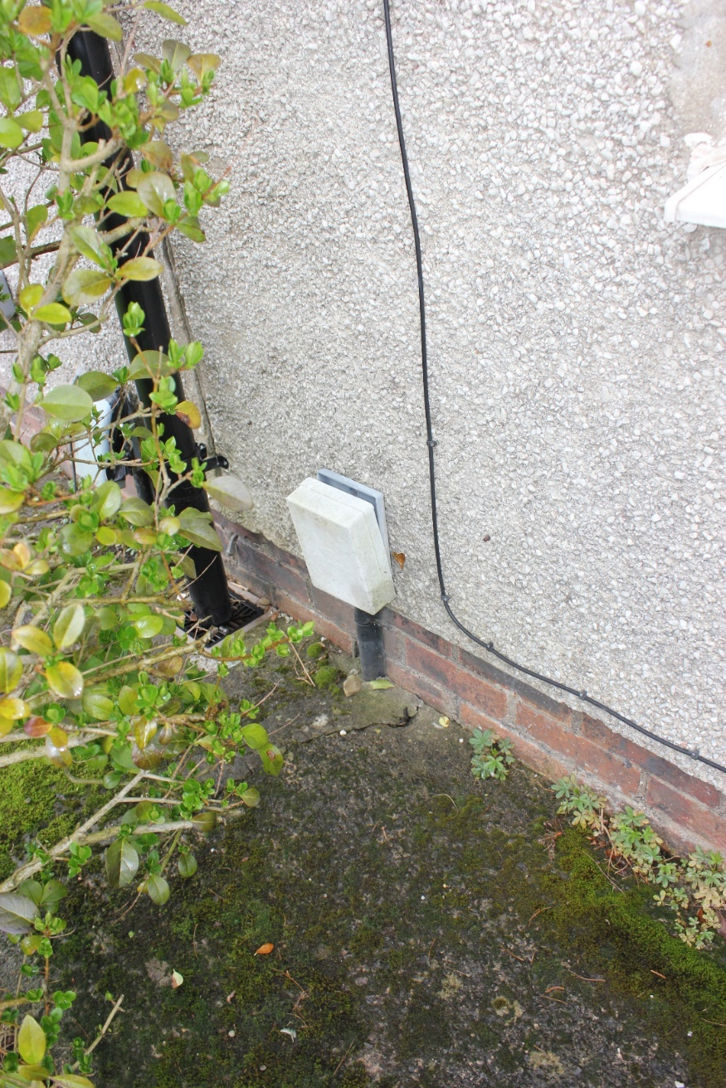
External features

Slide 14
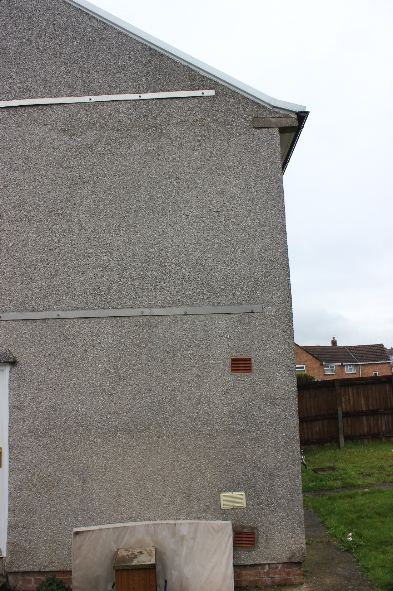
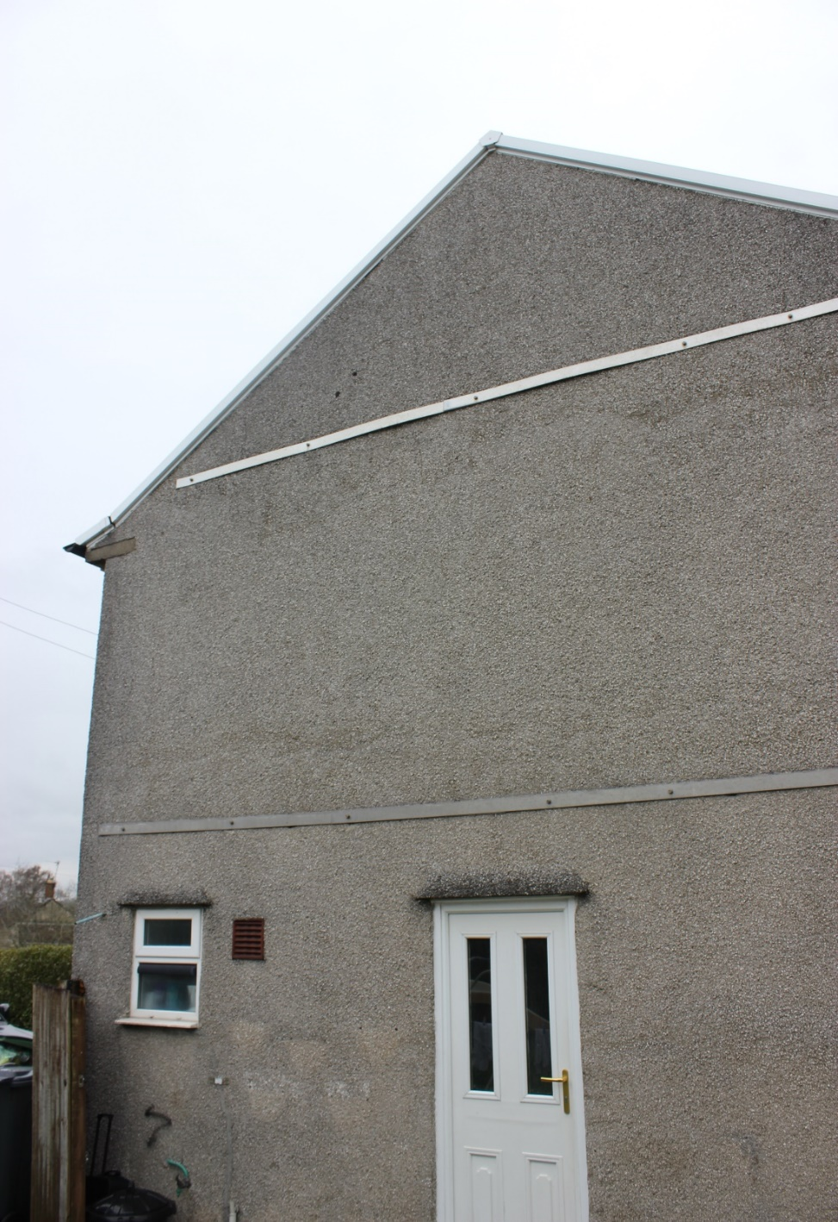
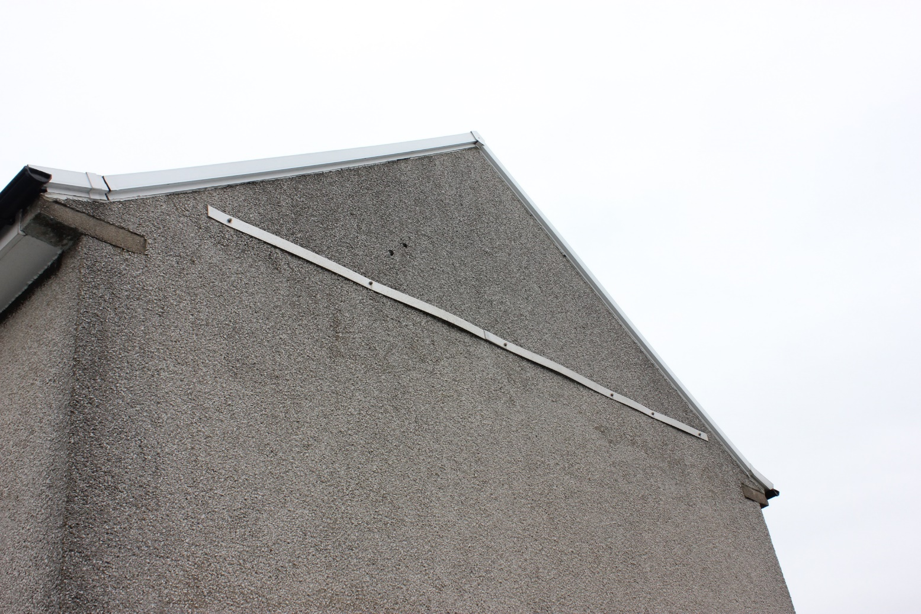
South elevation

Slide 15
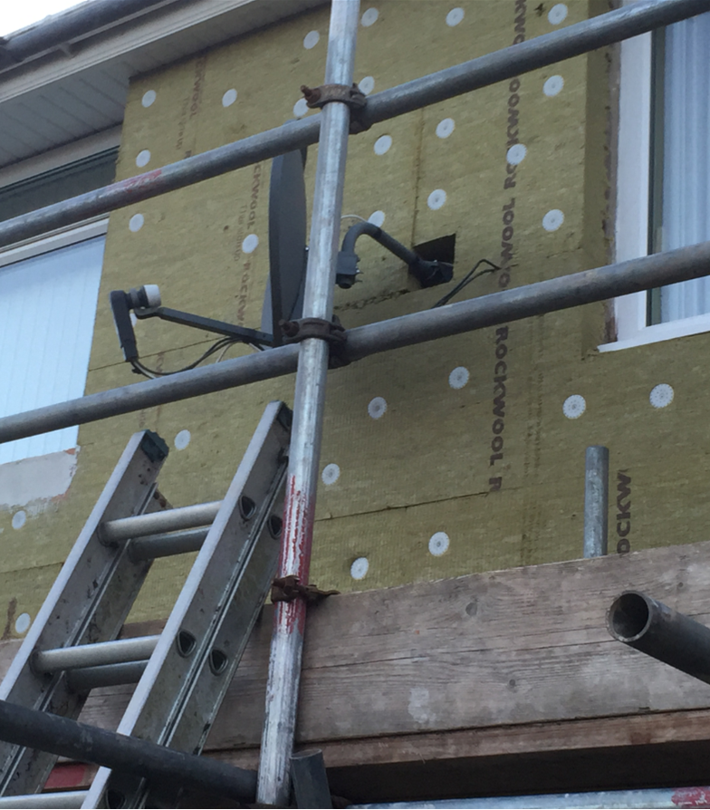
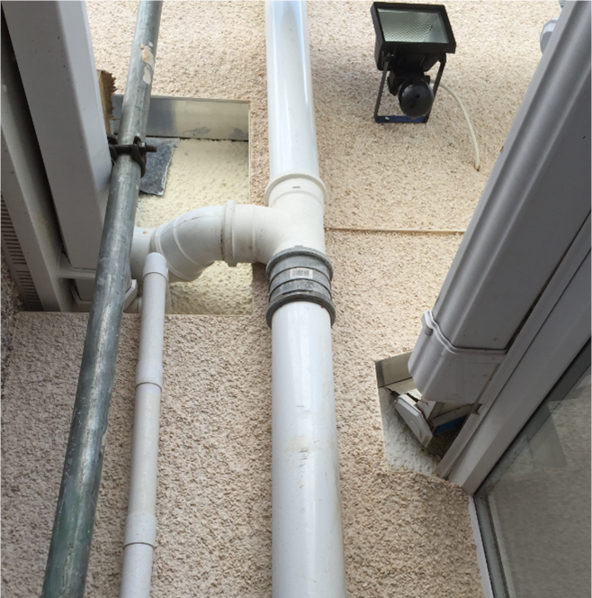
Design considerations Bad examples and lessons learned
Areas cut back to allow for pipes etc should be avoided or made as small as possible and sealed off, to avoid cold spots and potential water ingress.
Anything to be attached to the EWI, e.g. lighting, should have suitable boarding attached to building prior to EWI and special screws to fix to EWI to avoid water ingress.
Avoid cutting into EWI for external fittings

Slide 16
Other considerations
• Window element. Which configuration would work and, if existing windows perform well, could this be excluded?
• Possible combination with regular EWI – how might interface work - for frame and render application ?
• Range of architectural finishes?

Slide 17
Progress on tenders
PnH system
Procurement of a ‘Design [from outline concept] and build’ package from capable local contractor. Potential with CU contractor will be challenging?
Scope for manufacture and install procurement under “Pre-Commercial Procurement” rules.
Need to understand IP structure, potential for “licencing” the solution, and how far to incentivise tenderers.
Insulation to N, E & W elevations.
Insulation + renewable energy technology to South elevation.
Need to understand “quality Assurance” sign-off process – for the PnH team or the Sub Contractor??.
12 months monitoring required before start of PnH installation?

Slide 18
THANK YOU
PLUG-N-HARVEST ID: 768735 - H2020-EU.2.1.5.2.

