Slide 1
Plug-N-Harvest
WP1 and wp5
ORGANIZATION: aiguasol, CERTH, EIG
PRESENTER(S): a. Gonzalez, N. Nikolopoulos, C. SENDRA
MEETING: 2nd plenary meeting, Thessaloniki,
23RD – 24TH JANUARY 2018

Slide 2
Content
WP1 progress
  Objectives
Task 1.1 – End-User and Business Requirements
  KPI definition
    LEVEL(s) framework
    PnH Key Objectives
  KPI external validation
    Current status
    Next steps
  KPI development
    Current status
    Next steps
Tasks 1.2 & 1.3 – Use Cases, test scenarios and evaluation plans; Bulding types and Construction requirements
Task 1.4 – PnH architectural design, functional and technical specifications
Task 1.5 – Active-façade CFD simulation

Slide 3
Content
WP5 progress
  Objectives
Task 5.1 – Circular Economy Design Delimitants and Material Database
  Circular Economy Design Delimitants
    Current status
    Next steps
  Material Database
Task 5.3 – Life-cycle Costing analysis
Task 5.6 – Circular Economy Business Models and Exploitation Plans
  Circular Economy Business Models
    Current status
    Next steps
  PnH partners questionnaire regarding CEBM and Exploitation plans
    Current status
    Next steps

Slide 4
WP1 Objectives
The objectives of WP1 are:
  Systematically formalise all initial stakeholders‘ requirements
  Provide inputs for technical and non-technical work packages and align with validation activities
  Perform thorough pilot surveys to identify special needs and existing infrastructure of pilot premises
  Elicit the generic and specific User & Business Requirements and perform requirements refinement based on lessons learned
  Prepare a pilot evaluation and system validation framework
In particular, most of the requirements are expressed in Key Peformance Indicators (KPIs)

Slide 5
WP1 Timeline
Q1
Q2
Q3
Q4
Q5
Q6
Q7
Q8
Q9
Q10
Q11
Year 1 Year 2 Year 3
D1.1, D1.2, D1.3
Final
D1.4, D1.5
Final
T1.4, T1.5 Start
T1.1, T1.2, T1.3
Start
T1.4, T1.5 End
T1.1, T1.2, T1.3
End
D1.4, D1.5
First
D1.1, D1.2, D1.3
First

Slide 6

Task 1.1 KPI setting methodology –
LEVEL(s) Framework
The reference methodology and framework taken as the starting point in Task 1.1 is the Level(s) methodology
Level(s) has been developed as a common EU framework of core indicators for the sustainability assessment of office and residential buildings
  It provides a set of indicators and common metrics for measuring not only the environmental performance but also other relevant indicators of health and comfort, life cycle cost and potential future risk to performance
  It is a voluntary reporting framework
Level was chosen as a reference framework for the definition of the KPIs of the project because it is specifically developed as a tool for designing and constructing sustainable buildings under the Circular Economy (CE) principles.
  PLUG-N-HARVEST deals with building renovations applying the CE principles
The use of Level methodology will ease the environmental performance assessment of the whole solution and its comparison with other buildings designed or renovated under the CE principles

Slide 7

Task 1.1 LEVEL(s) Methodology – Dissemination activity with GBC
Level methodology is currently under a testing phase; during 2018 a beta tester process will be implemented allowing to fine tune the methodology. It’s also planned to introduce new basic tools (probably in excel format) to easily implement the methodology, at least at a comparative level.
It’s considered relevant the engagement in this testing phase, in order to compare the Plug&Harvest results but also to disseminate the project.
The dissemination and implementation of the Level(s) methodology, and the beta test process, will be done through the Green Building Challenge national sections. AIGUASOL has engaged in conversations with GBC Spain and JRC (the Level(s) developers) to include PLUG-N-HARVEST pilots as beta-testers of the Level methodology, which would increase project‘s visbility and relevance

Slide 8
Task 1.1 KPI setting methodology –
PnH Key Objectives
When adapting the Level framework to the PLUG-N-HARVEST objectives, a gap was observed between PnH‘s Key Objectives and Level‘s Macro-objectives
  New Macro-objectives had to be defined to properly address some of the project‘s Key Objectives (KO)
  Some KPIs were duplicated as they address a certain aspect of the whole building, and PnH‘s KO particularize the building in different subsystems
    ADBE
    IMCS
    OEMS
    ...
The use of PnH‘s KO seemed the better approach to better define the reference framework for each partner and the entire project‘s performance assessment

Slide 9
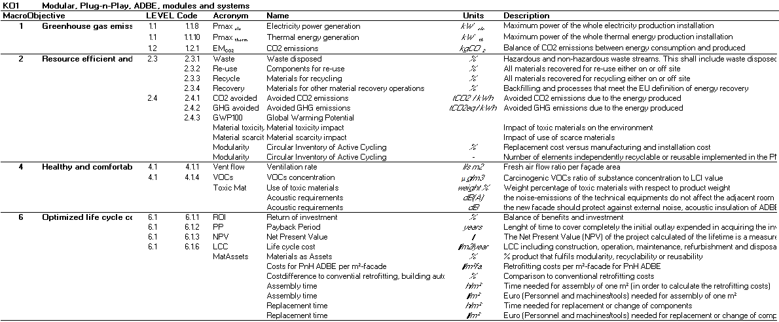
Task 1.1 KPI setting methodology –
PnH Key Objectives

Slide 10
Task 1.1 current status
OCT
NOV
DEC
JAN
FEB
MAR
APR
MAY
JUN
JUL
AUG
2018
2017
D1.1ª
Final
KPI list 1st Proposal (ALL)
KPI list Internal Validation (ALL)
KPI definitive list (External Survey) (ALL)
KPI methodologies developed (ALL)
D1.1a Final Version 1st Draft (AIGUASOL, ALL)

Slide 11
Task 1.1 next steps
JAN
FEB
MAR
APR
MAY
JUN
JUL
AUG
2018
D1.1ª
Final
KPI methodologies developed (ALL)
+
Workshop to discuss (ALL)
KPI definitive list (External Survey) (ALL)
KPI assignment for methodology development (AIGUASOL, ALL)
D1.1a Final Version 1st Draft (KPI Methodologies defined) (AIGUASOL, ALL)

Slide 12
Task 1.1 progress – External Survey
The external survey has been sent to:
138 external stakeholders from AIGUASOL‘s side
  26% opens
  8% clicks
94 external stakeholders (proposed by PnH partners)
Current participation:
8 answers
  75% from Spain (Barcelona, Murcia)
  25% from UK
Data from MailChimp

Slide 13
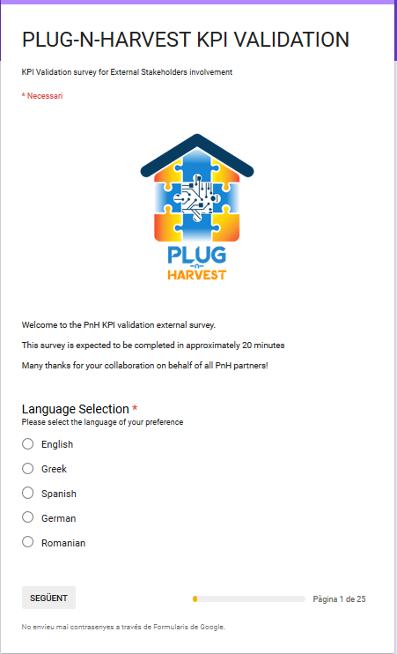
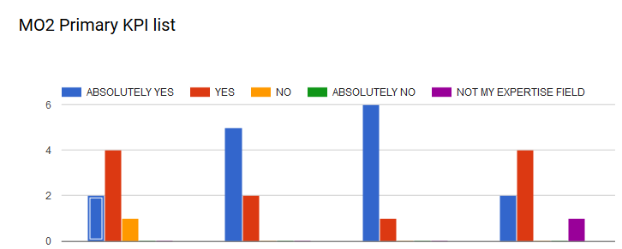
Task 1.1 progress – External Survey

Slide 14
Task 1.1 progress – External Survey
Upcoming tasks for the following weeks:
Keep encouraging potentially interested external parties to answer the External Survey
  All partners
One ‘country responsible‘ should keep track of participation
  CERTH – Greece
  ETL – UK
  SIEMENS – Romania
  RWTH – Germany
  AIGUASOL – Spain

Slide 15
Task 1.1 upcoming tasks– External Survey
JAN
1st FEB
14th FEB
28th FEB
The Main Objective of the External Survey is to validate the KPI list interally generated
Concurrently, it can be used as a dissemination strategy for PnH partners
2018
External Survey launch (AIGUASOL)
Sending of reminders (ALL)
External Survey end
KPI definitive list (External Stakeholders)

Slide 16
Task 1.1 progress – KPI development
Each KPI is assigned to a partner from the consortium for its definition and methodologies development
  Some KPIs will be developed in accordance with other partners who are expected to provide relevant inputs
A two-week period will be given to close the KPI assignment
Two months will be given to develop all KPIs definition and methodologies development
PARTNER | RESPONSIBLE | COLLABORATOR
CERTH | 6 | 10
RWTH | 6 | 8
CU | 0 | 10
ALUMIL | 4 | 12
AIGUASOL | 10 | 3
ODINS | 7 | 5
SIEMENS | 0 | 15
ETRA | 11 | 5
EIG | 13 | 4
ETL | 10 | 0
AHC | 0 | 3
RWM | 0 | 3
CCC | 0 | 3

Slide 17
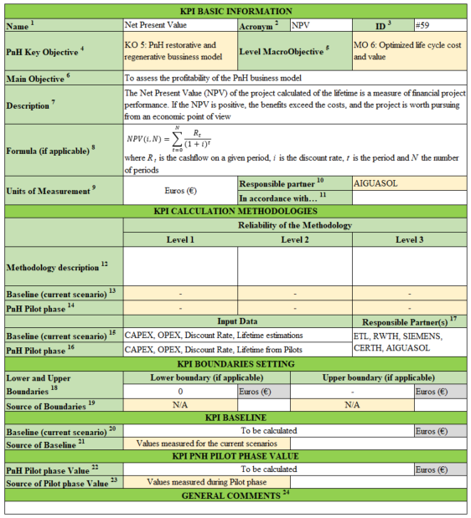

Task 1.1 progress – KPI development: Summary sheet
Color KEY:

Slide 18
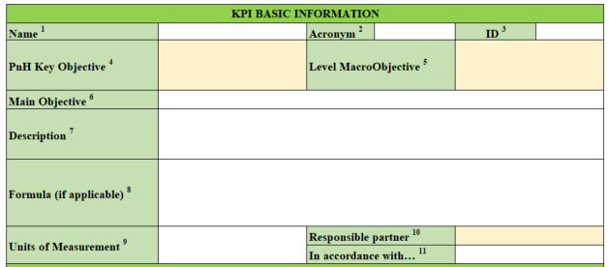
Task 1.1 progress – KPI development: Summary sheet
According with provided list
Selection from drop-down list
Short description of the KPI
Main Objective of the KPI
Formula to calculate, if applicable, and Units of measurement
Partner responsible and collaborators for KPI definition.
Development of methodologies is included

Slide 19
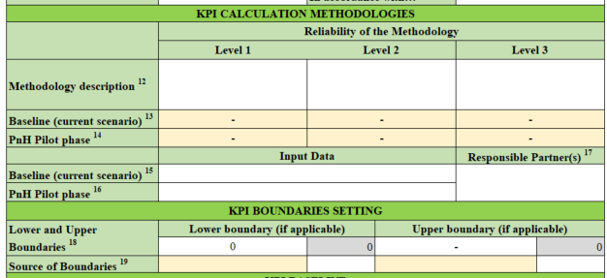
Task 1.1 progress – KPI development: Summary sheet
Responsible partner(s) of data collection
Description of the methodology at three different levels of reliability. In case of LEVEL KPIs, methodologies defined for LEVELs 1, 2 and 3 by JRC
Short description of the KPI
Reliability level for each phase of the project.
Select from drop-down list
Input data required to calculate the KPI for each phase of the project
Lower and Upper boundaries of the KPI, if applicable.
For source, select from drop-down list

Slide 20
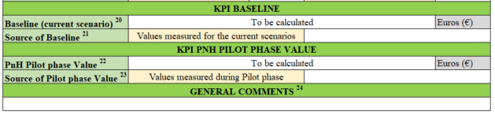
Task 1.1 progress – KPI development: Summary sheet
Additional comments, if required
KPI baseline (current scenarios value)
Source of baseline value, selected from drop-down list
KPI Pilot phase value (from Pilot demonstratives)
Source of Pilot phase value, selected from drop-down list

Slide 21
Task 1.1 progress – KPI definition
Upcoming tasks for the following weeks:
KPI assignment to PnH partners for their development
  2-week period for closing the definitive list of which KPIs are developed by each partner(s)
KPI development:
  General information: definition, units, etc.
  Methodologies definition
  Boundaries setting
Workshop to discuss the defined KPIs
KPI definition refinement
Definitive definition of all PnH project KPIs

Slide 22
Task 1.1 upcoming tasks – KPI methodologies definition
JAN
FEB
MAR
APR
MAY
JUN
2018
KPI assignment for methodologies definition (AIGUASOL)
(1st Apr) KPI methodologies developed (ALL)
(Mid-Apr) Workshop to discuss (ALL)
Methodologies refining (ALL)
KPI methodologies defined

Slide 23
WP1 – Tasks 1.2 & 1.3
Regarding building information, it will be thoroughly addressed in other parts of the Agenda of this meeting, by each bulding type

Slide 24
WP1 – Task 1.4
Task 1.4 is closely related with ADBE design and is dealt throughout today‘s Agenda (by Pilot)

Slide 25
WP1 – Task 1.5 Active-façade CFD
M15,33
M19,45
M33,48
M18,36
CFD prediction module
Dynamic energy process
engineering platform
Support RWM demo activities
LCC module

Slide 26
Task 1.5: Active-façade CFD simulation and optimization guidelines
Updated Objective: Along with Aachen, CERTH (12/01/2018, telco) has re-oriented the objective of T1.5 and its added value for PnH. The updated objective is to develop and build a CFD platform, which can operate as a feedforward toolkit for the Modelica Platform, which will be in position to evaluate and predict the overall energy performance of the active façade in terms of: a) achievable naturally driven ventilation rates (m3/h of high T), b) thermal gains considering as well c) achievable PV add-on electricity production (W).
Added value: This integrated CFD-Modelica platform will be in position to derive guidelines of how the ADBE façade is expected to operate more efficiently and maximize its energy/electricity gains. On a second level and after the definition of the optimum façade design aspects, this platform will be used as a basis for the APROS dynamic modeling of ADBE, foreseen to be conducted in WP2, as well.

Slide 27
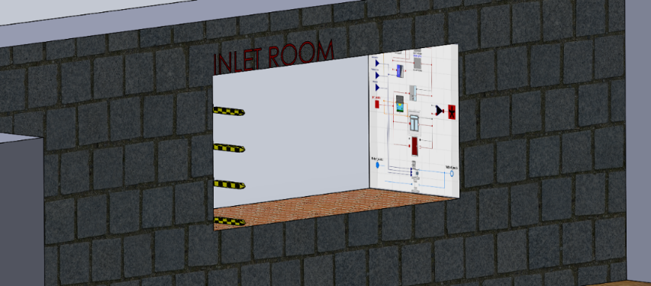
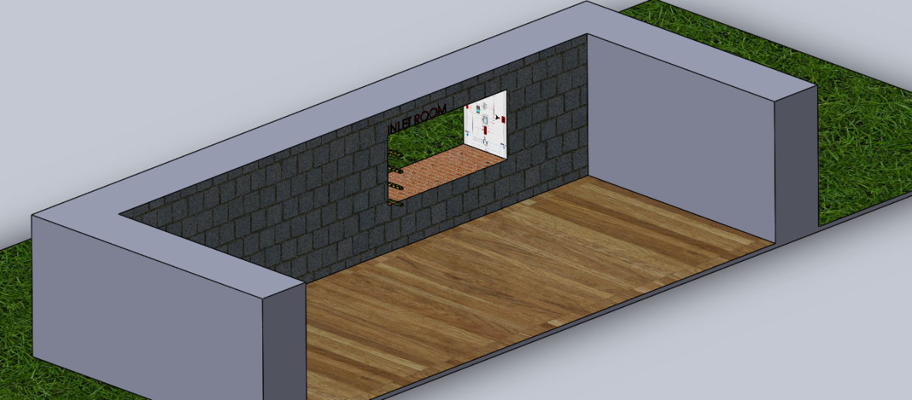
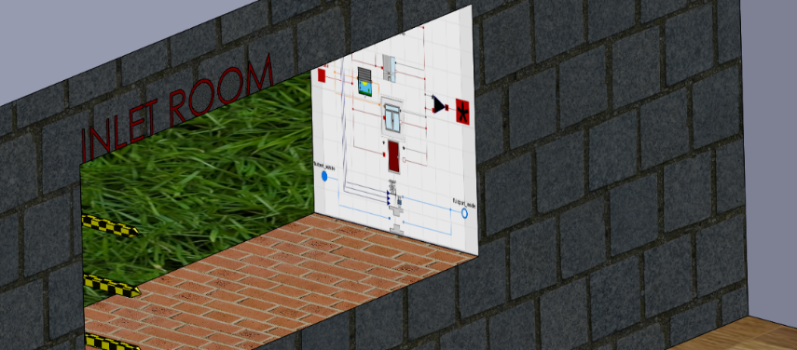
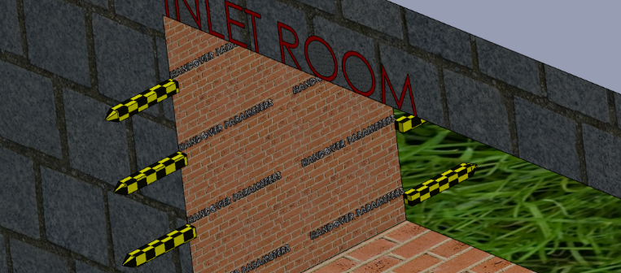
Task 1.5: Active-façade CFD simulation and optimization guidelines
Support the development of 0D models, capable of predicting the ADBE behavior, as fast and as accurate as possible;
For such a simulation, multiple “handover parameters” are defined; these act as connectors for data exchange between the ADBE façade and its surrounding environment (outer and inner)
Modelica 0D (Aachen)
Inlet
(main building volume)
Handover parameter
(ADBE->building volume)
Handover parameter
(external environment->ADBE)
ADBE (Modelica)

Slide 28
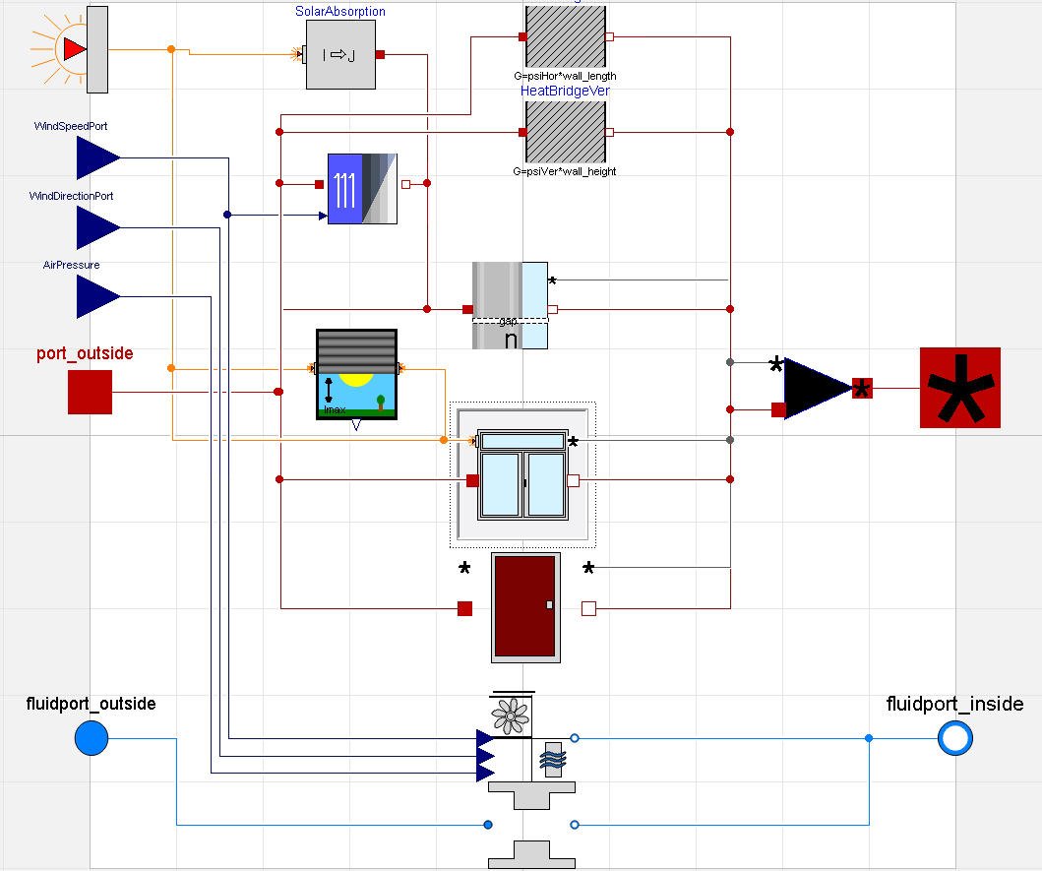
Task 1.5: Active-façade CFD simulation and optimization guidelines
Step 1: Validate/Improve 0D equations currently used in Modelica for the calculation of adjacent to ADBE (near–field) flow properties relevant to external induced far-field conditions as for example: (a) wind velocity, b) angle of attack, c) pressure, d) achievable volume flow rates entering the ducts) – Level 1 simulations
Milestone: Define a set of outside conditions
Assumption: the effect of neighborhood buildings geometry, will be omitted
Identify the range of errors expected….by the application of current standardized 0D equations (available Standards)
ADBE Façade
handover parameter
handover parameter
handover parameter
handover parameter
handover parameter
near-field
temperature
Q_flow
temperature
Q_flow
radiation
handover parameter
handover parameter
m_flow
(pressure)
m_flow
(pressure)

Slide 29
Task 1.5: Active-façade CFD simulation and optimization guidelines
Exterior Volume (from Far-Field -> Near-Field)
ADBE Façade
Step 2: Support the definition of Objectives (T2.2):
An advanced model that can predict the effect of ADBE PV element addition façade technical/operational characteristics on achievable volume and temperature inlet profiles, flowed inside the open ducts:
e.g. Temperature profiles, velocity and pressure profiles at every position adjacent to the external wall – Level 2 simulations
Limitation to be resolved: the effect of buoyancy effects on the above, can be quantified and can be integrated in the updated versions of the Modelica 0D “handover parameters” – Level 2 simulations
handover parameter
handover parameter
handover parameter
handover parameter
handover parameter
near-field
temperature
Q_flow
temperature
Q_flow
radiation
handover parameter
handover parameter
m_flow
(pressure)
m_flow
(pressure)

Slide 30

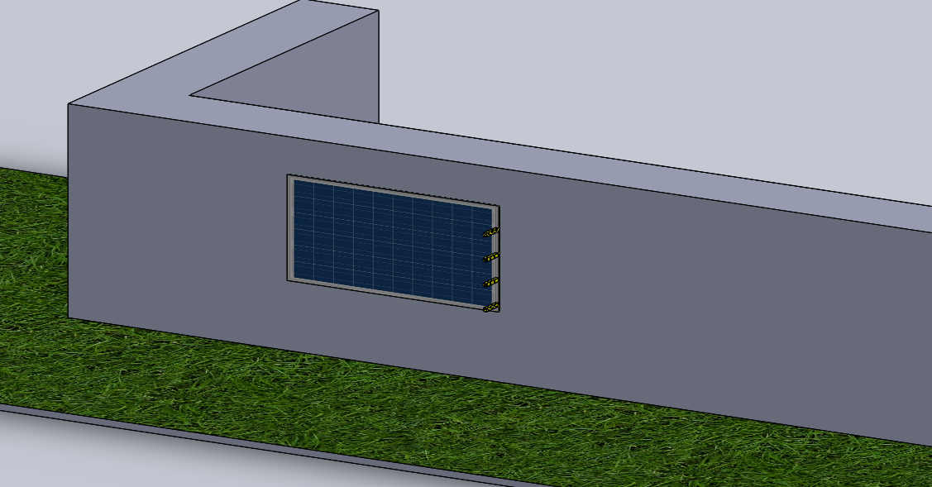
Task 1.5: Active-façade CFD simulation and optimization guidelines
Support the development of 0D models, capable of predicting the ADBE behavior, as fast and as accurate as possible
For such a simulation, multiple “handover parameters” are defined; these act as connectors.
For cases that a PV installed, which induces temperature gradients, the already available “handover parameters” in the Aachen’s Modelica platform need to be updated to consider that. Towards this objective, a range of numerical runs need to be executed, so that the 0D underpinning modules are updated to include this additional effect.
Temper. distribution
PV panel (ADBE)
Inlet
(main building volume)
Buoyancy effect that needs to be quantified in the Modelica “handover” connectors

Slide 31
Task 1.5: Active-façade CFD simulation and optimization guidelines
ADBE Façade
Building Volume (from Near-Field -> Far-Field)
Step 1: Validate the CFD model against available measurement data provided by Aachen, for isothermal conditions.
A RANS (Reynolds-Averaged-Navier-Stokes) will be applied, excluding the implementation of very highly sophisticated approaches (e.g. LES or Reynolds-Stress Models)
Objective: Identify the range of validity of 0D equations currently used in Modelica for the calculation of key performance indicators (Far-Field) relevant to thermal comfort experienced by building occupants, e.g. a) velocity profiles, b) volume distribution of aeration rates, c) temperature profiles, induced by the operation of ADBE ventilation configurations
handover parameter
handover parameter
handover parameter
handover parameter
handover parameter
temperature
Q_flow
temperature
Q_flow
radiation
near-field
handover parameter
handover parameter
m_flow
(pressure)
m_flow
(pressure)

Slide 32
Task 1.5: Active-façade CFD simulation and optimization guidelines
ADBE Façade
Building Volume (from Near-Field -> Far-Field)
The Near-Field parameters are located adjacent to ADBE (near –field) flow properties and are relevant to to (a) air volume flow rates exiting the ADBE, b) their temperature profiles, and c) its pressure profile adjacent to the duct outlet – Level 1 simulations
Milestone: Define a set of measurement campaigns
Assumption: the flow is considered as isothermal; thus for the validation no considerable heat exchanging mechanisms will be accounted for
Identify the range of validity expected….by the application of current MODELICA 0D equations
handover parameter
handover parameter
handover parameter
handover parameter
handover parameter
temperature
Q_flow
temperature
Q_flow
radiation
near-field
handover parameter
handover parameter
m_flow
(pressure)
m_flow
(pressure)

Slide 33
Task 1.5: Active-façade CFD simulation and optimization guidelines
ADBE Façade
Building Volume (from Near-Field -> Far-Field)
Step 2: Support the definition of Objectives (T2.2):
An advanced model that can predict the effect of ADBE façade technical/operational characteristics on achievable volume and temperature thermal comfort performance indicators:
e.g. Temperature profiles, velocity and pressure profiles at every position of the building (define area of interest), extrapolation of 0D equations better describing the heat transfer coefficients (e.g. Nusselt equation) adjacent the building ADBE inner surface – Level 2 simulations
handover parameter
handover parameter
handover parameter
handover parameter
handover parameter
temperature
Q_flow
temperature
Q_flow
radiation
near-field
handover parameter
handover parameter
m_flow
(pressure)
m_flow
(pressure)

Slide 34
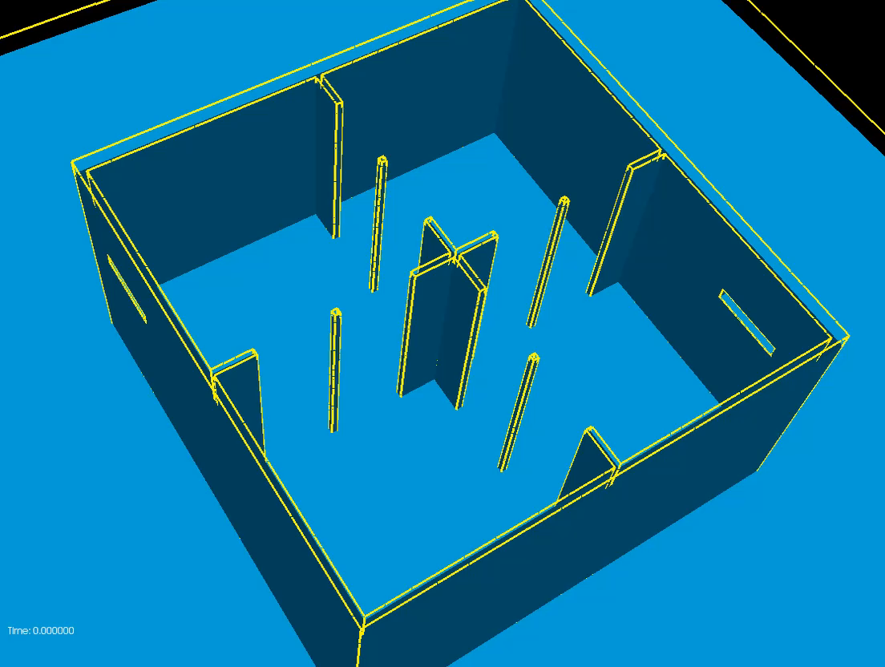
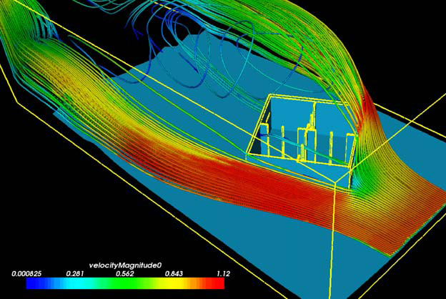
Task 1.5: Active-façade CFD simulation and optimization guidelines
A typical example:
References: T.S. Larsen, N. Nikolopoulos, A. Nikolopoulos, G. Strotos, K.-S. Nikas. Characterization and prediction of the volume flow rate aerating a cross ventilated building by means of experimental techniques and numerical approaches. Energy and Buildings, Volume 43, Issue 6, (2011), 1371-1381.
K.-S. Nikas, N. Nikolopoulos, A. Nikolopoulos. Numerical study of a naturally cross-ventilated building. Energy and Buildings 42, (2010), 422-434.

Slide 35
Task 1.5: Active-façade CFD simulation and optimization guidelines
ADBE Façade
ADBE system (itself) (from Near-Field -> Far-Field)
Step 3: Support the definition of Objectives (T2.2):
CFD can enhance the optimization of ADBE individual components, being embedded in the Modelica platform, by Aachen.
Again this can be done by individual components operation representation and data exchange following a “handover parameter” approach.
This list of components will be discussed in the course of the project, upon available time and resources.
Level 3- simulations
Example: handover parameter

Slide 36
Task 1.5: Active-façade CFD simulation and optimization guidelines
Step 1- Validation of the CFD model (Jan 2018-)
Aachen has conducted measurements in well controlled building volumes, as concerns ventilation systems. Aachen has provided CERTH with corresponding geometry and operational data, which will be used to develop, formulate and run the CFD model;
Comparison of the numerical results against experimental data as concerns velocity profiles at different locations will be made;
Similar studies can be tracked in the open literature;
The innovation lies on the coupling of CFD platforms with 0D model approaches, being in position to simulate the behavior of energy systems (e.g. innovative ones as that of ADBE active façade);
The objective of CFD is to increase the accuracy of such systems, especially for the case of components for which no previous experience and/or simplified equations exist (e.g. in our case the effect of PV panels on temperature profiles and achievable aeriation rates).

Slide 37
WP5 Objectives
The objectives of WP5 are:
  Develop business models for each one of the demo cases, adjusting to their singularities, technical and financial boundary conditions and national regulations, in order to obtain viable models based on renting and leasing options
  Design a modular ADBE solution (product & system) consistent with the concepts of circular economy
    The use of reusable non-toxic and recyclable materials and components for all demo cases implementations, and define market materials alternatives for the replicability
    The very low-cost installations for implementing the developed solutions, specifically the ADBE and IMCS ones
    Guarantee maximum energy reductions and maximum energy harvesting, allowing for reliable and measurable leasing/renting conditions required for all the involved actors of the business models
    Dimensioning and scalability of the business models at district scale, through link of the inputs and outputs of optimal energy management systems (OEMS) to the financial models
    Synthetize, define and automatize specific LCA and LCC KPIs’ as the basis of the development of the specific CAPEX and OPEX models to be implemented in the businesses strategies in general, and specifically for the demo cases

Slide 38
WP5 Timeline
Q1
Q2
Q3
Q4
Q5
Q6
Q7
Q8
Q9
Q10
Q11
Q12
Q13
Q14
Q15
Q16
Year 1 Year 2 Year 3 Year 4
D5.3, D5.4, D5.5, D5.6.1, D5.6.2
Final
D5.1.1, D5.1.2
Final
D5.5, D5.6.1, D5.6.2
Third
D5.2.2
Final
T5.2
Start
T5.3
Start
T5.4
Start
T5.1, T5.5,
T5.6
Start
D5.2.1 Final
D5.2.2 First
T5.3, T5.4, T5.5, T5.6
End
D5.5, D5.6.1, D5.6.2
First
D5.1.1,
D5.1.2,
D5.2.1
First
D5.5, D5.6.1, D5.6.2
Second
D5.3, D5.4
First
T5.1
End
T5.2
End

Slide 39
WP5 current status
NOV
DEC
JAN
FEB
MAR
APR
MAY
JUN
JUL
AUG
SEP
OCT
NOV
DEC
JAN
FEB
MAR
2018
2017
Partners’ Business Models & Direct/Indirect Exploitable Results identification (ALL but AHC, RWM, CCC LL)
Market Analysis, Development of CEBM for PnH DER (ALL but AHC, RWM, CCC)
CE Design Guidelines 1st Draft (EIG, AIGUASOL)
Material DB Web Tool development (EIG, AIGUASOL, CERTH?)
Partners’ characterization sheet validation (ALL but AHC, RWM, CCC)
D5.6.1a
D5.6.2a
D5.1.1a
D5.1.2a

Slide 40
Task 5.1 – Circular economy design delimitants, conditioners & materials database.
For the 5.1 task, EIG is developing the following documents:
  5.1.1a_Circular Economy Design Requirements, visual & periodically updated.
    To be discussed its inclusion in PnH website
  5.1.1b_Circular Economy Design Delimitants and Conditioners report
  5.1.2_Materials data base
      Definition of the requirements and desired characteristics of the web tool (in progress)
      Excel file (field definition, first draft) to search
      Single material data sheet

Slide 41

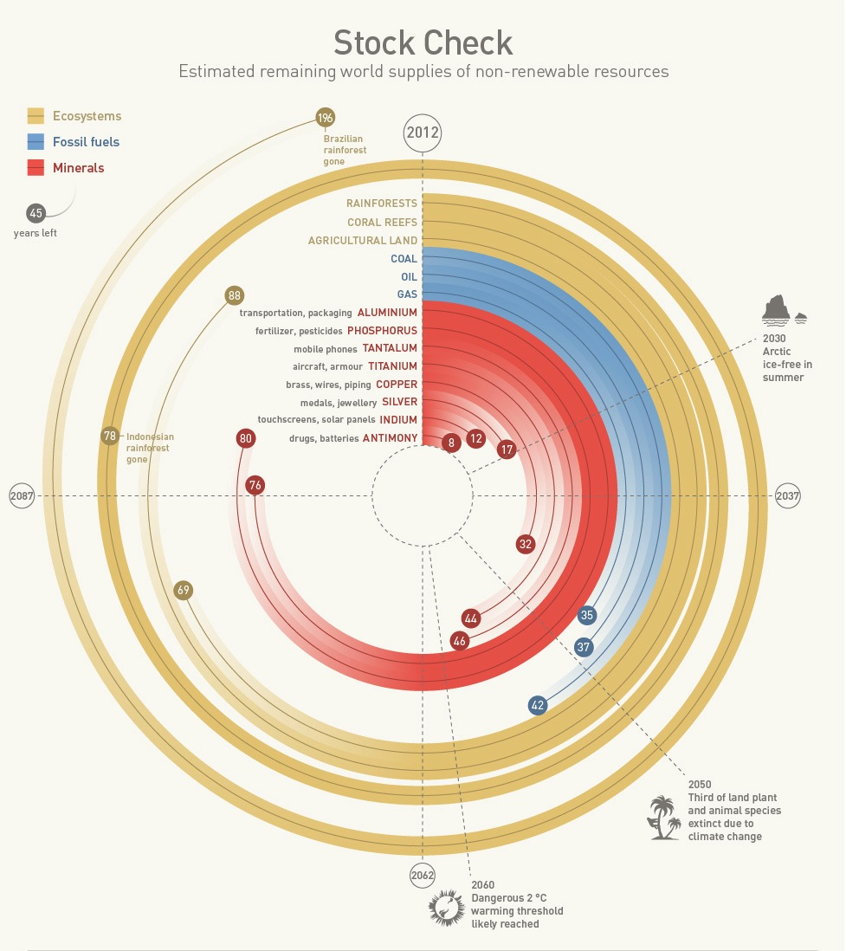

5.1.1ª_Circular Economy
Design Requirements
2.
Understanding what is behind a product / material
1.
Use safe materials
Work with supply chain to understand how products are made
Always opt for those suppliers that use renewable energy to power its activities. When possible, work in BIM or use systems like blockchain or materials passports to preserve traceability and transparency.
Prefer suppliers aligned with Sustainable Development Goals, UN Global Compact 10 principles or verified by a third party program.
  Example: FSC for wood.
Design with materials that are safe for the humans & the environment whenever they are used. Safe during manufacturing, use (intentional & unintentional), recycling, as well as if they end up in nature.
    Use products free of C2C banned substances
    At least prevent the exposure to toxic components
    Avoid & phase out all toxic components
    Use C2C CertifiedTM products
-
Source: www.un.org
+
1.1.
Use C2C Certified™ criteria
3.
Keep track on scarce materials
To find preferred materials, we will use a standardized and world –wide recognized methodology:
Cradle to Cradle^{CM} Products Certified Standard
  BASIC
  BRONZE / SILVER
  Optimized: GOLD / PLATINUM
-
…to guarantee they are safely recovered at the end of use cycle.
Example: steel
Cradle to Cradle and C2C are Registered Marks of MBDC, LLC
Cradle ot Cradle Certified is a Certification mark exclusively licensed by the C2CPII
+
Many materials commonly used, are in stock for less than 25 years, with current consumption yields. These are scarce materials. Track them to avoid to lose the control on them is critical in a circular economy.
Source: UN TEEB, US Geological Survey, BP. Worm et al. 2006

Slide 42
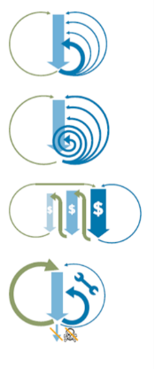

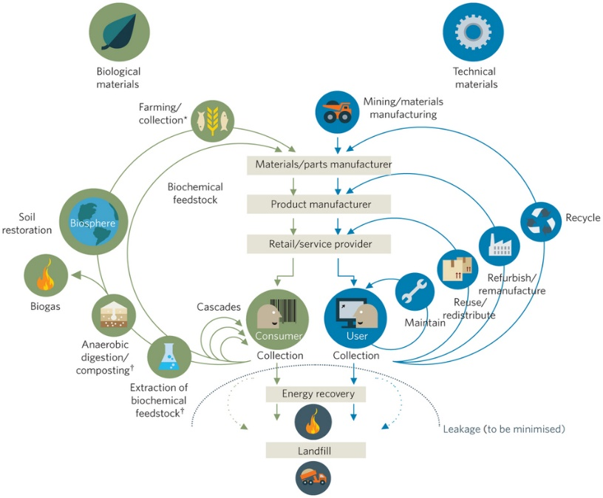
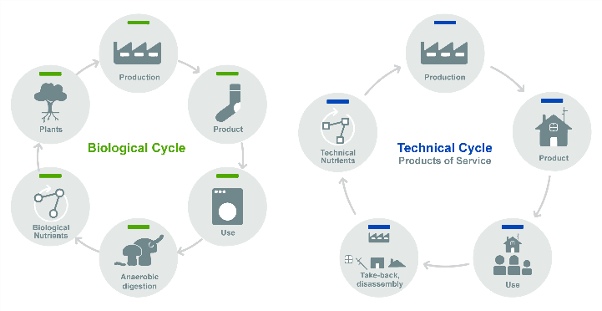
5.1.1ª_Circular Economy
Design Guidelines
4.2.
4.4.
Choose the inner cycle
Make it easy to disassemble
In the design process always keep in mind deconstruction beyond how to construct. Buildings are material banks.
Design to enable the disassembly of the product into separate materials, to make each of them recyclable through the adequate path.
Some Tips
Use mechanical joints that enable you to recover parts separately
Avoid the use of glues, welding, chemical joints, etc. .. which difficult materials separation
  Example: Fairphone
Inner cycle→ maintenance, repair, refurbish. Example: car parts re-utilization
4.
Cycle longer→ extend product’s life cycle. Example: second-hand markets
Think in System Circularity
Cascade use→ use materials for other suitable purposes. Example: use of denim cotton for insulation textiles.
Source for circularity
(select recycled/ rapidly renewable materials)
Design for circularity
(select reciclable materials)
System circularity
(Plan materials recovery. Materals Passports, take-back programs)
Pure inputs→ pure materials enable future materials recycling Example: steel
4.3.
Enhance materials productivity
Cascading keeps materials in circulation for longer. Thinks in life extension through maintenance, repair, parts and components recycling for other possible ways to enhance its productivity
  Example: wood cascading
4.1.
Define the Right Cycle
Materials are divided in 2 groups:
Biological Nutrients: renewable sourced (bioplastics, cotton, paper, etc…)
+ compostable /biodegradable after its use
  Example: PLA
Technical Nutrients: no renewable sourced (minerals, metals, plastics, etc.)
+ come back to industrial cycle
  Example: Nylon 6
5.
Rethink Business Model
Source: Ellen MacArthur Foundation 2012

Slide 43

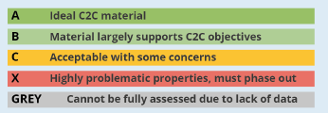
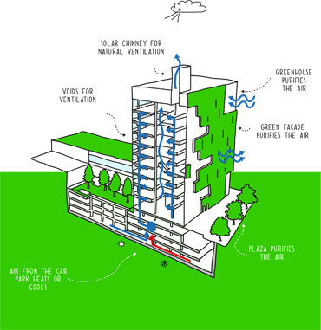
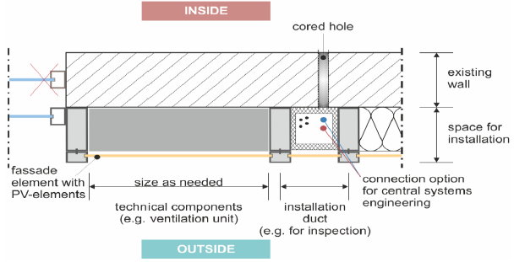
Circular Economy
Design Requirements
DR1.
Use safe materials
Content example:
2. Methodology to assess it
Use Cradle to Cradle Certified™ Products Standard Material Health quality category (C2CPII, 2015) to select safe materials for the ADBE system.
1. KPIs relevant to address DR1
Acronym | Name | Units | Description
VOCs | VOCs concentration | μg/m3 | Carcinogenic, Mutagenic or Reproductive toxin VOCs ratio of substance concentration to LCI value
Toxic Mat | Use of toxic materials | weight % | Percentage of toxic materials with respect to product weight
Source: Cradle to Cradle Certified™ Products Program v3.1, 2016 C2CPII
In Cradle to Cradle Certified™ Products Standard, materials in a product must be assessed using the following traffic light ABC-X rating system against 24 hazard end points listed on the following table:
4. Relevant Case studies
Park 20/20
Venlo City Hall
5. Success stories of the DG implementation within PnH project
3. Recommendations
  Select Cradle to Cradle Certified™ materials and products.
  Avoid the use of problematic materials
  Propose materials, products and suppliers to WP5 team for their pre-assessment

Slide 44
Task 5.1.2 – Materials Data Base
The database will be designed as:
a web tool in an open format, editable by 3rd parties to facilitate its expansion in the scope of other projects and specific actions.
will define all materials, components & chemical substances present or potentially eligible in/for the product at 100ppm level and above.
Electronic parts as Externally Managed Components (EMC) due to its high complexity would be treated as homogeneous components when they can’t be separated by conventional means, but they still need to fulfil the standards for material health. These components should be handled within a chain of custody and sent back to the assembly company at the end of its use phase (closed loop) or to equivalent companies that can guarantee the asset value (e.g. recovery of precious materials).
Materials including finishing and coatings should be assessed for its chemical risk at any level.
Material Health would be assessed against the 24 end points defined by the Cradle to Cradle methodology. The database will establish an ABC-X rating system for all chemicals being present in the product and process in order to enable the best educated material selection possible considering both chemical risk and performance (including economic performance).
Position against the 5 Design Guidelines
Material proposal’s & alternatives for different latitudes

Slide 45
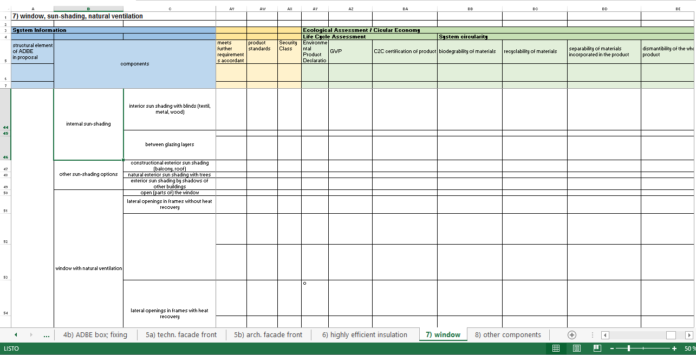
Task 5.1.2 – Materials Data Base
Current status:
Definition of fields to be included. Currently defined according to proposal’s objectives for the open database. We should determine whether we want to define more “internal” fields to enable KPI’s monitoring or not.
The first file is developed in Excel to enable contributions of all team members. To be defined the appropriate format to enable its integration in the project website.
Use one common data base between WP2 and WP5, including both requirements

Slide 46
Task 5.1.2 – Materials Data Base: General Database Excel
Requirements for the webtool:
Open (update, edition): we have to define levels of access. Account and password setting.
Format to be easily integrated in the project website.
Determine whether all the fields are to be visible to all users or not
Confidentiality issues
Others?

Slide 47
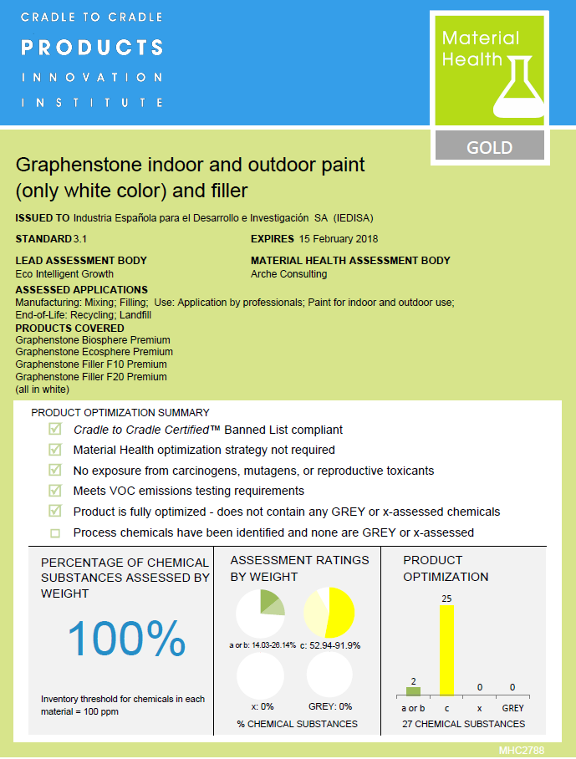
Task 5.1.2 – Materials Data Base: Single Material/Product DataCard
Example of Material Health Certificate.
Our Product/Material data sheet will contain also other relevant information related to the KO and KPI’s.

Slide 48
Task 5.1.2 – Materials Data Base
TO DO:
EIG needs input from the other team members (mainly WP2) to define the CE design delimitants and conditioners at product/material level. It is required a first draft of the module, materials of interest list, design specifications for the articulation of the ADBE with the IMCS and OEMS when applicable.
Definition of main requirements when transforming it into a web tool.
Coordination with CERTH to include the web tool in the Project website.

Slide 49
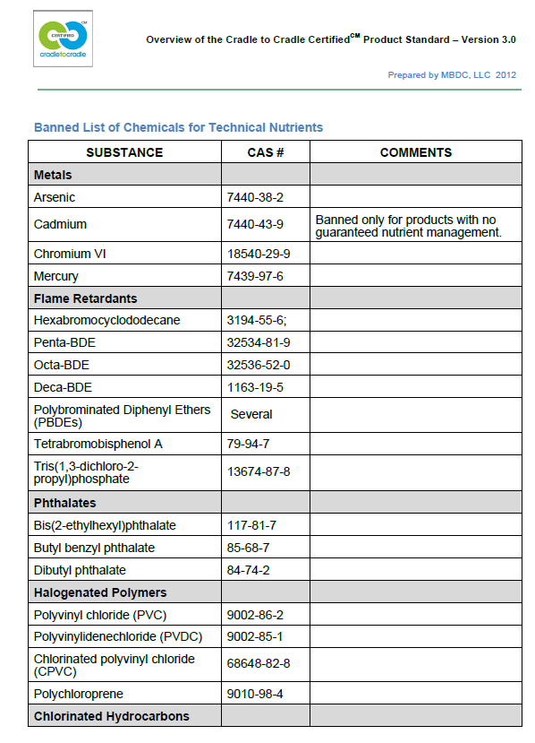
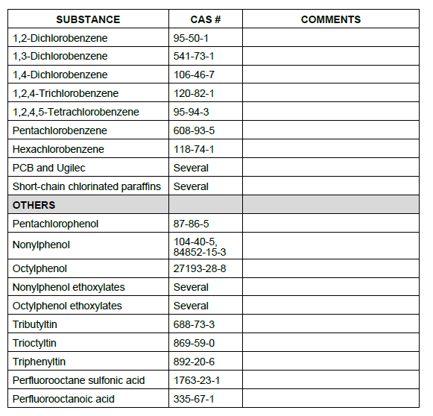
Task 5.1.2 – C2C Certified™ v3.1 Restricted List of Substances
V4 expected to be released at the end of 2018 with the following changes in MH:
Restricted List of Substances alignment with GreenScreen, REACH, GHS and international VOC standards (based on LEED and BRIEEM framework)
New approach to organohalogen restrictions – now including ALL organohalogens (in non-exempt materials)
Restricting PBTs at the Silver level and new methodology for assessing absence of PBTs and CMRs (proposed)

Slide 50
Task 5.3 – Life Cycle Costing tool
Objective: To calculate the main economic indicators for each component of the PLUG-N-HARVEST concept. Emphasis will be paid on the use of the recyclable materials required for the construction of the examined façade. The economic KPIs will be defined by AIGUASOL and EIG. Typical examples are the following:
Life-cycle cost of energy generation (€/ΜWhel or €/ΜWhth)
Annualized life cycle cost (€/kW‐yr)
Mitigation costs for energy demands and greenhouse emissions (€/kWh and €/tCO2)
Annuity gain (€/a)
Range of storage solutions ideas currently include: batteries for electricity and PCM storage tanks for heat. An additional idea would be the inclusion of heat pumps taking benefit of electricity storage.
Added value: This tool will be able to provide quantifiable information from being beneficiated using renting/leasing and circular economy principles as well as the fact that the PLUG-N-HARVEST buildings will be also able to sell their own-generated/stored RES surplus, which can significantly reduce the payback period of investments (goal < 10 y).

Slide 51
Task 5.3 – Methodology approach for LCC
A methodology approach step-by-step:
Determination of boundaries of the examined scenarios according to LCA boundaries
Data inventory of Infrastructure and installation
Identification of materials required for the construction
Operation modes depending on dynamic simulation or/and from demo activities (estimation of the energy and hot air production rates)
Maintenance cost and disposal cost depending on the life time of selected materials (emphasis given on the rate of recyclable materials)
Determination of the basic economic indicators per component for the LCC categories;
Future prediction of the cost for each component; focus on materials used and
For the environmental LCC, externalities depending on the LCA emissions should be considered
Performance of the results
Comparison to the existing conventional energy systems → benchmark
Calculation of the overall cost at a) demo scale and b) distinct level → scalability
Estimation of the avoidance cost because of the recyclable materials use → circular economy

Slide 52
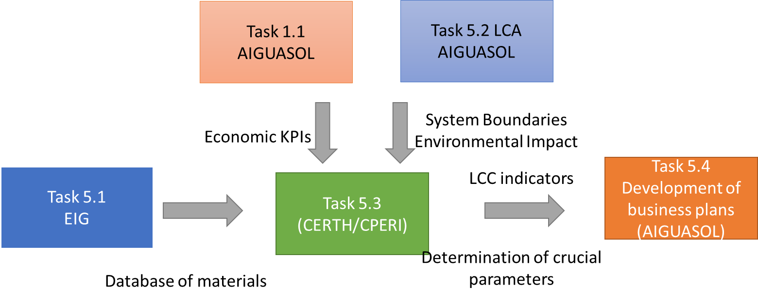
Interaction of Task 5.3 with other relevant tasks
LCC needs input from: Database of materials, LCA (system boundaries and Environmental Impact), market prices
LCC gives input to CBA for the implementation of feasible techno-economic studies

Slide 53
Task 5.3 – Life Cycle Costing tool: Indicative indicators
Manufacturing of façade and/or connected compoents
Percentage in the overall construction of each recyclable material | % (Mass in kg)
Specifications/type of the recyclable materials and corresponding price | TbF (Mass in kg and €/tn)
Operational costs
Cost of Energy Consumptions | €/kWh
Savings Costs corresponding to the replacement of conventional components | €/kWh
Efficiency rates for energy conversion | %
Efficiency rate of each connected component | %
Greenhouse emissions cost savings | €/kWh
Excess energy sold to grid | kWh
Tariffs and Green certificates for each country
Boundaries
Manufacturing
Decommissioning
Purity of the Recyclable materials | TbF* (Mass in kg)
Energy required for the decommissioning | Joule/tn separated material
Operation
Transportation costs
Cost of transportation from the manufacturing site to destination | TbF* (€/km)
Fuel used for this transportation (e.g. diesel, km,…) | TbF* (type of fuel, CO2/kg/km)
Decommissioning
*TbF: to be filled

Slide 54
Task 5.6 – Circular Economy Business Models (CEBM)
D5.6.1 already structured and with basic contents. In short, the contents are:
Typical Circular Economy Business Models (CEBM) description
  Emphasis on CEBM for Building Construction
Description of PnH partners organization‘ profiles, current Business Models and current Exploitation Strategy
Identification of project‘s Direct Exploitable Results (DER) and Indirect (individually) Exploitable Results (IER)
Market analysis and potential customers target
CEBM design for DER exploitation

Slide 55
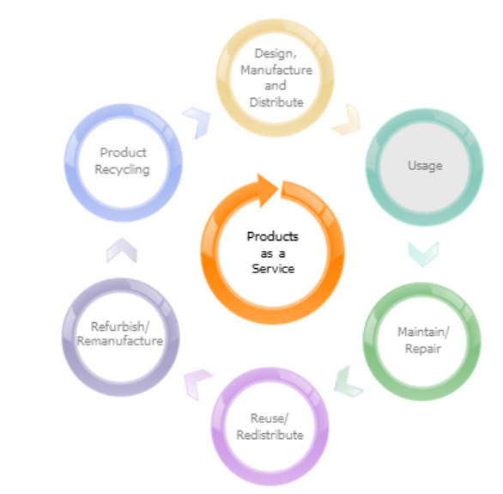
Task 5.6 – CEBM
The Circular Economy Business Models are based on the idea that instead of selling conventional products, it is possible to offer a service as a product:
The customers pay for the time or usage of it
The providers hold ownership of the product throughout its lifetime
  Holding ownership facilitates to manage the product through design, usage, maintenance, reuse, remanufacture and recycling
It is sought to achieve closer relations with the customer, enhanced product development from closer feedback loops, to provide greater business value to both parties and to improve customer satisfaction

Slide 56
Task 5.6 – CEBM
Some types of CEBM include:
Pay per service unit – the customer pays each time they use the service. As the provider is responsible for all life cycle costs, it is incentivized to design a product which is optimized for usage, maintenance, reuse of parts or product, remanufacture and recycling
Product renting or sharing – the customer pays to access the product for a certain period and other customers sequentially use the product
Product lease – ownership is still retained by the provider, but the customer has continuous access to the product. The provider typically controls, maintains and collects the product at the end of the leasing agreement
Product pooling – the product is simultaneously used by many customers

Slide 57
Task 5.6 – CEBM
The CEBM will be adapted to the building construction sector:
Circularity can be applied to different parts of the business model
The ‘degree‘ of potentiality for a certain Circular Economy Business Model adoption vary depending on the role of each actor in the business model (supplier, investor, developers, construction companies, demolition and recycling companies,...)

Slide 58
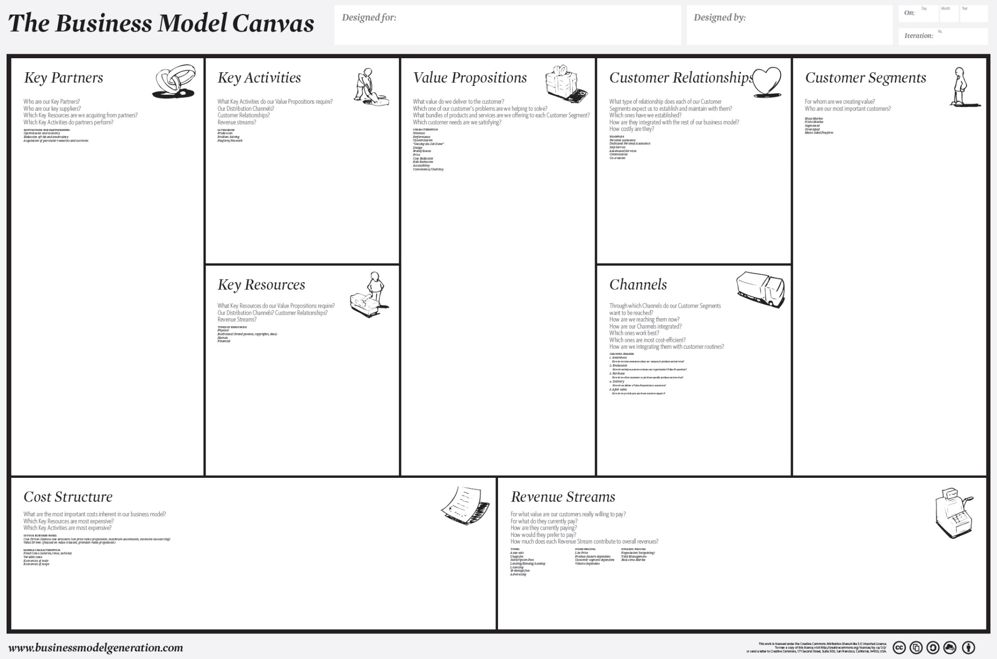
Task 5.6 – CEBM
To effectively adopt a CEBM, the provider should:
Thoroughly analyze how the business can create value. A Canvas or a SWOT analysis approach may be very helpful at this stage
Once the value creation opportunities have been identified, the proper(s) CEBM can be designed according with them
  Short cycle or long cycle?
  Closed cycles: cradle-to-cradle, circular sourcing, recycling and repurposing?
  Dematerialized services
  On-demand produciton

Slide 59
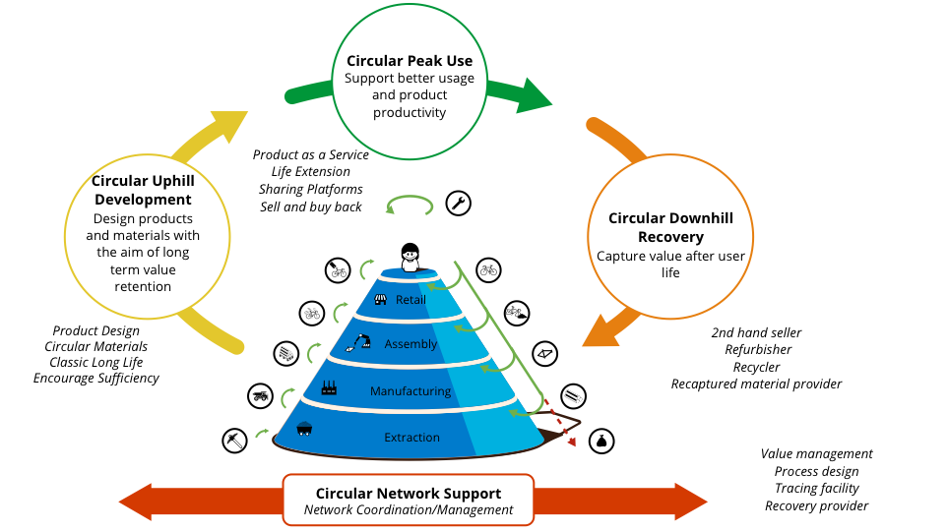
Task 5.6 – CEBM
The CEBM can be applied to different phases of product lifetime:
Circular uphill development (Pre-use)
Circular Peak use (In-Use)
Circular downhill recovery (Post-use)
Circular network support (collaboration between partners in the value chain)
The appropriate Business Model depends on the scope of what it is sought to redesign according with CE principles!

Slide 60
Task 5.6 upcoming tasks – CEBM
Upcoming tasks for the following weeks:
Document structure and partner questionnaire validation → ALL
Questionnaire filled in → ALL
  Organization profile
    Current Business Model
    Current Exploitation strategy
  Direct Exploitable Results (DER) identification → for the consortium as a whole
    How do you profile your organization‘s role in a CEBM to exploit each DER?

Slide 61
Task 5.6 upcoming tasks – CEBM
Upcoming tasks for the following weeks:
Questionnaire filled in → ALL
  Indirect Exploitable Results (IER) identification → for the organization individually
    Which IER can be exploited under the current (linear) business model?
    Which IER should be exploited under a CEBM?
    Strengths and Weaknesses for the transition to a CEBM
Future versions of the Deliverables will further expand this SWOT analysis and complement it with other tools

Slide 62
Task 5.6 upcoming tasks – CEBM
JAN
FEB
MAR
APR
MAY
JUN
The partners‘ characterization questionnaire will be sent to all partners for their feedback – next February
  After validated and improved, it will be sent again for its filled in → Current Business Model and Exploitation Strategy, DER/IER identification, Business Model adaptation to CE principles requirement,...
  The first market analysis will be carried out, to be expanded in future versions of the Deliverables.
Future versions of D5.6.1 and D5.6.2 will further detail CEBM incorporating lessons learned from Pilot demonstrations
2018
Partners’ characterization sheet validation (ALL)
Partners’ Business Models & Direct/Indirect Exploitable Results identification (ALL)
Market Analysis, Development of CEBM for PnH DER

