Slide 1
Plug-N-Harvest
WP5 – CIRCULAR ECONOMY BUSINESS MODEL AND EXPLOITATION PLAN
ORGANIZATION: AIGUASOL, EIG, CERTH
PRESENTER(S): ARNAU GONZÁLEZ, TONI HERENA, JORDI PASCUAL (AIGUASOL), Jordi shon (eig), CHRISTOS RAVANIS (certh), JOHN BLOWER (ETL)
Notes:
Integration, Pilot Implementation and assessment

Slide 2
Content
WP5 progress
Task 5.1 – Circular economy design delimitants, conditioners & material database
Task 5.2 – Evaluation methodologies and impact assessment of circular economy solutions
Task 5.5 – Standardization Models and Analysis
Task 5.6 – Exploitation Strategy & Business Plans

Slide 3
WP5 Timeline
Q1
Q2
Q3
Q4
Q5
Q6
Q7
Q8
Q9
Q10
Q11
Q12
Q13
Q14
Q15
Q16
Year 1 Year 2 Year 3 Year 4
D5.3, D5.4, D5.5, D5.6.1, D5.6.2
Final
D5.1.1, D5.1.2
Final
D5.5, D5.6.1, D5.6.2
Third
D5.2.2
Final
T5.2
Start
T5.3
Start
T5.4
Start
T5.1, T5.5,
T5.6
Start
D5.2.1 Final
D5.2.2 First
T5.3, T5.4, T5.5, T5.6
End
D5.5, D5.6.1, D5.6.2
First
D5.1.1,
D5.1.2,
D5.2.1
First
D5.5, D5.6.1, D5.6.2
Second
D5.3, D5.4
First
T5.1
End
T5.2
End

Slide 4
WP5 progress
Task 5.1: ongoing
  T5.1.1 – Circular economy design guidelines/requirements
  T5.1.2 – Progress done in Materials database for massive implementation
Task 5.2: ongoing
  T5.2.1 – Revision of CE assessment methodologies and preliminary design of a methodology for construction and building rehabilitation sector
  T5.2.2 – LCA of developed solutions: still to start
Task 5.5: ongoing
  Standardization Models and Analysis is annually updated
Task 5.6: ongoing
  Deliverables 5.6.1 and 5.6.2 were delivered to the EC in August 31st. These will be annually updated
  Solution on third parties’ involvement or modular façade manufacturing still to be finished

Slide 5
WP5 – Circular Economy Business Model & Exploitation Plan
T5.1 Circular economy design delimitants, conditioners & materials database
Task responsible: eig
PRESENTER(S): jordi shon
MEETING: CARDIFF Meeting, CARDIFF, 20-22 NOVEMBER 2018
Notes:
Integration, Pilot Implementation and assessment

Slide 6
Task 5.1 Circular economy design delimitants, conditioners & materials database
T5.1.1 Circular economy design guidelines/requirements
  Deliverable progress
T5.1.2 Materials database for massive implementation
  Data collection
  Progress

Slide 7



Task 5.1 Circular economy design delimitants, conditioners & materials database
MAKE USE OF CE Design guidelines
into the TENDERS
Ensuring this way that Plug-n-Harvest solution meets CE requirements
Through the technical specifications

Slide 8

Task 5.1 Circular economy design delimitants, conditioners & materials database
Defining a truly circular tender!!
EACH WP should revise the tender with the pilot site to make use of the Circular Economy Design guidelines in each Work Package
Through the technical specifications

Slide 9
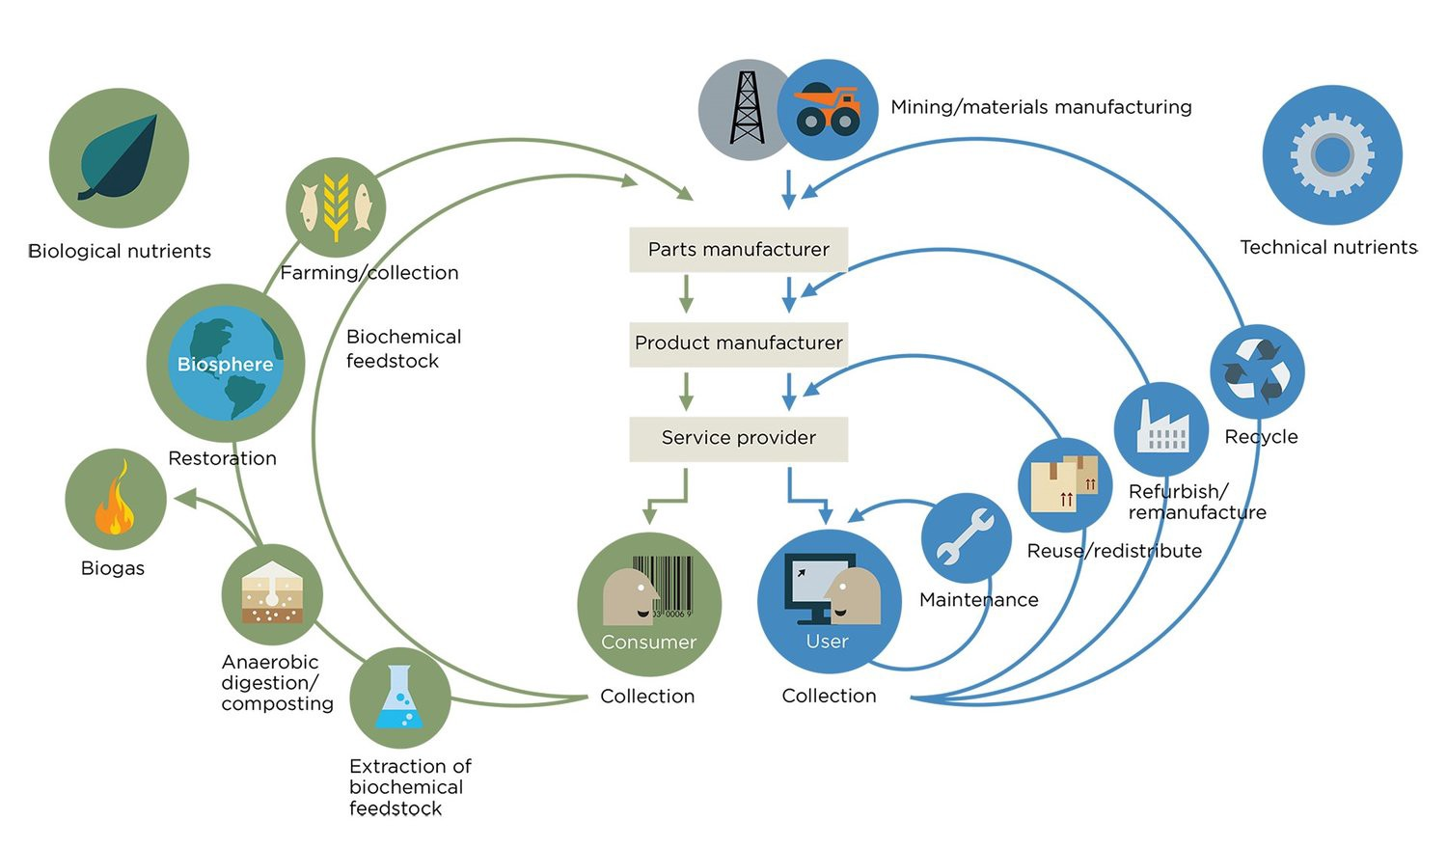
Task 5.1 Circular economy design delimitants, conditioners & materials database
Sub-task 5.1.2: Materials database for massive implementation
Generate a database of materials by latitudes.
It will be designed as a web tool in open format, editable by third parties.
The database will define all materials, components and chemical substances present or potentially eligible in/for the product at 100ppm level and above.

Slide 10

MATERIAL DATABASE (for massive implementation)
HOW TO NOURISH THE MATERIAL DATABASE?
Eco Intelligent Growth
Through those C2C materials that could be used in the Plug-N-Harvest solution
PILOT SITES
When a product is considered for the pilots, ask for all information within questionnaire (*TDS, MSDS, EPD..) to the manufacturer or constructor (up to each pilot site)
*TDS (Technical datasheet); MSDS (Materials safety datasheet); EPD (Environmental Product Declaration)

Slide 11
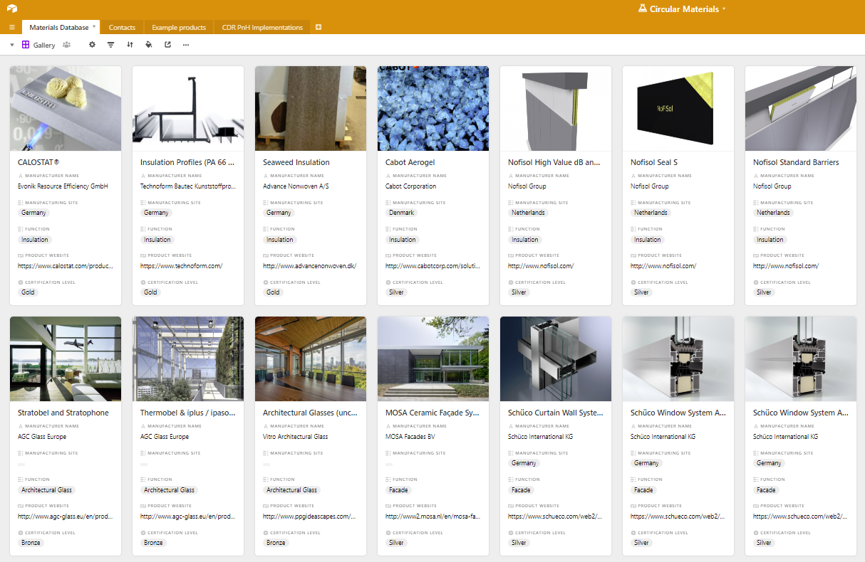
MATERIAL DATABASE (for massive implementation)
Database with all properties needed. Additionally, this database can be filtered by the product functionality, etcetera.
All data for KPIs and DPIs related to circular economy is gathered there. Using the data will generate:
Products RATING in order to help pilot sites in the material selection

Slide 12
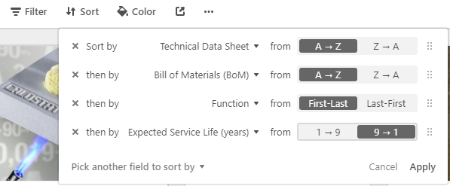
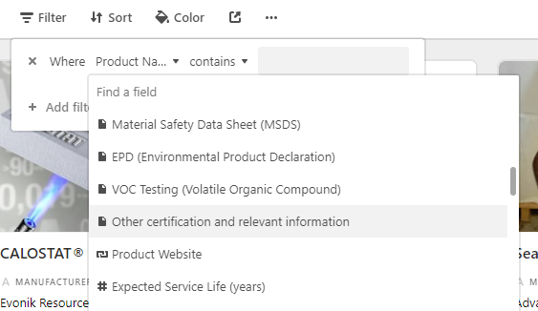
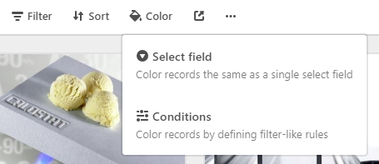
MATERIAL DATABASE (for massive implementation)
Different possibilities to visualize data within the Material Database
Filtering
Sorting
Colouring
https://airtable.com/shrqupcVajnDQd9YW

Slide 13
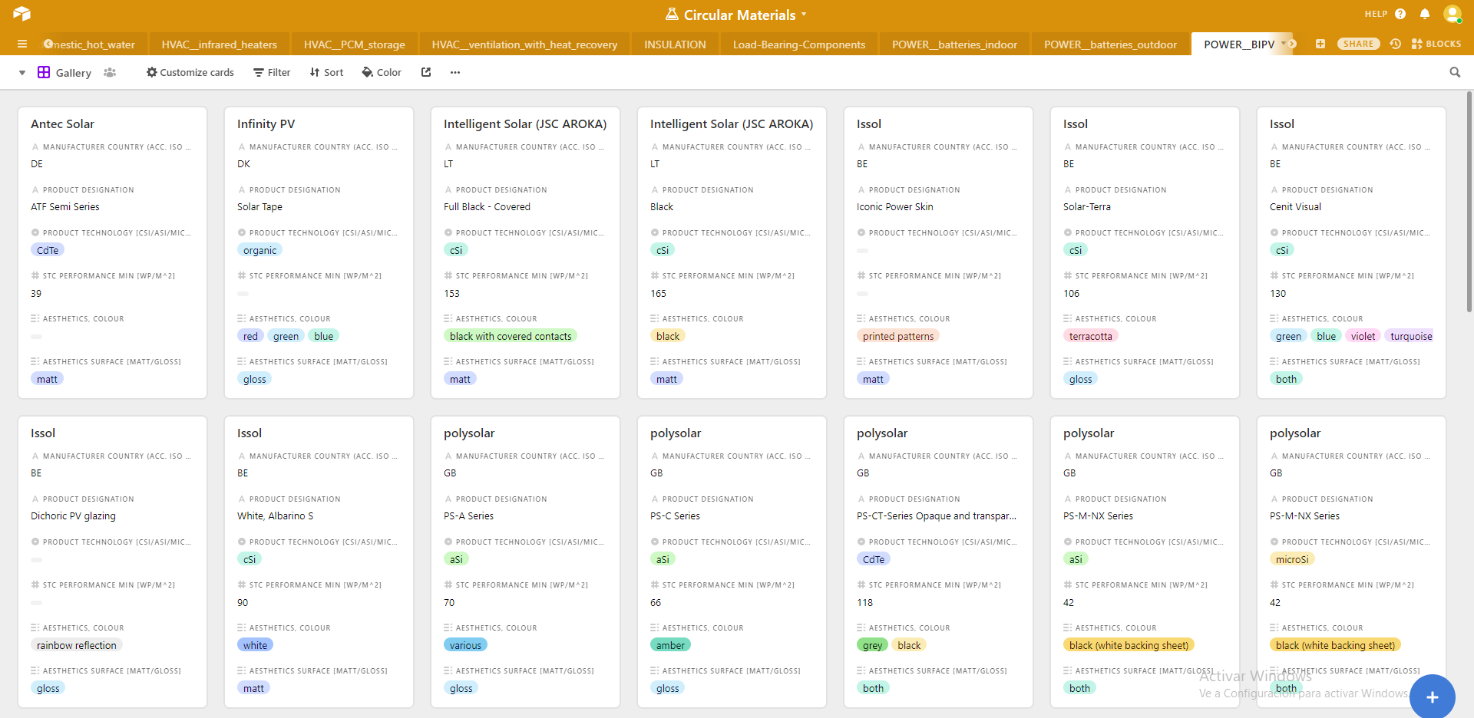
MATERIAL DATABASE (progress)
RWTH – EIG Collaborative process to MERGE both DATABASES
RWTH database has been integrated within the Airtable Material Database for PnH – SUBTASK 5.1.2.
More consistent list of products is now available with their key parameters (essential for choosing one product or another)

Slide 14
MATERIAL DATABASE (progress)
Components/functionality | Key parameters
Insulation | Fire resistance DNI EN 13501 Heat Conductivity Level
Window glazing | g-Value [-] Ug-Value [W/(m²K)]
Window frames | Uf-Value [W/(m²K)] Material
BIPV/BAPV modules | Performance STC [Wp/ m²] Technology (cSi, mSi, aSi, microSi, CDTE, CI(G)S, GaAS, OPV) Available colours and surfaces
Hybrid Collectors (Solar Thermal + PV) | Size WxHxD [cm] Weight [kg] Performance STC [Wp/ m²]
RWTH – EIG collaboration
Key parameters are defined by product functionality, in order to be able to find the most suitable product through the DDBB.
The configuration will be based on more parameters, but the key parameters can be used to easily compare products and make a first manual approach
Here there are some examples:

Slide 15
WP5 – Circular Economy Business Model & Exploitation Plan
T5.2 Evaluation methodologies and impact assessment of circular economy solutions
Task responsible: aiguasol
PRESENTER(S): Arnau Gonzalez, toni herena, JORDI PASCUAL
MEETING: CARDIFF Meeting, CARDIFF, 20-22 NOVEMBER 2018
Notes:
Integration, Pilot Implementation and assessment

Slide 16
Task 5.2 Evaluation methodologies and impact assessment of circular economy solutions
T5.2.1 Evaluation methodology for circular economy solutions implementation degree
  Started on month 7
  Revision of CE assessment methodologies and preliminary design of a methodology for construction and building renovation sector
T5.2.2 Circular economy-based environmental impact assessment and LCA metrics
  This task has not started yet. It will start on month 19 (March 2019)

Slide 17
Task 5.2 Evaluation methodology for CE solutions implementation degree
The CE degree of compliance measurement will be carried out in a twofold strategy:
  Calculation of several CE indicators and comparison of obtained values with a reference or baseline scenario (conventional retrofitting) values
  Conversion of obtained results for all indicators into money-based metrics, i.e. monetarization, and sum to get a single economic value of the solution
  This process will be carried out for the four pilot sites
First version of D5.2.1 (due on February 2019) will lay out the entire methodology, the calculation process for all indicators and the conversion factor to € (monetarization)
Second version of D5.2.1 (due on November 2020) will apply the methodology to the four PLUG-N-HARVEST pilots and therefore address the degree of circularity of them

Slide 18
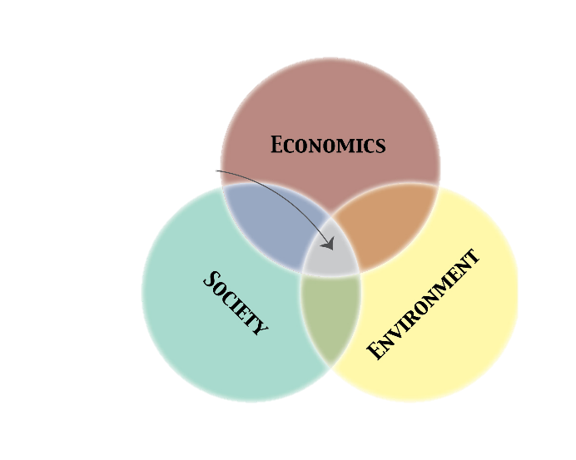
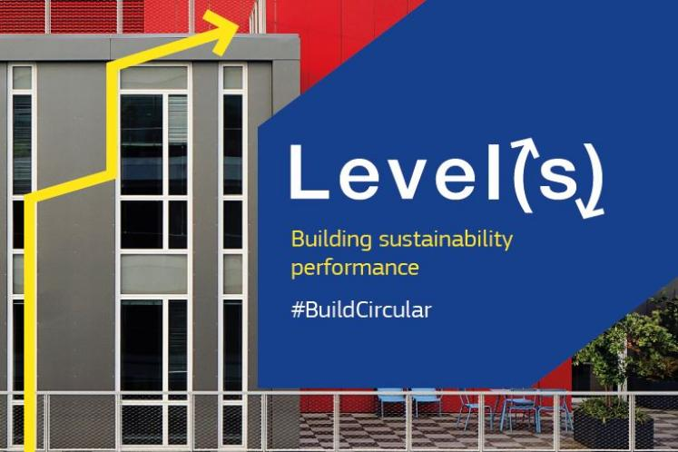



Task 5.2 Evaluation methodology for CE solutions implementation degree
The Evaluation methodology for CE solutions implementation degree assessment aims at addressing the three criteria of sustainability
The developed methodology combines aspects of three methodologies and adds new ones to properly address the economic, the environmental and the social aspects
  Level(s)
  Cradle to Cradle
  KPMG True Value

Slide 19
Task 5.2 Evaluation methodology for CE solutions implementation degree
The methodology will incorporate and establish a calculation methodology for a number of indicators (currently 23, but changes might be made) classified in 7 categories:
  Greenhouse gas emissions along a building lifecycle
  Resource efficient and circular material life cycles
  Efficient use of water resources
  Healthy and comfortable spaces
  Adaptation and resilience to climate change
  Optimized life cycle cost and value
  Social aspects

Slide 20
Task 5.2 Evaluation methodologies and impact assessment of circular economy solutions
Indicator | Upstream | Construction/ Installation | Use (Operation) | End of Life
Use stage energy performance
Life Cycle Costs (LCC)
Real estate value increase (also social)
Life Cycle GWP (CO₂eq)
Construction & Demolition Waste and Materials
Toxicity
Water consumption
Indoor air quality
Thermal discomfort
Job creation (number and type)
Increased use of local workforce
Energy poverty
Economic
Environmental
Social

Slide 21
Task 5.2 Evaluation methodology for CE solutions implementation degree
Each indicator will be calculated for two scenarios for each pilot site building:
  PLUG-N-HARVEST refurbished solution
  Conventional retrofitting solution
All indicators will receive a rating from 1 to 5 according to its performance
  The greater, the better
A graded comparison will be made in order to assess the degree of circularity
Additionally, a conversion to the economic value will be made by then obtain the aggregated economic value of the developed solution

Slide 22
Task 5.2 Evaluation methodology for CE solutions implementation degree
A graded comparison will be made in order to assess the degree of circularity
INDICATOR | PnH VALUE | CONV. RETROFIT VALUE | PnH RATING | CONV. RETROFIT RATING | CE COMPLIANT?
CPI 1 - Use stage energy performance | 18 kWh/m²/year (just an example) | 65 kWh/m²/year (just an example) | 4 | 2 | ✓
CPI n - … | - | - | 3 | 3/4 | ✗

Slide 23
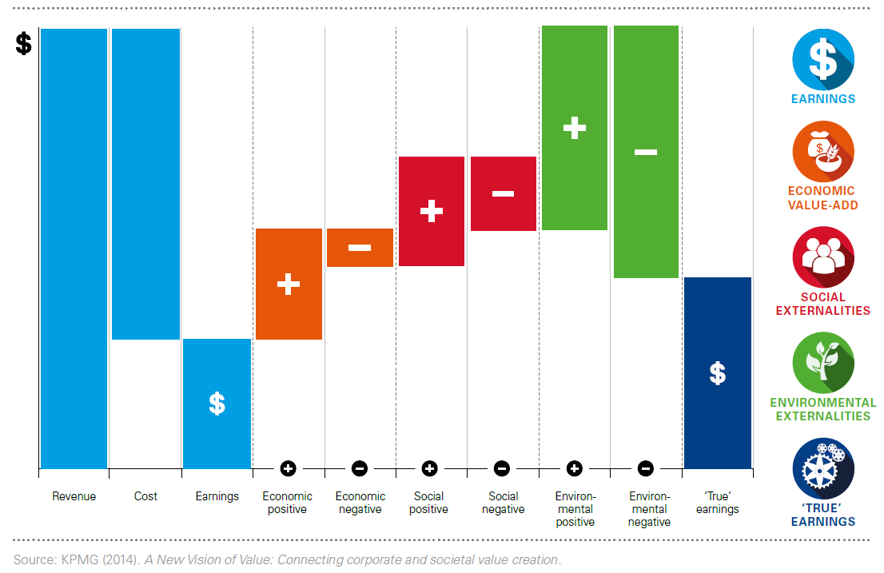
Task 5.2 Evaluation methodology for CE solutions implementation degree
A conversion to the economic value of the indicator will be made
Similarly as done with the EBITDA, an economic performance analysis can be carried out
  Having all indicators in a monetary metric will enable measuring the profit including all externalities
  The resulting value will be compared with a conventional retrofit in order to see the overall CE compliance

Slide 24
WP5 – Circular Economy Business Model & Exploitation Plan
T5.5 Standardization Models and Analysis
Task responsible: CERTH
PRESENTER(S): CHRISTOS RAVANIS
MEETING: 4th plenary Meeting, CARDIFF, 20-22 NOVEMBER 2018
Notes:
Integration, Pilot Implementation and assessment

Slide 25
Task 5.2 Evaluation methodology for CE solutions implementation degree
Standardization documents are of technical write-ups that illustrate the possible demands for systems or services, materials, components, specialized items, or exhibit a particular method, optimized procedure, or practice in detail.
Standards are generated and determined using a process of sharing knowledge and building consensus among technical experts that are nominated by interested parties.
There are multiple kinds of standardization types of documents as well. The most established one is the standard, which has a different code regarding the organization under it has been constructed: e.g., EN for European Standards, ISO or IEC for International standards. Other kinds of write-ups are Technical Reports (TR) Technical Specifications (TS), and Workshop Agreements (CWA).
At European level, all the members of CEN and CENELEC may embrace EN standards as national standards and need to remove any existing national standard which may come in dispute with them.

Slide 26




Plug-N-Harvest: Report On Standardization Models
Standardization P-n-H list of key concepts
Construction/Renovation
Aluminum structures
Energy efficiency, management
Façade technology: PVs & Batteries
Façade technology: Insulation
Façade technology: HVACs
Networking & Internet of Things
Software Development
System Security and Privacy
Circular Economy
Green Materials
Thermal Comfort
Air Quality

Slide 27
Plug-N-Harvest: Report On Standardization Models
Conclusions :
Standardization leads to uniform quality characteristics in the area of material qualities, such as thermal insulation, which, for example, provide information on the thermal conductivity of insulating materials. In the case of technical components and constructions, European standardization defines standards that are further tightened, for example, by national annexes.
Plug-n-Harvest development and products will be based on existing standards assisting to their integration, their operation and maintenance, as well as to the exploitation of them at the end of the project Façade technology: PVs & Batteries.
During the development of an innovative technology without the existing standard exploitation, product may not be escalate, distributed or be a part of another system (e.g. collaborations). Thus standardization procedure is a process that needs to involve all the consortium with no exceptions.
Notes:
START
After the analysis of the current plug n harvest standardization context at European and international levels, the following conclusions may be drawn:

Slide 28
WP5 – Circular Economy Business Model & Exploitation Plan
T5.6 Exploitation Strategy & Business Plans
Task responsible: aiguasol
PRESENTER(S): Arnau Gonzalez, toni herena, JORDI PASCUAL
MEETING: CARDIFF Meeting, CARDIFF, 20-22 NOVEMBER 2018
Notes:
Integration, Pilot Implementation and assessment

Slide 29
Task 5.6 Exploitation Strategy & Business Plans
Main outputs of D5.6.1 are:
  First approach of a market analysis of the building renovation sector in the four countries were pilots are found (Germany, Greece, Spain, UK)
    This market analysis is expected to be improved so contributions from local partners will be welcome
  Definition of potential CE-based business models and allocation of PLUG-N-HARVEST internal partners in the value chain of the PLUG-N-HARVEST solution and definition of potential roles for exploitation
    The final solution is still to be selected since we do not have defined yet the pilot implementation solution

Slide 30
Task 5.6 Exploitation Strategy & Business Plans
Product/ Service | Product as Service or Pay per Service | Maintenance and Upgrade | Reuse and Remanufacture | Valuable materials mining | CESCO models | Other BMs
ADBE | Commercialised as improved energy & comfort performance service. Both for residential and commercial based on a mixed model (ownership + service) | (For Tertiary Buildings) System maintenance Upgrade of components (when better performance technologies available) | (For Tertiary Buildings) Recovery for reuse or remanufacture of Aluminium fixing structure ADBE module | Recovery of valuable materials from ADBE | Commercialised as energy performance & comfort improvement service | Classical Linear BM for Façade solutions sale
ADBE + IMCS | (For Residential and Tertiary Buildings) Commercialised as: Improved energy performance Indoor air quality Comfort service | (For Tertiary Buildings) System maintenance Upgrade of components (when better performance technologies available) Upgrades of IMCS and/or PV panels Additionally, maintenance of ADBE | (For Tertiary Buildings) Reutilization of modular ADBE structure, IMCS Remanufacture: ADBE modules | Recovery of valuable materials from ADBE and electronic components from IMCS Mining of scarce materials | (For Residential and Tertiary Buildings) Commercialised as energy performance & comfort improvement service | -
ADBE + IMCS + OEMS | (For both Resid. and Tertiary buildings, public administration at building/district level) Commercialised as: Energy savings and/or efficient energy management at district/grid level Indoor air quality Intelligent energy mgmt. and trading system | System maintenance Upgrade of components (when better performance technologies available) | (For Tertiary buildings) Reusability: modular ADBE structure, IMCS Remanufacture: ADBE modules | Recovery of valuable materials from ADBE and electronic components from IMCS and OEMS Mining of scarce materials | (For both Resid. and Tertiary buildings and Public Administration at Building/District level) Commercialised as energy performance & comfort improvement service | -

Slide 31
Task 5.6 Exploitation Strategy & Business Plans
Product/ Service | Product as Service or Pay per Service | Maintenance and Upgrade | Reuse and Remanufacture | Valuable materials mining | CESCO models | Other BMs
Consultancy Services | (For Tertiary buildings or public building owners) Consultancy services of PLUG-N-HARVEST solution that best fits customer’s needs Advisory service for big tenants for building retrofit | Advisory for maintenance and upgrade service providers on financing opportunities or emerging technologies to optimize the system performance | (For Tertiary buildings or public building owners) Establishing the market conditions and concerned stakeholders’ requirements for the definition of specific BMs and exploitation plans | Guidelines and procedures definition to commercially consider the valuable materials | (For Tertiary buildings or public building owners) Improved energy service and building performance (comfort). Advisory on systems’ optimal configuration | Classical linear BM for Consultancy Services
BMS | Commercialised as secure monitoring and control service. Both for residential and commercial based on a mixed model (ownership + service) | (For Tertiary Buildings) Maintenance of hardware sensors and BMS gateways. Upgrade of BMS cloud platform (when new functionalities are available) | (For Tertiary Buildings) Recovery for reuse or remanufacture of hardware products such as sensors, actuators and gateways. | Recovery of valuable hardware components | Commercialised as cloud service for monitoring and control with advanced privacy and security features | Classical linear BM for BMS exploitation through software licenses sale
Circular Materials Database |  | Maintenance and updating of the DB
Teaching and Research capabilities | Research projects related with Circular Economy applied to construction sector under a “Pay per Service” scheme |  |  |  |  | Improved Teaching capabilities that might attract new students

Slide 32
Task 5.6 Exploitation Strategy & Business Plans
Main outputs of D5.6.2 are:
  Description of CE business models for project’s Direct Exploitable Results (DER)
    ADBE+IMCS+OEMS (entire PLUG-N-HARVEST solution)
    ADBE+IMCS
    ADBE alone
  Allocation of PLUG-N-HARVEST consortium partners in the value chain for DER exploitation and gaps identification

Slide 33
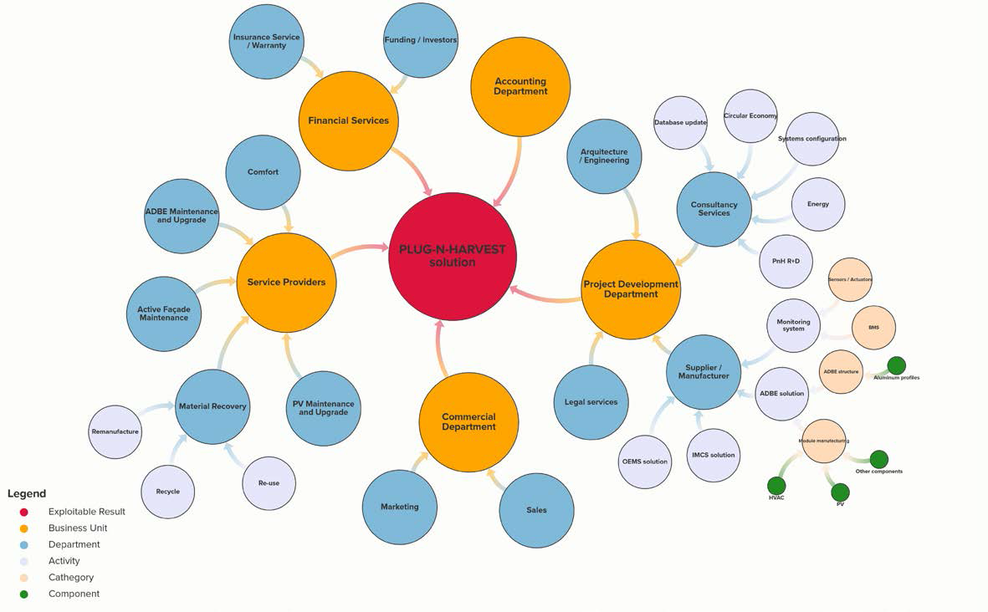
Task 5.6 Exploitation Strategy & Business Plans

Slide 34
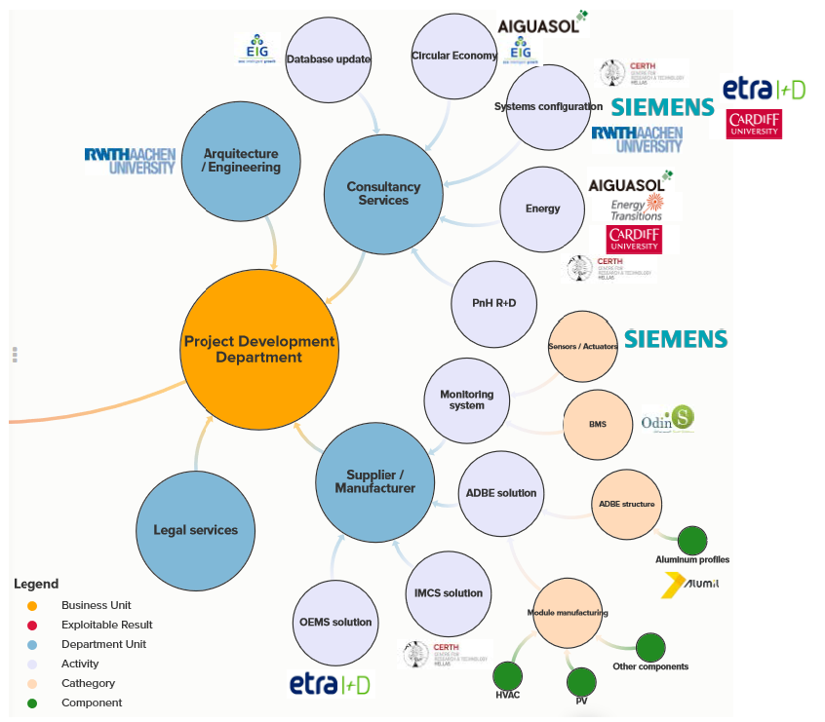
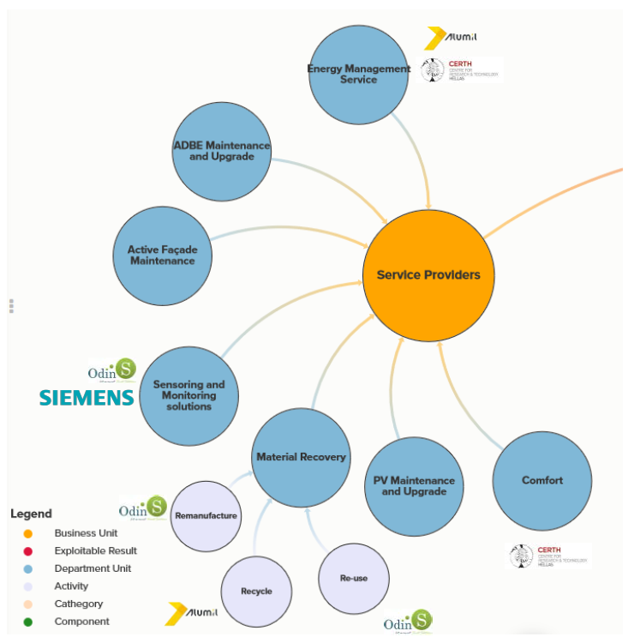
Task 5.6 Exploitation Strategy & Business Plans

Slide 35
Vision for Circular Economy Business Model (RWTH)
Service Life Time 20 Years
One Modular Kit Producer
Produces or buys the single parts of the modular kit
Provides the modular kit as a service (Leasing Circle)
Maintains the modules (maybe by subcontractor)
Take back of the whole module after 20 years or of technology parts after service lifetime
Reuse of parts with a longer SLT than 20 years, Recycling of remaining parts

Slide 36

Task 5.6 Exploitation Strategy & Business Plans
6 – Kit producer offering a complete service PnH GOAL
5 – OEMS + IMCS + PV + HVAC + Other (?) as a service
4 – OEMS + IMCS + PV + HVAC as a service
3 – OEMS + IMCS + PV as a service
2 – OEMS + IMCS as a service
1 – OEMS as a service
0 – “Business as Usual” WORST CASE
ALL SERVICES – 1 SERVICE TENDER
COMBINATION OF SERVICES AND PRODUCTS – 2 SEPARATE TENDERS ??
ALL PRODUCTS – 1 CONVENTIONAL TENDER
Notes:
The CE implementation must be supported by a CEBM to ensure that it is actually circular
We need to work with Modular Kit providers, end-users and other technology providers to define the achievable degree of circularity

Slide 37
Task 5.6 Exploitation Strategy & Business Plans
6 – Kit producer offering a complete service PnH GOAL
5 – OEMS + IMCS + PV + HVAC + Other (?) as a service
4 – OEMS + IMCS + PV + HVAC as a service
3 – OEMS + IMCS + PV as a service
2 – OEMS + IMCS as a service
1 – OEMS as a service
0 – “Business as Usual” WORST CASE
“FAR AWAY” INDUSTRY – WHY? WHICH ARE THE MAIN ISSUES?
“NEAR” INDUSTRY/PRODUCERS (AS A SEPARATE ELEMENTS) – WHICH ARE THE LIMITS, AND HOW THESE SEPARATE ELEMENTS WILL MODIFY THE OVERALL SOLUTION?
ALREADY AVAILABLE WITHIN THE CONSORTIUM – UNDER WHICH CONDITIONS?
Notes:
The CE implementation must be supported by a CEBM to ensure that it is actually circular
We need to work with Modular Kit providers, end-users and other technology providers to define the achievable degree of circularity

Slide 38
Task 5.6 Exploitation Strategy & Business Plans. NEXT STEPS
6 – Kit producer offering a complete service PnH GOAL
5 – OEMS + IMCS + PV + HVAC + Other (?) as a service
4 – OEMS + IMCS + PV + HVAC as a service
3 – OEMS + IMCS + PV as a service
2 – OEMS + IMCS as a service
1 – OEMS as a service
0 – “Business as Usual” WORST CASE
ABOUT THE AGREED COMON MODULAR KIT PRODUCER:
  COMMON EXECUTIVE SUMMARY TO “MOVE”?
  WHO WILL BE IN CHARGE?
DEMO OWNERS REQUIREMENTS AND DELIMITANTS
LEGAL
ADMINISTRATIVE
INTERNAL DIRECTIVES
HOW ARE YOU ABLE TO COMMERCIALIZE YOUR SERVICES. DETAILS NEEDED CONCERNING;
  SERVICE CONSTRAINS
  MAINTENANCE CAPACITY
  YEARS…..ETC.
Notes:
The CE implementation must be supported by a CEBM to ensure that it is actually circular
We need to work with Modular Kit providers, end-users and other technology providers to define the achievable degree of circularity

Slide 39
Task 5.6 Exploitation Strategy & Business Plans – CURRENT STATUS
Yesterday it was agreed that the ideal situation for PLUG-N-HARVEST successful implementation is to find a Modular Kit Producer (one single company or partnership) that would manufacture the modules and provide technical advice end users for the tenders
  Which strategy will we adopt to find this third party?
  Who is responsible for finding this external figure?

Slide 40
Task 5.6 Exploitation Strategy & Business Plans – NEXT STEPS
Close collaboration with end users to know the barriers for Circular Economy Business Models implementation in the pilot sites
  Legal and administrative barriers
  Other internal limitants for CE business models implementation
Collaboration with industrial partners to know how they are able to commercialize their services

Slide 41

The Plug-n-Harvest Concept: extending the concept definition

Slide 42
Original Concept and its Interpretation
  Our Concerns
  Potential Limitations of Original Concept Interpretation
  Extending the Interpretation
Further Versions of the Plug-n-Harvest System?
Next Steps

Slide 43
Original Concept
“The main strategic goal of the PLUG-N-HARVEST proposal is to design, develop, demonstrate and exploit a new modular, plug-n-play concept/product for [Adaptable/Dynamic Building Envelopes] ADBE - deployable to both residential and non-residential buildings - which is able to provide high (maximum possible) energy use reductions and high (maximum possible) energy harvesting from RES both at the single-building and the district scale while requiring medium-to-low installation costs and almost-zero operational costs.”

Slide 44
Original Concept
“Modular Plug-n-Play ADBE modules and systems which can be adjusted for the individual needs of the building ….. Moreover, the developed ABDE modules will be optimised in view of the .. technical as well as economic requirements of the energy supply concept and, most importantly they will embed energy harvesting from renewable energy sources and storage systems as an integrated part of the building structure, with the energy harvesting supply systems offering different functions adapted to the flexible space concept and different user demands .….”

Slide 45
Original Concept
“Energy harvesting supply systems have to be an integrated part of the building structure new kinds of standard elements.”

Slide 46
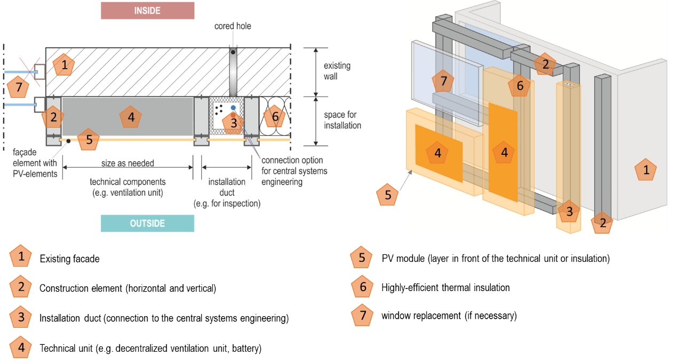

Slide 47
Our Concerns:
Too narrow a definition of the Plug-n-Harvest Concept may:
Be difficult to apply to low-rise housing.
Limit our ability to deliver good project outputs.
Limit commercial exploitation potential.

Slide 48
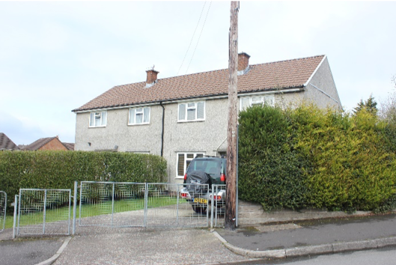
What to do about low rise?

Slide 49
Low Rise Building Problem
“The idea within the PLUG-N-HARVEST design is to use recurrent horizontal grids of offices and multi-family dwellings to determine fixed sizes of modules, which then incorporate passive and active components. Site-measured elements are able to cover differences in storey heights and additionally function as an installation channel for media supply and control as well as a fire barrier between storeys”

Slide 50
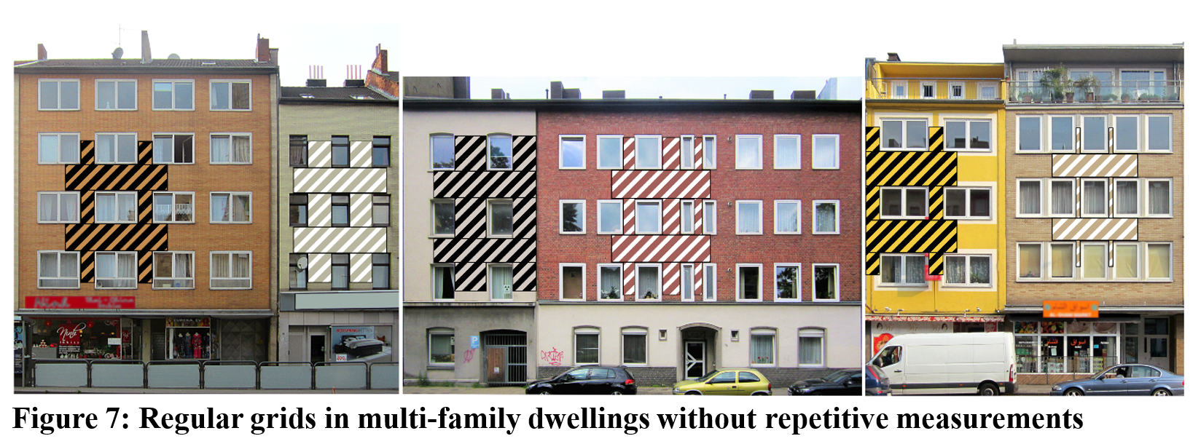

Slide 51
ADBE Not Possible?

Slide 52
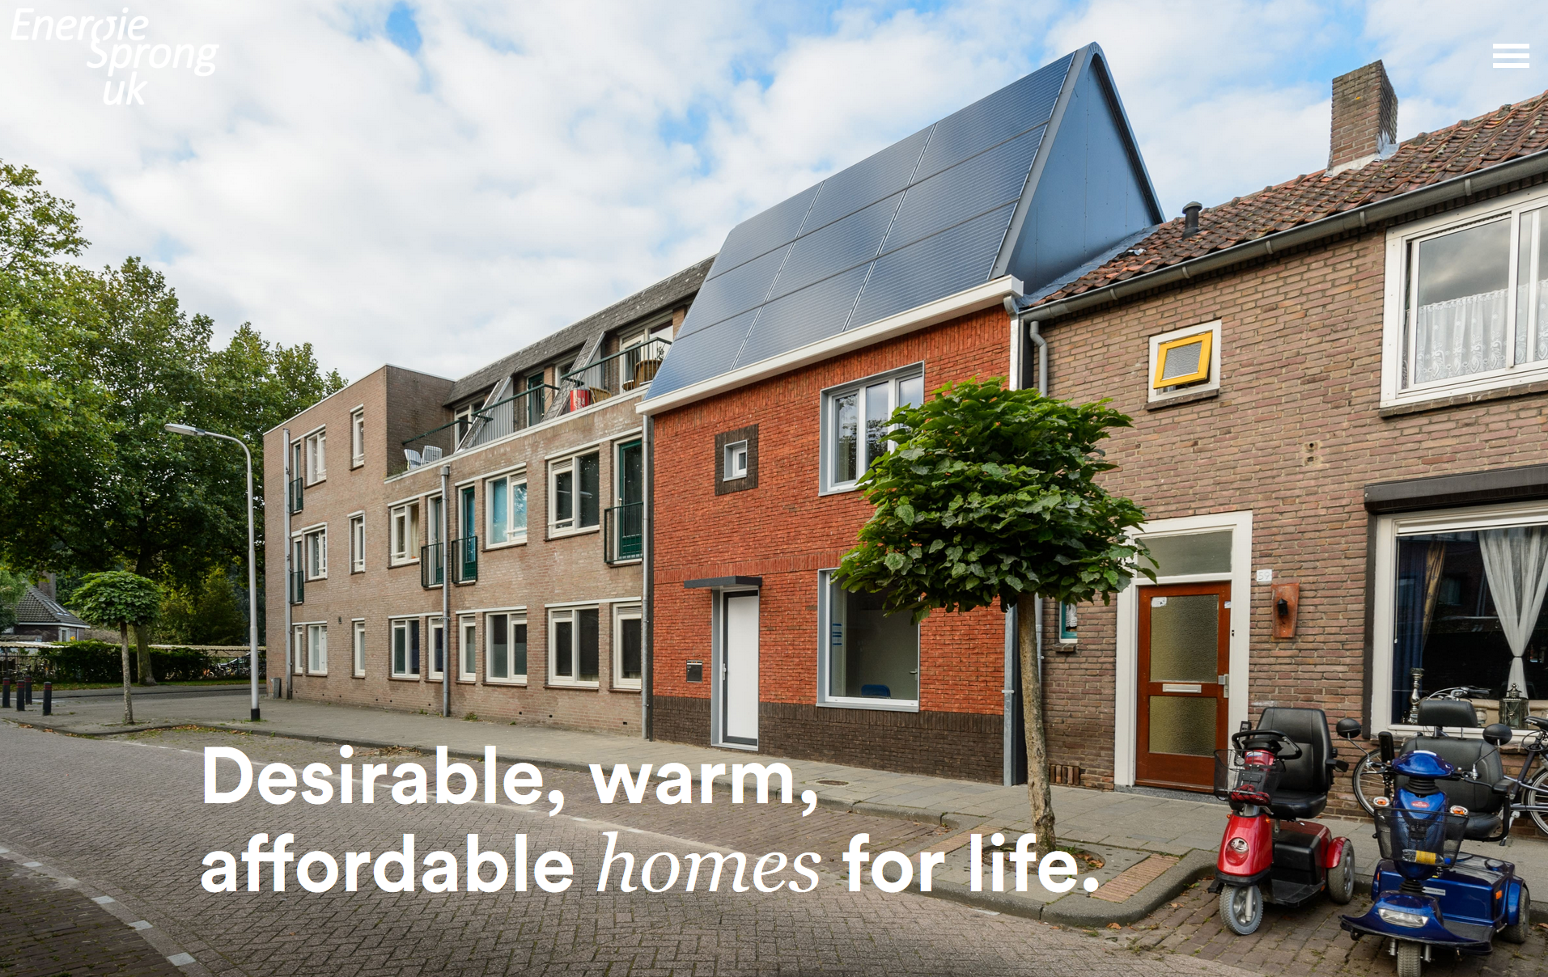

Slide 53
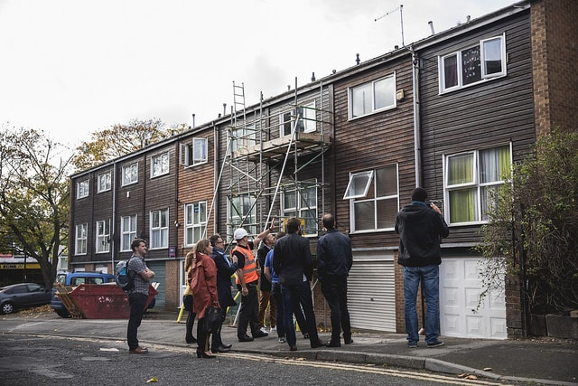
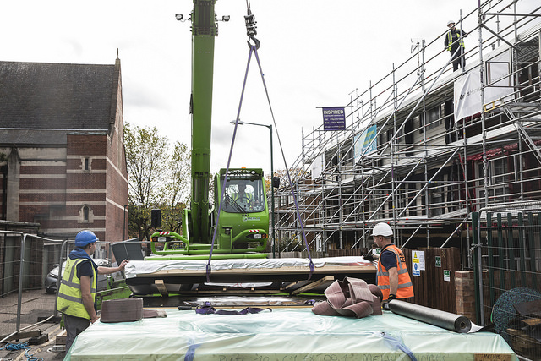
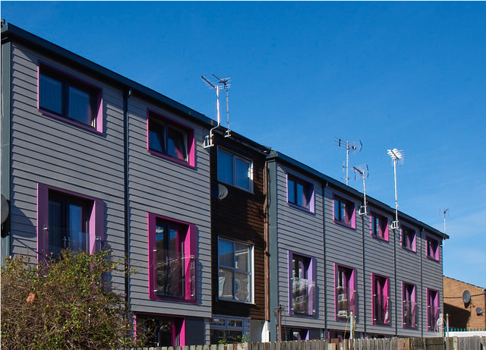

Modular Plug-n-Play ADBE modules?

Slide 54
Potential Limitations of Original Concept Interpretation
Façade is often not the the optimal position for energy harvesting technology (e.g. PV may be better positioned on the roof of some buildings).
Most energy harvesting equipment (e.g. heat pumps) has not been developed to be incorporated into a façade.
An aluminium framed façade system is not always the optimal method for fitting insulation to houses.

Slide 55
Extending the Interpretation
Plug-n-Harvest is an integral and enabling part of an energy system incorporating not just the facade but also energy harvesting equipment positioned elsewhere or external to the building:
The Plug-n-Harvest ADBE could contain wiring or equipment within a PV system where the PV array is positioned on the roof (or ground mounted external to the building).
The Plug-n-Harvest ADBE could contain pipe-work etc. within a heat pump systems where the evaporator and condenser are not located within the façade itself.
The Plug-n-Harvest ADBE could contain pipe-work and heat interface units to link district heating (and/or cooling) to buildings.

Slide 56
Further Versions of the Plug-n-Harvest System?
Plug-n-Harvest FULLY INTEGRATED - i.e. energy harvesting equipment is wholly integrated.
Plug-n-Harvest ENABLING - i.e. ADBE façade plays a key role: in linking energy harvesting technology positioned elsewhere on or external from building; and/or in linking the building to district heating and/or cooling systems.
Plug-n-Harvest LOW-RISE????

Slide 57
Next Steps?
Can we include the idea of further versions of Plug-n-Harvest (e.g. ENABLING, LOW-RISE) in the project plan?
Is it too late to redefine pilot project specifications?
Can we develop (outline) system specifications for further versions of Plug-n-Harvest (e.g. ENABLING, LOW-RISE) and calculate costs/benefits?
How do we embrace the opportunities opened up by further versions of Plug-n-Harvest in the exploitation plan?

